Slide 1
American Rescue Plan Act (ARPA) IDEA Part B Supplemental Funds
Lisa Pofelski-Rosa – Special Education Principal Financial Specialist

Slide 2
Agenda:
The American Rescue Plan Act (ARPA) – IDEA Part B Overview
ARPA IDEA Part B Allocations
GRA ARPA IDEA Part B Grants
Basics for ARPA IDEA Part B
Allowable Expenditures, Considerations, and Setup
New Sections of the IDEA Part B Application
Monitoring, Fiscal Year close out
Maintenance of Effort, Adjustment to local effort
Fiscal Year End, Important date reminders, and Resources

Slide 3
The American Rescue Plan Act (ARPA) – IDEA Part B Overview

Slide 4
The American Rescue Plan Act –IDEA Carve Out
Section 2014(a) of the American Rescue Plan Act of 2021 (ARP) provided more than $3 billion in supplemental funding for Fiscal Year 2021 for the three IDEA formula grant programs described and linked below:
• $2,580,000,000 for IDEA Part B Grants to States (Section 611)
• $200,000,000 for IDEA Part B Preschool Grants (Section 619)

Slide 5
IDEA American Rescue Plan Funds
These funds are provided to state educational agencies and lead agencies to help recover from the impact of the coronavirus pandemic and to safely reopen schools and sustain safe operations.
The IDEA Part B formula grants assist states in providing a free appropriate public education in the least restrictive environment for children with disabilities ages 3 through 21 (Part B, Sections 611 and 619).
Fact sheet: https://www2.ed.gov/policy/speced/leg/arp/arp-idea-fact-sheet.pdf

Slide 6
ARPA IDEA Part B Allocations

Slide 7
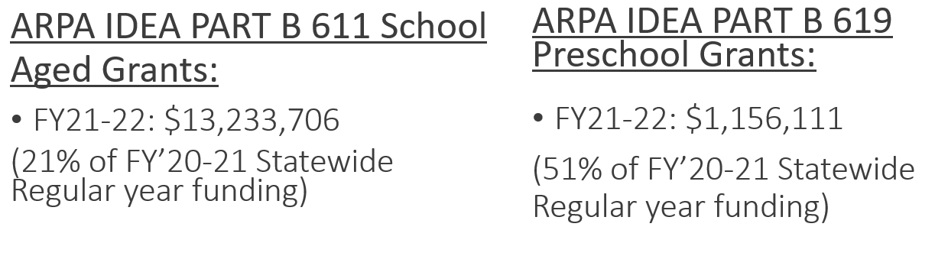
Idaho ARPA IDEA PART B Allocations

Slide 8
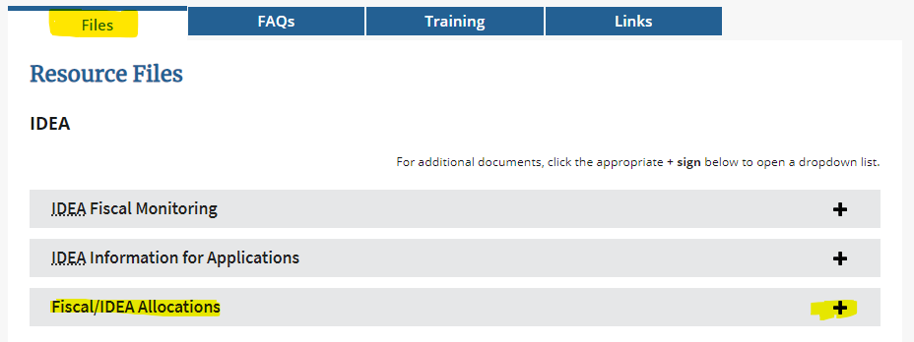
Updated LEA Allocations
Updated Allocations were sent out 7/26/2021
They can be found here: https://www.sde.idaho.gov/sped/funding/

Slide 9
GRA ARPA IDEA Part B Grants

Slide 10
GRA (GRANT REIMBURSEMENT APPLICATION)
When will Regular Year IDEA Part B and ARPA IDEA Part B Grants be available?
Regular Year IDEA Part B
  Grant Performance Period Effective date July 1, 2021 - 9/30/2023
  GRA Grants awarded when final IDEA Part B Applications are approved
ARPA IDEA Part B
  Grant Performance Period Effective date July 1, 2021 - 9/30/2023
  GRA Grants awarded when final IDEA Part B Applications are approved

Slide 11
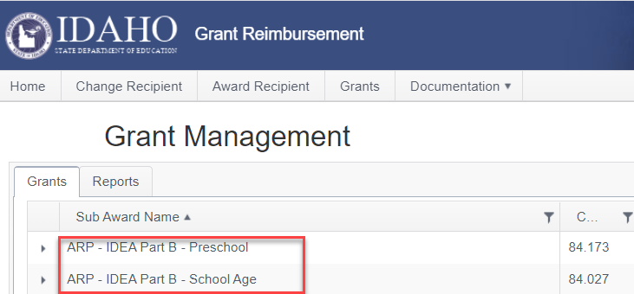
GRA - DRAWDOWN
Grants – ARPA IDEA Part B Allocations will appear in the GRA along with your other “Regular Year IDEA Part B” allocations.

Slide 12
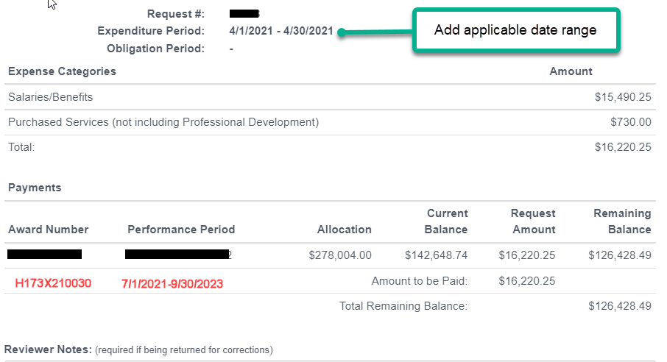
GRA Reimbursement claims
Complete ARPA reimbursement request as you would with a traditional IDEA Part B GRA request.

Slide 13
Basics for ARPA IDEA Part B

Slide 14

ARPA IDEA Part B EXPENDITURES – THE BASICS
ARPA IDEA Part B funds do contain a supplement not supplant requirement. This is different from ESSERIII.
ARPA IDEA funds are governed by the Uniform Grant Guidance (UGG) and the Education Department General Administrative Regulations (EDGAR).
All expenditures must be reasonable and necessary.
These are one time funds for one time resources.

Slide 15

ARPA IDEA Expenditure Considerations
ARPA IDEA Part B funds awarded are not a separate grant program.
ARPA IDEA Part B funds serve as a supplement to the FFY2021 IDEA Funds
States must ensure that the SEA and its LEAs can account for, and track the use of IDEA ARPA funds.

Slide 16
Allowable Expenditures, Considerations, and Setup

Slide 17

What can we spend ARPA IDEA PART B on?
ARPA IDEA Part B funds are IDEA Part B funds
= All the requirements for the use of IDEA funds apply!
Consider a focus on challenges from the Pandemic – “Cleaning Up for COVID”
  Disruption in the education of children with disabilities (Learning Loss response)
  Mental Health/Social Emotional Response Services
Consider a focus on the issue of equity in Special Education and Early Intervention services.
Consider Sustainability

Slide 18
Learning Loss Considerations
Addressing learning loss among students examples include:
Planning and implementing activities related to summer learning and supplemental programming.
Purchasing educational technology (including hardware, software, assistive technology or adaptive equipment and connectivity)
Implementing evidence-based activities to meet the comprehensive needs of students

Slide 19

Budgeting ARPA IDEA Part B Funds
ARPA IDEA funds must be used only to pay the excess cost of providing special education and related services in accordance with Part B of IDEA.¹ ²
Funds may be used for all allowable purposes under Part B of IDEA and are subject to all requirements and provisions that apply to IDEA funds.²
Remember the Supplement, not Supplant Rule!
¹34 C.F.R. §§ 300.705(a) and 300.815; see also 34 C.F.R. § 300.202(a)(2)
²https://www2.ed.gov/policy/speced/leg/arp/arp-idea-fact-sheet.pdf

Slide 20
Capital Expenditures Requirements
ARPA IDEA Part B - Equipment/Construction
LEA will be required to submit equipment and construction requests when using ARPA IDEA Part B funds.
Equipment and construction requests will be reviewed during the Final IDEA Part B Application if requested in the ARPA budget section.

Slide 21
Indirect Costs
Indirect costs are restricted under 34 C.F.R § 76.563 of EDGAR
34 C.F.R. §§ 76.564 through 76.569 apply to agencies of State and local governments that are grantees under programs with a statutory requirement prohibiting the use of Federal funds to supplant non-Federal funds, and to their subgrantees under these programs.

Slide 22
Indirect Costs Continued
Restricted indirect cost rates apply to the IDEA Part B regular formula grant funds and supplemental funds provided by the ARPA. States should calculate their restricted indirect costs on the IDEA Part B ARPA funds in the same way as they calculate indirect costs on their IDEA Part B regular formula grant award.
Only LEAs that have an indirect cost rate negotiated with the SDE’s Public School Finance may charge indirect costs to IDEA grants.

Slide 23
Private School Proportionate Share (PSPS)
34 C.F.R. §§ 300.130-300.144. Amounts to be expended for the provision of those services (including direct services to parentally placed private school children) by the LEA shall be equal to a proportionate amount of Federal funds made available under Part B of the IDEA.
The proportionate share is based on the total FFY 2021 funds received under the section 611 and 619 for both the Regular Year IDEA funds, and ARPA IDEA funds.
https://www2.ed.gov/policy/speced/leg/arp/arp-idea-fact-sheet.pdf

Slide 24
CEIS & CCEIS
Under section 618(d)(2)(B) of the IDEA and the regulations in 34 C.F.R. § 300.646(d), the State or the Secretary of the Interior shall require any LEA identified under 34 C.F.R. § 300.646(a) and (b) to reserve the maximum amount of funds under section 613(f) of the IDEA (i.e., 15 percent of the amount the LEA receives under Part B for any fiscal year) to provide CCEIS to address factors contributing to the significant disproportionality.
CEIS and CCEIS calculations are based on the total FFY 2021 funds received under the section 611 and 619 for both the Regular Year IDEA funds, and ARPA IDEA funds.

Slide 25
ARPA IDEA Part B –Accounting in Fund 259
New Fund 259 has been created for ARPA IDEA Part B tracking. (track School Age using function 521/Preschool using function 522)
ARPA IDEA Part B Grant Performance Period Effective date July 1, 2021 - 9/30/2023
ARPA IDEA Part B funds will require additional budgeting, reporting, and tracking within your accounting systems in each year you utilize the funds.
The separate fund codes will allow LEA and the SEA to track ARPA IDEA Part B expenditures.

Slide 26
CFDA (Catalog of Federal Domestic Assistance
CFDA Numbers for SEFA(Schedule of Expenditures of Federal Awards):
Regular Year IDEA Part B Section 611 - School Age: 84.027A
ARPA IDEA Part B Section 611 - School Age: 84.027X
Funds for students with disabilities, ages 3 through 21
Regular Year IDEA Part B Section 619 - Preschool Age: 84.173A
ARPA IDEA Part B Section 619 - Preschool Age: 84.173X
Funds for students with disabilities, ages 3 through 5

Slide 27
ARPA IDEA Part B Revenue Coding
ARPA IDEA Part B Fund and Revenue Codes:
Use the same revenue code identifier 445600 for both 611 and 619 funds, (identified in the Idaho Dept. of Ed. Chart of Accounts) but separate for your School Age, vs. Preschool Reimbursements using another element of account code within your accounting system. You must tie out your general ledger to the GRA.
Example:
259-445600-01… School Age 611 funds
259-445600-02… Preschool 619 funds

Slide 28
ARPA IDEA Part B Expenditure Coding
ARPA IDEA Part B Fund and Expenditure Codes:
Use the same method of coding that you would for the Regular Year IDEA Part B expenditures, by function and object.
Example:
259-521…object… School Age 611 expenditures
259-522…object… Preschool 619 expenditures

Slide 29
New Sections of the IDEA Part B Application

Slide 30

New ARPA Sections Created in the IDEA Part B Application
There will be an additional budget and expenditure section in the IDEA Part B Application for ARPA IDEA related tracking.
ARPA IDEA Part B LEA Allocations will flow through separate Sub Grants in the GRA, which will generate after the final IDEA application is approved.

Slide 31
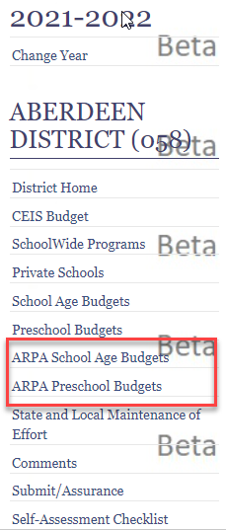

New ARPA IDEA Part B in the Web Application
There are new sections that will need to be completed during your IDEA Part B “Final Application” that will correspond to the new ARPA IDEA Allocations.

Slide 32
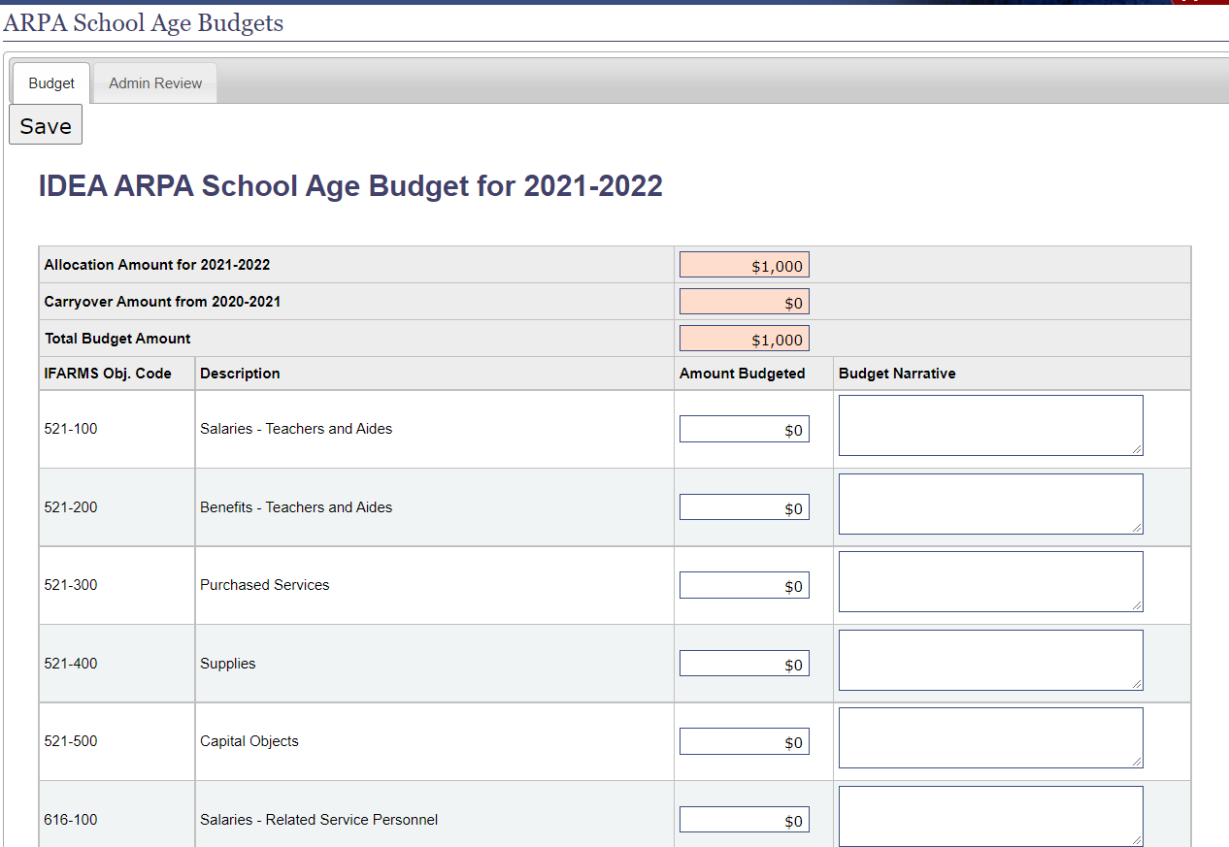
ARPA Budget View in the Application
Both new sections look just like your regular year IDEA Budget and Expenditure Sections.
The total budget must equal the total allocation.

Slide 33
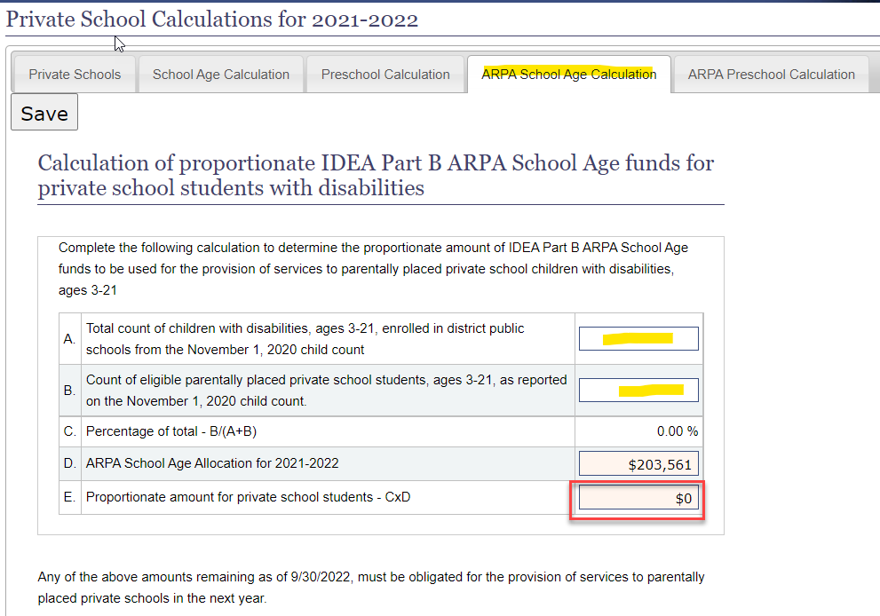
New ARPA Section of Private School Calculations
Just like the existing sections of the Private School calculation, there are now two additional tabs to complete for ARPA School Age and ARPA Preschool calculations.
Your private school proportionate allocation amounts auto-populate when you enter your student count.

Slide 34
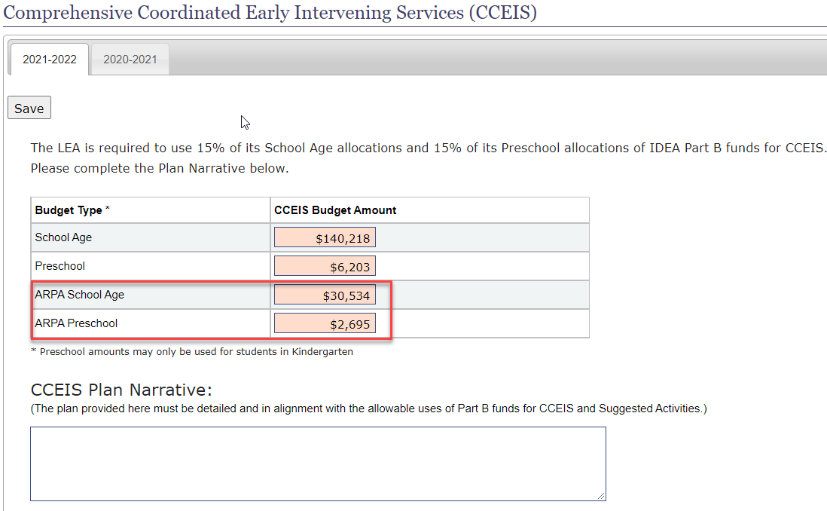
New ARPA CEIS and ARPA CCEIS
If you are required to use 15% of your Regular Year allocations for CCEIS, you are also required to set aside 15% of both of the ARPA allocations.
The application will auto populate based off of both of your ARPA allocations.

Slide 35
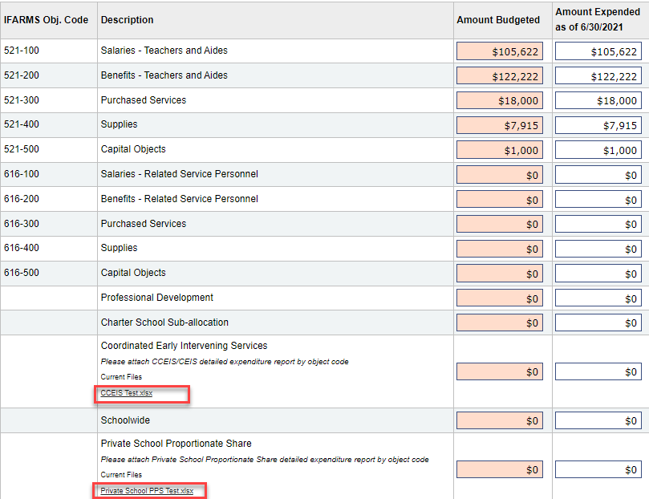
New Reports Required
There is a new “Add Files” button to add your reports for the detailed expenditures for:
Private School Proportionate Share
CCEIS
This applies to the Regular Year grants and will apply to the ARPA grants.
Upload a general ledger report by object code.

Slide 36
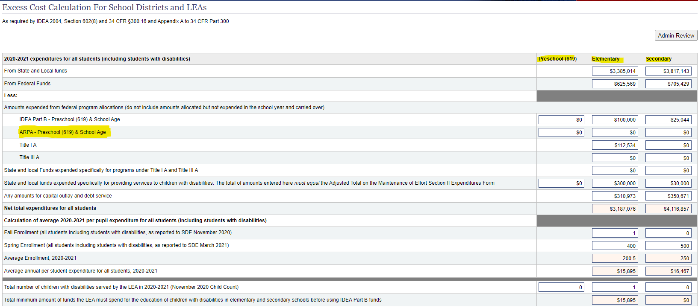
New Section of the Excess Cost Calculation
Since ARPA IDEA Part B funds are federal allocations, they are now added to the excess cost calculation section of the application.
You will enter expense based on your enrollment by age/grade.
Note, this line and the IDEA Part B line above must match what you report in the expenditure section of the IDEA Budgets sections.

Slide 37
Monitoring, Fiscal Year close out

Slide 38

Fiscal Monitoring & Reporting
All ARPA IDEA Part B expenditures must be monitored.
All LEAs are reviewed for Fiscal Monitoring at least once every four to five years.
Desk or field/on-site reviews.

Slide 39

Fiscal Year End close out process– Reminders
3 Funding streams to balance
Quarter 4 Wrap up for Special Education funding.
Balancing the three sources of Special Education funds is necessary, and required.
First meet Maintenance of Effort (apply any qualifying exceptions). Analyze MOE accounts 100-521, 100-522, 100-616, etc. Encumber expense through June.
Second, Balance Medicaid. Make sure your Medicaid fund is spent out, but not overspent. Encumber expense through June, apply expected reimbursements (accrued if applicable). Sweep/journal entry or adjust final expenditures between MOE and IDEA funds.
Third, finalize IDEA federal funds. If you have met MOE, and spent Medicaid, and spent out IDEA Part B federal funds, sweep your final expenses to MOE. ARPA IDEA is grouped with Regular Year federal IDEA funds- so spend these after meeting MOE & Medicaid.
***Note: You should not carry a negative fund balance in IDEA funds, or Medicaid.

Slide 40
Maintenance of Effort, Adjustment to local effort

Slide 41
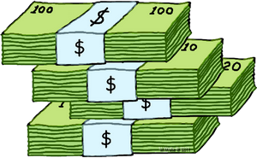
LEA Maintenance of Effort Review
34 CFR §300.203 LEAs Maintenance of Effort
IDEA Part B Funds must not be used to reduce the state and local level of expenditures for the education of children with disabilities.
The amount of local, or State and Local Funds expended for the education of children with disabilities, is the amount of funds that establishes the level of expenditures to be maintained from year-to-year and establishes the MOE level.

Slide 42
Standards for Determining Maintenance of Effort
There are no changes to Maintenance of Effort with ARPA IDEA Part B. All existing standards apply.
For a full review of Maintenance of Effort, please see the power point presentation or the PDF at:
https://idahotc.com/Resources/View/ID/821

Slide 43
Accounting for MOE – State Match
Medicaid State Match OSEP MEMO 15-10
https://sites.ed.gov/idea/idea-files/osep-memo-15-10-local-educational-agency-lea-maintenance-of-effort-moe-questions-and-answers/
LEAs must include state and local funds spent for the education of children with disabilities regardless of whether it uses those same funds to comply with other matching requirements i.e. Medicaid state match expense.
Example:
  Medicaid expense was $100,000
  Reimbursed portion was 71% or $71,000
  State match was 29% or $29,000 (check your FMAP rate)
  Any portion of state match used for the education of children with disabilities must be included in the maintenance of effort report

Slide 44
Adjustment to Local Effort - MOE
Any fiscal year that an LEA’s IDEA allocation exceeds the amount the LEA received for the previous fiscal year, under certain circumstances, the LEA may reduce the level of local, or State and local, expenditures otherwise required to meet MOE by up to 50 percent of the amount of the excess, as long as the LEA uses the freed up local funds for activities that could be supported under ESEA.¹ ²
¹section 613(a)(2)(C) of IDEA, 34 CFR §300.205
²https://www2.ed.gov/policy/speced/leg/arp/arp-idea-fact-sheet.pdf

Slide 45
LEA requirements to reduce MOE
An LEA may not take this reduction if the SEA determines the LEA is unable to establish and maintain programs of FAPE, or the SEA has taken action against the LEA under section 616 of IDEA.¹
An SEA must prohibit an LEA from taking the MOE reduction if the LEA’s determination is Needs Assistance, Needs Intervention, or Needs Substantial Support.¹
An LEA that is required to budget 15% under CCEIS due to disproportionality will not be able to take advantage of the MOE reduction.¹
LEAS must be able to monitor and track all “Freed Up Funds.”
¹https://www2.ed.gov/policy/speced/leg/arp/arp-idea-fact-sheet.pdf

Slide 46
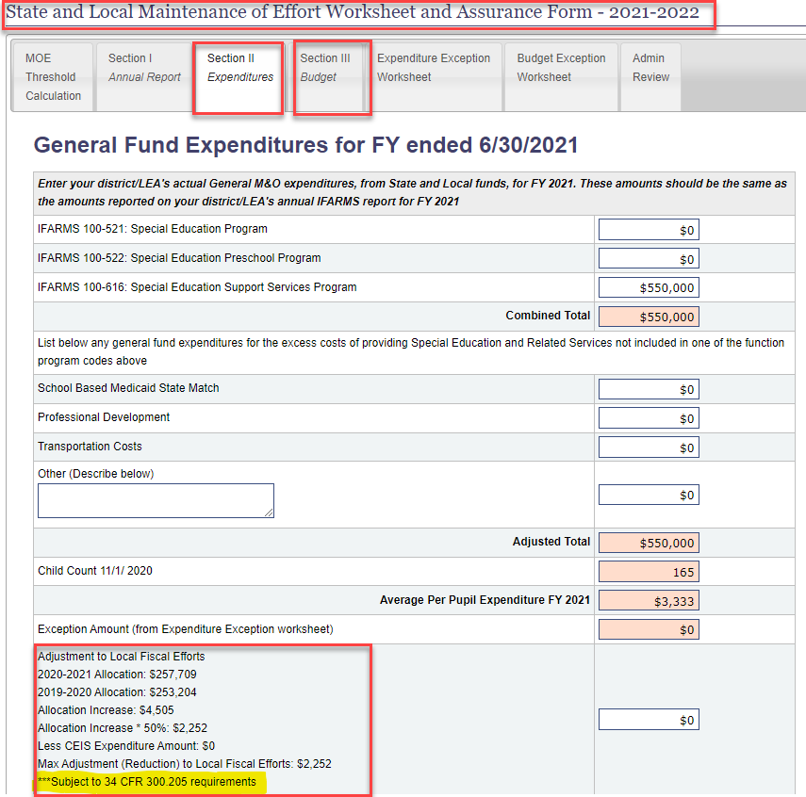
Adjustment to Local Fiscal Efforts in the IDEA Part B Web Application
In the IDEA Part B Web Application, under State and Local Maintenance of Effort, Section II Expenditures and Section III Budget, a calculation is performed to demonstrate the Max Adjustment.
*Subject to 34 CFR 300.205 requirements.

Slide 47

Maintenance of Effort Exception
Title 34 CFR §300.204 Exception to Maintenance of Effort
A LEA may reduce the level of its expenditures (local, or State and local; in total or per capita) below the level of those expenditures for the preceding fiscal year under certain circumstances.

Slide 48
MOE Exceptions cont’d
  Voluntary departure by retirement or departure for just cause of special education or related services personnel;
  Decrease in the enrollment of children with disabilities;
  Termination of costly expenditures for long‐term purchases, such as the purchase of an IEP software program;
  Termination of an exceptionally costly obligation to a particular child with a disability because the child:
    Has left the jurisdiction of the administrative unit;
    Has reached the age at which the obligation to provide FAPE to the child is terminated; or
    No longer needs the program of special education.

Slide 49
Fiscal Year End, Important date reminders, and Resources

Slide 50

Fiscal Year End close out & First Quarter Cleanup
Now is the time to Prioritize, Analyze and Review your funding streams (not just IDEA Part B).
Check for expiration date of each funding stream
Review how you can spend each funding stream-what is it for? Is it very specific (such as for PPE)?
Do I have overlapping funds that can be spent on the same items? Watch out for Supplemental vs. Supplanting restrictions.
Is my budget and appropriation in place, does it need approval or adjustment?
Do I have a matching effort requirement (like MOE)?
If so, what is my threshold?

Slide 51

Important Dates & Info.
IDEA Part B Final Application
https://apps.sde.idaho.gov/IDEA/Year/27/Home/Home
  Opening Date: Preliminary Application Approval Date
  Updated Allocations for regular year grants will require a revision to your School Age and Preschool Grant sections
  SDE Staff on site at New & Experienced Federal Programs Directors Meeting, Oct 11th-12th, 2021. Help sessions for IDEA Application available.
  Final Applications Due Date: November 15

Slide 52
IDEA Part B Application Resources
Here’s a link to a video that is how to prepare your IDEA Application. https://idhttps://apps.sde.idaho.gov/IDEA/Year/27/Home/Homeahotc.com/Resources/View/ID/692
Link to Application instructions: https://apps.sde.idaho.gov/IDEA/Content/files/2018-2019IDEAPartBApplicationInstructions.pdf
Here’s a link to the IDEA Part B Funding Manual:
https://apps.sde.idaho.gov/IDEA/Content/files/IDEA-Part-B-Funding-Manual.pdf

Slide 53
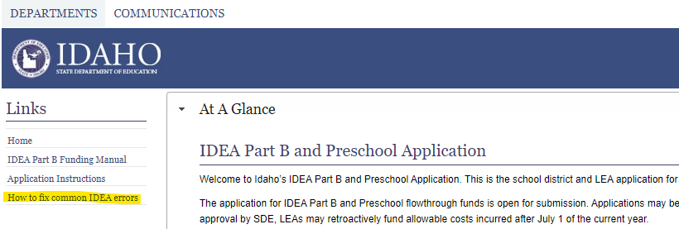
Helpful New Resources
New this year- “How to fix common IDEA errors”.
  This will show you how to fix the errors in the application, with full screen shots.
https://apps.sde.idaho.gov/IDEA/Content/files/Top-Errors-In-IDEA.pdf

Slide 54

Special Thanks
Big thank you to the SDE Programming and Project Development staff for quickly designing and implementing the ARPA IDEA Part B segments of the IDEA Application.
Thank you All for your hard work and dedication to the children in our communities!

Slide 55

Questions???

Slide 56


Special Education Funding Contact Information
Dr. Charlie Silva
Special Education Director
csilva@sde.idaho.gov
Phone: (208) 332-6806
Lisa Pofelski-Rosa
Principal Financial Specialist
Lpofelskirosa@sde.idaho.gov
Phone: (208)332-6916
Grace Dehner
Contracts & Fiscal Specialist
gdehner@sde.idaho.gov
Phone: (208) 332-6910
Website: http://www.sde.idaho.gov/sped/

Slide 57
Questions
Lisa Pofelski-Rosa| Principal Financial Specialist
Special Education Funding and Accountability Coordinator
Idaho State Department of Education
650 W State Street, Boise, ID 83702
208 332 6916
Lpofelskirosa@sde.idaho.gov
www.sde.idaho.gov

