Slide 1
Secure Website
Public School Finance

Slide 2
Secure Website (SFTP a.k.a. Wing FTP)
Located at: https://sftp.sde.idaho.gov/
Includes:
  Supporting documents for Foundation payments made in February, May, and July
  Supporting documents for some Special Distribution payments

Slide 3
Logging In to the Secure Site
Be sure you are using your 4 digit account code, not an email or other number
  Example: 001 Boise would be 0001, and 451 Victory 0451
The password is only provided to Superintendents and Charter School Administrators

Slide 4
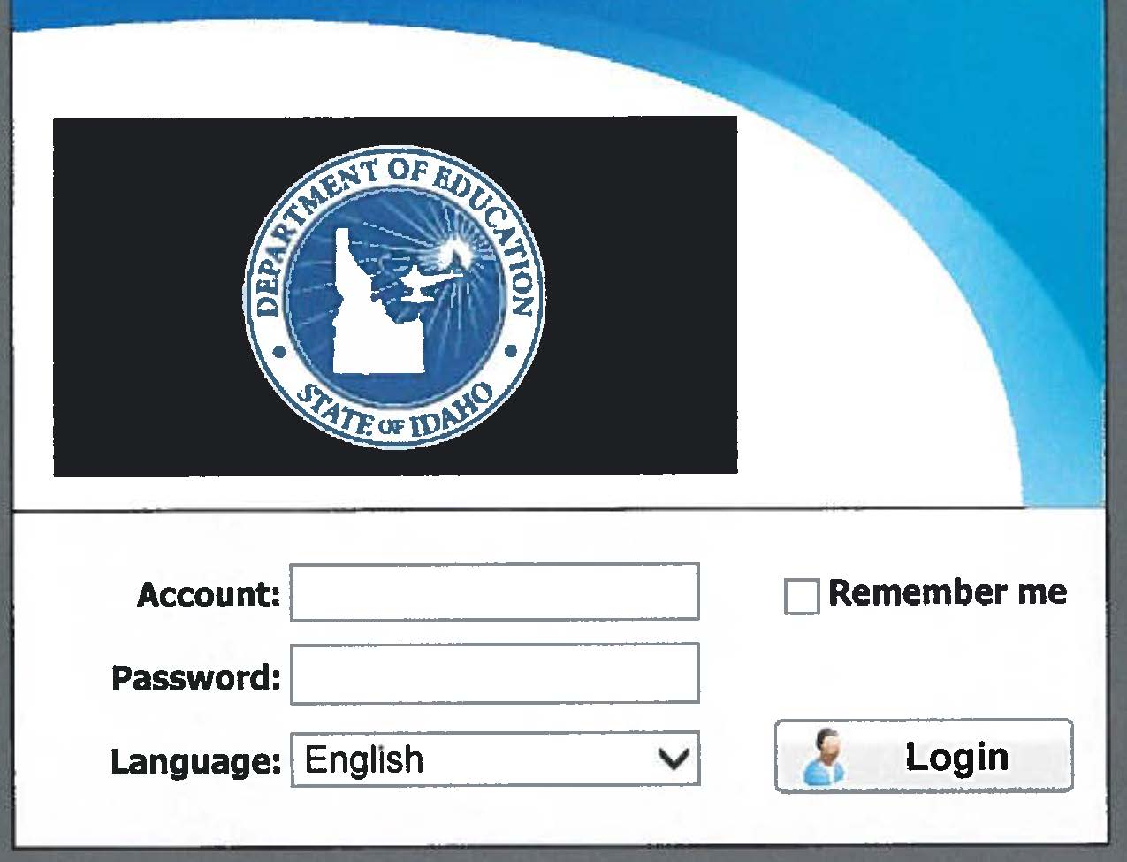
How to Navigate the Secure Website
Main Page
Enter your four digit Account code and Finance password

Slide 5
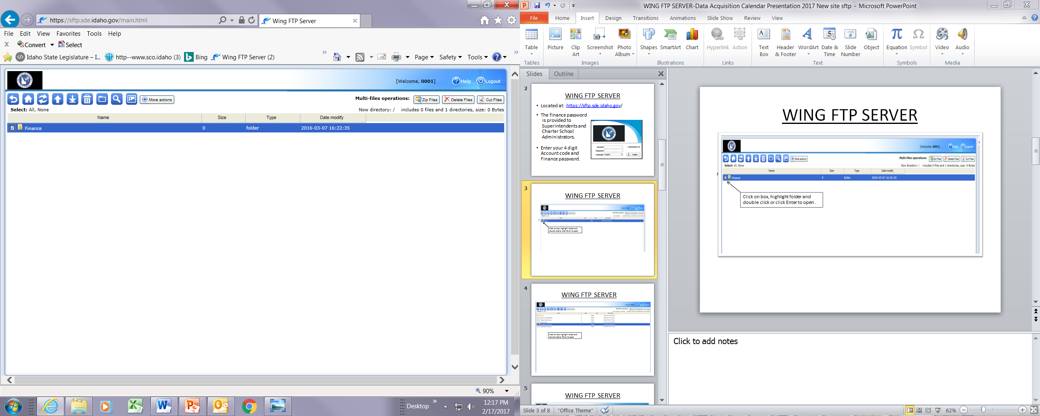
How to Navigate the Secure Website Continued…
Double click on Finance folder

Slide 6
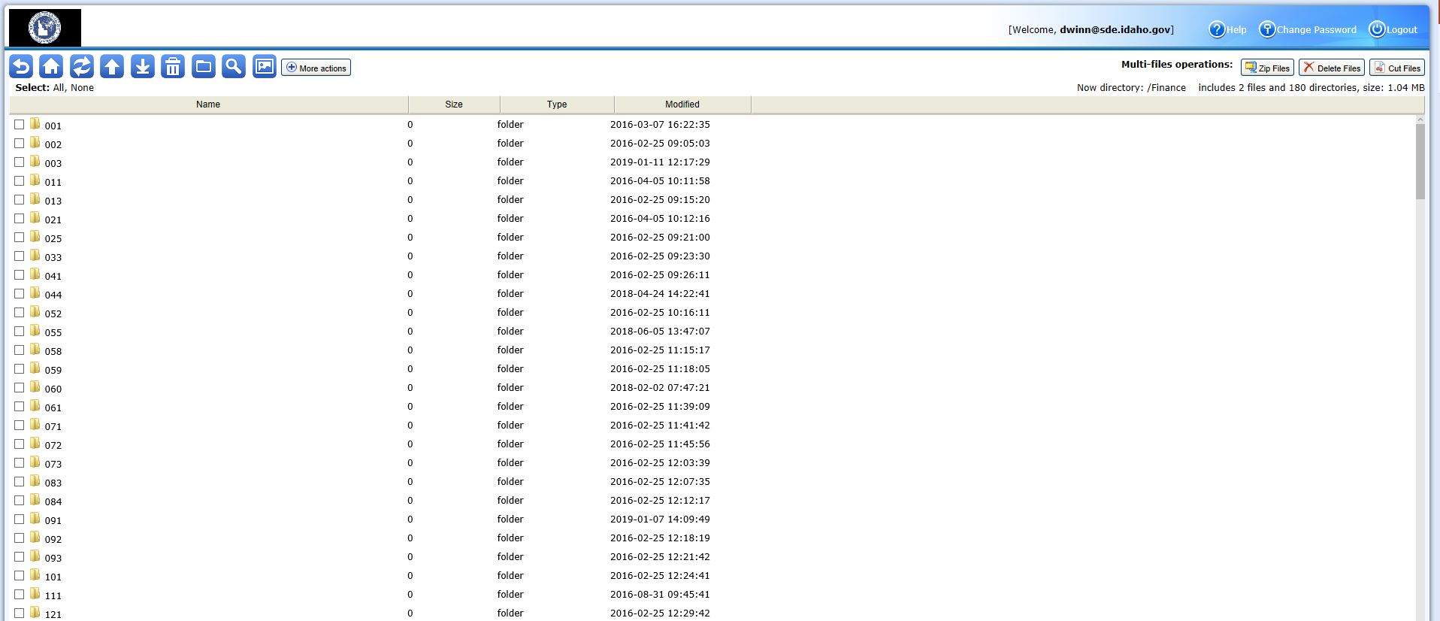
How to Navigate the Secure Website Continued…
Double click on School District or Charter School number. Your number will be the only folder available.

Slide 7
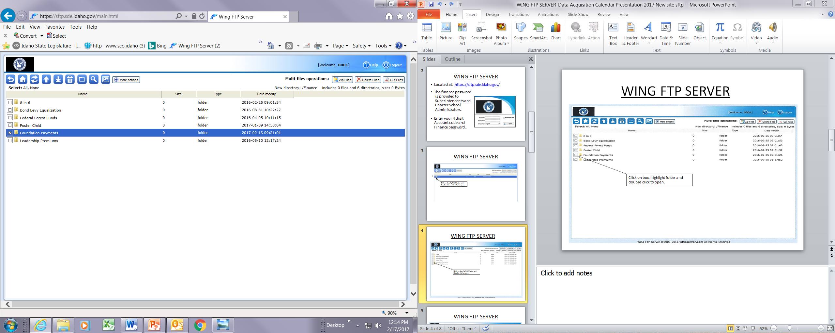
How to Navigate the Secure Website Continued…
To open, double click the desired folder

Slide 8
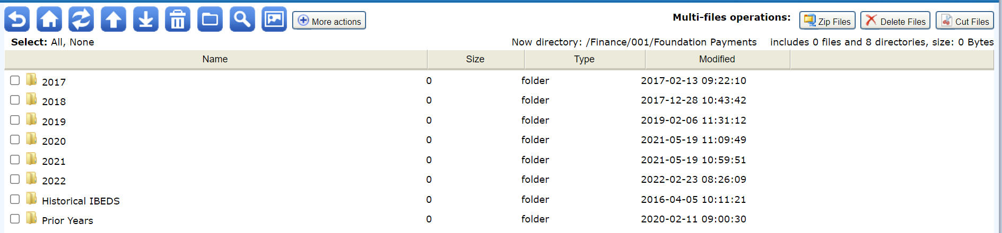
How to Navigate the Secure Website Continued…
Foundation Payment Page

Slide 9
SFTP – Important Notes
Reset your password when there are staff changes
The Finance folder in the SFTP is a separate account from all others you may have, please do not merge them
Reminder – access or changes can only be requested by Superintendents or Charter Administrators

Slide 10
Data Acquisition Calendar
Public School Finance

Slide 11
Data Acquisition Calendar
Located at: https://www.sde.idaho.gov/finance/
Includes a monthly list of reports due, who to contact, and why the report is required
The calendar is updated for each new fiscal year by July 1, and is updated regularly throughout the school year

Slide 12
Data Acquisition Calendar File

Slide 13
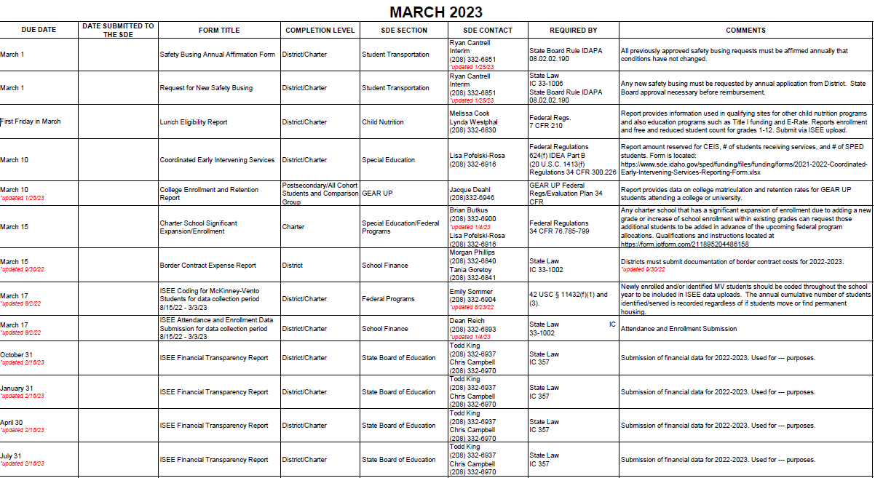
Data Acquisition Calendar File Continued…

Slide 14
Who to Contact
Morgan Phillips| Program Information Coordinator
Idaho State Department of Education
650 W State Street, Boise, ID 83702
208.332.6840
mphillips@sde.idaho.gov
www.sde.idaho.gov/finance
Tania Goretoy| Program Information Coordinator
Idaho State Department of Education
650 W State Street, Boise, ID 83702
208.332.6841
tgoretoy@sde.idaho.gov
www.sde.idaho.gov/finance

