Slide 1
IASBO Spring 2023

Slide 2
School Budget/Bonds & Levies/Building Requests
Carol Piranfar
Email - CLPiranfar@sde.idaho.gov
Phone – (208) 332-6844

Slide 3
Agenda
Idaho Schools Budget Compliance Guidance
    An overview of Idaho Code and submission timelines
State Budget Forms
    An explanation of the budget forms to be used and where to locate them
Amended Budgets
    The requirements of Idaho Code as it relates to budget adjustments
Tax Levies
    Brief overview of Idaho Code as well as the process and timeframes involved
New Building/Building Reconfiguration
    Information on how to add or change building for reporting

Slide 4
Idaho Code on School Budget Compliance
Budget Hearing Notice
  Idaho Code 63-802A
    No later than April 30th of each year – Notify the appropriate county clerk(s) in writing of the date and location of your budget hearing
    Related to Tax Levies - does not apply to Charter Schools
Publish Budget Hearing Notice
  Idaho Code 33-402 and 33-801
    A budget hearing notice, including the Four-Year Summary Form, must be published 10 days prior to the budget hearing
Set Budget Hearing and Present and Adopt Budget
  Idaho Code 33-801
    No later than 28 days prior to your July meeting, hold a public budget hearing to present a budget for the ensuing fiscal year
    The budget must be adopted either at the public budget hearing, or at a special meeting no later than 14 days afterwards

Slide 5
Idaho Code on School Budget Compliance
(Continued)
Submit Signed Copy of Budget to SDE
  Idaho Code 33-701(7)
    21 days or less after the budget is adopted, submit a signed copy of your budget packet to SDE, or no later that July 15th
Online Budget
  Idaho Code 33-357(b)(vii)
    The approved annual budget should be posted on the school district or charter school website within 30 days after its approval.

Slide 6
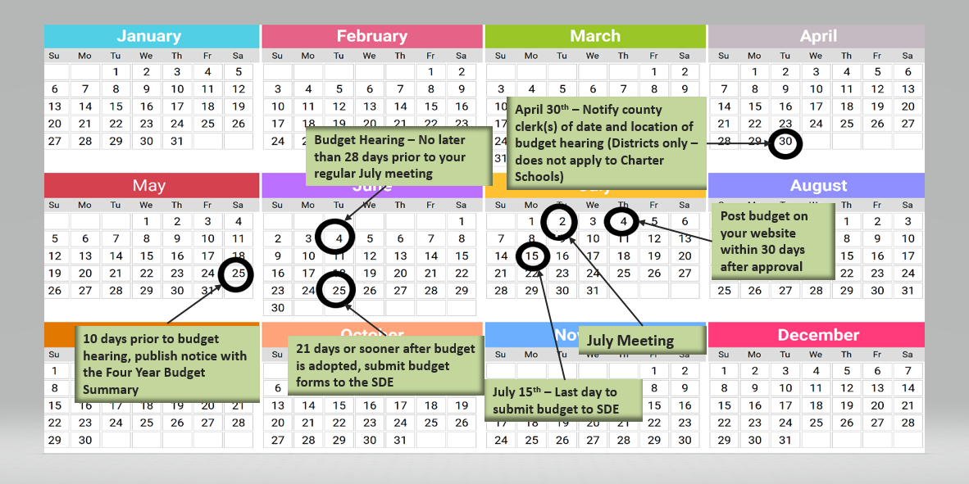
Budget Timeline Example
Notes:
July 15th submission date is important to Charters asking for the Advance Payment

Slide 7
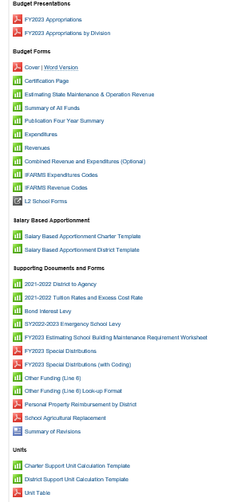
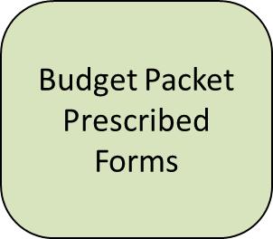
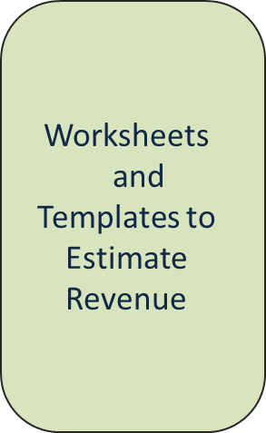
State Budget Forms

Slide 8
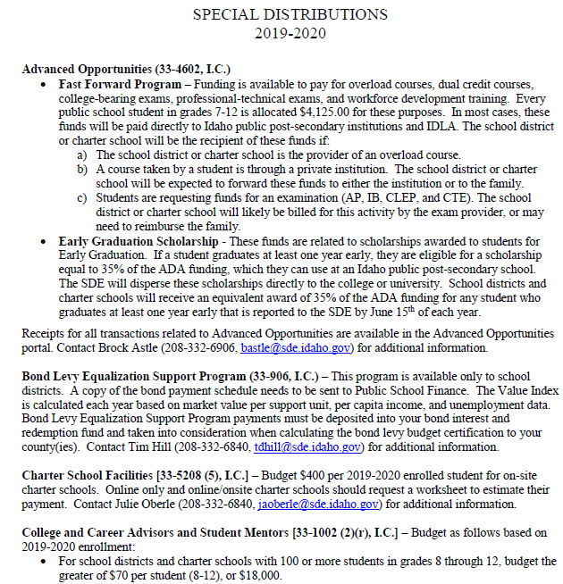
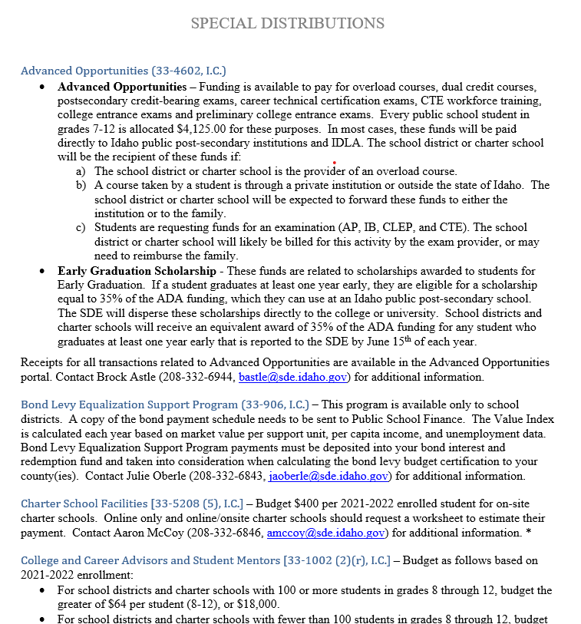
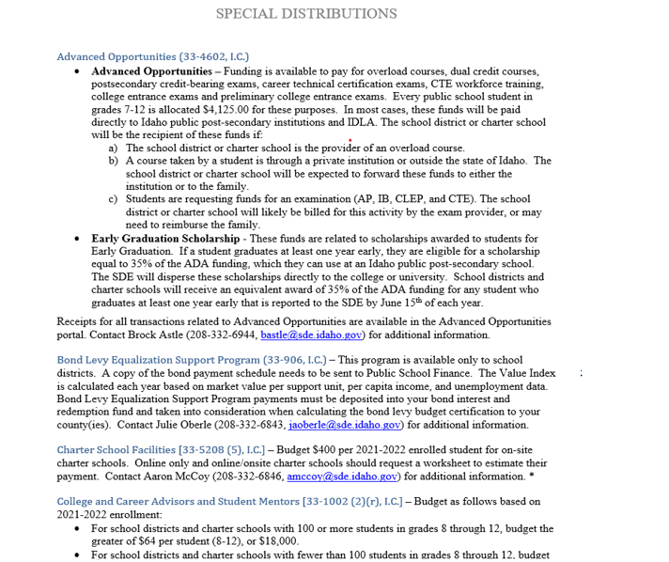
Special Distributions
See Website for 23-24 Information Later This Spring

Slide 9
Budget Forms/Packet
  Budget Packet
  Cover Page
  Certification Page
  Publication Four - Year Summary
  Summary Statement – All funds (SDE Form)
  Estimating State M&O Revenues
  Either:
    Separate Revenue and Expenditure Pages for All Funds
    Combined Revenue/Expenditure Pages for All Funds
  L2 & L2 Worksheet (n/a for Charter Schools)
  Voter Fund Tracker (n/a for Charters Schools)

Slide 10
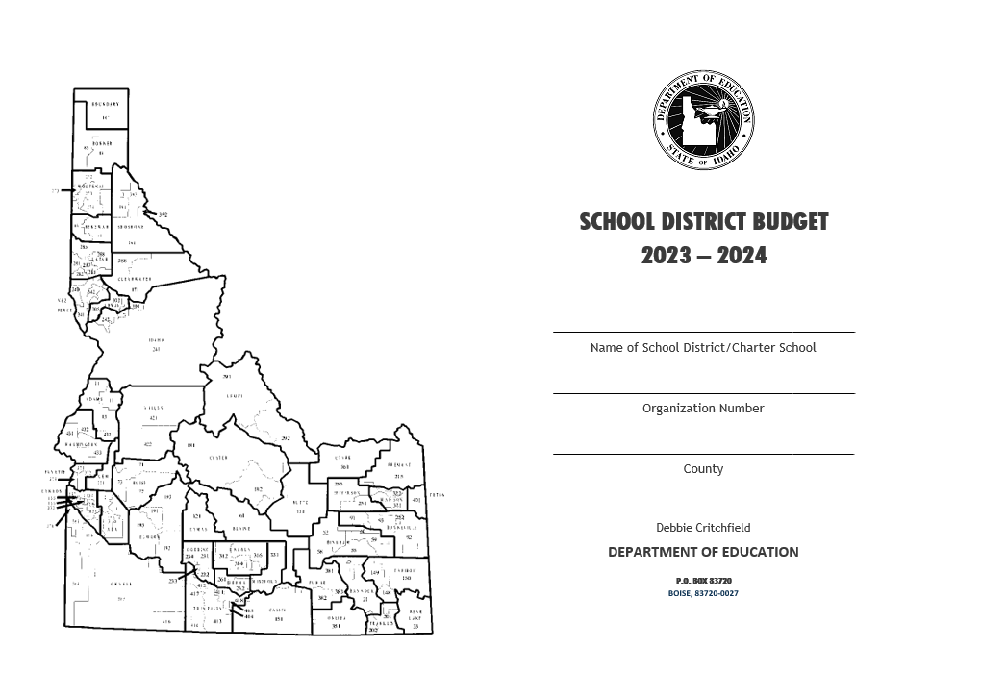
Cover Page

Slide 11
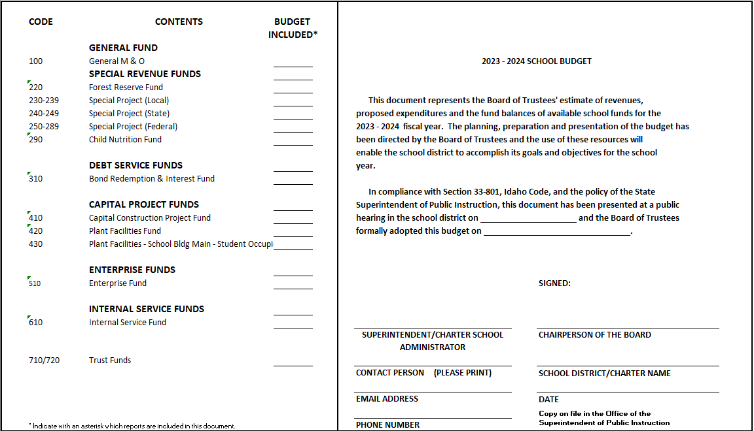
Certification Page

Slide 12
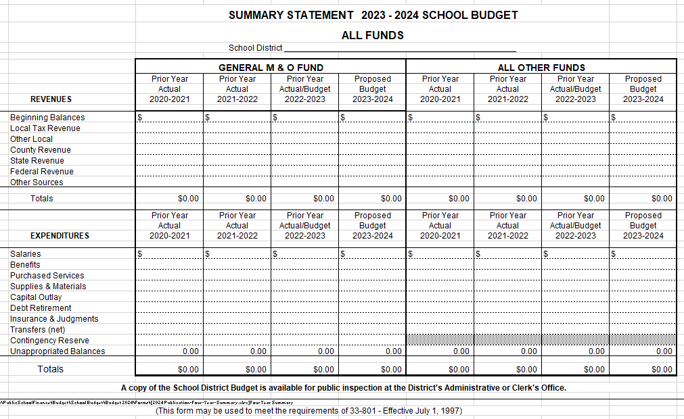
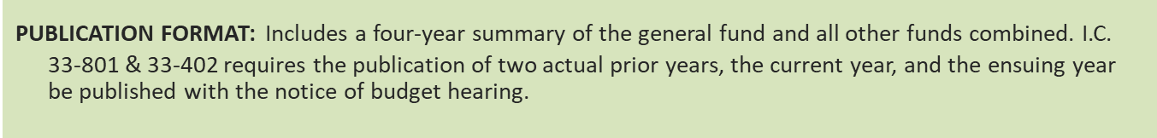
Four-Year Publication Form

Slide 13
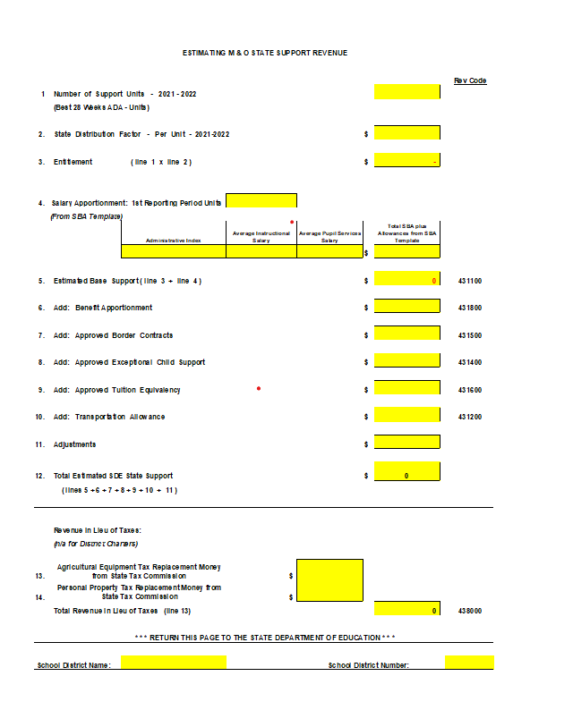
Estimating M&O State Revenue
Support Units from Best 28 Weeks ADA
2023-2024 State Distribution Factor (TBD)
From Salary Based Apportionment Template
From Other Supporting Documents and Sources
Property Tax Replacement Money
School District/Charter Name and Number

Slide 14
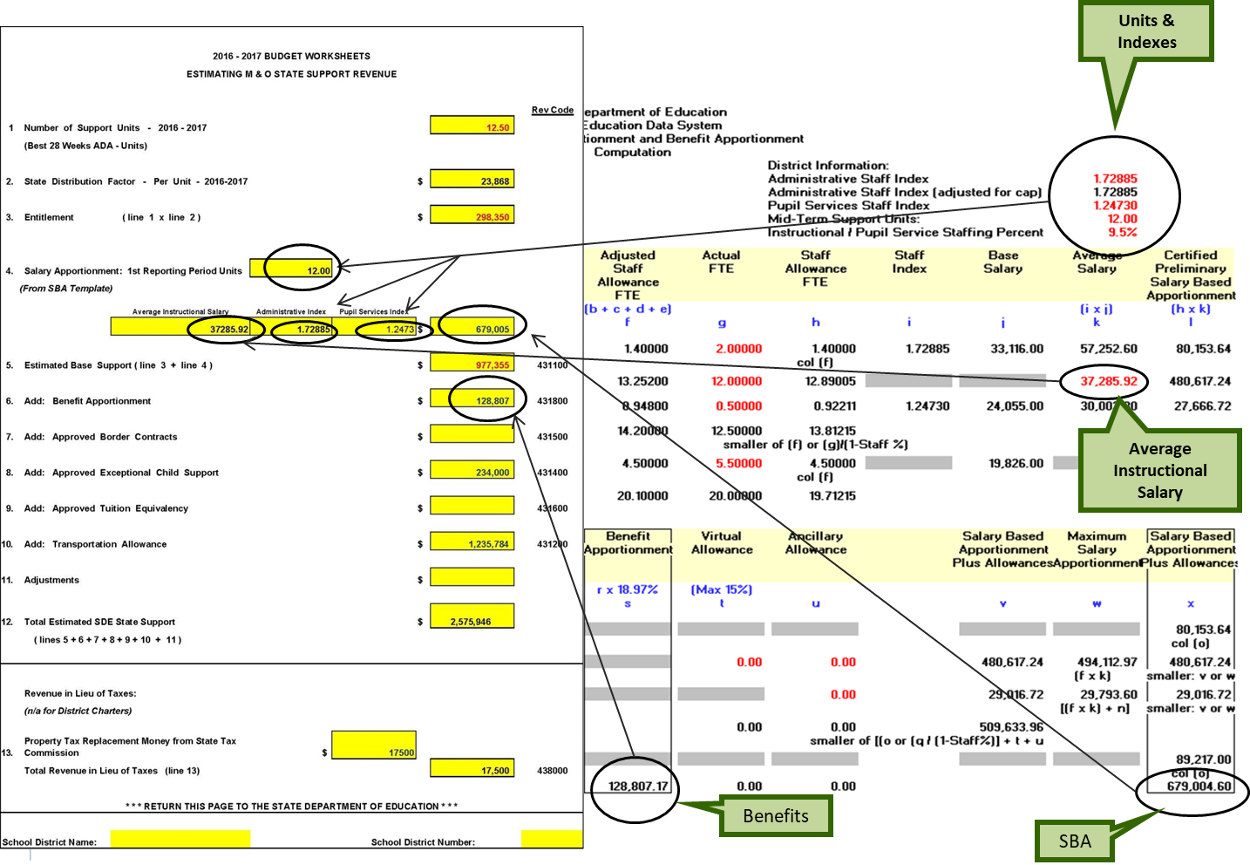
Example of Salary - Based Apportionment Information on Estimating M&O Sheet

Slide 15
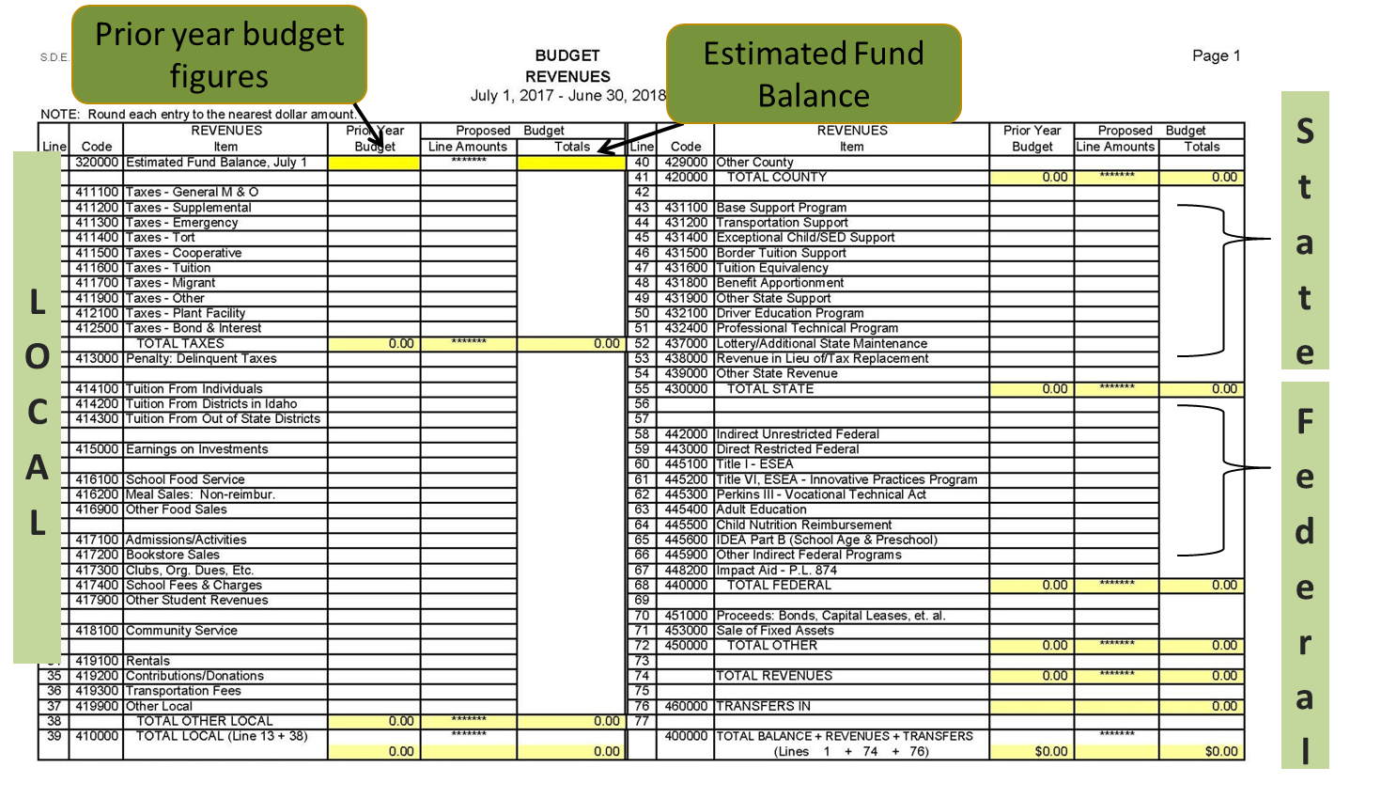
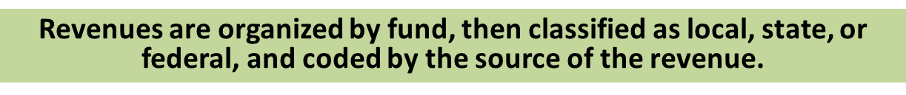
Revenue Pages
20XX-20XX

Slide 16
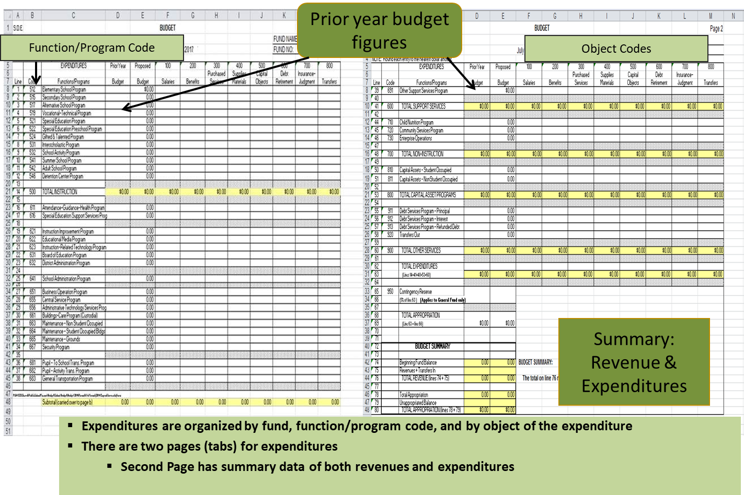
Expenditure Pages

Slide 17
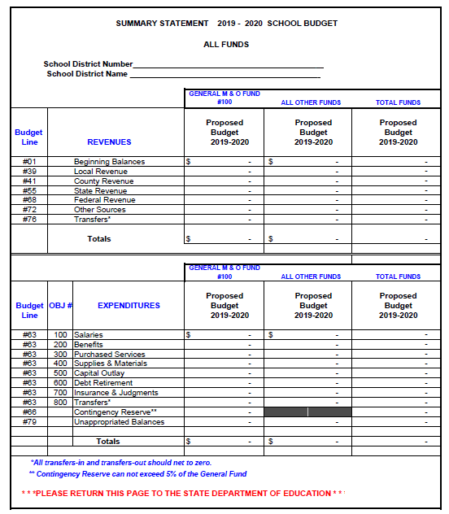
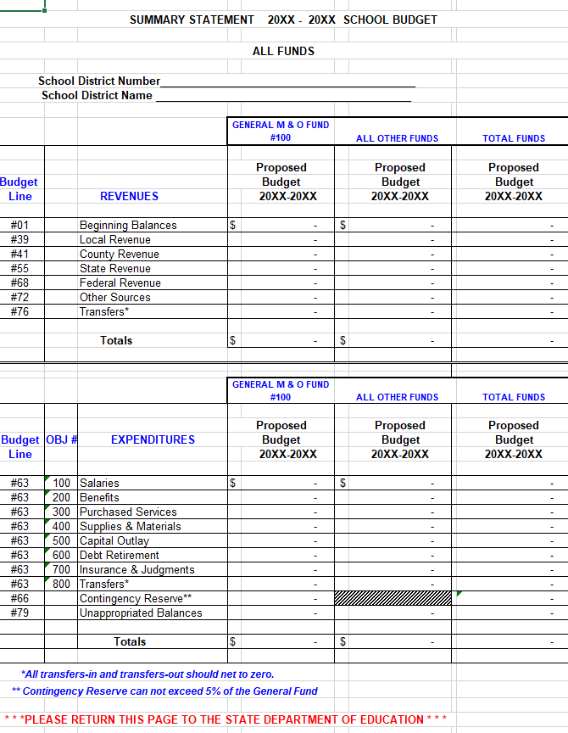
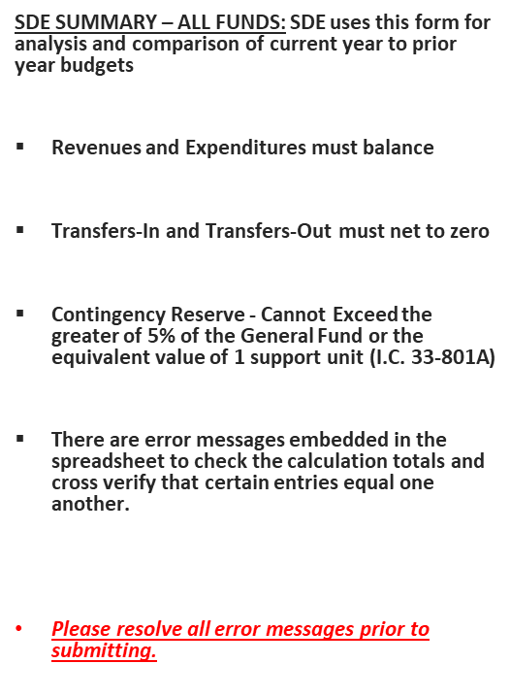
Summary Statement

Slide 18
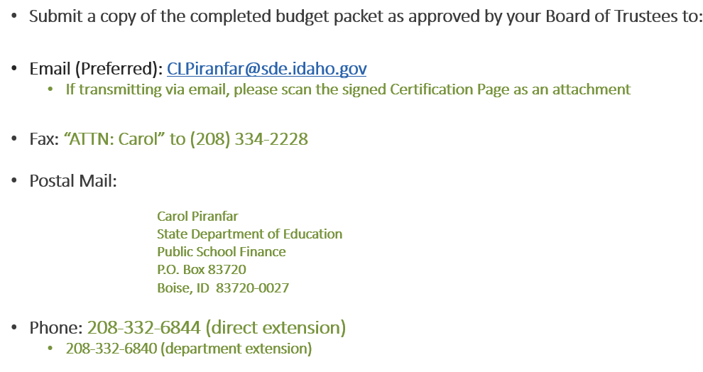
Budget Submission
Notes:
Mention that only one copy is needed.

Slide 19
Key Points
Know your critical dates and timelines
Know where to access your forms and who to call for questions
Use the forms, format, and codes (IFARMS) required by SDE and the State Tax Commission
Make sure you use the proper templates and information in forming your budget estimates
Make sure you address all errors, and that your budget is balanced
Make sure your packet is complete
Please make yourself available in the Summer if we have any questions or are missing paperwork

Slide 20
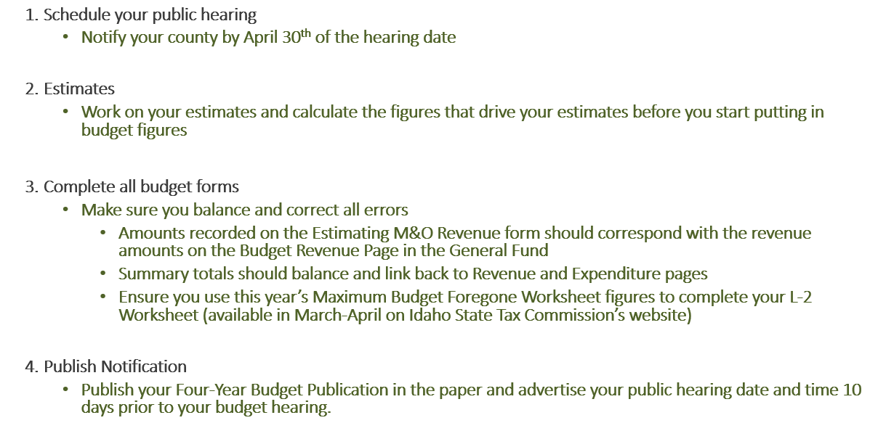
Sequential Reminders

Slide 21
Sequential Reminders
Hold your public hearing and formally adopt your budget
  The public hearing must occur at least 28 days prior to your July meeting
  The budget must be adopted at the public hearing or at a special meeting held no more than 14 days afterward
Send your Budget Packet to SDE
  21 days or less after adoption, and no later than July 15th
  Budget forms should be in the prescribed format designated by the SDE
  Put your school district/charter name and number on all forms
Post your adopted budget
  On your school district’s website within 30 days of adoption
Certify Documents
  Your budget, levy and elections result documents must be certified with the county on or before the Thursday preceding the 2nd Monday in September (9/7/23)

Slide 22
Amended Budgets
Budget adjustment procedures
Idaho Code 33-701 (9)
  Anyone proposing to amend the budget must notify the local board in writing, one week prior to the meeting at which the proposal will be made.
  Before a final vote of the amended budget is approved, notice shall be posted as prescribed in Section 33-402 Idaho Code.
  Amended budgets shall be submitted to the State Superintendent of Public Instruction.

Slide 23
Amended Budget (Continued)
Key Points
Utilize the same forms and format you would when completing your annual budget
Make sure you publish the Four-Year Summary form along with the date, and location of the budget hearing.
Make sure the certification page is signed by the board chair and the superintendent/charter school administrator, and forward a copy to the SDE when complete.

Slide 24
Tax Levies

Slide 25
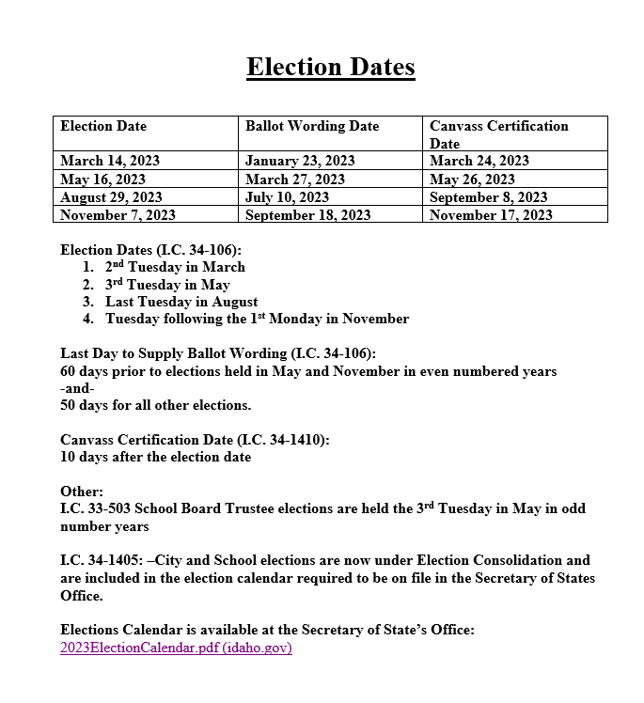
Election Dates
Notes:
Contact your County with question or the Secretary of State’s Office.

Slide 26
Bond and Levy Resources
County-the county should always be the first place to ask any questions on this process.
Budget and Levy Training-given by the State Tax Commission (STC).
  Trainings will be smaller sessions just for school districts this year.
2023 Schedule Not yet Available on Website
Check State Tax Commission Website for Updates
Usually Held in April and May in Several Regions.

Slide 27
Idaho Code 33-802(B) & (C)
The Idaho Legislature last year passed Idaho Code 33-802(B) & (C) which are now in affect.
  This requirement is for Supplemental Levies
  (B)Requires that you clearly disclose on the ballot, in detail, how the money will be spent
  (C)Requires publishing a summary of how the Supplemental Levy funds were spent
  IDLA’s Idaho Rural Education Association (IREA) hosted a Zoom webinar on these requirements
  Zoom Cloud link: IREA Supt JIT Supplemental Levies & Budget Committees

Slide 28
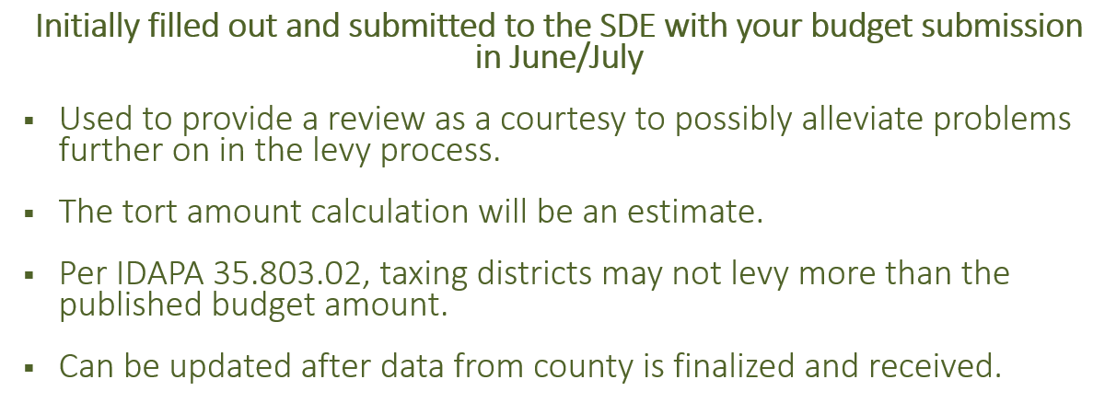
L2 Information

Slide 29
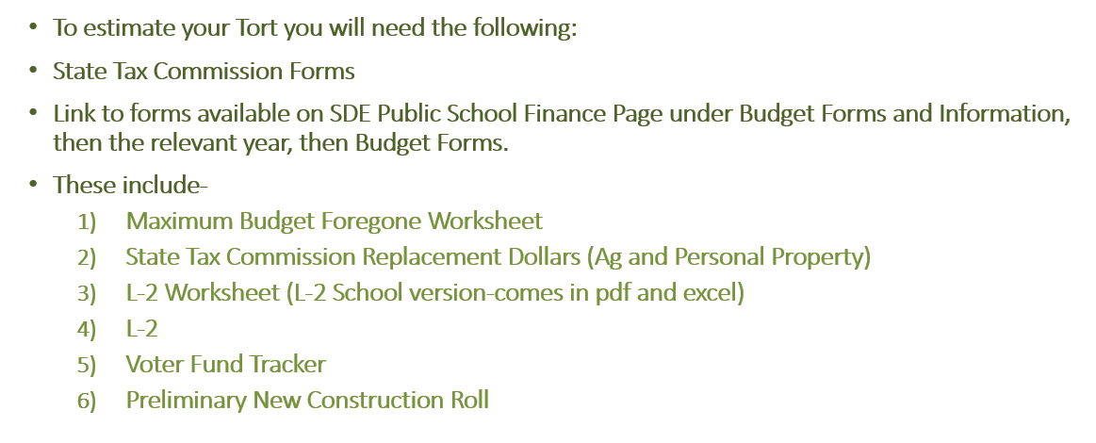
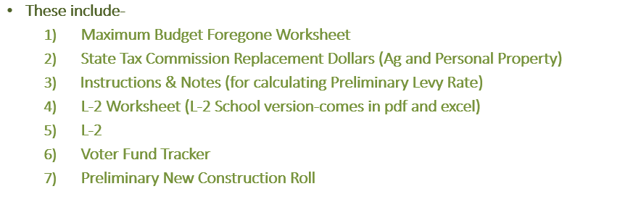
Completing Tort Levies

Slide 30
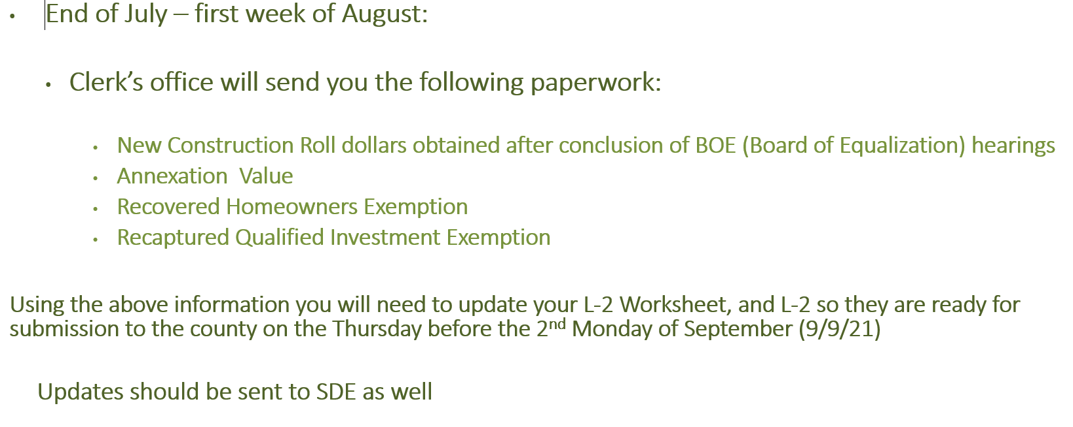
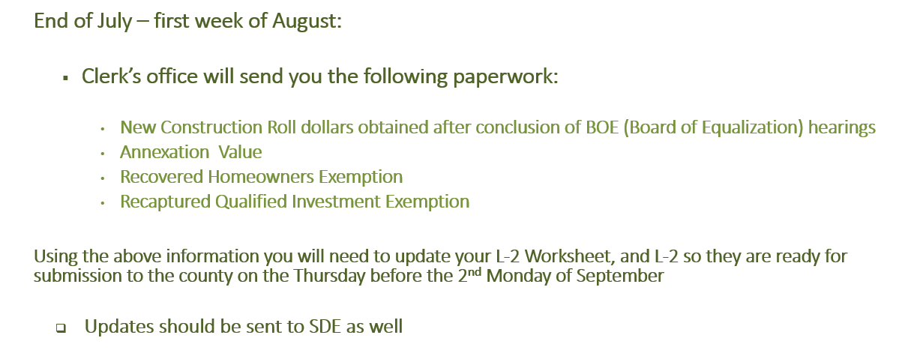
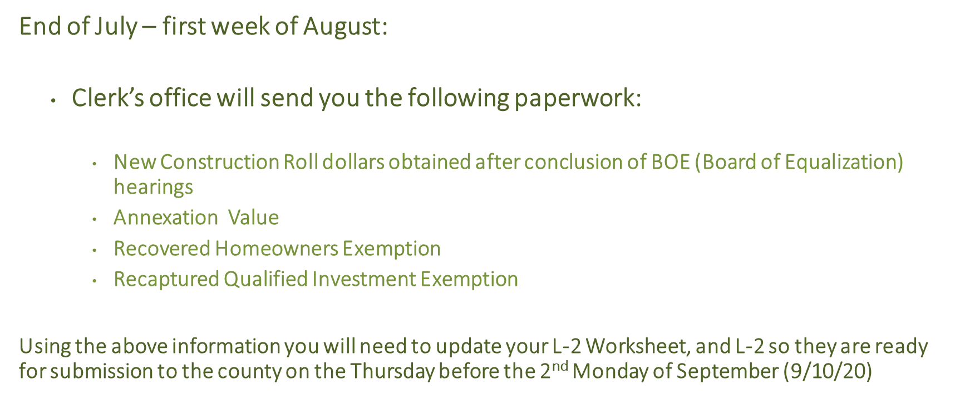
Levies & County Clerk’s Office

Slide 31
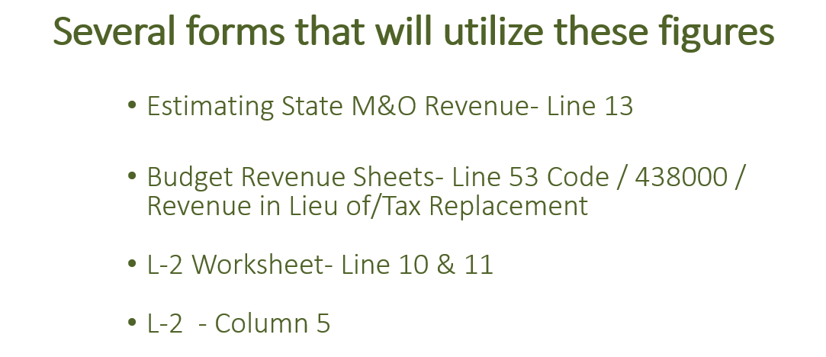
Agricultural Replacement/Personal Property Replacement

Slide 32
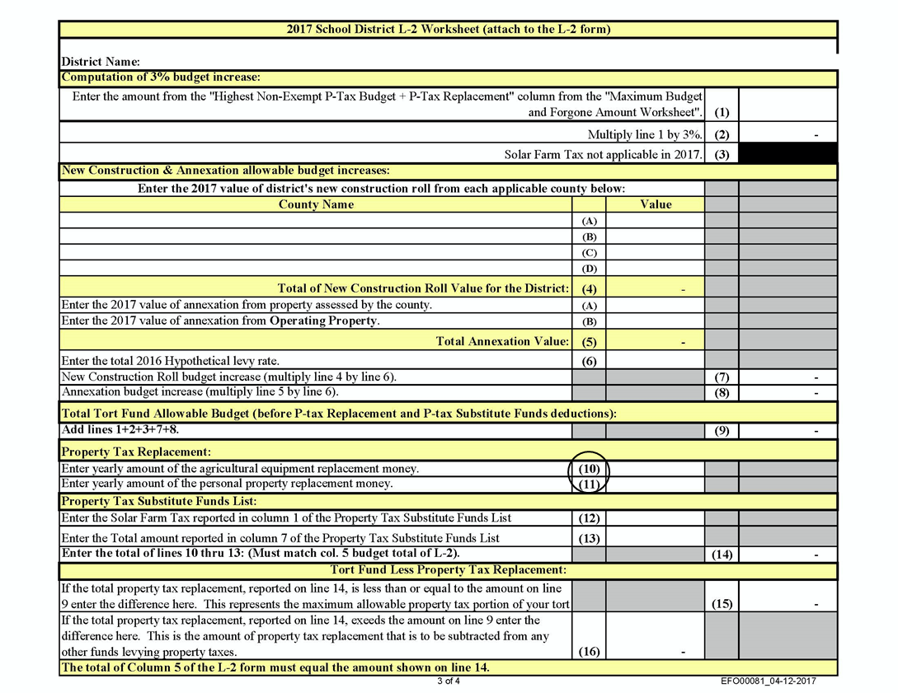
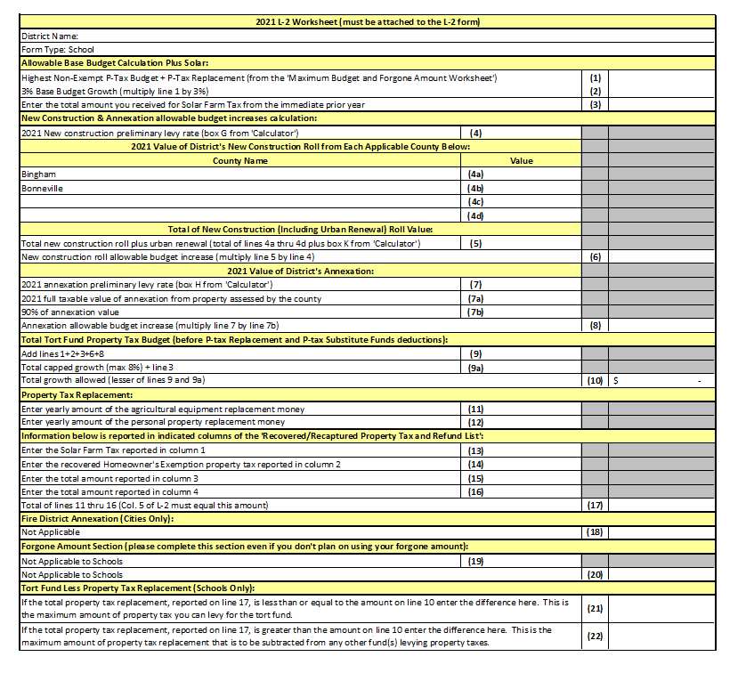
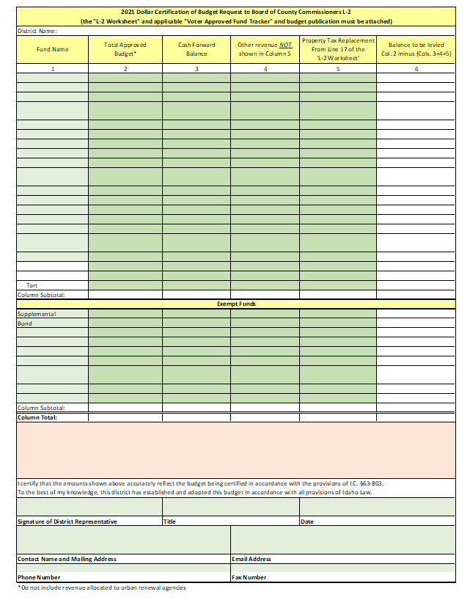
New L-2 Forms from the Tax Commission
Line 17 of the L-2 Worksheet Must Equal Column 5 of the L-2
This amount goes on line 53 of the budget general fund

Slide 33
For Specific Tax Levy Questions
County Clerk and Elections Clerk
Idaho State Tax Commission:
    Ben Seloske 334-7541
    Alan Dornfest (policy) 334-7742
Secretary of States Office 334-2852
Consult your Legal Advisor and Auditor
State Department of Ed:
    Julie Oberle 332-6843 and/or Carol Piranfar 332-6844

Slide 34
New Buildings and Building Reconfigurations

Slide 35
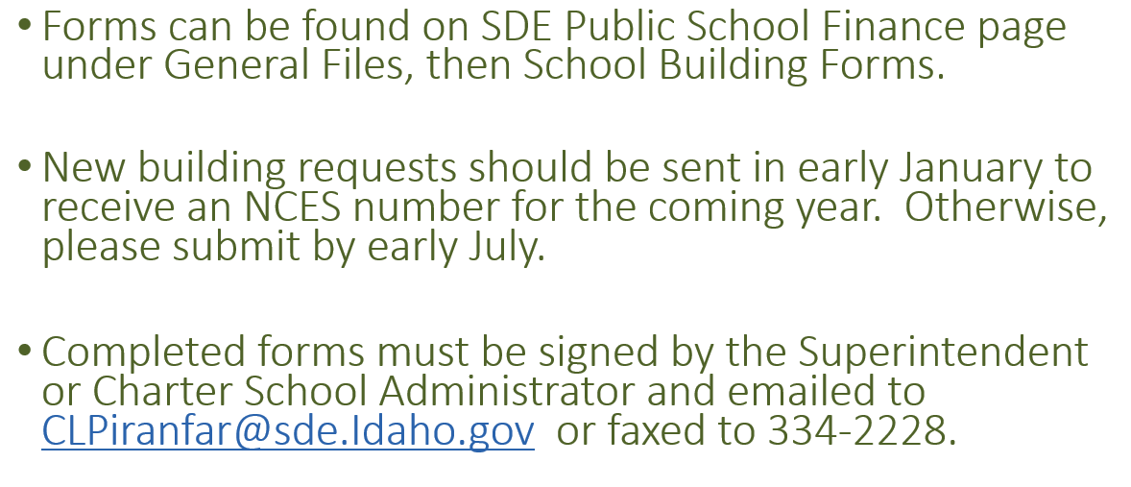
New Building/Building Reconfigurations

Slide 36
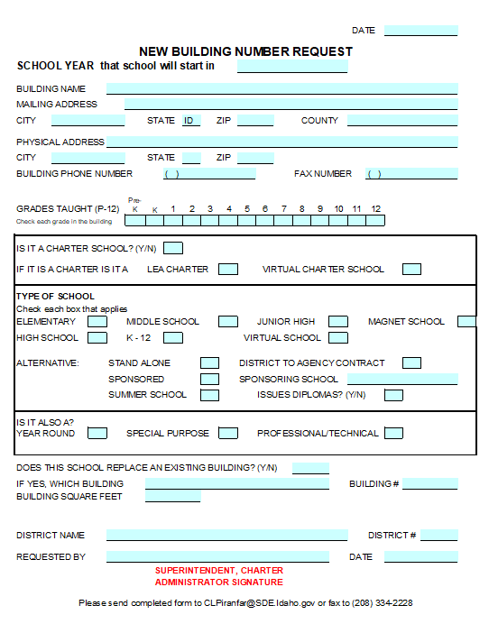
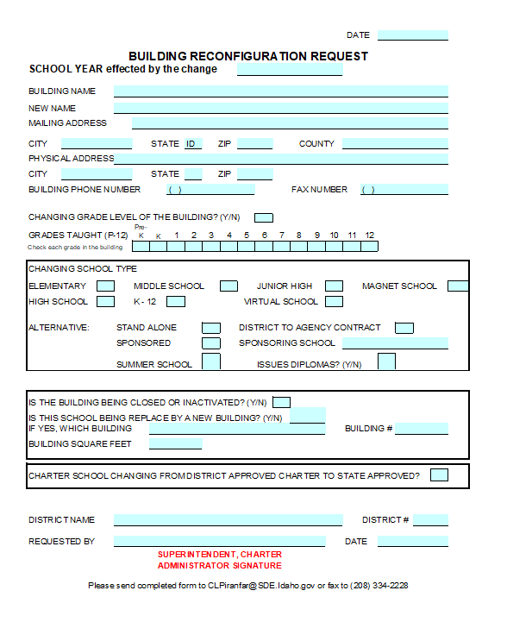
New Building Number Request/Building Reconfiguration Request Forms

Slide 37
Questions?
Carol Piranfar | Financial Specialist
Idaho State Department of Education
650 W State Street, Boise, ID 83702
208.332.6844
clpiranfar@sde.idaho.gov
www.sde.idaho.gov

