Slide 1
Title I-D 101: Neglected,
Delinquent or At-Risk Programs
Important things to know – even if you don’t have a Juvenile Detention Center in your geographical boundaries
Notes:
There are actually 4 programs related to Title ID - since we have approximately 3750 students in the state of Idaho that are served by these programs annually – maybe even some from your district/charter!

Slide 2
Program Purpose & Structure

Slide 3


Vision: Actions aligned to Purpose/GOALS!
Office of Safe and Healthy Students – Improve education outcomes
Title I – Improving the Academic Achievement of the Disadvantaged
Title IA – Improving Basic Programs Operated by LEAs
  Neglected Set-Asides for At-Risk Programs
Title ID - Prevention & Intervention Programs for Children and Youth who are Neglected, Delinquent, or At-Risk
ESSA Idaho Consolidated Plan –
All Idaho students persevere in life and are ready for college and careers;
All education stakeholders in Idaho are mutually responsible for accountability and student progress;
Idaho attracts and retains great teachers and leaders.
School Improvement & Support –
Increase the quality of the student experience through teaching and learning.
http://static1.squarespace.com/static/55a7359de4b08b8d7618135c/55a73711e4b01d8bd291e7fe/55a73711e4b01d8bd291e800/1437022027450/Commongoals.jpg
Notes:
What do all of these have in common??? Current & FUTURE success of students!
These are In addition to the other organizations/programs have the same or similar goals/priorities/desired outcomes (IDEA, Heath & Welfare, Dept of Corrections, etc., etc. etc.)
Sometimes things feel disjointed!
The Purposes/Goals of the different programs/plans we are tasked under:
Title I-D is administered by the Office of Safe and Healthy Students: OSHS directly supports efforts at the State and local level to improve education outcomes for students with the ultimate goal of providing all students—regardless of zip code, race, ethnicity, religion, family income, sex (including gender identity), sexual orientation, disability, language status, gender, or migrant status—with a high-quality education.
The goals of Title I, Part D, are to:
- Improve educational services for these children so they have the opportunity to meet challenging State academic content and achievement standards;
- Provide them with services to successfully transition from institutionalization to further schooling or employment; and
- Prevent youth who are at-risk from dropping out of school, and to provide dropouts and children and youth returning from correctional facilities with a support system to ensure their continued education.

Slide 4
Program Purpose
The purposes of Title I, Part D are to:
Provide educational services for students in neglected or delinquent facilities that support them the opportunity to meet challenging State academic content and achievement standards;
Provide a successful transition from facilities to school or employment; and
Prevent at-risk youth from dropping out of school and to provide students returning from facilities with a support system to ensure their continued education.

Slide 5
Delinquent/Needing Supervision:
Who are these youth?
Delinquent: Up to age 21, who do not have diploma or GED
(Attend school onsite, virtually or day program)
  Pre-adjudicated (court diversion residential programs, i.e. substance abuse programs)
  Adjudicated to live in delinquent facilities (short or long-term)
  Post-adjudicated/probation (court ordered - transitional day program)
In Idaho more and more kids are being diverted to other programs instead of incarceration = “Needing Supervision”
Notes:
Focus in Idaho - more and more kids are being diverted to other programs instead of incarceration

Slide 6
Neglected: Who are these youth?
Neglected: Children live in neglected facilities due to neglect, abandonment, or death of parents-guardians
(Attend school on-site, off-site or virtually)
  Neglect = failure to meet children’s basic needs that results in a void that places children in harms way –
    Needs/voids may be there whether the failure is the responsibility of parent, community, or society
SY2021-22 | 6
Notes:
Child Neglect is a failure to meet children’s basic needs – whether the failure is the responsibility of parents, communities or society – and this void places children in harm’s way
Many are here in Idaho in referral programs to avoid incarceration in other states. Parents are placing them in private boarding schools because of mental health issues, substance abuse, or other errant behaviors

Slide 7
At-Risk: Who are these youth?
“At-Risk” is defined in Idaho Administrative Procedures Act (IDAPA) 08.02.03.110
An At-Risk youth is any secondary student grade seven through twelve who meets any three of the following criteria:
Has repeated at least one grade
Has absenteeism that is greater than ten percent (10%) during the preceding semester.
Has an overall grade point average that is less than 1.5 (4.0 scale) prior to enrolling in an alternative secondary program.
Has failed one or more academic subjects.
Is two or more semester credits per year behind the rate required to graduate.
Has substance abuse behavior.
Is pregnant or a parent.
Is an emancipated youth.
Is a previous dropout.
Has serious personal, emotional, or medical problems.
Is a court or agency referral.
Demonstrates behavior that is detrimental to their academic progress.
Notes:
Child Neglect is a failure to meet children’s basic needs – whether the failure is the responsibility of parents, communities or society – and this void places children in harm’s way
Are you behavior plan systems (RTI/MTSS/Sped) in place so that students can get the help they need????
These students may also be in pre-diversion programs – SRO/courts/probation officers working closely with schools

Slide 8
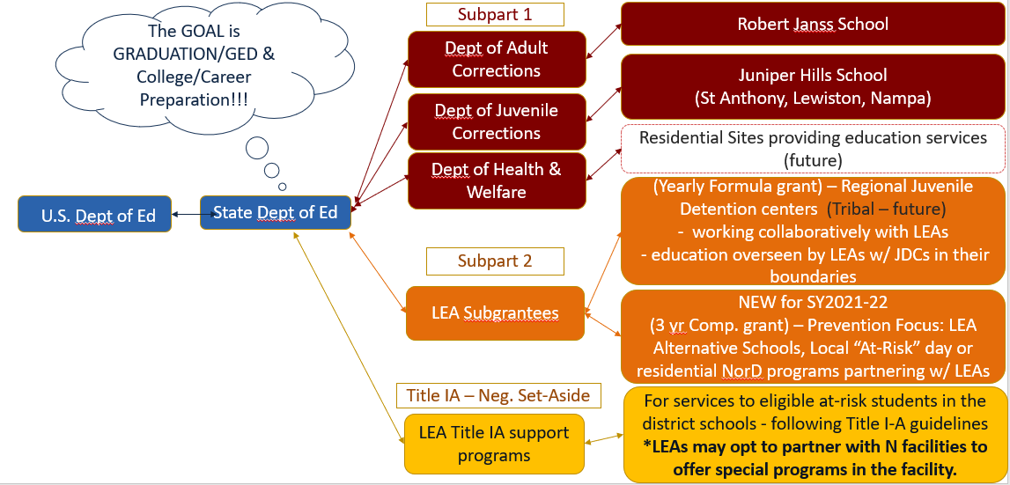
Service Structure

Slide 9
Understanding the Idaho
Juvenile Justice System

Slide 10
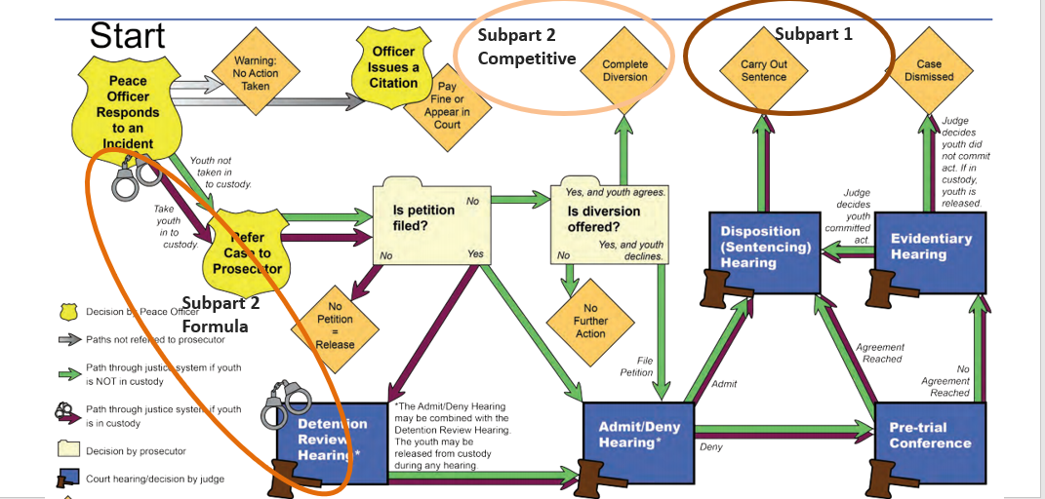
Juvenile Justice System in Idaho

Slide 11
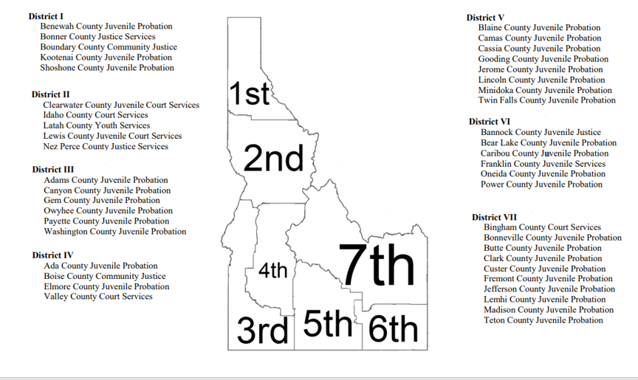
Idaho Judicial Districts/Probation

Slide 12
Subpart 1
State Agency Programs

Slide 13
Subpart 1 – State Agency Programs
More than 900 students are annually supported by the Title I-D, Subpart 1 program in facilities under the jurisdiction of:
  Idaho Department of Corrections
    Robert Janss School (9 locations)
  Idaho Department of Juvenile Corrections
    Juniper Hills School (3 locations)
  Future Grantees:
    Idaho Department of Health & Welfare
      State Mental Health Hospitals

Slide 14
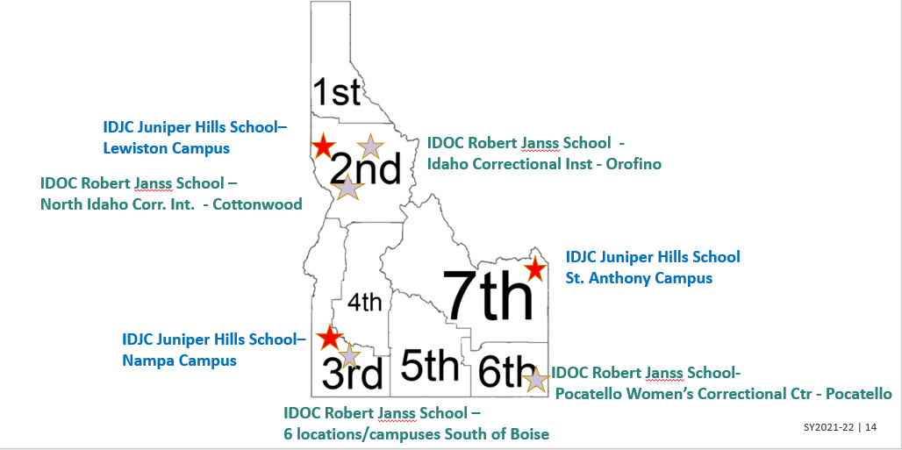
Current State Agency Programs

Slide 15
LONG TERM & Residential
Records will be requested by IDOC or IDJC so they can be enrolled in a State Agency “school”
Students are “unenrolled” from a district
  Use exit code #2B
    2B identifies students who are exiting the public school system and entering a private or other non-public/federal or state education setting.
SY2021-22 | 15

Slide 16
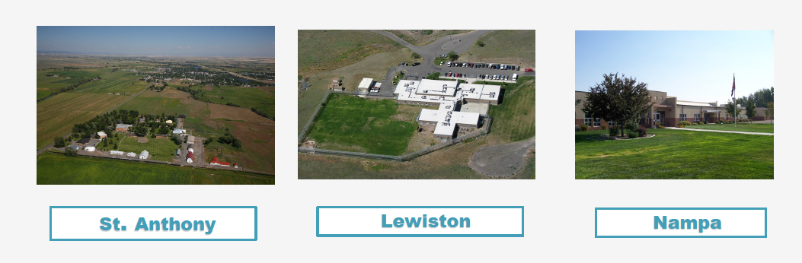
Example: State Agency Program
Idaho Department of Juvenile Corrections – Juniper Hills School
Middle School
High School
Certifications
Work-based Learning
Post-Secondary
GED
Accredited
Direct instruction/Mastery-based
Highly Qualified Teachers
Core subjects + Electives
Monthly presentations (Life skills, SEL, college/career)
Notes:
Electives – Woodshop, Basic Auto, Small Engine Repair, Bicycle Repair, Horticulture/Greenhouse, PE, PLATO electives, Art Talk, etc.
GED Academy – for those who it is determined that they won’t be able to accumulate enough credits to graduate
Certification – CPR/First Aid, OSHA, Microsoft Office, Flagger, Food Handler, etc.
Approximately 20% of students – in higher ed correspondence courses

Slide 17
Academic & Other Services
Academic/Education | Other Services
Special Education - IEP | Sex Offenders
SPED Related Services – OT or Speech/Lang | Oppositional Defiant Disorder
504 Accommodation Plans | Conduct Disorder
English Language Learner | Drug/Alcohol
 | Mental Health
Notes:
40% of students entering IDJC qualified for Special Education Services

Slide 18
Center Funding
General funding – IDJC budget
+
Federal Funding
  IDEA – Special Education Federal Funding
  Title ID, Subpart 1 – Supplemental Support & Transition Activities
  Title IIA- Teacher Improvement/Training

Slide 19
Subpart 2
County Juvenile Detention Partner Programs

Slide 20
Subpart 2 –County Detention Centers
Annual “Formula” grant
More than 2750 students were supported in
SY2019-20 by district/facility partner programs located in:
  11 County/Regional Juvenile Detention Centers
See Administrative Rule – IDAPA 08.02.02, section 240 - regarding education within Idaho JDCs.
Notes:
In the future – only 11 County Juvenile Detention Centers will be based on “Formula” grant. This means that their funds are directly tied to their Fall “Count” numbers.
The contracted site & other Partner programs will be eligible for the “Competitive” grant.
Administrative Rule - IDAPA – 08.02.02 section 240 governs education within Idaho JDCs.

Slide 21
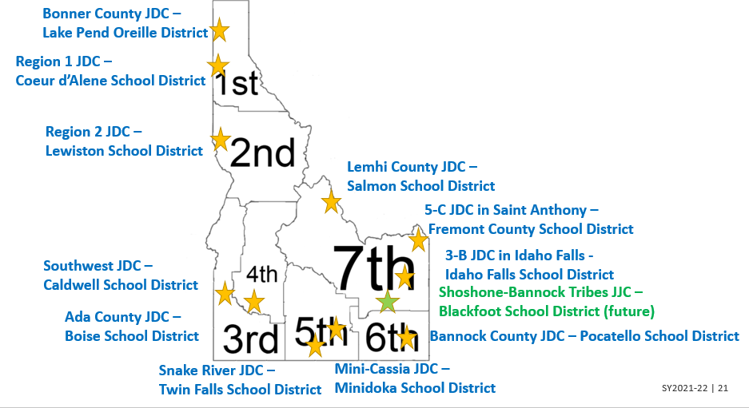
Idaho County & Tribal Detention Centers

Slide 22
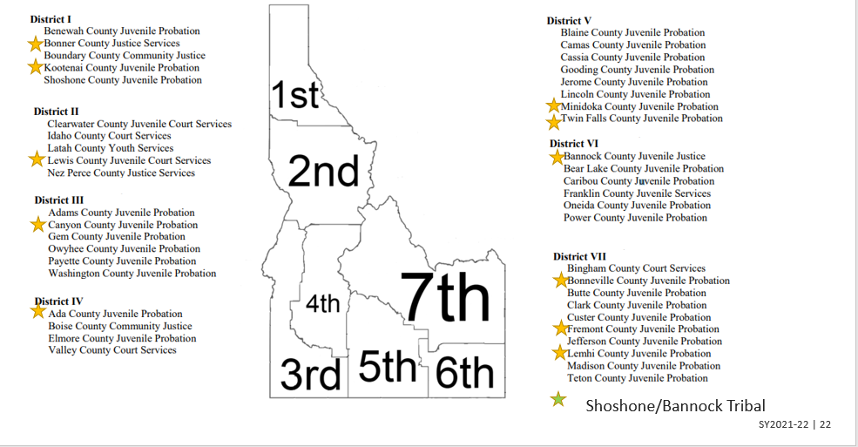
ID Judicial Districts

Slide 23
SHORT TERM & Residential
Short-term - avg 5 to 10 days
Continue coursework from the classes they are enrolled in their districts/schools.
  Attendance is taken in the detention center classroom and ADA is “counted” by sponsoring district to cover cost of classroom/teacher.
  Students are NOT unenrolled by own district. Students are marked as absent. Students are duel enrolled!
Notes:
See Attendance and Enrollment Manual – pg 24
Juvenile Detention Center Attendance (I.C.33-2009)
Facilities that provide for the temporary care of children, as defined as Juvenile Justice Reform Corrections Act, who require secure custody, for their own or the community’s protection, in physically restricting facilities pending court disposition or subsequent to court disposition. To qualify for state funding of instructional programs at the Juvenile Detention Centers, school districts must apply for such funding on forms provided by the SDE. Applications are subject to the review and approval of the State Superintendent of Public Instruction. JDC’s shall submit reports to the local school district as may be required.
Attendance for Juvenile Detention Centers is reported using the assigned school and building number of 915. The supervising teacher submits to the school district the daily attendance including the name, age, sex and grade level of each student and the days of instruction provided. A day of instruction consists of a minimum of four (4) hours, which does not include lunch periods, breaks, passing time, recess, etc.
On the Juvenile Detention Center daily attendance report, include only those days in which the student is actually participating in an instructional program. Days in which the student is just being housed in a JDC, do not count as days of instruction. On the daily attendance report, the total weekly attendance days from the JDC are summarized, including number of noninstructional days and the number of days in session in each week, which must equal 5.
Note: Do not count emergency closures days as part of regular instructional days.
Note: Summer Juvenile Detention Centers are reported exactly the same as the regular JDC program

Slide 24
IMPORTANT - I-D Neglected/Delinquent Education Coordinator
Role Code = NDE role
Submit an updated “Program Contact File” via ISEE
All LEAs
  All districts should have someone coded in IDCI as Neglected/Delinquent Education Coordinator (NDE) so the student doesn’t lose credit for classes in which they are enrolled.
Districts who provide education program in Juv. Detention Centers
  NDE Coordinators, JDC teacher or Transition Staff in these districts need to know who to contact when students in other LEAs within the region to coordinate/continue learning for the student during their stay in detention.
  SDE needs to know who to communicate with in regards to Title ID grants

Slide 25
Example: County Detention Center
Bonner County Detention Center - Classroom
Lake Pend Oreille is the grantee district because the JDC is located within it’s geographical boundaries.
  MOU/agreement in place between LPO and Bonner Co.
  Classroom instructional staff are employed by LPO
Notes:
Short-term placements

Slide 26
Academic & Other Services – Detention Center
Academic/Education | Other Services
Classes 5 hours/weekday in JDC classroom by 1 certified teacher & para | Screening & assessment for mental health
Continue coursework from classes w/ Intervention support in basic Math, ELA, SS and Science | Screening & assessment for substance abuse problems
IEP & 504 requirements met | Referrals to community services
Transition support – works with multiple districts to coordinate coursework and the transition IN and OUT of detention. | 7 Habits of Highly Effective Teens
SY2021-22 | 26

Slide 27
Funding
Basic educational program (funding through SDE)
+
Supplemental $ (Title ID)

Slide 28
Subpart 2: Competitive Grants
LEA At-Risk or LEA/Partner Programs

Slide 29
Subpart 2 – NEW Competitive Grant
Grant cycle 2021-2024
6 LEAs were awarded a total of $259,000/year* in July 2021
More than 1150 students will be supported
  2 LEA At-Risk Programs
    Mt. Home - Bennett Mtn. Alternative School
    Nampa – Gatesways Program
  4 LEA/Partner Programs
    Orofino – Idaho Youth Challenge Academy
    Pocatello – Bannock County Youth Development
    Lewiston – Northwest Children’s Home
    Coeur d’Alene – Kootenai Behavioral Health
*based on Federal funding – Title ID annual count

Slide 30
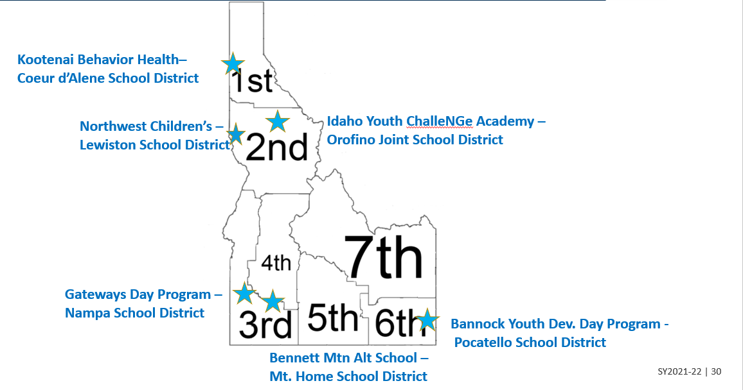
Subpart 2 Competitive Grants

Slide 31
Example: Transition/Step-down Program
Bannock County Youth Development Center
Bannock County Juvenile Court
Bannock County Juvenile Probation Department
Pocatello School District
Mission: to provide a secure, safe environment for juveniles who are placed in its care by the courts.
Goals: Address citizenship, school attendance, drug/alcohol problems, self-worth, individual accountability & decision-making skills
Notes:
https://www.bannockcounty.us/wp-content/uploads/Family-Guide-to-Juvenile-Justice.pdf

Slide 32
Bannock YDC
Serves 35-40 youth annually
Ages 14-18
  High or very high risk level to re-offend
  Safety concern for the community
  Disruptive behavior in the school setting
  Substance abuse issues
  Credit deficiencies
Operates year round.
  Students may enter the program at any time during the year and transition back to the alternative high school or comprehensive high school at the beginning of each block or trimester.
Average length of stay is approximately 120 days.
Program can accommodate up to 13 students at one time
Successes
Academic
  2015 = 7 diplomas & 2 GEDs
  2016 = 6 diplomas & 2 GEDs
  2017 = diplomas & 3 GEDs
  2018 = 10 diplomas
  2019 = 8 diplomas
    1 is enrolled in college
    2 are working as journeymen in their trades
    3 are employed in entry-level jobs
    2 are unemployed
Criminal Activity
  Much lower recidivism of program participants
SY2021-22 | 32

Slide 33
Bannock Academic & Other Services
Academic/Education | Other Services
Transcript Review & Planning | Restorative Justice Strategies
Credit Recovery | Life skills
Blended Learning platform | Physical Health & Meals
Study & Work skills | Service Learning
Transition Planning | Social/Emotional Counseling
College & Career Counseling | Substance abuse therapy
FAFSA & Post-Secondary application support

Slide 34
Funding Example
Bannock County
Location/learning space
Technology
2 FT employees
  Probation officer
  Coordinator
Pocatello School District
1 full-time teacher
  YDC ½ day & Detention site classroom ½ day
  Acts as a liaison between district and county
  Blended learning & On-line courses
Furniture & Technology
Curriculum Materials
Professional Development Opportunities
  Restorative Justice
  Trauma-Informed Practices
Nutrition Services

Slide 35
Title IA Neglected Set-Aside

Slide 36
Title IA – Local Neglected or At-Risk Programs
Approximately 100+ students were supported by Title I-A Neglected Set-Aside funds in the past
Current sites:
  3 district/neglected facility partner program sites
    Students residing in the facilities receive Title IA type interventions/support
  2 district administered At-risk programs
    students residing in the facilities attend and receive support through at-risk programing within the school/district
Notes:
This # will increase as the number of counting sites has increased.

Slide 37
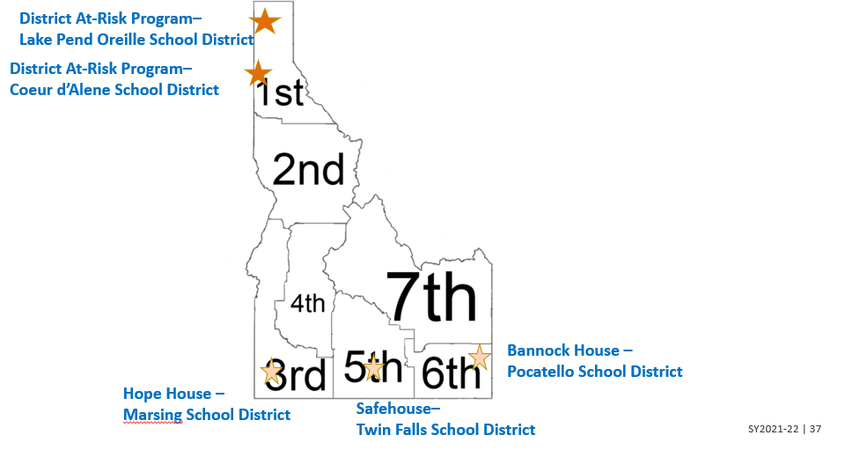
Districts Receiving a Neglected Set-Aside
Notes:
Light orange = districts who are partnering with local agencies to provide Title IA type services to students
Dark orange = districts who are providing drop-out prevention programs to at-risk students

Slide 38
Example: Crisis program
Twin Falls – The Safe House: Empowering Youth
  Fourteen youth between the ages of 11 to 17 in a comfortable home-like setting
  These may include youth from child protection, runaways, homeless, couch surfing youth, juvenile justice youth and status offenders who are in need of shelter.
  Students receive on-site tutoring provided by a Twin Falls staff member.

Slide 39
Academic & Other Services
Academic/Education | Other Services
Continued attendance at school | Independent living skills
Transportation to school of origin | Anger Mgt. skills
On-location Tutoring Support | Family & Peer counseling
 | Recreation activities
 | Referrals to substance abuse education, medical/dental care, or other community programs

Slide 40
Funding
  Neglected Set-Aside $ used for Tutoring support on-location after school hours.

Slide 41
Counting, Application & Evaluation

Slide 42
How are funds generated?
Subpart 1 Counting Sites
Subpart 2 Counting Sites
Title IA Neg. Set-Aside
For a program to generate Subpart 1 funds, children and youth must be -
In a program for youth who are N or D, including juvenile and adult correctional facilities and community day programs
Enrolled in State funded “regular program of instruction”
Enrolled in a program that has an average length of stay of at least 30 days
20 years of age or younger who have not received diploma or GED
For a program to generate Subpart 2 funds, children and youth must be –
Living in local institutions for children and youth who are Delinquent or “needing supervision”
Living in the institution for at least one day during the annual 30 day count period
5 through 17 years of age
For an LEA to receive Neglected funds children and youth must be -
Living in local Neglected institution
Counted in the Annual Fall Count
Students who are residents in locally-run Neglected facilities generate additional dollars for the LEA's in which they are located, since their residents may attend school in the LEA on a temporary or ongoing basis.
Set-aside rate is calculated on per/student basis

Slide 43
Determining Counting Sites - CRITERIA
Purpose – mission of facility/program
Location
Registered through IDHW
  Children’s Residential Care
  Treatment Center
  OR
  Hospital
  State, county, or tribal Juvenile Detention Center
How they are placed in facility?
  Adjudicated or Court Involved
  Parent placed
  Other
Average length of stay (short <30 days vs. long term >30 days)
On-site or Off-site educational program
  Who oversees educational program
    SDE
    IDJC
    Private

Slide 44
Annual Survey/Count – Subpart 1 & 2
Steps to Counting
SDE Coordinator identifies sites within their district boundaries with the help of LEAs
Sites & Districts are notified by email and sent PDF “fill-in” form
Sites should receive a personal call/visit from local Title ID Coordinator and/or SDE Coordinator to assist them and answer questions
Sites “Count” students & provide PDF form to LEAs
  Subpart 1 state agency sites (one pre-determined date)
  Subpart 2 (30 day count w/ at least one Oct day)
LEAs complete the ONLINE (new) form
https://www.sde.idaho.gov/federal-programs/neglected/index.html
Sites & Districts are identified: July - Aug
Sites & Districts are sent forms: by the middle of Oct
Count timeframe: Sept – Nov
SUBMIT COPY OF SIGNED FORM TO SDE BY EMAIL By - Dec 15th
Notes:
Goal is to get this information out the first week of October.

Slide 45
Application – Subpart 1
ONLINE (coming soon!) form application submitted by the State Agency
Current Memo of Understanding (MOU) between agency & contracted sites
  Lists the responsibilities, duties, & services provided by each entity
  Dated, signed by both entities & submitted with application
Budget
  Aligned to project goals listed in the application
On-line application information & preliminary budget amounts distributed by Apr 31
SUBMIT COPY OF SIGNED APPLICATION TO SDE BY - May 31

Slide 46
Application – Subpart 2 (Detention Ctrs)
Joint ONLINE (coming soon!) application submitted by the LEA for the partner facility
  Signed by both the LEA and the Facility
Current Memo of Understanding (MOU) between district and facility
  Lists the responsibilities, duties, & services provided by each entity
  Dated, signed by both entities & submitted with application
Budget
  Aligned to project goals listed in the application
Application information distributed w/ preliminary budget amounts by Apr. 31
SUBMIT COPY OF SIGNED APPLICATION TO SDE BY: Aug 31 (same as CSFGA)

Slide 47
Application – Subpart 2 (Competitive)
Look for information regarding the Competitive Title ID Subpart 2 grant application Spring 2024 for the 2025-2028 grant cycle.

Slide 48
Evaluation/Reporting – Subpart 1 & 2
On-line Evaluation tool –
https://apps.sde.idaho.gov/NeglectedAndDelinquent/Year/27/Home/Home
Enrollment/# Students served throughout the year
# days Ed. Program operates
Demographics
Outcomes upon release & w/in 90 days after exit
  Diploma, GED, Credits, Job training, Employment
Academic Performance (pre/post for those students spending >30 days)
  Reading
  Math
LEAs are ultimately responsible for submitting data for partner programs
TOOL OPENS: Aug 15
SUBMIT VIA ON-LINE “Evaluation” TOOL BY: Sept 30)
Notes:
https://apps.sde.idaho.gov/NeglectedAndDelinquent/Year/27/Home/Home

Slide 49
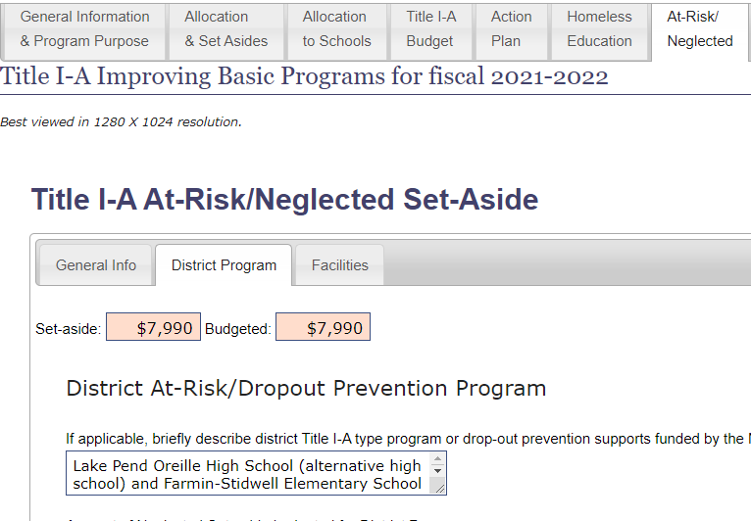
Title IA – Neglected Set-Aside
These amounts will be prefilled in on the CFSGA online tools based on the Fall Title I-D Annual Count.
NEW - Complete the
At-Risk/Neglected Tab
Remember these funds may be used:
To support Title IA type programing in a partner facility serving “Neglected” students
OR
To support district drop-out prevention activities for “At-Risk” district youth.
Notes:
Your Title IA allocation was increased based on the fall count. These are additional funds you would have NOT received if it weren’t for the counting the site(s) within your district.

Slide 50
Title IA – Neglected Set-Aside - Continued
Districts who receive/set-aside these funds need to report the number of students who were served using these funds through the Title IA Annual Performance Report (APR)
Include the # of students (by grade-level)
- being served in partner programs
AND/OR
- being served through district dropout/at-risk prevention programs
Notes:
Please contact Suzanne if you need assistance in accessing and/or filling out the on-line tool if this is a new process for you.

Slide 51
ESSA Requirements related to Title I-D
Requirements and Responsibilities to receive the funds
  State agencies and districts are required to:
    Meet the educational needs of neglected, delinquent, and at-risk children and youth, and assist in the transition of these students from correctional facilities to locally operated programs,
    Ensure that these students have the same opportunities to achieve as if they were in local schools in the State, and
    Evaluate the program outcomes and disaggregate data on participation by gender, race, ethnicity, and age
    Meet federal programs monitoring requirements
Notes:
Look at the VERBS!
- Meet educational needs
- Assist in transitions between programs
- Ensure the same opportunities to achieve
- Evaluate the program
- Disaggregate the data
States are monitored just like districts and facilities!
Monitoring documents need to be viewed as the roadmap to success instead of roadblocks to the “real work” districts do!
Need to change perspective from compliance to improvement!

Slide 52
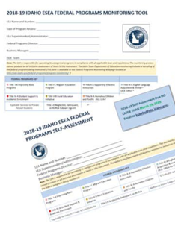
Federal Program Title ID Indicators
Self-Assessment & Federal Program Monitoring Tool
https://sde.idaho.gov/federal-programs/program-monitoring/
Title IA – Neglected/At-Risk Set-Aside
PROG 46 Neglected indicator (under Title IA)
OR
Title I-D Subgrant
Program Mtg
ND 1 Program Management
ND 2 Annual Fall Count
ND 3 Evaluation of Program
ND 4 Staffing & Professional Dev.
ND 5 Instruction
ND 6 Evaluation of Student Achievement/Outcomes
ND 7 Family/Parent Engagement
ND 8 Transition Services
ND 9 Fiscal Accountability
Notes:
The self-assessment MUST be completed and submitted annually!

Slide 53
Questions?
Suzanne Peck | Title ID Neglected, Delinquent or At-Risk Coordinator
Idaho State Department of Education
650 W State Street, Boise, ID 83702
208.332.6800
speck@sde.idaho.gov
sde.idaho.gov/federal-programs/neglected/index.html

