Slide 1
Migrant Services in MSIS
Mini-Training January 2022

Slide 2
How to Navigate in MSIS
How to find Services in MSIS

Slide 3
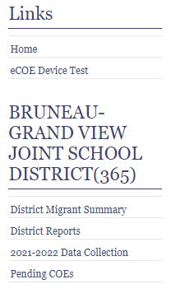
Getting into MSIS
Log into MSIS
Click on the District Migrant Summary on the navigation pane (left side of the screen).
Select the student.

Slide 4

Finding Services
Click on Current Year Data on the last tab
Select “Regular Term” or “Summer Term”

Slide 5
How to Complete Regular Term Services
Regular Term is the regular school year, as opposed to Summer Term

Slide 6

Regular Term – ISEE Attributes
ISEE Attributes: These are from ISEE, but are useful pieces of information to help you better serve children. You cannot change them in MSIS.

Slide 7
Regular Term – Verification Date
This is a critical piece of data you collect each year.
This date represents a date you spoke with the parent and confirmed that they were residing in Idaho. (Best practice.)
This date may also represent a date that the student was enrolled in school and not absent. (Distant 2nd best.)

Slide 8
Residency Verification Date Rules
Must be on or after the 3rd birthday (if turning 3).
Must be before 22nd birthday.
Must be before the End of Eligibility and before graduating or getting a GED.
Must be on or after September 1st for the current school year.

Slide 9
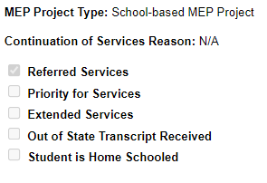
Project Type & Continuation of Services
MEP Project Types: All projects in Idaho are School-based, so this is pre-filled.
Continuation of Services: This is from the student row in the District Migrant Summary and cannot be changed here.

Slide 10
Regular Term – Odds and Ends
Referred Services: Migrant staff referred a child to a non-MEP paid service (e.g. Lion’s Club for glasses, food banks, government agency, clinic, etc.) and the liaison ensures that the family followed through on the recommendation.
Priority for Services: Student qualifies as PFS for the current year (see Mini-Training #2 for more)
Extended Services: Support or Instructional Services provided outside the regular school day (e.g. before or after school, weekends)
Out of State Transcript: District received an out of state transcript for this (high school) student. This is reported in MSIX.
Student is Home Schooled: If the family states that the child is homeschooled, mark this.

Slide 11
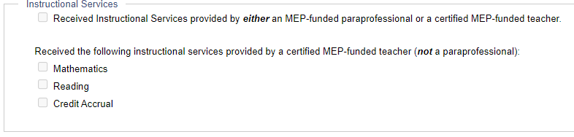
Regular Term – Instructional Services
If the student received instructional services (e.g. classes, tutoring, etc.) by either a teacher OR para paid out of migrant funds, mark the first box.
If it was a teacher in the first box, mark if the teaching was in math, reading, or for credit accrual.

Slide 12
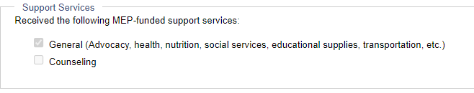
Regular Term – Support Services
If the child received support services of any kind by a migrant paid staff person, mark general.
If this service was counseling, mark both.

Slide 13
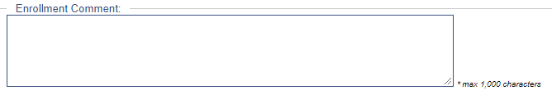
Regular Term – Enrollment Comment
This goes to MSIX and will help liaisons in other states understand when something odd in the student’s enrollment happened and why.
An example: a student went to Mexico for several weeks in winter when there is no farm work in the area. The district made arrangements for the student to take work with him and did not withdraw him, so it looks like he never left.
Another example: A student moves to a new district, but continues to drive to the old district to finish her senior year.
Another example: A student does not show enrollment for 3 years, nor is he home schooled, but you know he attended a private school.

Slide 14
How to Complete Summer Term Services
Summer Term is after the regular year is over and before the next school year begins.

Slide 15

Summer Term Differences - Dates
Attendance Begin Date is the first day the student attended summer school, OR received home-based summer services OR first received a support service after the school year ended.
Attendance End Date is the last day the student attended summer school, OR received home-based summer services OR received a support service (must be at least 2 contacts for a support service).

Slide 16
Summer Differences - Attended
Attended Migrant Funded Summer School:
For now, this box must be checked for any student to count as receiving summer services. This will probably be eliminated this year as the dates and services checked will allow us to determine if a student should count as receiving a summer service (Instructional or Support).

Slide 17
Summer Term Differences – Enrollment Comment
You may wish to make a comment if the student was served through home visits or virtually for credit accrual support, rather than in a traditional summer school.
If the student showed up for one day and then disappeared, you might make a note to say this.

Slide 18
Timeline for Services Data Entry
Avoid the last minute crunch!

Slide 19
Residency Verification Dates
Ideally at the beginning of the year (except 3 year-olds).
Critical to do these within allowed timeframes:
Before 22nd birthday
On or after 3rd birthday (if turning 3)
On or after September 1st (and before 8/31)
Before the End of Eligibility (EOE), Grad, or HSE date
Before the student leaves the district!

Slide 20
Priority for Services
Ideally by October 31 for returning students
Within 2 weeks of being identified for newly identified students

Slide 21
Regular Term Services
Referred, Support, and Instructional Services should be entered as they happen or at least once per month.
These can only be entered once, regardless of how many times they are provided.

Slide 22
Summer Term Attendance Dates
Enter Attendance Begin Date as soon as summer school starts for those who come the first day and for new students as soon as they start. Do NOT enter dates before students actually attend for at least one day.
Enter Attendance End Date can be entered on the last day of summer school, using attendance records to capture the last day each child attended.

Slide 23
Summer Term Services
Enter all summer term services as they take place.
Instructional Services can be entered as you enter the Begin Attendance Date. This will save you some time.
Support Services can be entered after the second contact.
Referred Services can be entered when you confirm that the service took place.

Slide 24
End of the Year Review
No more services can be entered after we roll over the data base in mid-September.
Use the Bad Dates report to check that each student has a valid date. If a student has a “bad date” that will exclude her from counting, it will give the rule that was broken as a reason.
Review each student to make sure that everything is complete before the rollover date.

Slide 25

Questions?
Sarah Seamount | Migrant Education Coordinator
Idaho State Department of Education
650 W State Street, Boise, ID 83702
208.332.6958
sseamount@sde.idaho.gov
www.sde.idaho.gov/federal-programs/migrant
Julissa Lara | Migrant Education Program Specialist
Idaho State Department of Education
650 W State Street, Boise, ID 83702
208.332.6907
jlara@sde.idaho.gov
www.sde.idaho.gov/federal-programs/migrant
Tania Scurtu| Migrant Education Admin. Asst.
Idaho State Department of Education
650 W State Street, Boise, ID 83702
208.332.6928
tscurtu@sde.idaho.gov
www.sde.idaho.gov/federal-programs/migrant

