Slide 1
Determining Who Gets Priority for Services
Mini-Training December 2021

Slide 2

Welcome & Introductions
A quick introduction in the chat – Include Your
Name
District
Role(s)
What made you come to this?

Slide 3
Why Do We Identify Priority for Services?
1304 (d) PRIORITY FOR SERVICES.—In providing services with funds received under this part, each recipient of such funds shall give priority to migratory children who have made a qualifying move within the previous 1-year period and who—
(1) are failing, or most at risk of failing, to meet the challenging State academic standards; or
(2) have dropped out of school.

Slide 4
“Shall Give Priority”
How do we define phrase this in Idaho?
If there are not enough resources for all migrant students to receive a service, these students are prioritized and get served first (e.g. spaces in a summer program). OR
PFS student receive services with greater intensity than other migratory students (e.g. frequency of meeting with a graduation specialist).

Slide 5
How to Determine Who is PFS
The easy way!

Slide 6
Timing Matters: Start Early in the Fall
PFS status must be determined for every migrant student every year.
It is important to start as early as possible, ideally in September, but not later than October.
Students will only appear on the list if they have a Qualifying Arrival Date (QAD) in the last 1 year.

Slide 7
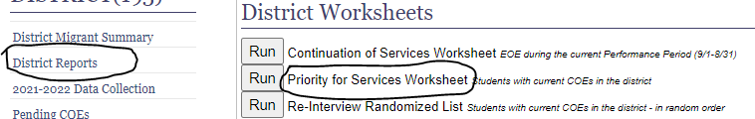
Step 1 – Priority for Services Worksheet
In MSIS, on the navigation toolbar (left side of the page) click on District Reports.
Go to District Worksheets
Click Run next to the Priority for Services Worksheet.
The worksheet will open in Excel.
Save the Excel worksheet. You will use this worksheet all year, adding students as they arrive.

Slide 8
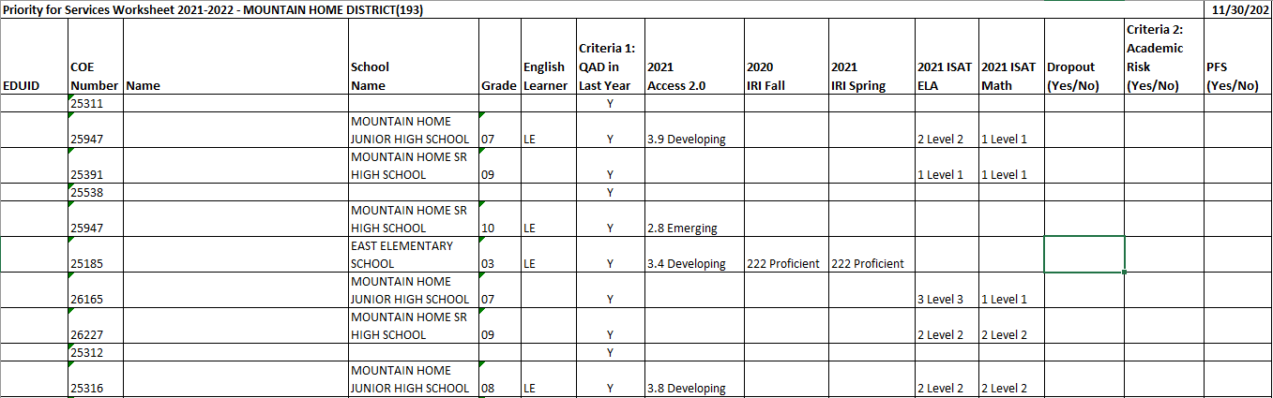
PFS – Worksheet
The worksheet will only show students who meet the requirement that the Qualifying Arrival Date (QAD) was in the last 1 year.

Slide 9
Step 2 – Review Scores (Columns H-L)
Look for and add information for students who do not a have state assessment.
Look in MSIX for other state assessments. OR
Look for district assessments that you can use. These should be skills assessment, not unit tests for a particular curriculum. See the guidance for examples.
Make note of these in the appropriate column (e.g. Column K = reading/ELA, Column L = Math, etc.).

Slide 10
Step 2 –Previously Dropped Out (Column M)
In column M of the spreadsheet, put in “Yes” for any student who has previously dropped out.

Slide 11
Step 3 – Determining Academic Risk
(Column N)
If the student is less than proficient or less than “at grade level” for ANY of columns H-L. Mark “Yes” on Column N.
If the student dropped out (Column M) mark “Yes” on Column N.
Mark all others as “No” if no academic risk OR mark N/A if not in school (e.g. preschool not in school or “here to work” OSY)

Slide 12
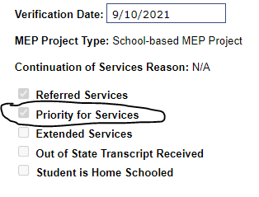
Step 4 – Determine PFS (Column O)
If Column N is Yes, put “Yes” in Column 0 (PFS).
Look up the student in MSIS.
Under Current Year Data, check the box PFS.

Slide 13
PFS for New Enrolling Students
Add newly identified students to the bottom of the spreadsheet.
Put “Yes” in Criteria 1 (column G) if the QAD is in the last year, which it probably is.
Look up state assessment scores in MSIS or MSIX and add to columns H-L and complete column M.
Determine if the student qualifies and mark in MSIS if appropriate.

Slide 14
More Information

Slide 15
Where to Find Guidance
On the Migrant Program website (https://www.sde.idaho.gov/federal-programs/migrant/index.html) under Files / Guidance.
Document link: https://www.sde.idaho.gov/federal-programs/migrant/files/data-collection/msis/pfs/Priority-for-Services-Guidance.pdf

Slide 16
Completing Samples Together

Slide 17
Samples
Grade | English Learner | Criteria 1: QAD in Last Year | 2021 Access 2.0 | 2020 IRI Fall | 2021 IRI Spring | 2021 ISAT ELA | 2021 ISAT Math | Dropout (Yes/No) | Criteria 2: Academic Risk (Yes/No) | PFS (Yes/No)
 |  | Y
10 | LE | Y | 2.8 Emerging
03 | LE | Y | 3.4 Developing | 222 Proficient | 222 Proficient
08 |  | Y |  |  |  | 2 Level 2 | 3 Level 3
07 | LE | Y | 3.1 Developing |  |  | 1 Level 1 | 1 Level 1
07 |  | Y |  |  |  | 3 Level 3 | 3 Level 3

Slide 18

Questions?
Sarah Seamount | Migrant Education Coordinator
Idaho State Department of Education
650 W State Street, Boise, ID 83702
208.332.6958
sseamount@sde.idaho.gov
www.sde.idaho.gov/federal-programs/migrant
Julissa Lara | Migrant Education Program Specialist
Idaho State Department of Education
650 W State Street, Boise, ID 83702
208.332.6907
jlara@sde.idaho.gov
www.sde.idaho.gov/federal-programs/migrant
Tania Scurtu| Migrant Education Admin. Asst.
Idaho State Department of Education
650 W State Street, Boise, ID 83702
208.332.6928
tscurtu@sde.idaho.gov
www.sde.idaho.gov/federal-programs/migrant

