Slide 1
Migrant Education
Fidelity of Strategy
Implementation (FSI) Tool
Overview, Scoring, and Reporting

Slide 2
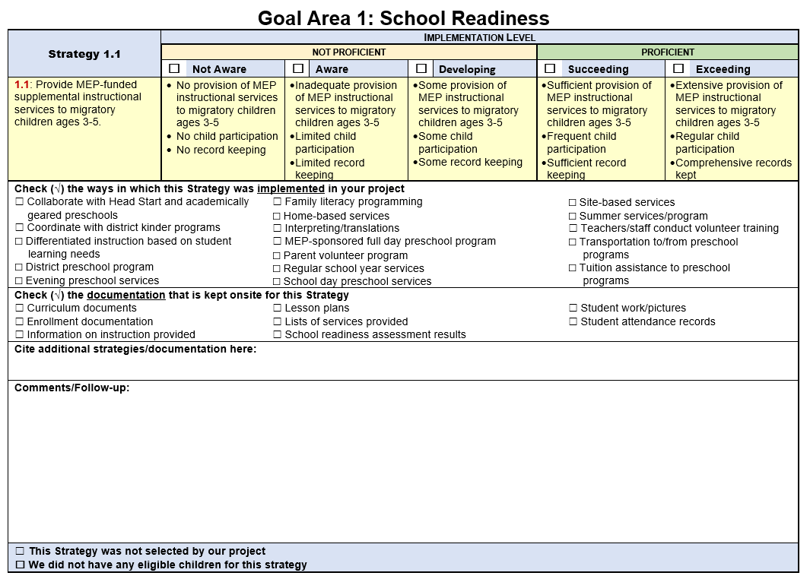
FSI: Fidelity of Strategy Implementation Tool

Slide 3
Why do we use it?

Slide 4
Purposes
To inform the implementation evaluation of the Idaho MEP as required by the U.S. Department of Education, Office of Migrant Education.
To measure the level of implementation of each Strategy to determine the extent to which MEP services are delivered with fidelity.
To serve as a self-assessment guide to local MEPs in implementing migrant-funded services in the 4 Goal Areas of: 1) School Readiness, 2) English Language Arts [ELA] and Mathematics, 3) High School Graduation/Services to Out-of-School Youth [OSY], and 4) Non-Instructional Support Services.

Slide 5
MEP Strategies (2020-2023)

Slide 6
School Readiness
Strategy 1.1: Provide MEP-funded supplemental instructional services to migratory children ages 3-5 (e.g., site-based, home-based, regular school year, summer services, parent volunteer program).
Strategy 1.2: Provide parents with ideas, activities, and materials for use at home with their children to promote first language development, family literacy, and school readiness (e.g., parent activities, trainings, PAC meetings, home visits, family nights, mini workshops, small group and one-on-one parent/ child activities, Preschool Initiative (PI) Consortium incentive Grant (CIG) materials including preschool learning kits).

Slide 7
ELA and Mathematics
Strategy 2.1: Provide migrant-funded resources and training to migratory families to promote literacy and numeracy skills (e.g., extended day kindergarten, backpacks and school supplies, family reading and math nights, individual libraries, math manipulatives, migrant summer school, field trips, tutoring, after school programs, books, online programs and mobile apps, Saturday school/programs, community supports).
Strategy 2.2: Provide migratory students with evidence-based supplemental ELA and math instruction aligned to State standards (e.g., summer school, IDLA advancement, ICON, after-school tutoring, home-based instruction, extended day kindergarten, online reading and math interventions, STEM programs).

Slide 8
ELA and Mathematics (cont.)
Strategy 2.3: Collaborate with district, State, and Federal programs to provide professional development to new and experienced teachers and paraprofessionals on evidence-based strategies for developing academic language. (e.g., MEP staff attend Go-To strategies training, Idaho Association for Bilingual Educators Conference, Biennial Federal Programs Conference).

Slide 9
HS Graduation/Services to OSY
Strategy 3.1: Coordinate/provide secondary migratory students (grades 6-12) mentoring to support graduation and college/career readiness (e.g., student monitoring system, individual plans for students at-risk of dropping out, graduation specialists, postsecondary counseling, college visits, presentations at PAC meetings, coordination with CAMP, leadership institutes, career fairs/speakers, CIS software training, parent outreach and mentoring, parent and student training on graduation requirements, summer school, credit recovery opportunities, supplies).

Slide 10
HS Graduation/Services to OSY (cont.)
Strategy 3.2: Coordinate/provide services for OSY/dropouts to support continuing education and career readiness (e.g., contact OSY/dropouts using school records, MSIX Missed Enrollment Report, MSIS Discrepancy Report; conduct exit interviews; provide educational counseling; provide supplies and services to H2A and Here to Work OSY; provide referrals to agencies and organizations that also serve migratory students and families).

Slide 11
Support Services
Strategy 4.1: Provide professional development for MEP and non-MEP staff on the migratory lifestyle and the unique needs of migratory students and how to address those needs (e.g., program and cultural awareness presentations, field or home visits for teachers and administrators, training on mobility/academic/social gaps/specific stresses of migratory families).
Strategy 4.2: Provide support services to students and families to increase student engagement in school (e.g., extracurricular activities, parenting classes, mental health, parent literacy workshops, instructional home visits, food/clothing/shelter, legal services, workshops on domestic violence, sexual abuse).

Slide 12
Support Services (cont.)
Strategy 4.3: Establish partnerships and/or agreements among the school districts and community health care providers and public health agencies to provide information on, and referrals to, individualized health advocacy services to benefit migratory students and families needing health services (e.g., glasses, dental, mental, health, immunizations, school-based health screening services, partnerships with MSHS, Public Health Department, Health and Human Services, CCI).

Slide 13
How to do the FSI

Slide 14
Directions for Completing the FSI
Gather a group of key staff to discuss your project’s implementation of each Strategy during the performance period.
During your discussion, check the ways in which the Strategies were implemented and documentation relevant to your project, and cite additional strategies/documentation not listed.

Slide 15
Completing the FSI (Cont.)
After reaching consensus, check the applicable rating.
Ratings are based on a 5-point rubric:
1 = Not Aware
2 = Aware
3 = Developing
4 = Succeeding
5 = Exceeding
If the strategy is one that was optional and not selected or that you didn’t have students to participate in, there will be boxes at the bottom of the page to mark that.
Not Proficient
Proficient

Slide 16
Completing the FSI – Together
This is a great opportunity to spend time with the family liaison, director and any other migrant staff to reflect on the year’s accomplishments. It should be a celebration.
It is also a great opportunity to discuss changes or improvements and to plan for the next year.
It should only take 60-90 minutes to complete, but is time well spent.

Slide 17
When to Do the FSI

Slide 18
Timeline
Recommended to complete in May in preparation for CFSGA.
Regular year only (no summer) projects please submit your completed FSI to Sarah Seamount by June 30, 2021
Year-round projects (with summer) please submit your completed FSI to Sarah Seamount by September 15, 2021

Slide 19

Questions?
Sarah Seamount | Migrant Education Coordinator
Idaho State Department of Education
650 W State Street, Boise, ID 83702
208.332.6958
sseamount@sde.idaho.gov
www.sde.idaho.gov/federal-programs/migrant
Julissa Lara | Migrant Education Program Specialist
Idaho State Department of Education
650 W State Street, Boise, ID 83702
208.332.6907
jlara@sde.idaho.gov
www.sde.idaho.gov/federal-programs/migrant
Tania Scurtu| Migrant Education Admin. Asst.
Idaho State Department of Education
650 W State Street, Boise, ID 83702
208.332.6928
tscurtu@sde.idaho.gov
www.sde.idaho.gov/federal-programs/migrant

