Slide 1
Diving into Doing a CNA & MPO Evaluation
Sarah Seamount
Migrant Education Program Coordinator

Slide 2

Welcome & Introductions
A quick introduction in the chat – Include Your
Name
District
Roles
What made you come to this session?

Slide 3
Session Objectives
Provide information on completing a successful CNA.
Provide information on annually completing MPO Data Collection.

Slide 4
How to Conduct a Local Comprehensive Needs Assessment

Slide 5
Legal Rationale for Doing a Local CNA-
ESEA/ESSA SEC. 1306. [20 U.S.C. 6396] COMPREHENSIVE NEEDS ASSESSMENT AND SERVICE-DELIVERY PLAN; AUTHORIZED ACTIVITIES.
(a) COMPREHENSIVE PLAN.—
(1) IN GENERAL.—Each State that receives assistance under this part shall ensure that the State and its local operating agencies identify and address the unique educational needs of migratory children in accordance with a comprehensive State plan

Slide 6
Process Divides Naturally into 3 Steps
Conduct preliminary work (Fall)
Gather, analyze, and summarize data (Winter)
Write a final summary of findings and make program services decisions (Spring)

Slide 7
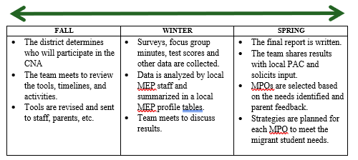
Page 7 - Timeline

Slide 8
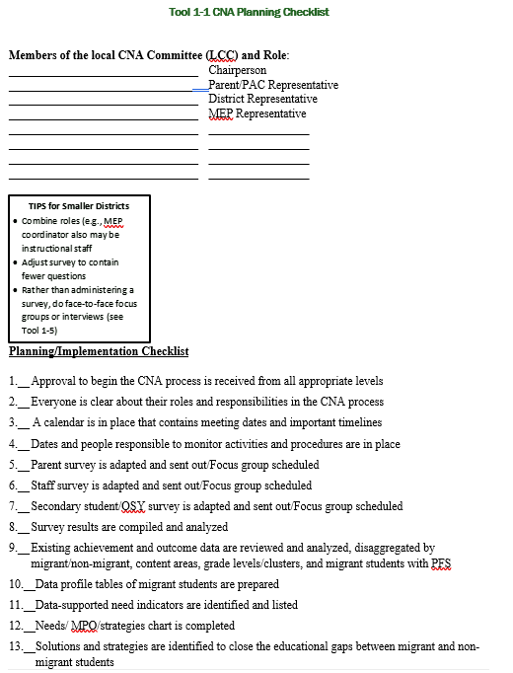
Page 13 – Checklist
Checklist
Who is on the committee?
Activities to complete
Cluster into 3 meetings in a year. (For districts doing annually 1-2 meetings are sufficient.)

Slide 9
To Make it Easy – Use the Checklist
Activity- Page 13
Fill out the top with your committee. Who will you include?
Divide the checklist into 3 meetings. Group items together.
Calendar meetings on timeline on page 20.

Slide 10
Plan the Work – Meeting 1
Share the reason for the CNA with the committee. (See toolkit)
Go over the surveys to make any changes.
Determine who will be responsible for conducting surveys and collecting results.
Schedule the next meeting.
(May skip this meeting if doing annually.)

Slide 11
Preparing for the Second Meeting
Conduct and tabulate surveys.
Translate comments so that everyone on the committee can read them.
Conduct focus groups (parent and/or student) if you wish. (Translate notes as needed.)
Run MSIS CNA reports (comparison and raw data) and create easy to read charts.

Slide 12
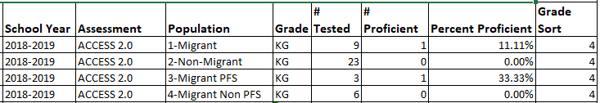
CNA Raw Assessment Data in MSIS
Report that compares student assessment results for migrant vs non-migrant and PFS vs non-PFS for all state assessments.
Raw Numbers may be more useful for charts.

Slide 13
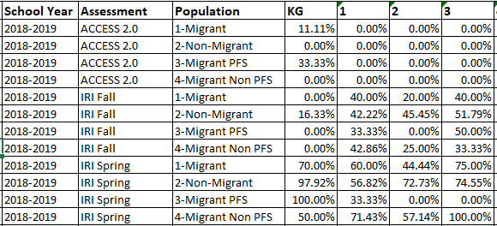
CNA Proficiency Comparison in MSIS
Report that compares the % proficient for migrant vs non-migrant and migrant PFS vs non-PFS for all state assessments.

Slide 14
Discuss the Results – Meeting 2
Committee goes over results creates concern statements.
What areas of concern were found on surveys or focus groups?
What areas of concern were found in the data?
Use the Data Profile to list concerns and the data that supports them.
(May combine with meeting 3 if doing annually.)

Slide 15
Preparing for Meeting 3
Assemble all of the data and concern statements.
Print or plan to display MPO choices from last year’s CFSGA, along with the plan for implementing them.

Slide 16
Using Needs to Plan – Meeting #3
Briefly revisit the data from meeting 2.
Go over concern statements in the Data Profile and revise if needed.
Complete the “Needs-MPO/Strategy-Priority Matrix.”
Review the MPOs/plans in use now
Discuss changes to the MPO/plans for the coming year.

Slide 17
How to Conduct an MPO Evaluation with Data
How to get it done step by step so September 15th is easy!

Slide 18
Rationale for MPO Data Collection
1304 STATE APPLICATIONS; SERVICES.
(b) PROGRAM INFORMATION.—Each such application shall include—
a description of how, in planning, implementing, and evaluating programs and projects assisted under this part, the State and its local operating agencies will ensure that the unique educational needs of migratory children, including pre-school migratory children and migratory children who have dropped out of school, are identified and addressed through—
(D) measurable program objectives and outcomes;

Slide 19
Process Divides Naturally into 4 Steps
Before the process – Select MPOs in CFSGA based on your local CNA.
Select the forms you will need for the MPOs you are working on.
Create a place to keep data as it is collected.
Collect Data throughout the year.
Summarize data to enter into MSIS.

Slide 20
Step 1 – Gather Forms Needed
Single instrument each for parent surveys, staff surveys, and student surveys that can be used once or at events. (3 very short surveys)
List of high school students for those on track to graduate
Pre-post testing for summer school

Slide 21
Step 2 – Data Collection Plan
Create a place to keep data all year
Will it be done on paper? Or electronically?
Who will be collecting the data?
WHERE will it be? (At least 2 people should know this!)

Slide 22
Step 3 – Collect Data
Have surveys ready for parents and students at events. Have surveys for staff at training for migrant program.
Consider using Google forms or Survey Monkey and share the link and QR code via postcards with parents and students.

Slide 23
Step 4 – Tabulating Results/Entering in MSIS
As soon as you have the data for an MPO, tabulate the results.
Enter the numbers into MSIS under Data Collection.
Enter a comment for any goal not met.
Submit when complete.

Slide 24
Fidelity of Strategy Implementation
After completing MPOs, take an hour with the team and complete the FSI.
This is a self-assessment you can do with your team to determine how well implementation is going.
You will check the box for the level of fidelity you feel fits your current implementation.
Then check the boxes for data you know you have. (You do NOT need to gather or submit this data.)
Discuss what changes you want to make for next year as part of preparing to complete the CFSGA.

Slide 25
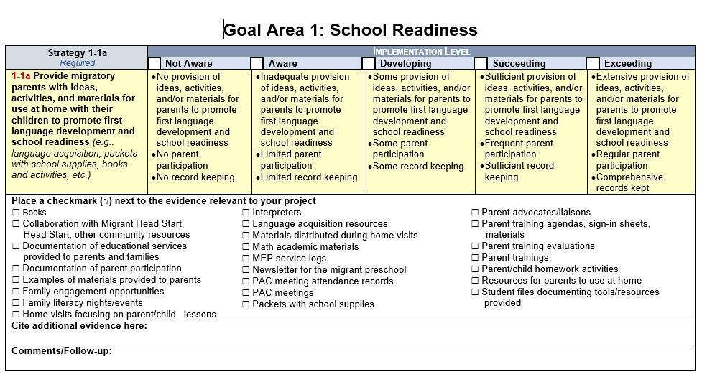
FSI

Slide 26

Questions?
Sarah Seamount | Migrant Education Coordinator
Idaho State Department of Education
650 W State Street, Boise, ID 83702
208.332.6958
sseamount@sde.idaho.gov
www.sde.idaho.gov/federal-programs/migrant
Julissa Lara | Migrant Education Program Specialist
Idaho State Department of Education
650 W State Street, Boise, ID 83702
208.332.6907
jlara@sde.idaho.gov
www.sde.idaho.gov/federal-programs/migrant
Tania Scurtu| Migrant Education Admin. Asst.
Idaho State Department of Education
650 W State Street, Boise, ID 83702
208.332.6928
tscurtu@sde.idaho.gov
www.sde.idaho.gov/federal-programs/migrant

