Slide 1
Correcting a Certificate of
Eligibility (COE) in MSIS
Sarah Seamount
Migrant Education Program Coordinator
Welcome! In the chat, please type your name, role and school district.
Notes:
Hi! My name is Sarah Seamount and I am the Migrant Education Coordinator. Today’s Mini-training is about how to correct an error on a Certificate of Eligibility or COE. In the Chat, please type your name, role and school district.

Slide 2
Preventing Errors
The best way to “correct” errors? Before the eCOE is submitted!
Notes:
The best way to “correct” errors is to prevent them before they happen. This will save you and me a lot of time.

Slide 3

Avoiding Errors Minimizes Corrections
Before submitting, check the birth certificate, school information system (e.g. Powerschool), or other.
Verify the dates of birth.
Verify the complete names and spellings.
Verify the address/phone.
An ounce of prevention is worth a pound of cure.
Notes:
As the old saying goes, “An ounce of prevention is worth a pound of cure.” Checking the birth certificate is the best way to ensure that student names and dates of birth are correct. You will also find that using Google Maps is a good way to ensure that cities and streets are spelled correctly.

Slide 4
Corrections Not Requiring OTIS
Notes:
There are two kinds of errors that may need correction. The first are those that do not require an OTIS ticket to fix. We will talk about those that do require an OTIS ticket to correct a bit.

Slide 5
You Discover a Mistake – Step 1
It happens. A mistake sneaks past your vigilant eye. What now?
First, determine if there is an error requiring an OTIS ticket.
These cases require an OTIS ticket:
  The student has two different EDUIDs, one in MSIS and a different one in your school SIS.
  There are errors in the student’s name(s).
Notes:
Everyone makes mistakes; we are all human. So what do you do when you find an error on an approved COE? First, decide if you need an OTIS ticket. We will cover what to do for errors that do not require an OTIS ticket first. The two cases that require an OTIS ticket to correct are for students with duplicate EDUIDs (in other words the student has 2 “unique” IDs) and for errors in the student’s name. We will come back to these.

Slide 6
Decide Who Can Correct – Step 2
Errors not requiring an OTIS ticket:
Liaison can correct: current address or phone number
  Movement History Screen → Edit
Request an un-submit: for correcting the parent name or anything in Qualifying Moves & Work
Notes:
Next, decide who can correct the error. You can correct the COE current address or phone number. Just go to the Movement History screen and click on Edit. This can also be done at any time, such as when a family moves within your district and isn’t eligible for a new COE. Updating addresses and phone numbers will help keep your Parent Contact Info report accurate, which can be very helpful in calling parents for parent events.
If the correction needs to be made to a parent name or to anything in the Qualifying Moves & Work section, you will need to have the COE unsubmitted in order to make changes.

Slide 7
Request an Un-submit – Step 3
Contact your Regional MEP Coordinator to discuss the error(s).
He/she will confirm that the error does not require an OTIS ticket.
He/she will request that the COE be unsubmitted for corrections.
Notes:
In order to have a COE un-submitted, you will need to contact your regional coordinator and let him/her know the COE number and why the COE needs to be unsubmitted. You can do this by email as long as it doesn’t include any information about the student. It is okay to email the COE number.

Slide 8
Warning
The Migratory Agricultural Worker status is only good for 3 years, based on the date the recruiter interviews the parent.
If the date of the migratory worker move is more than 3 years ago, (or the COE is expired) we will NOT un-submit a COE as it could not be approved when re-submitted.
Notes:
Part of the reason only a regional can request that a COE be unsubmitted, is to have another set of eyes double-check that we don’t ever un-submit a COE that can’t be re-approved. This is important because the Migratory Agricultural Worker status is only good for 3 years, based on the date the recruiter interviews the parent. When you resubmit a COE, a new interview date is generated by the system. Let me repeat that. When you resubmit the COE, a new interview date is automatically generated by the system as of the submission date.
If the date of the migratory worker move is more than 3 years ago on that day, (or the COE is expired) we will NOT un-submit a COE as it could not be approved when re-submitted.

Slide 9
Correct the COE & Re-submit – Step 4
When the COE is un-submitted, export the COE to your device.
Make the corrections to the eCOE in the eCOE Builder on the device.
Reminder: if the corrections are to the Qualifying Moves & Work section, you will have to get a new parent signature.
Re-import the eCOE to MSIS and Re-submit the eCOE for approval.
Notes:
Once a COE is un-submitted, you will export the COE to your device and make the corrections that are needed. Remember, if there are changes made to the Qualifying Moves & Work section it will require an new parent signature. Follow the regular process for importing, reviewing, and submitting the COE.

Slide 10
Corrections Requiring an OTIS Ticket
Notes:
Now we are going to talk about the corrections that require an OTIS Ticket and how you will do it

Slide 11
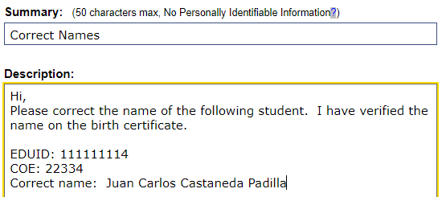
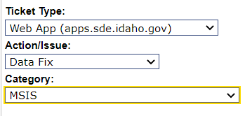
Name Corrections – OTIS Request
NEW
This is the only step needed for a name correction.
This is suggested verbiage you could use to make the request for a name correction.
This is the type of OTIS ticket you need to request.
Notes:
Student name corrections will be handled by migrant staff at the SDE. So when you create this OTIS ticket it will come to me (and probably Sandy or Kelly in the future). You will choose Web App, then Data Fix, and then MSIS and it will automatically go the migrant queue, which I can use and interact with. Remember NOT to put student PII in the Summary or Title. Then give me the information that shows above: the EDUID, COE number, and the correct name spelling. It can also be helpful to add what the difference is. You can request a change in spelling, add missing names, such as a middle name or additional last name. You can also request changes to more than one name on the COE. Please fill out a separate OTIS ticket for a different COE. We will try to correct any tickets we receive within the same week.

Slide 12
Duplicate EDUID – the Main Culprit
An EDUID is created when a name and date of birth are entered into the SLDS system that are not already there.
In the COE approval process, the regional is prompted to create an EDUID if the system doesn’t already have that name and DOB.
So, if a name is misspelled or different or the DOB is different, the system cannot match the student and creates a duplicate (a 9-letter bad word!).
Notes:
The main culprit for getting duplicate EDUIDs seems to be a COE with a wrong date of birth for a student. When the regional is approving the the COE the system attempts to match the name and date of birth with an existing student. If it can’t find a match, but one that is similar, the system will ask the regional if he or she wants to create a new EDUID. Since we know that many popular names, Juan Martinez for example, may belong to more than one student, the regional will choose to create a new EDUID. To avoid this common problem, I’ve asked the regionals not to create a new ID if the student is listed on the COE as attending a school. Those students should already have an EDUID. Instead the regional will contact you to find out if the student has an EDUID in your school system. Hopefully this will help us eliminate one cause. The other common problem is when we create an EDUID for a preschool child who then gets a new EDUID when he or she starts school because of a wrong date of birth. This is why it is so important to check the birth certificate for the correct name and date of birth.

Slide 13
Gather Needed Information – Step 1
Verify the student’s name and DOB on the birth certificate. This is critical.
Make note of which EDUID is currently in use in your school SIS.
Notes:
In order to create this type of OTIS ticket it is important to have the information you will need.

Slide 14
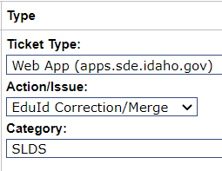
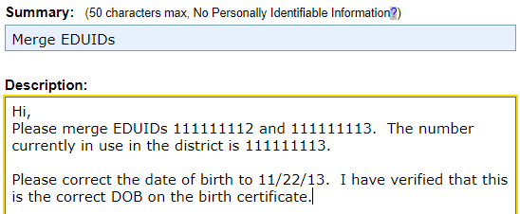
Create an OTIS Ticket – Step 2
This is how you create the OTIS ticket for merging two EDUIDs
This is the type of OTIS ticket you need to request.
This is suggested verbiage you could use to make the request for merging two EDUIDs.
Notes:
Here is the way to create an OTIS ticket to get duplicate EDUIDs merged. The ticket type is Web App, then EDuId Correction/Merge, then SLDS, which stands for State Longitudinal Data System. Again, no PII in the Summary or Title. In the description please include all of the information above if you are also correcting a date of birth.

Slide 15
Verify the Merged EDUIDs – Step 3
Once the merge is complete, wait until the following day and check to make sure that the COE is correct.
Wait 4-5 days and be sure the EDUID is updated on MSIX as well.
If it is, print a new copy of the COE and provide it to the parents.
Notes:
There is some follow up that needs to happen after the correction is done. First, on the day after you are notified through OTIS that the correction is made, please verify that the student ID is now correct in MSIS and on the eCOE. Since we upload to MSIX on Monday, Wednesday, and Friday, please also verify that the correct is made there. It takes a day or two for these corrections to be processed, so I’d wait 4-5 days to verify MSIX. Finally, print a new copy of the COE for the cume file and for the parents.

Slide 16
Name Correction after a Merge – Step 4
If there are still errors on the COE, check what kind they are and go back to the process in the previous sections as needed to correct these.
Notes:
If you have done an EDUID merge and there is still an error on the COE, go back to the type of error and correct it. I would do the merge first.

Slide 17
Questions?
Sarah Seamount | Migrant Education Program Coordinator
Idaho State Department of Education
650 W State Street, Boise, ID 83702
208 332 6800
sseamount@sde.Idaho.gov
www.sde.Idaho.gov/el-migrant/migrant
Notes:
And that is the end of the presentation and recording and we will do some Q & A now. Thank you for attending.

