Slide 1
Completing MPO Evaluation
In MSIS
Sarah Seamount
Migrant Education Coordinator
March 11, 2021

Slide 2
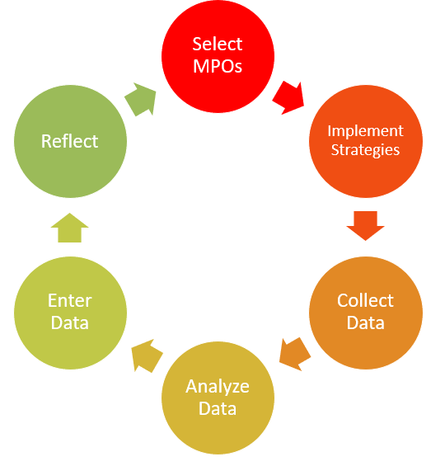
Evaluation Process
Already done or in progress for
2020-2021

Slide 3
MPOs versus Strategies
Measurable Program Outcomes: measure how successful we are at meeting a goal, which came from a need identified in our Comprehensive Needs Assessment (CNA). These include a set criteria or number that must be met in order to accomplish the MPO.
Strategies: are methods for working toward that goal. There are many strategies (listed as examples) for each MPO. Some will work to meet more than one MPO. You can come up with other strategies to meet these goals as well.

Slide 4
Data Collection

Slide 5
What Data to Collect
Parent Surveys
Student Surveys
Staff Surveys
Pre-Post test scores for Instructional Services
List of mentored students (and if they earned credits)
MSIS Services Report

Slide 6


How to Store Data
OR
Keep MPO Data in 1 place, but with at least 2 who know where it is!

Slide 7
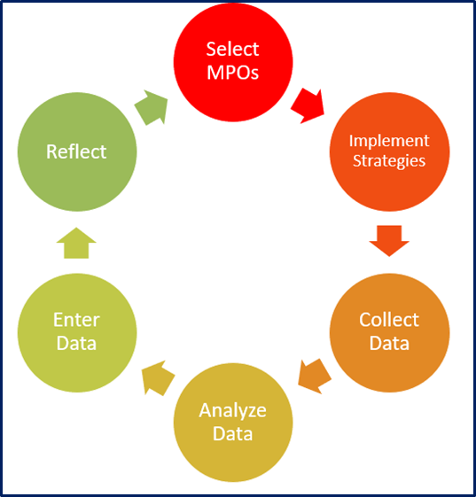
Data Analysis

Slide 8
Tallies, Summaries, Reports
Before entering data in MSIS, and depending on which MPOs you are reporting for:
Tally parent, student, and staff surveys
Calculate % of students showing gains
Calculate % of mentored students earning credits
Run MSIS Services report

Slide 9
For 2020-2021 Only
Idaho is doing an outside evaluation this year.
Much of the data needed will be taken from MSIS.
From districts we only need Surveys
  Please scan all surveys and upload to the SFTP.
  File name: DistrictName Surveys (e.g. Aberdeen Surveys)

Slide 10
Entering Data

Slide 11
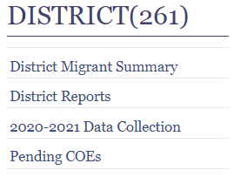
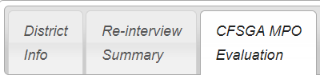
Data Collection 2020-2021
Log into MSIS
Look on the left side navigation bar
Click on 2020-2021 Data Collection
Then click on CFSGA MPO Evaluation

Slide 12
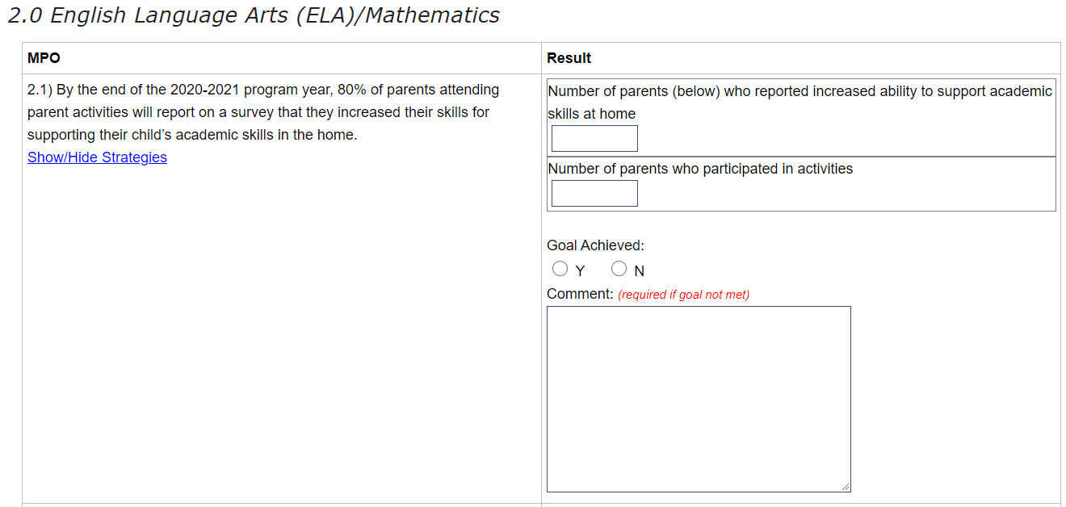
Entering Data and Using Comments
Enter both numbers in results
Save (The system will calculate if the goal is achieved.)
If no, make a comment. If yes, comments are welcome, but not required.
SAMPLE

Slide 13


Due Dates
For districts without a summer school program: DUE 6/30/20xx (or closest business day)
For districts with a summer school program: DUE 9/15/20xx (or closest business day)
OR

Slide 14
Reflecting on
Evaluation

Slide 15
Making Decisions from Evaluation
After the evaluation discuss the outcomes:
How many MPOs were met?
For those that weren’t,
  What was the cause?
  What other strategy could you try?

Slide 16
Selecting MPOs for Next Year
Continuing Discussion:
What will you continue?
What changes, if any, will you make to your plan for next year (CFSGA)?

Slide 17
Questions?
Sarah Seamount | Migrant Education Coordinator
Idaho State Department of Education
650 W State Street, Boise, ID 83702
208.332.6958 (office) | 208.550.9851 (cell)
sseamount@sde.idaho.gov
https://www.sde.idaho.gov/federal-programs/migrant/index.html

