Slide 1
Idaho Migrant Preschool
Learning Kit Training
Irene Chavolla, Consultant
Sarah Seamount, Migrant Education Program Coordinator

Slide 2
Welcome and History of the Project
Idaho applied with 8 other states for the 3 year Preschool Initiative (PI) Consortium grant in 2014-2015.
Work with the consortium started with the 2015-2016 school year.
Idaho contracted with Irene Chavolla to complete tasks of the PI Consortium late in the first year.
She has been an integral part of the project and created all of the lessons that you will learn about here.
The grant itself ended up lasting 5 years instead of 3 and has just finished its last year.

Slide 3
PI Consortium History
Year 1: Townhall meeting
  Networking locally, regional and statewide
Year 2: Preschool Field Tests
  Assessments
  Instruction
Year 3: Professional Development
  Early Childhood Development Milestones
  Educating the Educator: Effective Lesson Planning and Tips for Parents of Early Learners
  PI Lesson Plan Template

Slide 4
PI Consortium History (Continued)
  Year 4:
    Learning Kit Backpacks
  Year 5:
    Instructional Units (STEM)
    Preschool Initiative website (ESCORT.org)

Slide 5
Learning Kits
Idaho’s Extension of the PI Consortium Concept

Slide 6
Enhancing the PI Learning Kits
The PI Consortium concentrated on STEM lessons .
Idaho added additional literacy, math, and social emotion learning lessons (as well as STEM lessons).
Expanded kits to include 6 books and all materials.

Slide 7
Learning Kit Expectations
Migrant family liaison will:
Meet with parent and child 6 times in one year.
Model the 2 lesson activities for one book at each visit.
Encourage parents to repeat activities with other books or materials regularly between visits.
Gradually let the parent take the lead in teaching the child.
Provide a “Graduation” certificate and a copy of, Don’t Say a Word Mama/No Digas Nada, Mama.

Slide 8
Developing Gross and Fine Motor Skills
Gross/large: are the ability to use the larger muscles of your legs, arms, and torso. Giving your child the space and opportunities to run, jump, throw, catch, climb, hop, skip, etc. will increase your child’s balance, coordination, body awareness, physical strength, and reaction time.
Fine/small: are ability to coordinate the brain and fine muscles in our hands and wrists or hand eye coordination. It's important to know that kids need to use gross muscles before they can use fine muscles.

Slide 9
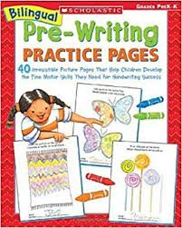
Bilingual Pre-Writing Practice Pages
Material to help with
pre-writing skills
Fine motor skills
Practice holding a writing utensil
“Homework” to do when older siblings do theirs
40 page PDF file
You will be able to choose pages to print (or the whole thing) to give to children at each visit.

Slide 10
Organization of the Lesson Plan Book
All information is given in English and Spanish in the following sections:
  Suggested books
  Lessons for the 6 books in the kit
  Literacy lessons
  Math lessons
  Social Emotional lessons
  STEM lessons

Slide 11
Literacy and Math
Literacy
Early literacy is comprised of print concepts, phonological awareness as well as letter and word recognition.
  Book introduction
  Rhyming
  Letter recognition
  Retelling story
Math
Early math knowledge provides vital life skills. It will help children problem solve, measure and develop their own spatial awareness, and teach them how to use and understand shapes.
  Matching
  Numbers and counting
  Colors and shapes
  Patterns and classifying

Slide 12
SEL and STEM
Social Emotional Learning
Children need to develop social and emotional skills during the preschool years because they help develop critical for long-term school and life success.
  Being able to get along and cooperate with others
  Manage strong feelings
  Focus attention, and
  Persist at challenging tasks
Science, Technology, Engineering, and Math
STEM is about exploration and children making their own discoveries. They are making guesses or hypotheses while learning to make sense of the world around them. This empowers them to continue this type of exploration outside of the classroom.
  Make important connections between everyday life and the STEM disciplines
  Skills learned are transferable to other subjects
  Develop their communication and problem-solving
  Explore and make sense of themselves and the environment in which they live
  Encourages non English-speaking children to benefit because they can participate in scientific explorations that do not demand a broad vocabulary.

Slide 13
Books and Lessons

Slide 14


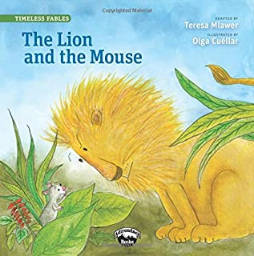
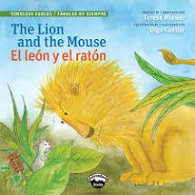



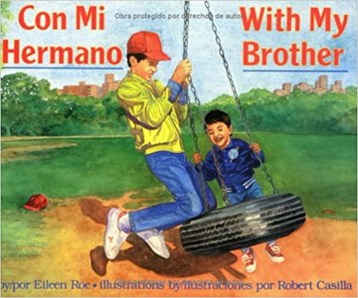


Books in the Learning Kits

Slide 15
Activity Lessons for Each Book
2 literacy-language activities/lessons
2 numeracy-math activities/lessons
Materials to carry-out the lessons
*Intended to use for home-based/outreach sessions
*Easily executed with minimal training
*Parent user friendly
*Replicable

Slide 16
The Carrot Seed by Ruth Krauss
Literacy
Book Walk, Book Talk
Objective: The child will build background knowledge and comprehension skills prior to reading a book.
Math
Simple Patterns
Objective: The child will make simple patterns, such as ABA and AABB.

Slide 17
Giraffes Can’t Dance by Giles Andreae
Literacy
Story Retelling/Order the Events
Objective: The child will retell a story by sharing the important story parts in the right order.
Math
Identify and Describe Shapes
Objective: The child will identify and describe shapes, which are early geometry skills.

Slide 18
Good Night Moon by Margaret Wise
Literacy
Story Retelling/Order the Events
Objective: The child will learn to retell a story by sharing the important story parts in the right order.
Math
Matching
Objective: The child will be able to match objects that are the same or similar.

Slide 19
Lion and the Mouse by Darice Bailer
Literacy
Story Retelling/Order the Events
Objective: The child will retell a story by sharing the important story parts in the right order.
Social-Emotional
Working Together
Objective: The child will learn how working together benefits everyone, even the strongest and most independent people.

Slide 20
Tortillas are Round by John Parra and Roseanne Greenfield Thong
Literacy
Story Retelling/Order the Events
Objective: The child will retell a story by sharing the important story parts in the right order.
Math activity
Shapes, Geometry and Spatial Sense
Objective: Child will learn how to recognize, identify and analyze the characteristics of geometric shapes. The child will discover what makes each shape unique.

Slide 21
Con Mi Hermano by Eileen Roe
Literacy
Story Retelling/Order the Events
Objective: The child will retell a story by sharing the important story parts in the right order.
Math
Big or small
Objective: The child will differentiate between big and small by sorting big and small items.

Slide 22
Break out groups – 15 minutes

Slide 23

Group work : Group 1
Select one of the 6 books
Look at math lessons
Select a general math lesson that can be used with your book
Present the lesson to the group

Slide 24

Group work : Group 2
Select one of the 6 books
Look at literacy lessons
Select a general literacy lesson that can be used with your book
Present the lesson to the group

Slide 25
Group Presentations
  Tell why you selected lesson activity.
  Briefly model teaching lesson.

Slide 26
Reflection on Lesson Activities
What will be challenging about the activities for parents?
What will parents need in order to successfully carry out the various activities?
What can you do help parents?

Slide 27
Reflection
In the chat, write one word to describe how you’re feeling about the
Learning Kits
Preschool Lesson Book

Slide 28
Where to from Here?
The Future of the Learning Kits

Slide 29
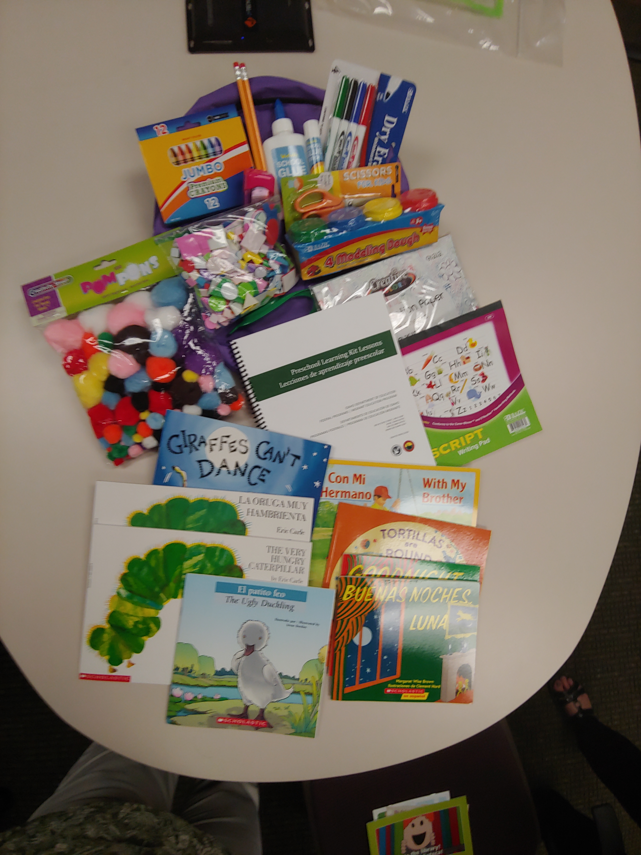
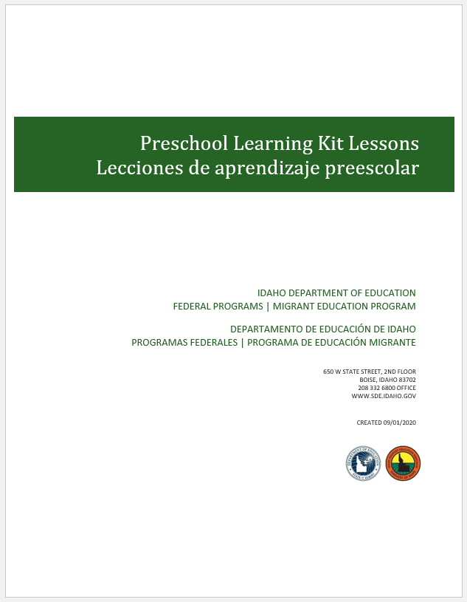
Learning Kits for and by Districts
For districts to continue making Learning kits, we will provide:
List of books
List of items
Backpack contents
Vendors used
Lesson Plan book PDF
Practice Pre-Writing Pages

Slide 30
Preschool Resources

Slide 31


Resources
ESCORT.org
  Projects
    Preschool initiative
      Resources
        FOR PARENTS
        PRESCHOOL RESOURCES
        ASSESSMENT TOOLS
        COORDINATION & COLLABORATION
        CURRICULA/LEARNING MATERIALS
        MIGRANT EDUCATION PROGRAM
        PARENT ENGAGEMENT
        PROFESSIONAL DEVELOPMENT
        CULTURAL AWARENESS
        LINKS

Slide 32
Questions?
Sarah Seamount | Migrant Education Coordinator
Idaho State Department of Education
650 W State Street, Boise, ID 83702
208.332.6958
sseamount@sde.idaho.gov
www.sde.idaho.gov
Irene Chavolla | PI Consortium Consultant
208.863.3770
igchavolla@gmail.com

