Slide 1
New Superintendent Orientation 2022
Idaho State Department of Education

Slide 2
Assessment & Accountability
Ayaka Nukui, Director
Kevin Chandler, Director

Slide 3
Idaho’s Comprehensive Assessment System

Slide 4

Testing Days or Window Openings
WIDA
Screeners
NAEP LLT-13
& Field Test
ISAT
Interims
ELA/L,
Math,
Science
IDAA
ELA/L,
Math,
Science
SAT
LCI
August
September
October
November
December
January
February
March
April
May
ISAT
Interims
ELA/L,
Math,
Science
ISAT
Summatives
ELA/L,
Math,
Science
PSAT/
NMSQT
IRI
IRI
ACCESS
Alternate ACCESS & Kindergarten Alternate ACCESS Field Test

Slide 5


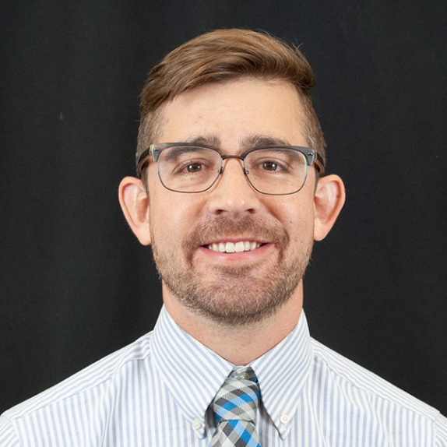
WIDA Screeners
Assessment | WIDA Screeners (Kindergarten W-APT / WIDA Screener)
Description | ACCESS annually assess English learner English language Proficiency in Reading, Writing, Listening and Speaking. Idaho Code §33-1617 outlines the English Learner program requirements to achieve improved academic performance. Idaho Code §08.02.03. subsection 111.06.a through 111.06.m
Testing Window | 08/01/2022 to 06/30/2023
Subjects | English Language Proficiency (Reading, Writing, Listening, Speaking)
Required Grades | K-12
Student Population | Provisional English learners newly enrolled in Idaho
Reported Results | K WAPT Speaking and Listening oral proficiency score (low, mid, high, exceptional) Reading and Writing diagnostic score (skill description) WIDA Screener Results are reported as English proficiency levels and scale scores for each language domain and four composite areas Level 1 (Entering), Level 2 (Emerging), Level 3 (Developing) Level 4 (Expanding), Level 5 (Bridging), Level 6 (Reaching)
Websites
Contact Details
Andrew Bennett
ELP Assessment Coordinator
208-332-6909
abennett@sde.idaho.gov

Slide 6


IRI
Assessment | Idaho Reading Indicator (IRI)
Description | The Idaho Reading Indicator assesses students in the five critical domains of early reading: phonological awareness, phonics, vocabulary, comprehension, and fluency Idaho Code §33-1806 outlines that the Idaho State Department of Education shall be responsible for the administration of the IRI.
Testing Window | 08/1/2022 to 09/30/2022 (fall) 05/01/2023 to 05/31/2023 (spring)
Subjects | Reading
Required Grades | K-3
Student Population | All Students
Reported Results | Overall scores are reported as achievement levels: Tier 1 (At Grade Level) Tier 2 (Near Grade Level) Tier 3 (Below Grade Level)
Websites
SDE logo
Contact Details
Marissa Gravel ELA/L Assessment Coordinator 208-332-6988 mgravel@sde.idaho.gov

Slide 7

ISAT Interims ELA/L
Assessment | Idaho Standards Achievement Test - Interims in English Language Arts/Literacy
Description | The ISAT interims are administered at various points in the learning process to determine if students are on track toward proficiency. The ICA, SICAs, IABs, & FIABs assess various Claims and Targets to provide teachers with information to refine their instructional practices
Testing Window(s) | 08/10/2022 to 02/24/2023 (fall) 06/05/2023 to 07/28/2023 (summer)
Names | Read Literary Text, Read Informational Text, Language & Vocabulary Use, Brief Writes, Revision, Research, Performance Task, Editing, Research, Listen/Interpret, Write & Revise. etc.
Grades | 3-8 and high school
Student Population | All Students
Reported Results | Scale Score, and Performance Level data is reported from an Interim Comprehensive Assessment (ICA).​ Performance Level data is reported from a Interim Assessment Block (IAB) or a Focused Interim Assessment Block (FIAB). Item-level analysis is also found online in the Reporting system
Websites
Contact Details
Marissa Gravel ELA/L Assessment Coordinator 208-332-6988 mgravel@sde.idaho.gov

Slide 8
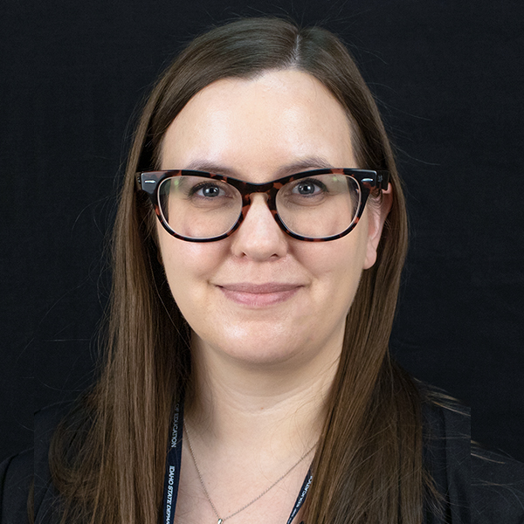
ISAT Interims Math
Assessment | Idaho Standards Achievement Test - Interims in Math
Description | The ISAT interims are administered at various points in the learning process to determine if students are on track toward proficiency. The ICA, SICAs, IABs, & FIABs assess various Claims and Targets to provide teachers with information to refine their instructional practices
Testing Window(s) | 08/10/2022 to 02/24/2023 (fall) 06/05/2023 to 07/28/2023 (summer)
Names | Operations and Algebraic Thinking, Measurement and Data, Number and Operations-Fractions, Number and Operations in Base Ten, Expressions and Equations, Geometry, Algebra and Functions, etc.
Grades | 3-8 and high school
Student Population | All Students
Reported Results | Scale Score, and Performance Level data is reported from an Interim Comprehensive Assessment (ICA) & Shortened Interim Comprehensive Assessment (SICA). Performance Level data is reported from a Interim Assessment Block (IAB) or a Focused Interim Assessment Block (FIAB).
Websites
Contact Details
Brianna Lynch Mathematics & Science Assessment Coordinator 208-332-6979 blynch@sde.idaho.gov

Slide 9
ISAT Interims Science
Assessment | Idaho Standards Achievement Test - Interims in Science
Description | Each science interim “testlet” is a cluster that assesses student mastery of the new three-dimensional science standards. The three dimensions include a content area (physical, Earth, or life science) a science practice, and a crosscutting concept.
Testing Window | 08/10/2022 to 02/24/2023 (fall) 06/05/2023 to 07/28/2023 (summer)
Names | Earth’s Place in the Universe 1: Changing Landscapes; Hereditary 1: Inheritance and Variation of Traits; Molecules to Organisms 1: Survival Structures, etc.
Grades | 3-8 and high school
Student Population | All Students
Reported Results | The number of scoring assertions answered correctly is reported for each science interim. Scoring assertions inform educators of the task completed by the student and an inference of the student’s knowledge, skill, & ability.
Websites
Contact Details
Brianna Lynch Mathematics & Science Assessment Coordinator 208-332-6979 blynch@sde.idaho.gov

Slide 10


PSAT/NMSQT
Assessment | Preliminary SAT/National Merit Scholarship Qualifying Test
Description | PSAT/NMSQT is the qualifying test for entry to the National Merit Scholarship Program and connects students to College Board programs in preparation for the SAT. Idaho offers PSAT/NMSQT to the sophomores at no cost to districts, schools, parents, or students. *Juniors may participate in the NMSQT at their own expense.
Testing Days | 10/12/2022 (primary) or 10/25/2022 (alternate) (school can choose)
Subjects | Reading, Writing and Language, Mathematics
Applicable Grades | 10 (optional, state-sponsored) and 11 (optional)
Student Population | All Students
Reported Results | Total Score Section Scores Evidence-Based Reading and Writing Mathematics
Websites
Contact Details
Kevin M. Chandler Director of Assessment 208-332-6893 kchandler@sde.Idaho.gov

Slide 11
ACCESS
Assessment | ACCESS
Description | ACCESS annually assess English learner English language Proficiency in Reading, Writing, Listening and Speaking. Idaho Code §33-1617 outlines the English Learner program requirements to achieve improved academic performance. Idaho Code §08.02.03. subsection 111.06.a through 111.06.m
Testing Window | 01/23/2023 to 03/03/2023
Subjects | English Language Proficiency (Reading, Writing, Listening, Speaking)
Required Grades | K-12
Student Population | All Identified English Learners
Reported Results | Results are reported as English proficiency levels and scale scores for each language domain and four composite areas Level 1 (Entering), Level 2 (Emerging), Level 3 (Developing) Level 4 (Expanding), Level 5 (Bridging), Level 6 (Reaching)
Websites
Contact Details
Andrew Bennett
ELP Assessment Coordinator
208-332-6909
abennett@sde.idaho.gov

Slide 12
Alternate ACCESS
Assessment | Alternate ACCESS for ELLs Field Test & Kindergarten Alternate ACCESS for ELLs Field Test
Description | Administered to students in K-12 with significant cognitive impairments who meet IDAA participation criteria. This is a stand-alone field test which is separate from the ACCESS for ELLs administration.
Testing Window | 02/14/2023 to 04/17/2023
Subjects | English Language Proficiency (Reading, Writing, Listening, Speaking)
Required Grades | K-12
Student Population | All identified English learners who meet the IDAA participation criteria
Reported Results | Results gathered from the Alternate ACCESS for ELLs Stand-Alone Field test will not be reported.
Websites
Contact Details
Andrew Bennett
ELP Assessment Coordinator
208-332-6909
abennett@sde.idaho.gov

Slide 13



NAEP
Assessment | National Assessment of Educational Progress
Description | The National Assessment of Educational Progress (NAEP) is the only assessment that measures what US students know and can do in various subjects across the nation, states, and in some urban districts. Also known as The Nation’s Report Card, NAEP has provided important information about how students are performing academically since 1969.
Testing Window | NAEP LLT-13: 1/23/2023 to 3/10/2023 NAEP Field Test/Field Trial: 1/23/2023 to 3/10/2023
Subjects | Mathematics and Reading
Required Grades | 4 and 8
Student Population | All students are eligible for selection except those who take the IDAA and 1st year English Learners.
Reported Results | The Nation’s Report Card releases Idaho results after spring testing. State testing happens on odd numbered years.
Websites
Contact Details
Paul Kleinert, Ph.D. NAEP Coordinator 208-332-6957 pkleinert@sde.idaho.gov

Slide 14
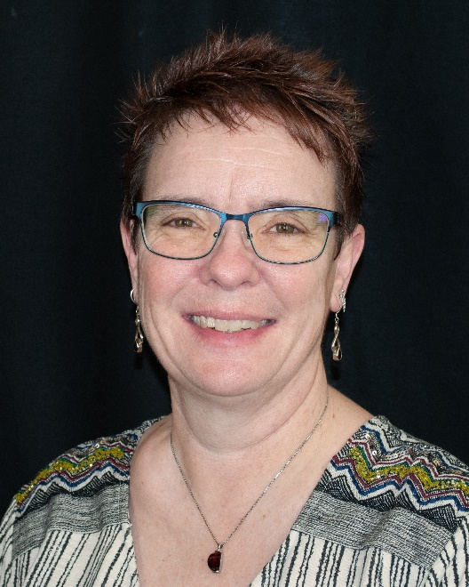
LCI
Assessment | Learner Characteristics Inventory
Description | The LCI is a survey of learning characteristics of students with the most significant cognitive disabilities (SCD) who qualify for the IDAA. The LCI also includes the four IDAA participation criteria students must meet to qualify for participation in the IDAA. Teachers complete the LCI only once for each student. The LCI must be completed before students can access their IDAAs.
Testing Window | 01/31/2023 to 05/12/2023
Subjects | The LCI must be completed before students can access their IDAAs.
Required Grades | ELA/Literacy & Math: 3-8 and high school Science: 5, 8, and 11
Student Population | Students with the most SCD who meet all 4 participation requirements, representing about 1% of the total student population.
Reported Results | N/A
Websites
Contact Details
Karren Streagle, Ph.D. Alternate Assessment Coordinator 208-332-6824 kstreagle@sde.idaho.gov

Slide 15
ISAT ELA/L
Assessment | Idaho Standards Achievement Test in English Language Arts/Literacy
Description | The summative ELA/L ISAT is given at the end of the learning process and allows students to demonstrate the full-range of their knowledge, skills and abilities.​ ​ Results from the summative assessment provide educators data on student proficiency.
Testing Window | 03/13/2023 to 05/12/2023
Subjects | English Language Arts/Literacy
Required Grades | 3-8 and 11 Optional for 9 and 10
Student Population | All Students
Reported Results | Scale Score, and Performance Level data is reported in an Individual Student Report (ISR).​ ISRs include the student's performance in each reporting category.​ Item-level analysis is also found online in the Reporting system
Websites
Contact Details
Marissa Gravel ELA/L Assessment Coordinator 208-332-6988 mgravel@sde.idaho.gov

Slide 16
ISAT Math
Assessment | Idaho Standards Achievement Test in Math
Description | The summative math ISAT is given at the end of the learning process and allows students to demonstrate the full-range of their knowledge, skills and abilities. Results from the summative assessment provide educators data on student proficiency.
Testing Window | 03/13/2023 to 05/12/2023
Subject | Math
Required Grades | 3-8 and 11 Optional for 9 and 10
Student Population | All Students
Reported Results | Scale Score, and Performance Level data is reported in an Individual Student Report (ISR). ISRs include the student's performance in each reporting category. Item-level analysis is also found online in the Reporting system
Websites
Contact Details
Brianna Lynch Mathematics & Science Assessment Coordinator 208-332-6979 blynch@sde.idaho.gov

Slide 17
ISAT Science
Assessment | Idaho Standards Achievement Test in Science
Description | The summative science ISAT is given at the end of the learning process and allows students to show mastery of the new three-dimensional science standards. The three dimensions include a content area (physical, Earth, or life science) a science and engineering practice, and a crosscutting concept.
Testing Window | 03/13/2023 to 05/12/2023
Subject | Science
Required Grades | 5, 8, and 11
Student Population | All Students
Reported Results | Scale Score, and Performance Level data is reported in an Individual Student Report (ISR). ISRs include the student's performance in each reporting category.
Websites
Contact Details
Brianna Lynch Mathematics & Science Assessment Coordinator 208-332-6979 blynch@sde.idaho.gov

Slide 18
IDAA ELA/L, Math, and Science
Assessment | Idaho Alternate Assessment in English Language Arts/Literacy, Math, and Science
Description | The IDAA is an alternate to the ISAT taken by qualifying students with the most significant cognitive disabilities (SCD). Qualifying students that the IDAA in all content areas, not just in one content area. The Learner Characteristics Inventory (LCI) is a required component of the IDAA.
Testing Window | 03/13/2023 to 05/12/2023
Subjects | ELA/Literacy, Math, & Science
Required Grades | ELA/Literacy & Math: 3-8 and high school Science: 5, 8, and 11
Student Population | Students with the most SCD who meet all 4 of the IDAA participation criteria, representing about 1% of the total student population.
Reported Results | Scores are reported as proficiency levels corresponding with ISAT: Level 4: Advanced Level 3: Proficient Level 2: Basic Level 1: Below Basic
Websites
Contact Details
Karren Streagle, Ph.D. Alternate Assessment Coordinator 208-332-6824 kstreagle@sde.idaho.gov

Slide 19
SAT
Assessment | SAT
Description | The SAT can be used for scholarship application, course placement, and admission decisions at higher education institutions and other organizations. Idaho offers the SAT to the juniors at no cost to districts, schools, parents, or students.
Testing Days | 04/12/2023 (primary) 04/25/2023 (make-up)
Subjects | Reading, Writing and Language, and Mathematics
Required Grades | 11 (Grade 12 can participate if they missed the grade 11 administration for an approved reason.)
Student Population | All Students
Reported Results | Total Score Section Scores Evidence-Based Reading and Writing Mathematics
Websites
Contact Details
Kevin M. Chandler Director of Assessment 208-332-6893 kchandler@sde.Idaho.gov

Slide 20


Civics
Assessment | Civics
Description | Idaho students will be required to take the United States Citizenship Test as outlined in Idaho Code §33-1602.7. The civics test may be taken as often as necessary for the student to pass the test. LEAs are required to assess all students using the questions from the U.S. Citizenship Naturalization Test.
Testing Window | Civics assessment administration date is determined by LEA.
Subject | Civics
Required Grades | Anytime between grades 7-12
Student Population | All Students
Reported Results | LEAs will determine the passing threshold a student will need to meet in order to fulfill the graduation requirement.
Websites
Contact Details
Peter Kavouras
Social Studies Coordinator
208-332-6975
pgkavouras@sde.idaho.gov

Slide 21
Accountability

Slide 22
Purpose
To promote data-driven decision making and resource allocation

Slide 23
Our Service
To assist you with non-fiscal data!
Data Requests
Business Rules
Goal/Target Setting

Slide 24
Data Requests
Redacted
Accountability Website
Report Card (idahoschools.org)
Unredacted
ADEA (Assessment Data Export Application)
Various platforms
ISEE platforms
Submit a ticket via OTIS

Slide 25
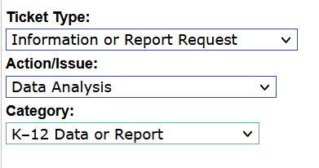
Submit a Ticket via OTIS
Submit OTIS for unredacted or unconventional data
Request may take 2+ weeks depending on difficulty/availability

Slide 26
Business Rules
Consolidated State Plan
How we identify schools in need to allocate federal resources
What we provide to schools in need
Business Rules
Identification calculations
Inclusion and exclusion criteria

Slide 27
Goal/Target Setting
Tools
Similar district/school tool*
Growth tool*
*the tools have not been updated with 2022 data

Slide 28
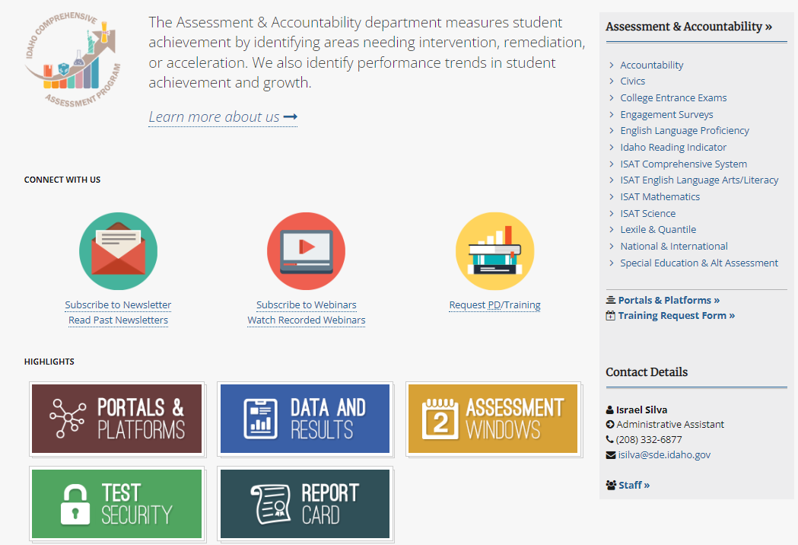
Assessment & Accountability
https://sde.idaho.gov/assessment/index.html

Slide 29
Assessment & Accountability
Assessment
Kevin M. Chandler
Director
(208) 332-6893
kchandler@sde.idaho.gov
Accountability and Federal Reporting
Ayaka Nukui
Director
(208) 332-6926
anukui@sde.idaho.gov
ISAT
Mathematics
Brianna Lynch
Coordinator
(208) 332-6979
blynch@sde.idaho.gov
ISAT
Science
Brianna Lynch
Coordinator
(208) 332-6979
blynch@sde.idaho.gov
ISAT
ELA/Literacy
Marissa Gravel
Coordinator
(208) 332-6988
mgravel@sde.idaho.gov
Idaho Reading
Indicator
Marissa Gravel
Coordinator
(208) 332-6988
mgravel@sde.idaho.gov
English Language
Proficiency
Andrew Bennett
Coordinator
(208) 332-6909
abennett@sde.idaho.gov
Special Education
& Alt. Assessment
Karren Streagle, Ph.D.
Coordinator
(208) 332-6824
kstreagle@sde.idaho.gov
College
Entrance Exams
Kevin M. Chandler
Director
(208) 332-6893
kchandler@sde.idaho.gov
Accountability and
State Reporting
Valerie Steffen
Coordinator
(208) 332-6948 vsteffen@sde.idaho.gov
National & International
Paul Kleinert, Ph.D. NAEP Coordinator (208) 332-6957 pkleinert@sde.Idaho.gov
Civics
Peter Kavouras
Coordinator
(208) 332-6975
pgkavouras@sde.idaho.gov

Slide 30
Questions
Ayaka Nukui, Director
Kevin Chandler, Director
Idaho State Department of Education
650 W State Street, Boise, ID 83702
208-332-6877
assessments@sde.Idaho.gov

Slide 31
ESEA Federal Programs
Kathy Gauby, Interim Director

Slide 32

Purpose of Federal Programs
The Federal Programs department meets regulations and provides assistance to school districts under the requirements of the Elementary and Secondary Education Act (ESEA), currently enacted as the Every Student Succeeds Act (ESSA).
We accomplish this by implementing federal program monitoring to ensure districts are compliant with the law.
We focus on addressing challenges and improving the academic success of students who are struggling and at-risk so they meet state academic standards.
https://www.sde.idaho.gov/federal-programs/index.html

Slide 33
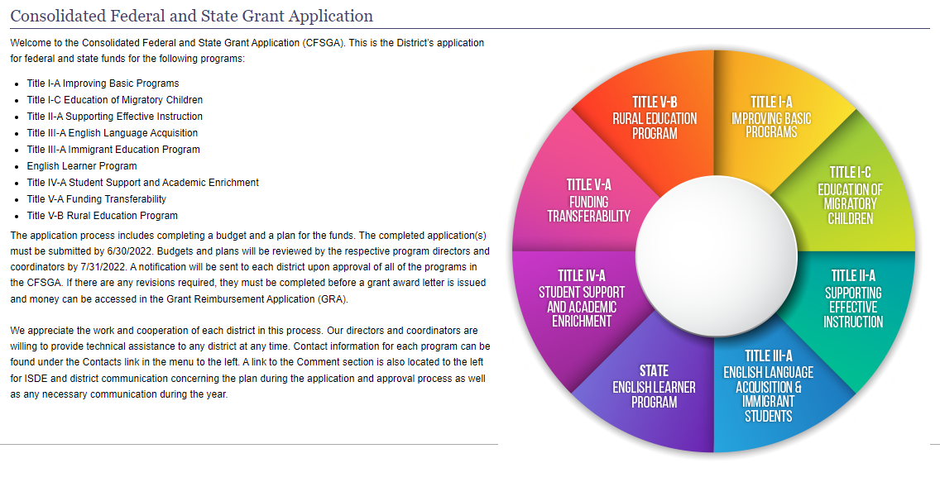
Elementary & Secondary Education Act (ESEA)
Federal Programs team supports district and charter Local Education Agencies with grant applications and program requirements.
https://apps.sde.idaho.gov/CFSGA/Home/Home
New & Experienced Federal Programs Conference – September 12-13, 2022 Nampa Civic Center

Slide 34
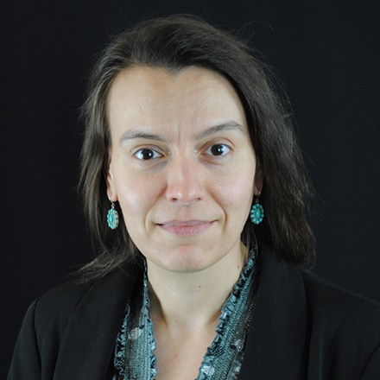
Grant Funding and Fiscal Accountability
Check on the status of Federal funds under ESSA (amount, obligation period, etc.)
Funding questions for Federal programs under ESSA (data used to calculate allocations)
Allowable use of Federal funds in general (programs under ESSA)
Fiscal ESSER questions
Alexandra McCann amccan@sde.Idaho.gov http://www.sde.idaho.gov/federal-programs/funding/

Slide 35
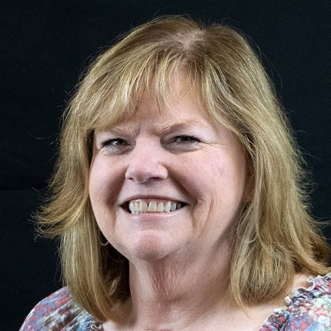
Title I-A Improving Basic Programs
Funding vs Serving
Schoolwide and Targeted Assistance Programs
Consolidated Federal and State Grant Application (CFSGA)
Schoolwide/Improvement Plan (SWIP)
Stacie Rekow srekow@sde.Idaho.gov
https://www.sde.idaho.gov/federal-programs/basic/

Slide 36
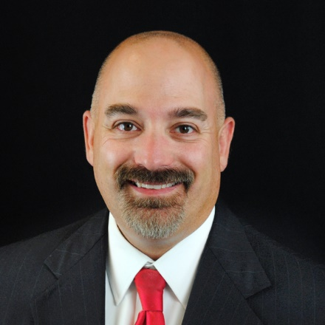
Title I-A School Improvement
School Improvement Designation questions
Schoolwide/Improvement Plan (SWIP)/Funding questions
State Sponsored Activities (ISN, ISM, IPN, IPMP, IBC) questions
New cohort of schools in improvement will be identified Fall 2022
Tyson Carter tcarter@sde.idaho.gov
http://www.sde.idaho.gov/federal-programs/sis/

Slide 37

Title I-A Family and Community Engagement
School-Parent Compact Questions and template
Family Engagement School District Policy Questions
Family Engagement School Building Plan Questions
Implementing a full-service community school program
2022 FACE Conference –November 14-15, 2022
Jill Mathews jmathews@sde.idaho.gov http://www.sde.idaho.gov/federal-programs/face/index.html

Slide 38
Title I-A Foster Care
Idaho Foster Care Process Questions
Foster Care Transportation Questions
Reimbursement form for Title IV-E and Court-Ordered Tuition Equivalency
The role of the District Foster Care Liaison
Jill Mathews jmathews@sde.idaho.gov http://www.sde.idaho.gov/federal-programs/foster-care/

Slide 39
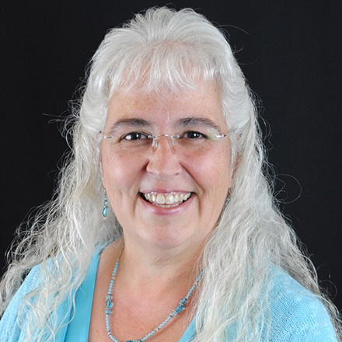
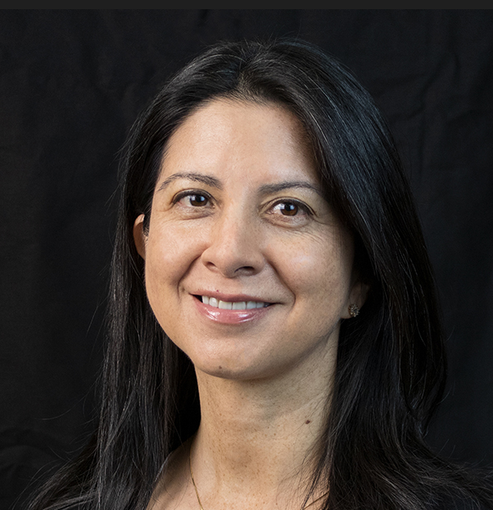
Title I-C Migrant Education Program
Program and student services best practices
Use of migrant funds
Data collection and the Migrant Student Information System (MSIS)
Parent Employment Survey requirements for all districts
Sarah Seamount sseamount@sde.idaho.gov
Julissa Lara jlara@sde.Idaho.gov
https://www.sde.idaho.gov/federal-programs/migrant/

Slide 40

Title I-D Neglected, Delinquent, or At-Risk Program
Supports the education, drop-out prevention and transition of students
Idaho Department of Corrections
Robert Janss School (9 locations)
Idaho Department of Juvenile Corrections
Juniper Hills School (3 locations)
County Juvenile Detention Centers
11 locations
Other LEA At-Risk/Drop Out Prevention Programs
Emily Sommer esommer@sde.Idaho.gov
http://www.sde.idaho.gov/federal-programs/homeless/index.html

Slide 41
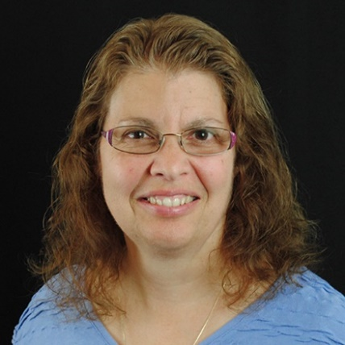
Title II-A Supporting Effective Instruction
Danielson Workshop/Administrator Renewal Questions
Consolidated Federal and State Grant Application (CFSGA)/Title II-A Allowable Activities
Career Ladder Data System (CLDS)
Instructional support services for schools in improvement
Kathy Gauby kgauby@sde.idaho.gov
http://www.sde.idaho.gov/federal-programs/teacher/index.html
http://www.sde.idaho.gov/federal-programs/ed-effectiveness/index.html

Slide 42
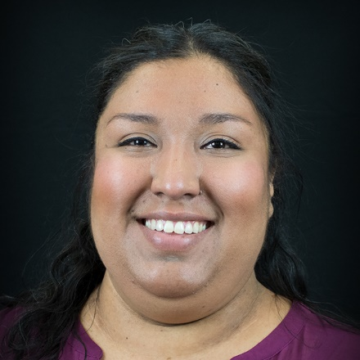
Title III-A English Learner Program
English Learner Program Technical Assistance
English Learner Management System (ELMS)
Go to Strategies – professional development
Maria Puga mpuga@sde.idaho.gov
Julissa Lara jlara@sde.Idaho.gov
http://www.sde.idaho.gov/el-migrant/el/index.html

Slide 43
Title IV-A Student Support & Academic Achievement
CFSGA –Consolidated Federal & State Grant Application
Title IV-A Grants Overview
Title IV-A Non-Regulatory Guidance
Stacie Rekow srekow@sde.Idaho.gov
http://www.sde.idaho.gov/federal-programs/ssae/

Slide 44
Title V-B Rural Education
Small Rural School Achievement (SRSA) Program – operated by the U.S. Department of Education https://www2.ed.gov/programs/reapsrsa/index.html
Rural and Low-Income School (RLIS) Program
http://www.sde.idaho.gov/federal-programs/rural/index.html
Kathy Gauby kgauby@sde.idaho.gov

Slide 45
Title IX-A Homeless Education Program
LEA Homeless Education Liaison
10 specific duties
Identification and Support
Community partners
Training ALL staff
Homeless Ed. training & website resources
Idaho MV/Homeless Education Mini-Manual
Annual Liaison Training
ARP-Homeless 1 (competitive) and ARP-Homeless 2 (formula)
Emily Sommer esommer@sde.Idaho.gov
http://www.sde.idaho.gov/federal-programs/homeless/index.html

Slide 46
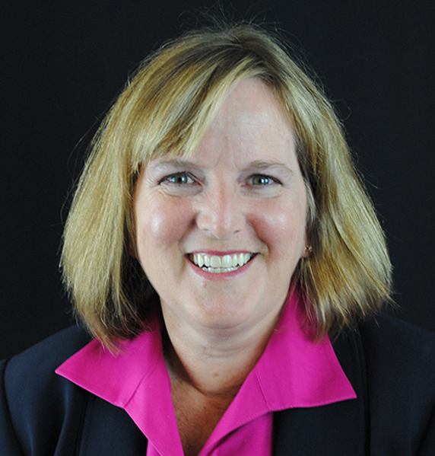
Equitable Services to Private Schools
Eligibility-
Title I-A for students who live within the district’s attendance area and attend a non-profit private schools located within and outside the district boundaries
Title I-C, II-A, III-A, and IV-A for students who live and attend private schools within the district boundaries
Michelle Taylor mtaylor@sde.Idaho.gov
https://www.sde.idaho.gov/federal-programs/equitable-services/

Slide 47

ESEA Federal Program Monitoring
Federal Programs Monitoring
Monitoring Tool (onsite, hybrid, desk)
Monitoring Self-Assessment Tool (annually when not receiving an onsite visit)
http://sde.idaho.gov/federal-programs/program-monitoring/
Michelle Perreira mperreira@sde.Idaho.gov
Stacie Rekow srekow@sde.Idaho.gov

Slide 48

Pandemic Relief Funds/ESSER
Elementary and Secondary School Emergency Relief (ESSER) Funds
Coronavirus Aid, Relief, and Economic Security (CARES) Act (March 27, 2020)
Coronavirus Response and Relief Supplemental Appropriations (CRRSA ) Act (December 27, 2020)
American Rescue Plan (ARP) Act (March 11, 2021)
ARP ESSER Homeless I and II
Lisa English lenglish@sde.Idaho.gov
https://www.sde.idaho.gov/federal-programs/prf/

Slide 49
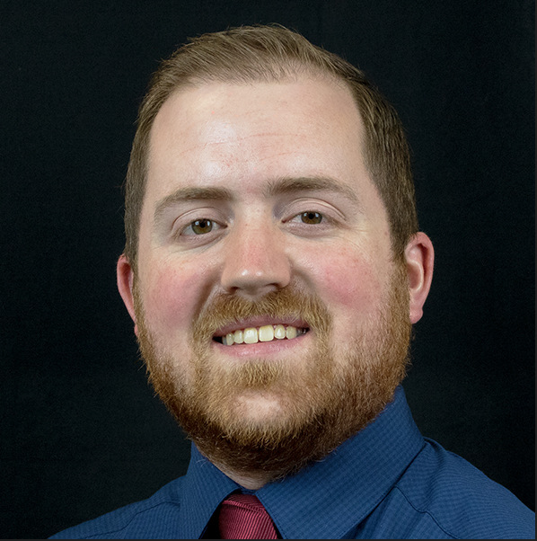
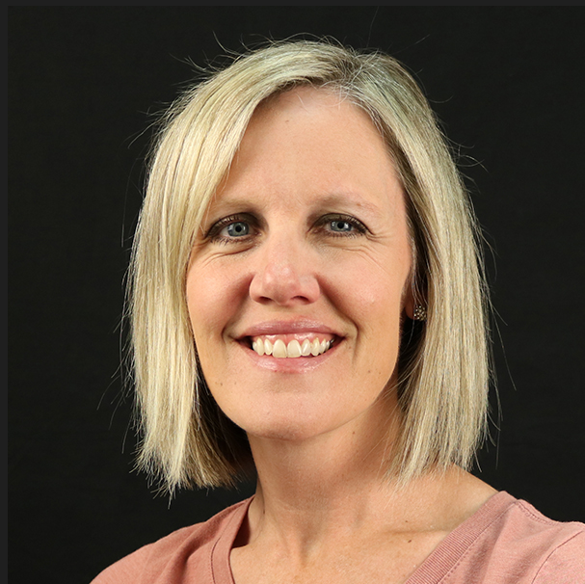
ESSER Reporting
ESSER Data and Reporting
Aaron Kennedy akennedy@sde.idaho.gov
https://www.sde.idaho.gov/federal-programs/prf/
ESSER Program Monitoring
ESSER Use of Funds
Katie Watkins kwatkins@sde.idaho.gov
https://www.sde.idaho.gov/federal-programs/prf/

Slide 50
Administrative Support Staff
Two administrative assistants
Title I-A, II-A, IV-A, VI-B, IX-A programs
Title I-C and III-A programs
Cassandra Skinner kskinner@sde.idaho.gov
Maria “Yuni” Rueda Barerra mbarerra@sde.idaho.gov

Slide 51
Questions?
Kathy Gauby, Interim Director
Idaho State Department of Education
650 W State Street, Boise, ID 83702
208-332-6889
kgauby@sde.idaho.gov
http://www.sde.idaho.gov/federal-programs/

Slide 52
School Choice
Michelle Clement-Taylor, Coordinator

Slide 53
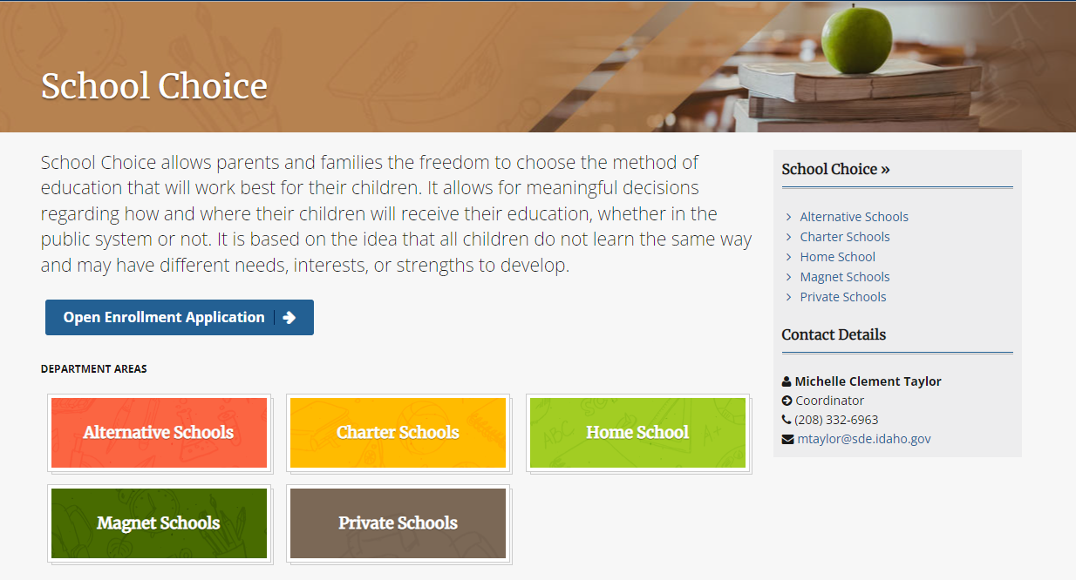
School Choice

Slide 54
Questions?
Michelle Clement-Taylor, Coordinator
Idaho State Department of Education
650 W State Street, Boise, ID 83702
208-332-6963
mtaylor@sde.idaho.gov

Slide 55
Office of Indian Education
Johanna Jones, coordinator

Slide 56
OFFICE OF INDIAN EDUCATION
MISSION:
To maintain the unique status of American Indians, preserve their cultural identity, and raise cultural awareness.
Vision:
To increase equitable educational opportunities, relevant learning environments, and high-quality teaching to create learning atmospheres where all American Indian students achieve educational success.

Slide 57

FIVE TRIBES OF IDAHO

Slide 58
IDAHO INDIAN EDUCATION
1948
PUBLIC SCHOOLS
District 25, Pocatello
District 44, Plummer-Worley
District 55, Blackfoot
District 304, Kamiah
District 341, Lapwai
District 484, Chief Taghee Elementary
BIE SCHOOLS
District 535, Coeur d’ Alene Tribal School, K-8
District 537, Shoshone-Bannock Jr/Sr High School, 6-12

Slide 59
FEDERAL DOLLARS
IMPACT AID
Federally connected
General aid
Copy of application
JOHNSON O’MALLEY
Supplement, not supplant
Meet unique educational needs
SDE contract
Eligible student
LIEC
Indian Education Plan
Annual Report

Slide 60
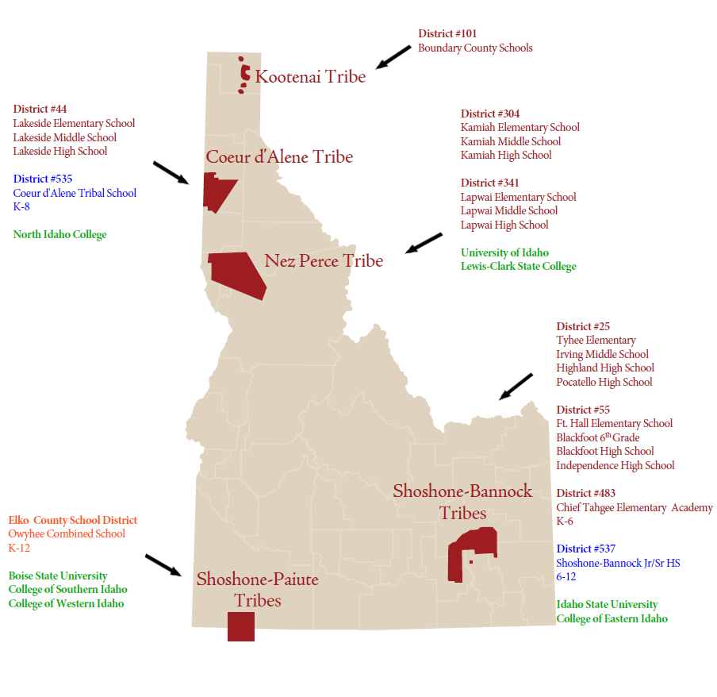
IDAHO EDUCATIONAL SYSTEM

Slide 61
RESOURCES
Local Tribe(s)
Local Tribal Education Department(s)
Idaho Indian Education Committee
Office of Indian Education
https://www.sde.idaho.gov/indian-ed/
IHEs
Libraries

Slide 62


OPPORTUNITIES

Slide 63
Questions?
Johanna Jones, Coordinator Idaho State Department of Education
650 W State Street, Boise, ID 83702
208 332 6800
jjones@sde.Idaho.gov
www.sde.Idaho.gov/indian-ed

Slide 64
Student Transportation
Kyle Rahn, Director

Slide 65
Contact Information
Kyle Rahn, Director, (208) 332-6856, krahn@sde.idaho.gov
Lori Olsen, Administrative Assistant, (208) 332-6851, lolsen@sde.Idaho.gov
Zane Cliver, Financial Specialist, Sr., (208) 332-6832, zcliver@sde.idaho.gov
Tony Dechand, Region 1 & 2, Specialist, (208)-784-3079, tdechand@sde.idaho.gov
Brandon Collar, Region 3, Specialist, (208) 332-6850, bcollar@sde.idaho.gov
Ali Stolzman, Region 4 & 6, Specialist, (208) 539-3867, astolzman@sde.idaho.gov
Lloyd Sorensen, Region 5 & 6, Specialist, (208) 221-7839, lsorensen@sde.idaho.gov
Website - http://www.sde.idaho.gov/student-transportation

Slide 66
Important Dates and Deadlines
For School Districts and Charter Schools:
Odometer Report for odometers ending 6/30 – due July 30
Mileage Summary (to be submitted prior to reimbursement claim) – due September 1
Reimbursement Claim – due September 1
Funding Cap Appeal Application - due January 15
Safety Busing - due March 1
Ridership Counts – three collections dates/ year, due TBD
For Charter Schools Only:
Advance Payment Requests (initial) - due December 15
Advance Payment Requests (reconciliation) - due June 1
Other Important Dates:
Driver Records Check– after July 1 or before start of school
Route Approval by Board – after August 1 or before start of school

Slide 67
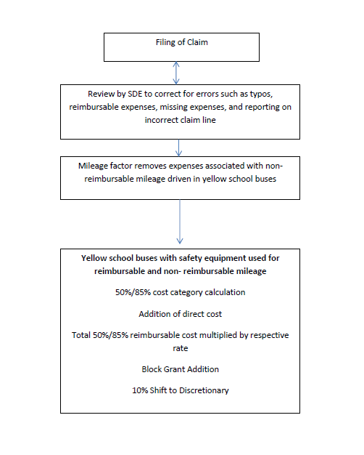
Reimbursement Claim - Flow Chart

Slide 68
Mileage
Reimbursable Non-Reimbursable
Regular To/From School (R) Regular To/From School (NR)
Unique To/From School (R) Unique To/From School (NR)
Shuttle Trips (R) Shuttle Trips (NR)
Summer Programs (R) Summer Programs (NR)
Field Trips (R) Field Trips (NR)
Maintenance (R) Other (NR)
Training (R) Extracurricular/Activities (NR)

Slide 69
Questions?
Kyle Rahn, Director
Idaho State Department of Education
650 W State Street, Boise, ID 83702
208.332.6851
krahn@sde.idaho.gov
www.sde.idaho.gov/student-transportation

Slide 70
Special Education
Dr. Charlie Silva, Director

Slide 71

Special Education Mission Statement
To enable all students to achieve high academic standards and quality of life, the Special Education department works collaboratively with districts, agencies, and parents to ensure students receive quality, meaningful, and needed services.

Slide 72
Special Education Staff
Dr. Charlie Silva
Director
208-332-6806
Brenda Arnold
Administrative
Assistant
208-332-6806
Lisa
Pofelski-Rosa
Principal Financial Specialist, Funding and Accountability
208-332-6916
Alisa Fewkes
Coordinator, Data & Reporting
208-332-6919
Kimberli Shaner
Coordinator, Dispute Resolution
208-332-6914
Kailey Bunch-Woodson
Coordinator, Program Evaluation
208-332-6925
Randi Cole
Coordinator, Secondary Transition
208-332-6918
Shannon Dunstan
Coordinator, Results Driven Accountability/Early Childhood
208-332-6908
Dr. Karren Streagle
Coordinator, Alt Assessment/Low Incidence/Medicaid
208-332-6824
Debi Smith
Coordinator, Special Populations
208-332-6915
Kateryna Dyer
Financial Specialist, Funding and Accountability
208-332-6910
Will Spoja
Program Specialist, Reporting & Support
208-332-6933
TBD
Program Specialist, Dispute Resolution
208-332-6912

Slide 73

State Resource Alignment
State Strategic Plan Goals:
All Idaho students persevere in life and are ready for college and careers.
All education stakeholders in Idaho are mutually responsible for accountability and student progress.
Idaho attracts and retains great teachers and leaders.

Slide 74
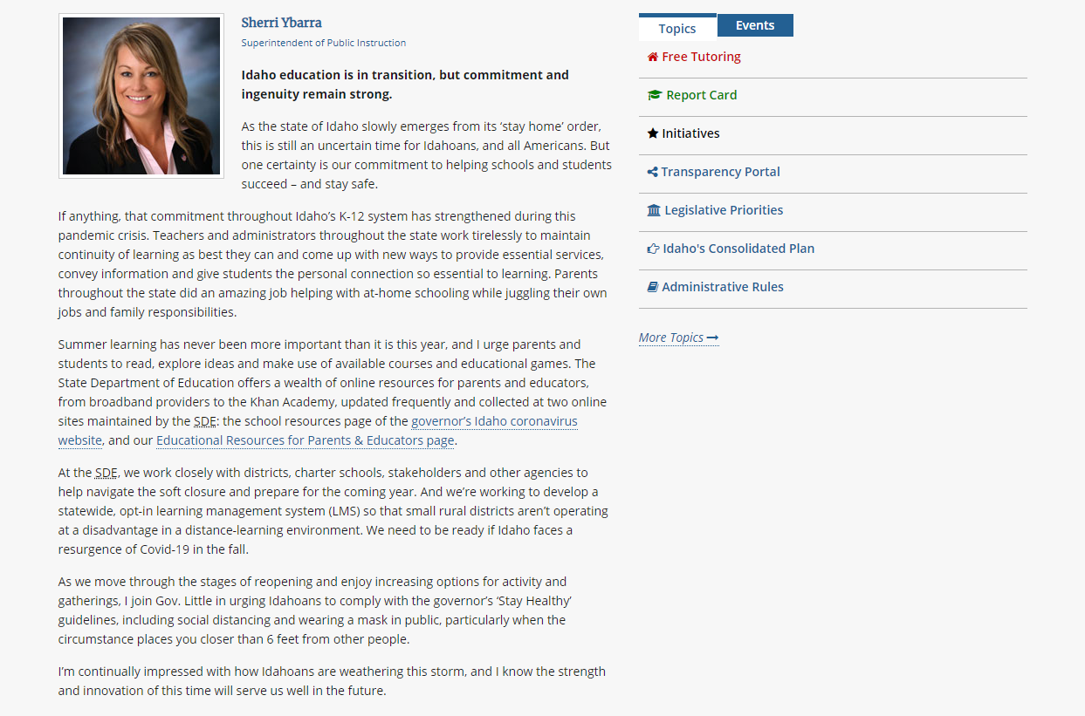
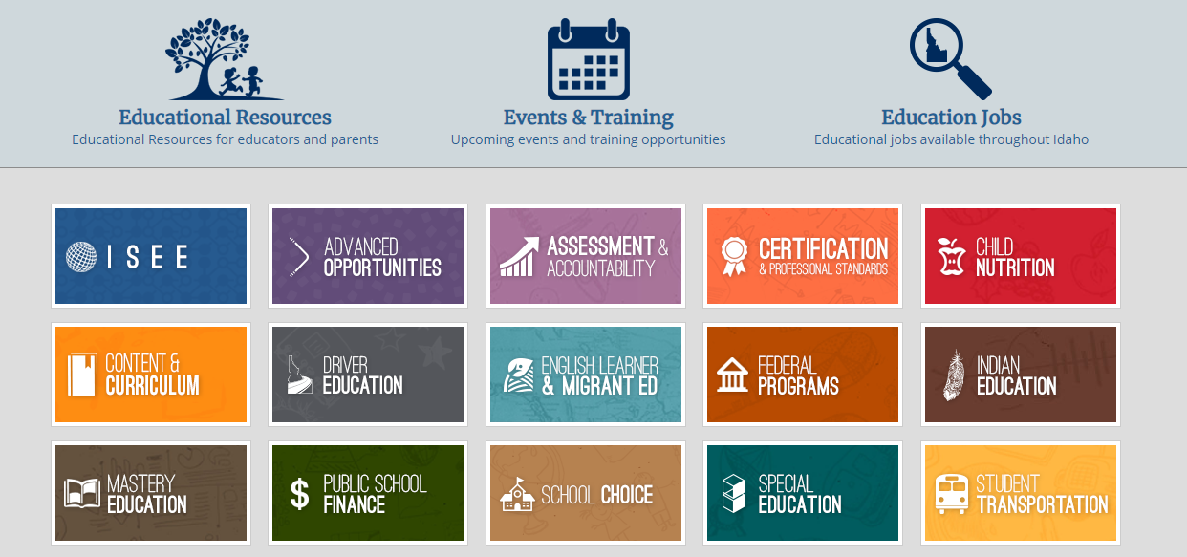
State Dept. of Education Website
https://sde.Idaho.gov/

Slide 75
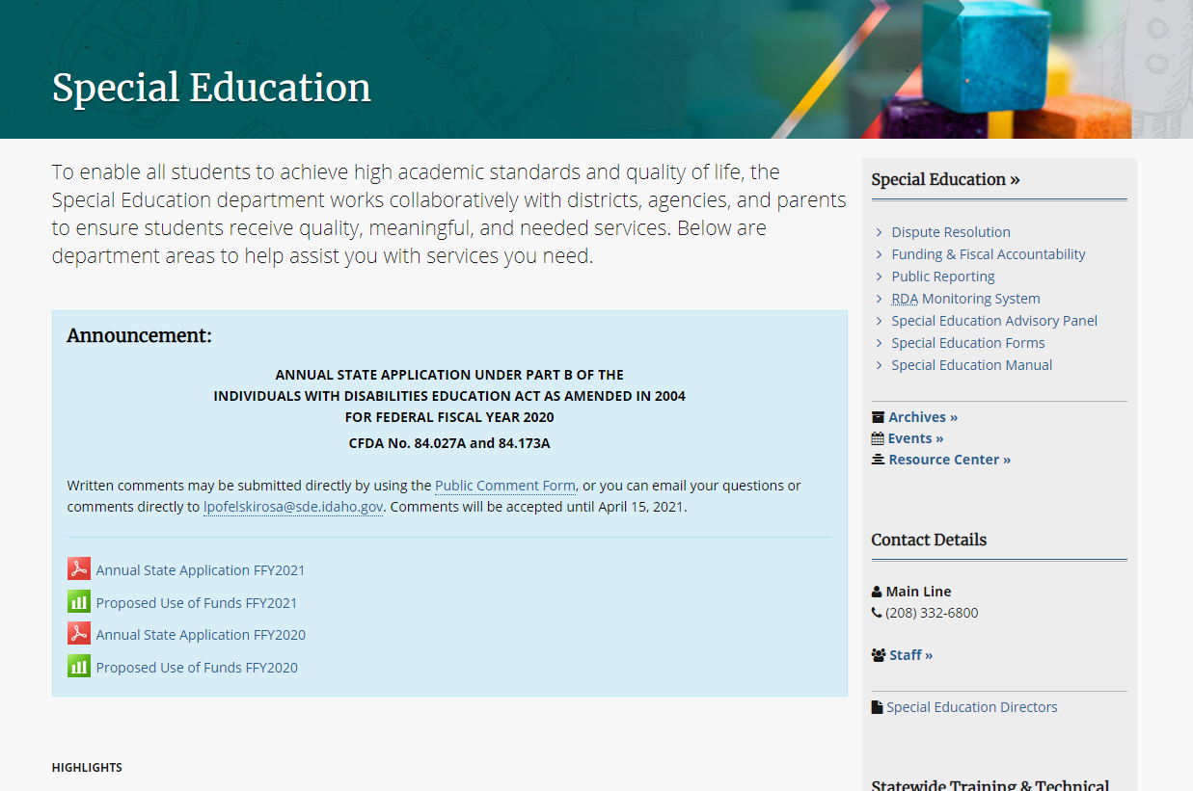
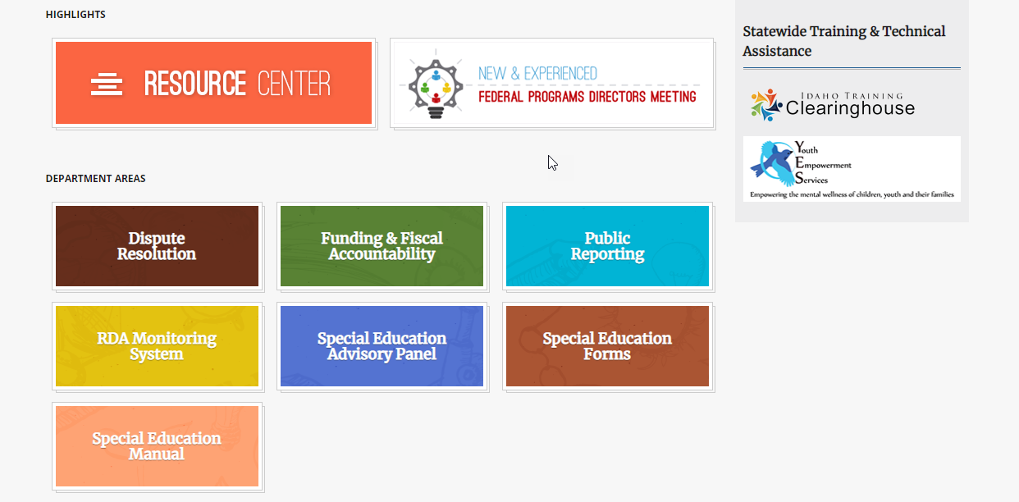
State Dept. of Education Website (pt. 2)

Slide 76
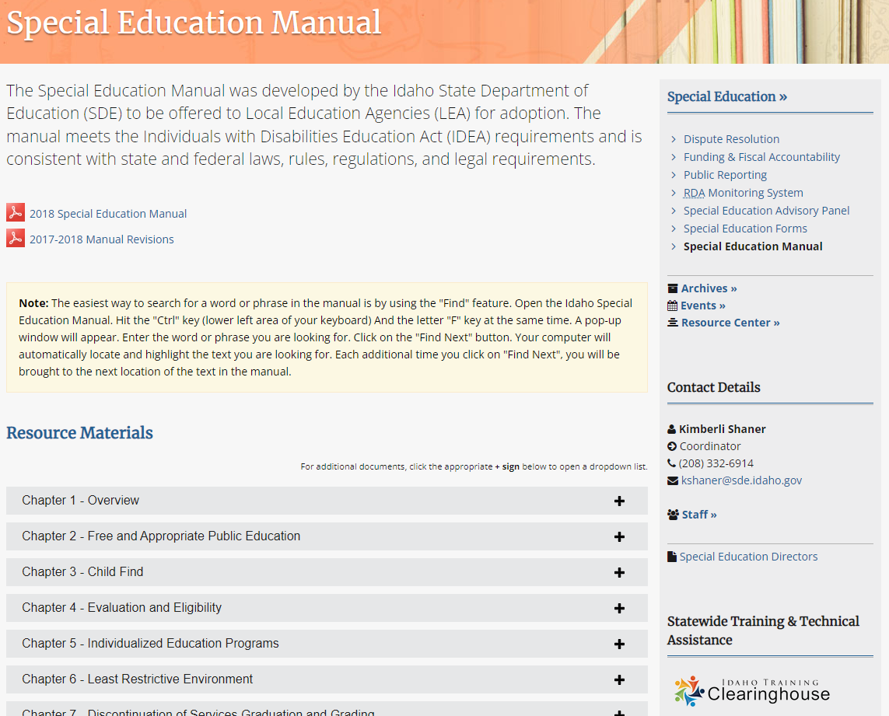
State Dept. of Education Website (pt. 3)
Open the Manual here
Manual Resources & Guidance Documents

Slide 77
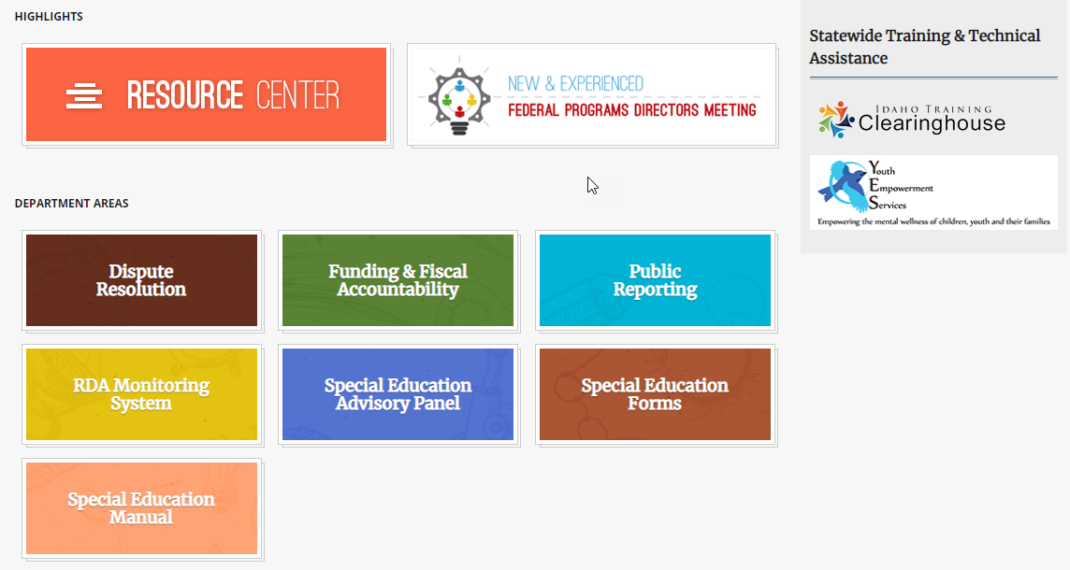
State Dept. of Education Website (pt. 4)
Link to ITC Homepage

Slide 78


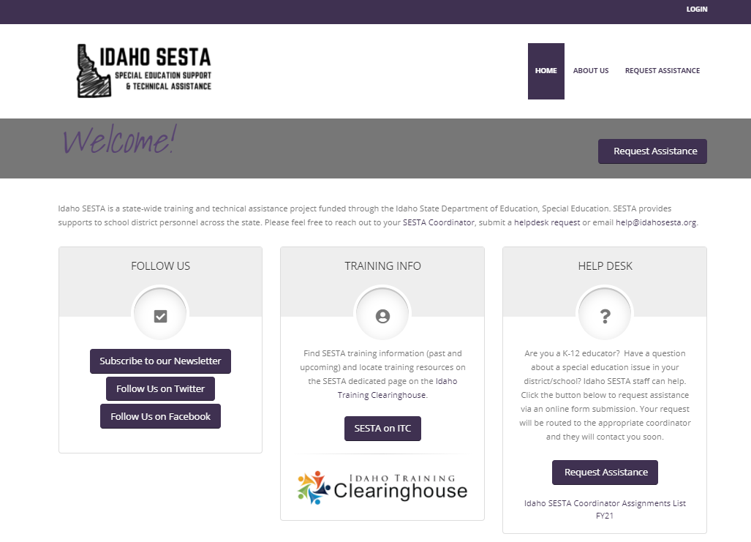
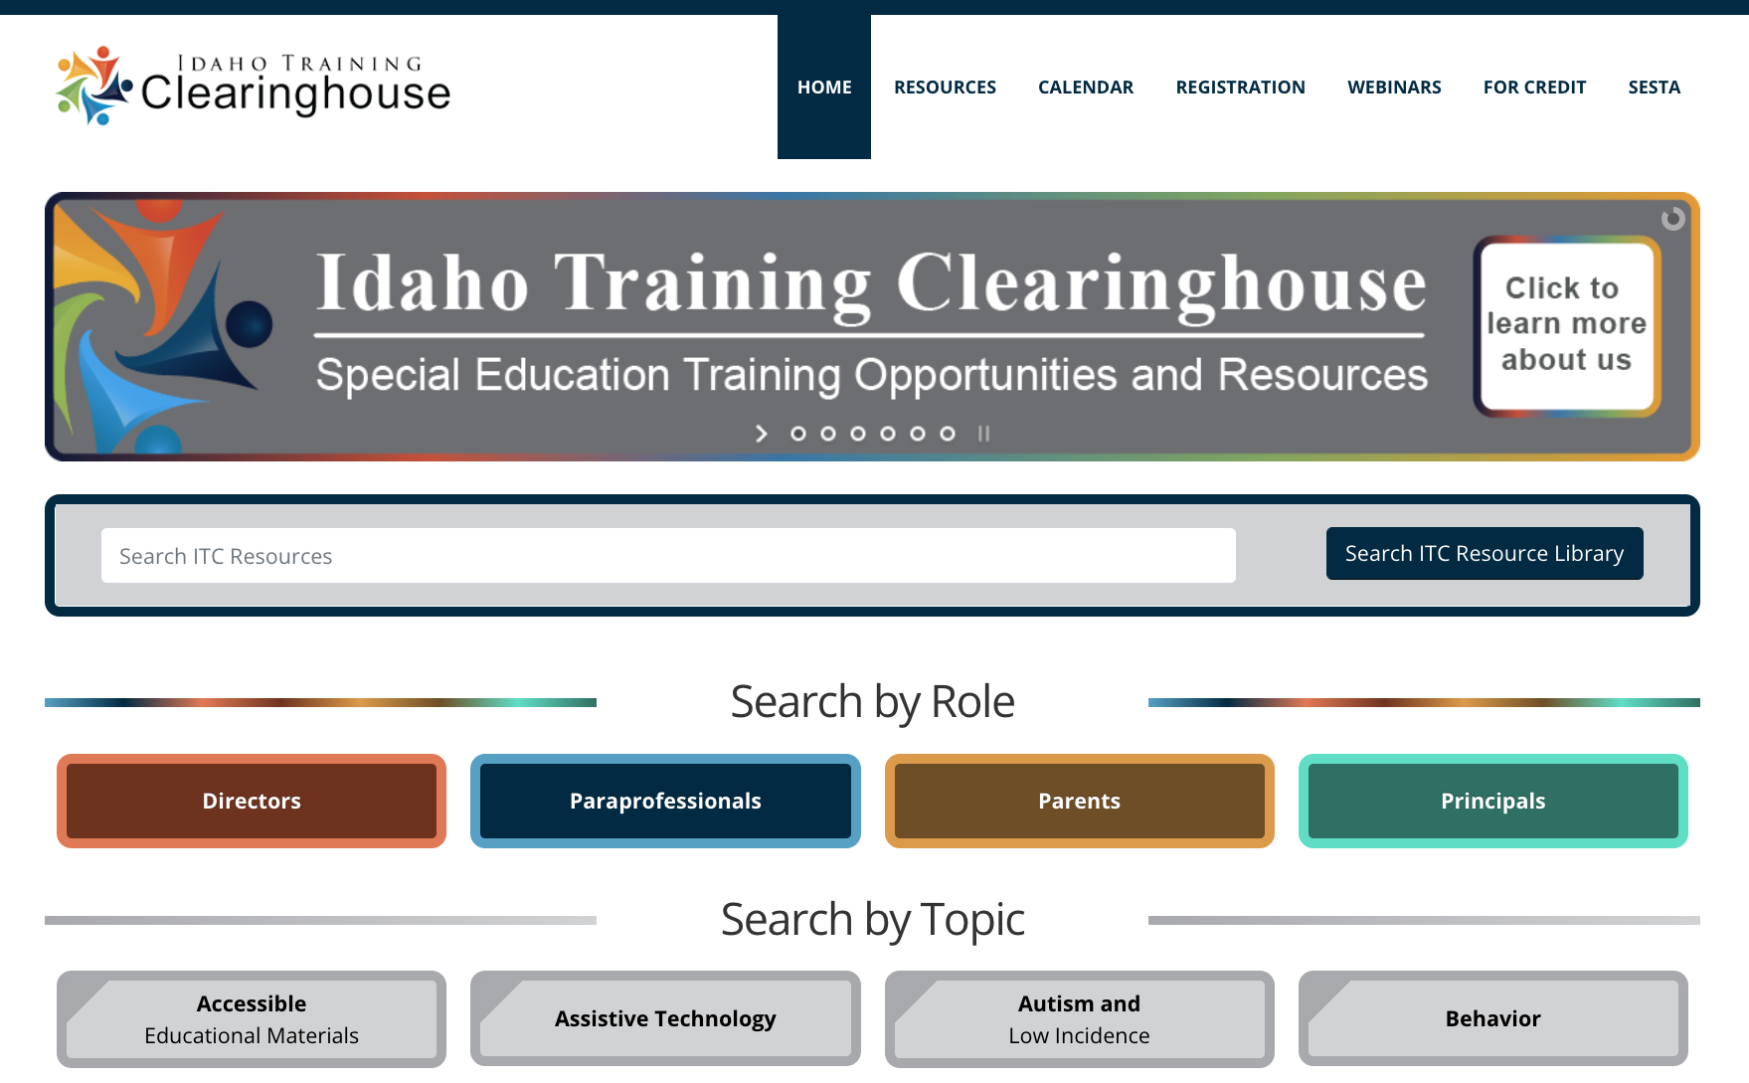
Overview of Statewide Resources
https://idahosesta.org/
https://idahotc.com/

Slide 79
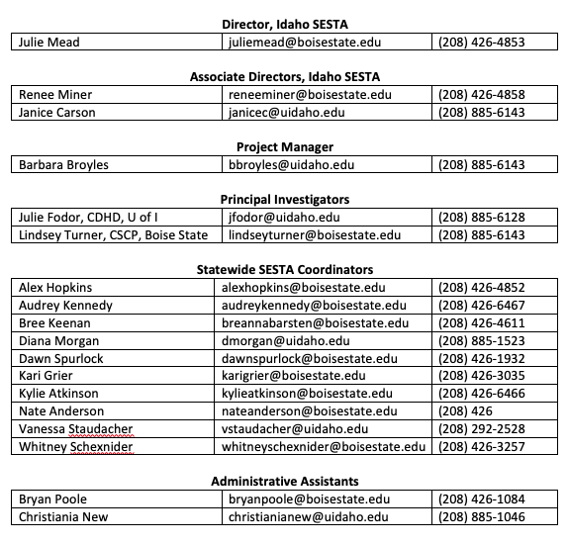
Idaho SESTA

Slide 80
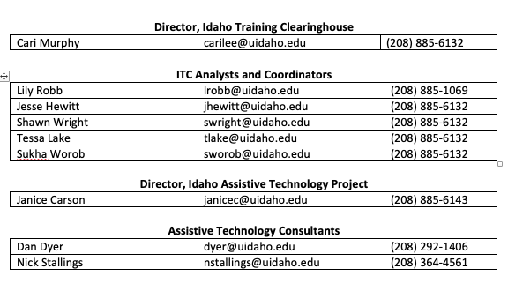

Idaho SESTA (2)

Slide 81
Dispute Resolution Updates
Kimberli Shaner, Dispute Resolution Coordinator

Slide 82
The Dispute Resolution Team
Kimberli Shaner- Dispute Resolution Coordinator
TBD- Dispute Resolution Program Specialist
Contractor Roles | Number of Contractors
Facilitators | 17
Mediators | 5
Complaint Investigators | 7
Hearing Officers | 3

Slide 83
Dispute Resolution Options
Dispute Resolution
Informal Conflict Resolution
Mediation
Due Process Hearing
State Complaint
Facilitation

Slide 84
Facilitation
A voluntary process where, at no cost to parent or district, we provide a neutral facilitator to run the meeting. Used as a proactive tool to build good relationships and compliant IEPs.
Eligibility and evaluation meetings
Annual IEP meetings (over 36,000 students throughout Idaho)
Three-year re-evaluation meetings
Anytime an IEP Team is called to discuss behavioral problems, new information, or concerns about the progress of the student

Slide 85
Mediation
A voluntary process where, at no cost to parent or district, we provide a neutral third party to aid parties in building formal, written and enforceable agreements over any special education issue.
Up to three representatives for each party
Issue specific (not full IEP team)
Confidential process (not discoverable)
Can modify an IEP without a full team
Mediator is not a decision maker – decisions are owned by the parties
SDE does not enforce mediated agreements

Slide 86
State Administrative Complaint
Any individual or agency can allege that an LEA has violated any component of the IDEA within the past 365 days.
SDE contracted Complaint Investigator provides a report within 60 days.
Investigatory costs assumed by SDE
Complaints can be regarding individual or systemic concerns
LEAs can choose to correct non-compliance prior to an investigation
Founded allegations require corrective actions to be overseen by SDE
Mediation is automatically offered to both parties

Slide 87
Due Process Hearing
Districts or parents may request that a Hearing Officer (HO) decide any matter relating to the identification, evaluation, educational placement, or provision of FAPE.
Costs associated with Due Process Hearings are assumed by LEAs
Alternatives to hearing decisions that are built into the system:
Resolution Sessions
Resolution Period for Mediation
Decisions are appealable to District Court (not SDE)

Slide 88
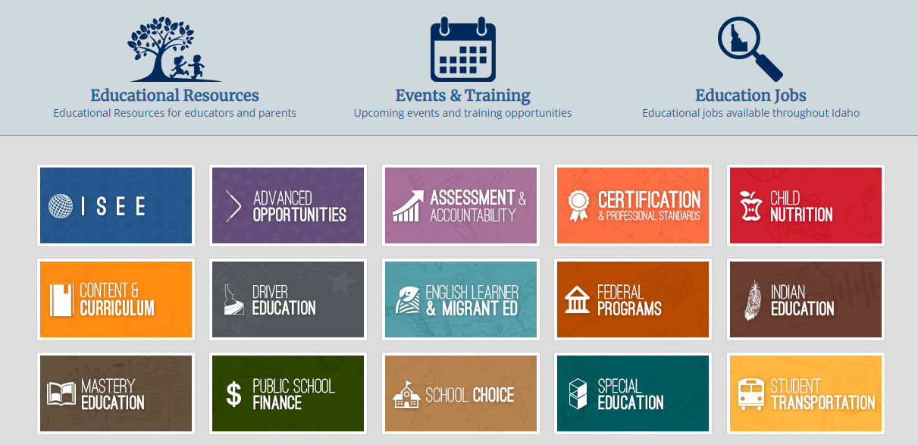
SDE Home Page
Link to Page: Idaho State Department of Education (SDE))

Slide 89
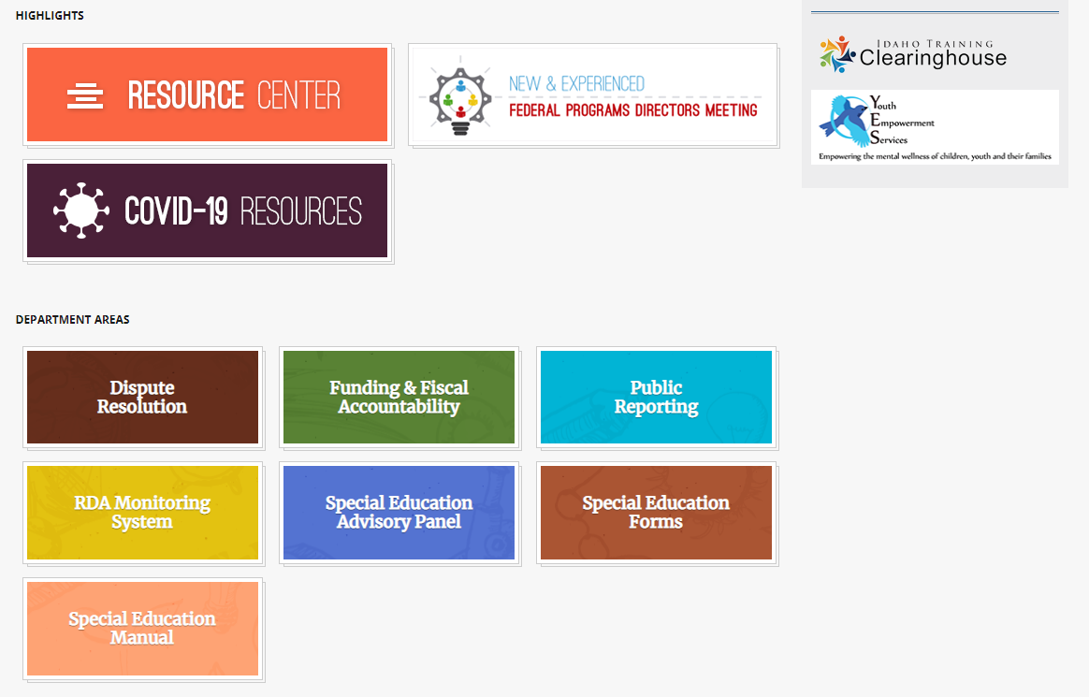
SPED Home Page

Slide 90
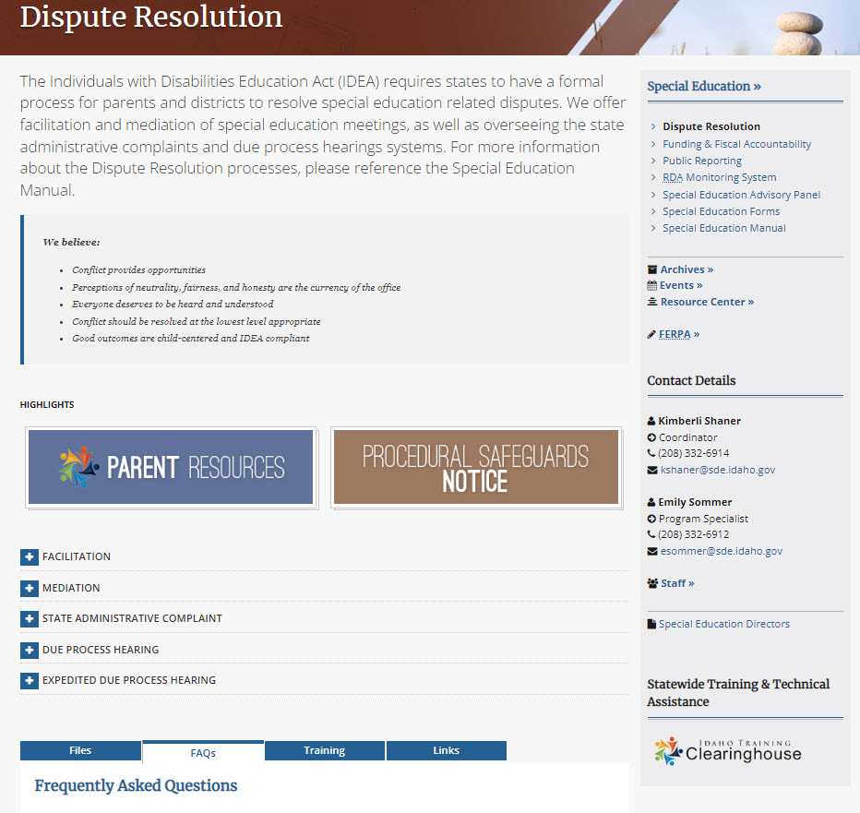
Dispute Resolution Website Home Page
Description of the scope of the DR office
Our Guiding Principles
(+) Expandable information buttons for each process
FAQs for each DR process

Slide 91
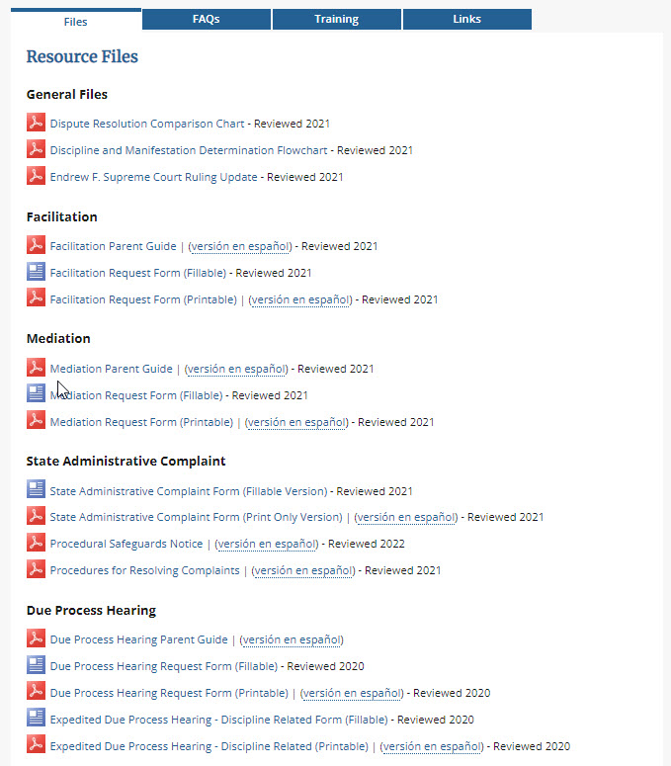
How to Request Dispute Resolution Services
Complete a request form and email it to our office.
Facilitation Request Form
State Complaint Form
Due Process Hearing Request Form

Slide 92
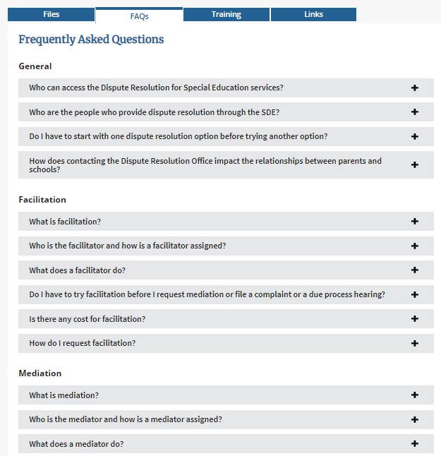

Dispute Resolution Website FAQs

Slide 93
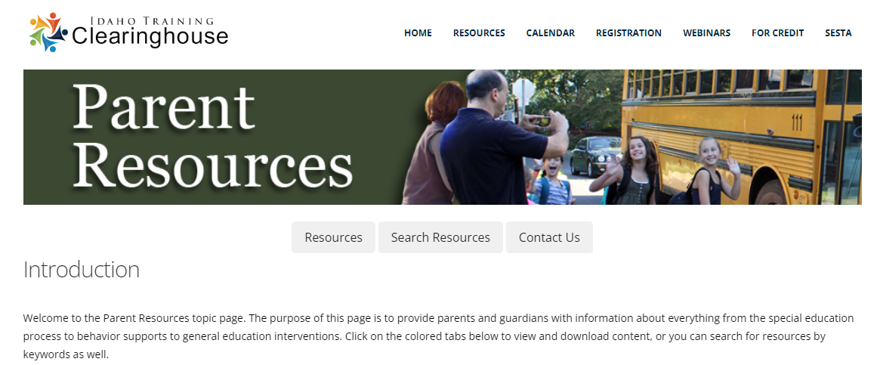
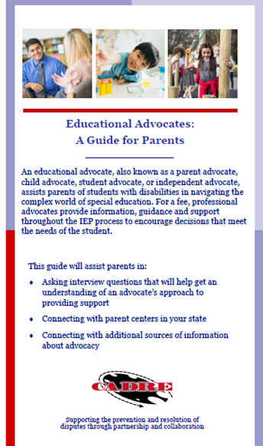
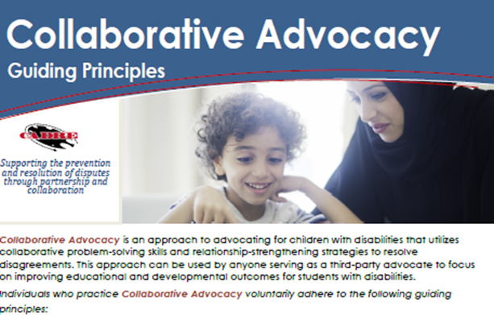
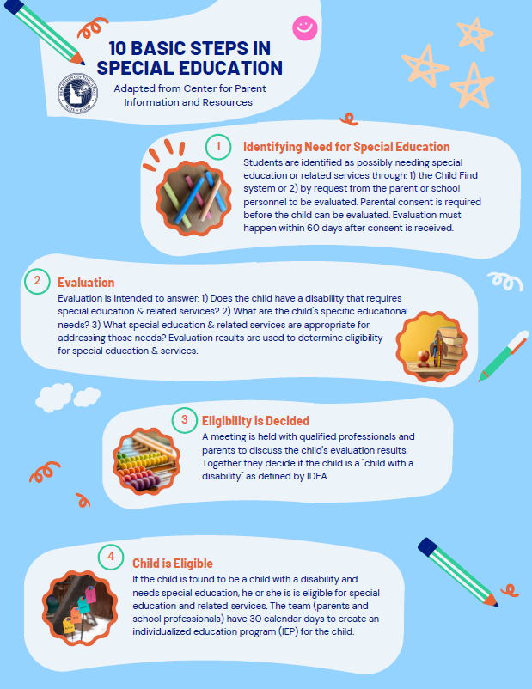
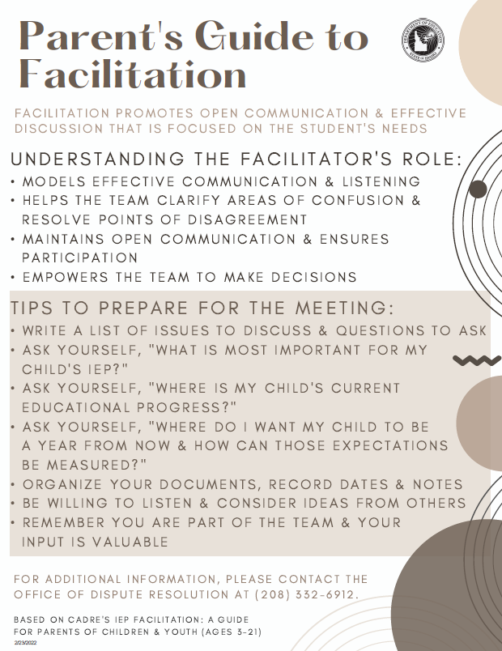
Dispute Resolution – Parent Resources
Idaho Training Clearinghouse: Parent Resources
Collaborative Advocacy: Guiding Principles
SPED Basics
Parent's Guide to Facilitation
Educational Advocates: A Guide for Parents

Slide 94
Funding and Accountability
Lisa Pofelski-Rosa, Principal Financial Specialist

Slide 95
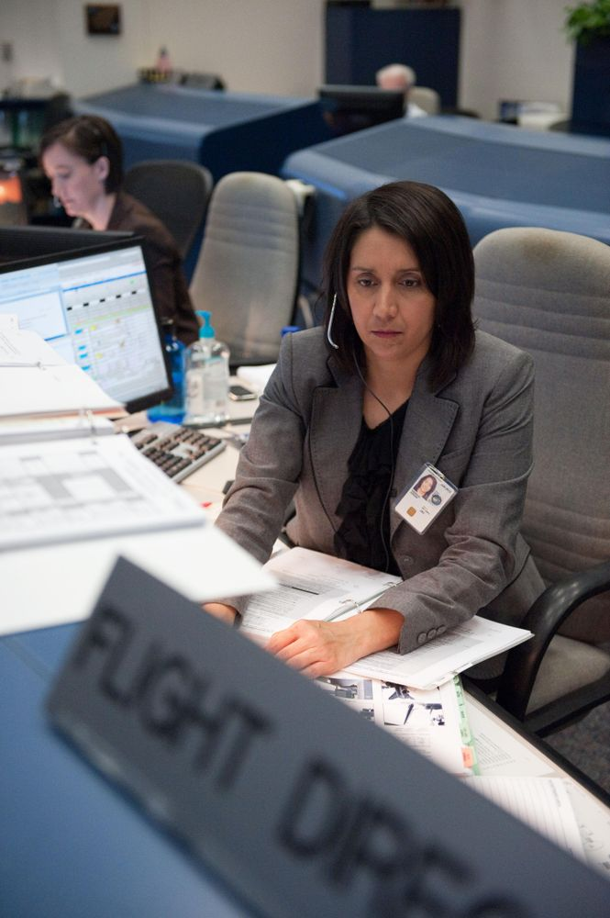
Special Education Funding and Fiscal Accountability
Who are we, and what do we do?
Oversee Federal Funds for IDEA Part B
Approve LEA grant applications
Process reimbursement requests
Fiscal Monitoring of sub recipients

Slide 96

Idaho Special Education Funding Sources
Total Funding
$ 310,996,093
Where does this come from?
(Reported via 2020 Financial Summary Report data)

Slide 97
Special Education Funding Sources
Annual Special Education funding for
The Exceptional Child Programs for
Districts and Charter schools equates to
$310,996,093 (based on FY2019-20)
This funding includes:
State and Local funds (for all SpEd students) 72%
Federal IDEA Part B School Aged funding 17%
Federal IDEA Part B Preschool funding 1%
Federal Medicaid Reimbursement dollars 10%
Notes:
What makes up the Special Education funding? There are 2 federal IDEA Part B grants, Medicaid reimbursements, and your General fund. Not all LEAs bill for Medicaid, but as you can see, across our state of Idaho, that makes up around 10% of all funding used to support Special Education. This pie chart illustrates how much your General fund has to contribute to support Special Education services.

Slide 98

Individuals with Disabilities Education Act (IDEA)
IDEA Part B and Preschool Federal Grant Funds
Idaho receives federal funding annually from the U.S. Department of Education.
The purpose is to assist states in meeting the costs of providing special education and related services to children with disabilities.
Allocations are determined according to a formula outlined in IDEA law.
Funding is subject to certain eligibility requirements and other conditions, as outlined in IDEA regulations.

Slide 99


IDEA Part B Federal Grants
Section 611 - School Age
Funds for students with disabilities, ages 3 through 21
Section 619 - Preschool Age
Funds for students with disabilities, ages 3 through 5

Slide 100
IDEA Part B Fiscal Year 2022-2023
FFY 2022-2023 IDEA Part B
Total: $65,862,888
Administration: $900,000
State Level Activities: $5,918,631
Flow through LEAs: $59,044,257
FFY 2022-2023 IDEA Part B Preschool
Total: $2,361,670
(100% Flow through LEAs)

Slide 101

IDEA PART B Grant Allocations
Regular Yearly Grant Allocations
2021-2022 IDEA PART B 611 School Aged Grants: $63,642,931
2022-2023 IDEA PART B 611 School Aged Grants: $65,862,888
2021-2022 IDEA PART B 619 Preschool Grants: $2,275,446
2022-2023 IDEA PART B 619 Preschool Grants: $2,361,670
One Time Supplemental American Rescue Plan Act Allocations
Period of Availability: (7/1/21-9/30/23)
ARPA IDEA PART B 611 School Aged Grants: $13,233,706
(21% of FY’20-21 Statewide Regular year funding)
ARPA IDEA PART B 619 Preschool Grants: $1,156,111
(51% of FY’20-21 Statewide Regular year funding)

Slide 102


Compliance Requirements
IDEA Part B funds are Federal funds.
There are specific regulations and compliance requirements.
Ensuring the proper use of funding encourages more positive outcomes for children.

Slide 103


Compliance with Federal Laws and Regulations
Individuals with Disabilities Education Act (IDEA) US Code Title 20 Chapter 33.
Education Department General Administrative Regulations (EDGAR) 34 CFR Chapter 3.
Uniform Grant Guidance (UGG) 2 CFR Chapter 2 Part 200 & 3474.

Slide 104
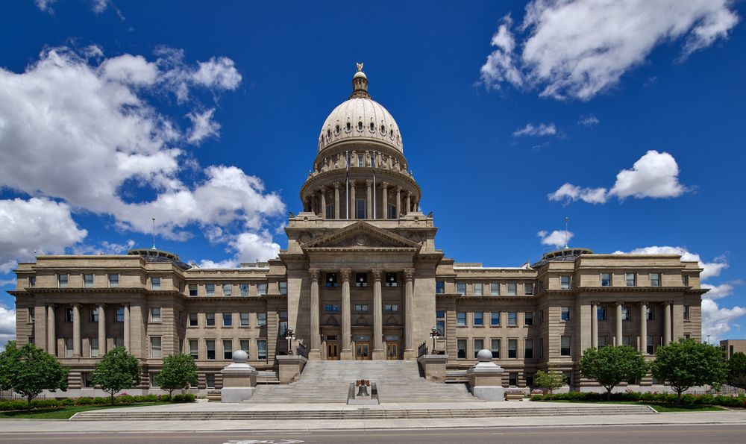
Compliance with State & Local Laws and Regulations
Idaho Statutes Title 33 Chapter 20 Education of Exceptional Children.
Idaho Administrative Code IDAPA Rule 08.
State and LEAs policies and procedures.

Slide 105

Federal Compliance to Remember
Title 34 CFR §300.203 LEAs Maintenance of Effort (MOE) states IDEA Part B Funds must not be used to reduce the state and local level of expenditures for the education of children with disabilities.
Talk to your Special Education Director, Business Manager or Special Education Funding and Fiscal Accountability office to get familiar with these concepts.
Notes:
MOE is something you need to be in the loop on. Please look for more information on our website, and by talking to your Business Manager and Special Education Director.

Slide 106


Fiscal Monitoring
The Special Education Funding and Accountability Office provides Special Education fiscal monitoring and oversight
LEAs are reviewed at least once every four to five years
Desk or field/on-site reviews

Slide 107

Thank you

Slide 108
Questions?
Dr. Charlie Silva
Special Education Director
(208) 332-6806
Alisa Fewkes
Data & Reporting Coordinator
(208) 332-6919
Lisa Pofelski-Rosa
Financial Specialist Principal
Funding & Accountability
(208) 332-6916
Kateryna Dyer
Contracts & Fiscal Financial Specialist
(208) 332-6910
Brenda Arnold
Administrative Assistant
(208) 332-6896
Kailey Bunch-Woodson
Program Evaluation Coordinator
(208) 332-6925
Randi Cole
Secondary Special Education Coordinator
(208) 332-6918
Debi Smith
Special Populations Coordinator
(208) 332-6915
Dr. Karren Streagle
Alt Assessment/Low Incidence/
Medicaid Coordinator
(208) 332-6824
Shannon Dunstan
Results Driven Accountability/
Early Childhood Coordinator
(208) 332-6908
Kimberli Shaner
Dispute Resolution Coordinator
(208) 332-6914
Will Spoja
Reporting & Support Program Specialist
(208) 332-6933
TBD
Dispute Resolution Program Specialist
(208) 332-6912

Slide 109
Federal Child Nutrition Programs
Lynda Westphal, Director

Slide 110
2022-2023 School Year Back to Normal Operations National School Lunch Program

Slide 111
Supply Chain Disruptions
School nutrition operators continue to struggle to get the products they need . . .
in the changing format that USDA requires
that comply with USDA regulations
in sufficient quantities
in a timely manner
at a contracted and budgeted price
This includes food and beverages, as well as supplies, equipment and technology

Slide 112
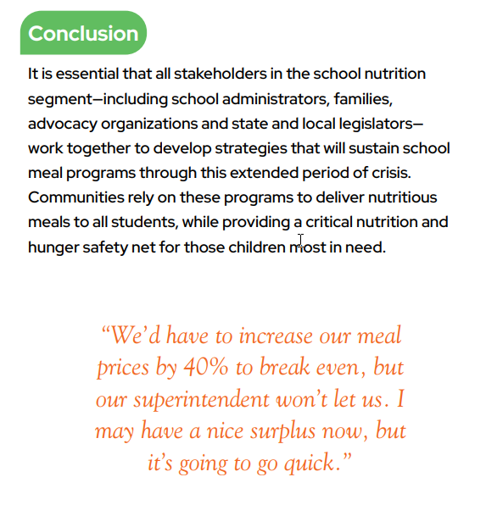
Supply Chain Disruptions
July 22, 2020: Staying Afloat in a Perfect Storm: Supply Challenges, School Nutrition Association. Supply-Chain-Staying-A-Float.pdf (schoolnutrition.org)

Slide 113
USDA Supply Chain Assistance Funds
Round 1 = $5,297,777 (41.5% claimed)
Round 2 = $5,015,725 (to be released August 2022)
The Supply Chain Assistance funds support procurement of agricultural commodities grown in the US and enable USDA’s Food and Nutrition Service (FNS) and Agricultural Marketing Service (AMS) to enhance the toolbox for school nutrition professionals working hard to make sure students have access to healthy meals.
These funds must be used to purchase domestic unprocessed or minimally processed foods under the Buy American Provision (without waivers) to support school food authority operations in school year 2022-2023.

Slide 114
Keep Kids Fed Act
Enacted June 25, 2022, the law provides:
$0.40 Cents more for lunch reimbursement
$0.15 cents more for breakfast reimbursement
Extend no-cost waivers, including those for schools unable to meet nutrition standards due to supply chain disruptions and to reduce administrative and reporting burdens
The Act did not provide free meals to students this year

Slide 115
Reimbursement for 2022-23
Severe Need applies to a school that served 40% or more of its lunches as Free and Reduced in the
2nd preceding year.
Breakfast
Free $2.26
Reduced $1.96
Paid $0.50
Lunch
Free $4.41
Reduced $4.01
Paid $.85
Severe Need Breakfast
Add $0.41 (by site) for Free and Reduced
Especially Needy is paid to those districts that served 60% or more free and reduced lunches in the
2nd preceding year
Especially Needy Lunch
Add $0.02 (by district)

Slide 116
Counting and Claiming
Starting 2022-23, standard counting and claiming applies
As children go through the line, they must be counted by student name (therefore eligibility status)
Claims must be submitted by student eligibility and school

Slide 117
Meal Charging
Starting 2022-23, when standard counting and claiming resumes -
Reduced and paid children must be charged their portion for a meal
Reduced price children can only be charged
30 cents for breakfast, and
40 cents for lunch
Each SFA is required to have a charging policy
This might be nice to include in your annual training

Slide 118

Run Direct Certification in August
Must be run three distinct times per year!
At the beginning of the school year
3 months after the first run
6 months after the first run

Slide 119
Collect Free and Reduced Applications
In 2022-23 an application is required for children to get a free or reduced meal if they are not categorically eligible (Directly Certified)
In order to qualify for free or reduced-price meals, the household must submit a completed income application after July 1, 2022 for the current school year and the income listed must fall at or below the Income Eligibility Guidelines (IEG) for the household size for either free or reduced meals
Can be online or paper application!
Notes:
You must have an application to provide meal benefits to a student in the 2022-23 school year after the 30-day carryover. This can be either on-line or a paper application.

Slide 120
Processing Applications
Application Approval
When processing applications, determining officials must record the eligibility determination as follows:
Indicate the approval date
Indicate the level of benefit for which the child(ren) is approved
Sign or initial, and date the application
Application Denial
The written notification must advise the household of:
Reason for denial of benefits
Right to appeal
Instructions on how to appeal
Ability to reapply for free and reduced price benefits at any time during the school year
Incomplete Applications = the household cannot be approved for benefits. Missing information needs to be obtained before processing application.

Slide 121
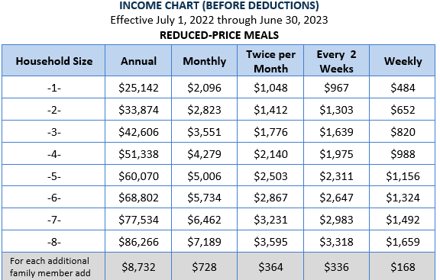
Income Eligibility Guidelines (IEGs)

Slide 122
30-Day Carryover Waiver in 2022-23
For 2022-23 ONLY
Per USDA Waiver #26 Use Prior Year Eligibility Determinations for SY2022-2023 only for 30 day carryover
If a child had an application in 2021-22, you must use the most recently approved application
If there is no application go to the previous year
If a child had an application in 2020-21, use that application
No application? Go to the previous year
If a child was free or reduced in 2019-20 and has no other application you can use this determination for the first 30 days
The 30 day carryover must not be reported in ISEE or on Verification.
Once the 30-day carryover ends – there is no requirement to send a letter to the family, it is just nice to do. The family reverts to paid on the thirty-first day.

Slide 123
Income Surveys
In 2022-23 an Income Survey can ONLY be collected from families in schools operating the Community Eligibility Program or Provision 2 breakfast and lunch program
Both Applications and Surveys cannot be sent out when operating a USDA Meal Program

Slide 124
Other Waivers from USDA
More to come? Waivers are being released as programs start. Look for more information as USDA releases it.
Waiver 7: Local School Wellness Policy Triennial Assessment which provides a new first triennial assessment deadline of June 30, 2023. Accordingly, LEAs required to complete a triennial assessment by June 30, 2022, may choose to accept the new regulatory deadline and instead complete their first assessment by June 30, 2023. An opt-in form was sent out on June 29, 2022

Slide 125
Other Grants from USDA to SFAs
Equipment Grants will be released in October
TIG Mini Grants will be released in December
Fresh Fruit and Vegetable Program (FFVP) released in April 2023

Slide 126
Other Programs Available
Child and Adult Care Food Program (CACFP)
After School Supper
At Risk Snack (on days without regularly scheduled instruction for all students)
Summer Food Service Program (SFSP)
During the summer when school is out

Slide 127
Questions
What are your questions for the State agency?
2022 New Superintendent Orientation | 127
Notes:
Do you have any questions of me? I know this was a very high lever introduction to CNP, but I could talk about the nuances for hours.

Slide 128
Contact Us
Lynda Westphal
Director
(208) 332-6823
Jennifer Butler
NSLP Coordinator
(208) 332-6929
Teresa Goodsell
USDA Foods Coordinator
(208) 332-6805
Kim Sherman
CACFP Coordinator
(208) 332-6935
Sharon D’sa
Administrative Assistant
(208) 332-6821
Cambria Steffler
NSLP Coordinator
(208) 332-6861
Pamela Murray
CACFP & USDA Foods Program Specialist
(208) 332-6831
Domonique Ayarra-Sykes
CACFP & SFSP Coordinator
(208) 332-6819
Melissa Cook
Financial Specialist, Sr.
(208) 332-6830
Jamie Gibson
NSLP & Grant Coordinator
(208) 332-6902
Kathrine Forstie
Financial Specialist
(208) 332-6834
Mary Ann Liby
SFSP & CACFP Coordinator
(208) 332-6828
Shawn Charters
Contracts & Grants Program Specialist
(208) 332-6822
Jax Dunham
NSLP Coordinator
(208) 332-6825

Slide 129
USDA Nondiscrimination Statement
In accordance with federal civil rights law and U.S. Department of Agriculture (USDA) civil rights regulations and policies, this institution is prohibited from discriminating on the basis of race, color, national origin, sex (including gender identity and sexual orientation), disability, age, or reprisal or retaliation for prior civil rights activity.
Program information may be made available in languages other than English. Persons with disabilities who require alternative means of communication to obtain program information (e.g., Braille, large print, audiotape, American Sign Language), should contact the responsible state or local agency that administers the program or USDA’s TARGET Center at (202) 720-2600 (voice and TTY) or contact USDA through the Federal Relay Service at (800) 877-8339.
To file a program discrimination complaint, a Complainant should complete a Form AD-3027, USDA Program Discrimination Complaint Form which can be obtained online at: https://www.usda.gov/sites/default/files/documents/USDA-OASCR%20P-Complaint-Form-0508-0002-508-11-28-17Fax2Mail.pdf, from any USDA office, by calling (866) 632-9992, or by writing a letter addressed to USDA. The letter must contain the complainant’s name, address, telephone number, and a written description of the alleged discriminatory action in sufficient detail to inform the Assistant Secretary for Civil Rights (ASCR) about the nature and date of an alleged civil rights violation. The completed AD-3027 form or letter must be submitted to USDA by:
mail: U.S. Department of Agriculture Office of the Assistant Secretary for Civil Rights 1400 Independence Avenue, SW Washington, D.C. 20250-9410; or
fax: (833) 256-1665 or (202) 690-7442; or
email: program.intake@usda.gov
This institution is an equal opportunity provider.

Slide 130
Questions?
Lynda Westphal, Director
Idaho State Department of Education
650 W State Street, Boise, ID 83702
208-332-6825
lwestphal@sde.idaho.gov

Slide 131
Safe School Environment and Discipline: Key Statutes and Rules
Dr. Eric Studebaker, Director

Slide 132
Safe Environment and Discipline
IDAPA 08.02.03.160
Each local education agency will have a comprehensive policy and procedure encompassing the following:
School Climate
Student Discipline
Student Health
Violence Prevention
Possessing Weapons on Campus
Substance Abuse: Tobacco, Alcohol, and other Drugs
Suicide Prevention
Student Harassment
Drug-free School Zones
Building Safety including Evacuation Drills
Relationship Abuse and Sexual Assault Prevention and Response

Slide 133
School Climate
SDE working definition:
School climate refers to the quality and character of school life. School climate is based on patterns of students', parents' and school personnel's experience of school life and reflects norms, goals, values, interpersonal relationships, teaching and learning practices, and organizational structures. A sustainable, positive school climate fosters youth development and the learning necessary for a productive, contributing and satisfying life in a democratic society. This climate includes:
Norms, values and expectations that support people feeling socially, emotionally and physically safe.
People are engaged and respected.
Students, families and educators work together to develop, live and contribute to a shared school vision.
Educators model and nurture attitudes that emphasize the benefits and satisfaction gained from learning.
Each person contributes to the operations of the school and the care of the physical environment.

Slide 134
Student Harassment – Intimidation - Bullying
Statute §18-917A
(1) No student shall intentionally commit, or conspire to commit, an act of harassment, intimidation or bullying against another student.
(2) As used in this section, “harassment, intimidation or bullying” means any intentional gesture, or any intentional written, verbal or physical act or threat by a student that:
(a) A reasonable person under the circumstances should know will have the effect of:
(i) Harming a student; or
(ii) Damaging a student’s property; or
(iii) Placing a student in reasonable fear of harm to his or her person; or
(iv) Placing a student in reasonable fear of damage to his or her property; or
(b) Is sufficiently severe, persistent or pervasive that it creates an intimidating,
threatening, or abusive educational environment for a student.
An act of harassment, intimidation or bullying may also be committed through the use of a land line, car phone or wireless telephone or through the use of data or computer software that is accessed through a computer, computer system, or computer network.
(3) A student who personally violates any provision of this section may be guilty of an infraction.

Slide 135
Requirements: Harassment – Intimidation - Bullying
§33-1630 [33-1631]
(1) School districts and charter schools shall undertake reasonable efforts to ensure that information on harassment, intimidation and bullying of students is disseminated annually to all school personnel, parents and students, including an affirmation that school personnel are authorized and expected to intervene or facilitate intervention on behalf of students facing harassment, intimidation or bullying.
(2) School districts and charter schools shall provide ongoing professional development to build skills of all school staff members to prevent, identify and respond to harassment, intimidation and bullying. The state board shall promulgate rules regarding the content of the professional development required by this subsection.
(3) District policies shall include a series of graduated consequences that may include, but are not limited to, referral to counseling, diversion, use of juvenile specialty courts, restorative practices, on-site suspension and expulsion for any student who commits an act of bullying, intimidation, harassment, violence or threats of violence. Guidelines for such policies will be set forth in the rules of the state board.
(4) Annually school districts shall report bullying incidents to the state department of education in a format set forth in rule by the state board. District policy shall designate persons to whom bullying reports are to be made and a procedure for a teacher or other school employee, student, parent, guardian or other person to report or otherwise provide information on bullying activity.

Slide 136
Prevention and Response: Bullying – Harassment - Intimidation
The content of ongoing professional development for school staff related to bullying, harassment and intimidation shall include:
School philosophy regarding school climate and student behavior expectations.
Definitions of bullying, harassment, and intimidation.
School prevention strategies or programs including the identification of materials to be distributed annually to students and parents.
Expectations of staff intervention for bullying, harassment, and intimidation.
School process for responding to bullying, harassment, and intimidation including the reporting process for students and staff, investigation protocol, the involvement of law enforcement, related student support services and parental involvement.
Other topics as determined appropriate by the school district or charter school.
Graduated consequences shall include a series of measures proportional to the act(s) committed and appropriate to the severity of the violation. Graduated consequences should be in accordance with the nature of the behavior, the developmental age of the student, and the student’s history of problem behaviors and performance.
Graduated consequences may include, but are not limited to:
Meeting with the school counselor;
Meeting with the school principal and student’s parents or guardian;
Detention, suspension or special programs;
and, Expulsion.

Slide 137
…continued from previous slide
The graduated consequences are not intended to prevent or prohibit the referral of a student who commits acts of harassment, intimidation or bullying to available outside counseling services, and/or to law enforcement pursuant to §18-917A, Idaho Code.
Students with disabilities may be afforded additional protections under the Individuals with Disabilities Education Act (IDEA) and §504 of the Rehabilitation Act; school districts and charter schools shall comply with applicable state and federal law when disciplining students with individualized education programs (IEPs) or 504 plans for committing acts of bullying, harassment, and intimidation
School district and charter school employees are authorized and expected to intervene or facilitate intervention on behalf of students facing harassment, intimidation, and bullying. Intervention shall be reasonably calculated to:
Correct the problem behavior;
Prevent another occurrence of the problem;
Protect and provide support for the victim of the act;
Take corrective action for documented systemic problems related to harassment, intimidation, or bullying.
Annual reporting will occur at the end of the school year through an aggregate report identifying the total number of bullying incidents by school districts and charter schools, grade level, gender, and repeat offenders. The State Department of Education shall provide school districts and charter schools with the guidelines and forms for reporting.

Slide 138
Firearms and Other Weapons
§18-3302I
Threatening Violence Upon School Grounds- Firearms and Other Deadly or Dangerous Weapons.
(1)(a) Any person, include a student, who willfully threatens by word, electronic means or act to use a firearm or other deadly or dangerous weapon to do violence to any person on school grounds or to disrupt the normal operations of an educational institution by making a threat of violence is guilty of a misdemeanor.
(b) Any person, include a student, who knowingly has in his possession a firearm or other deadly or dangerous weapon, or who makes, alters or repairs any firearm or other deadly or dangerous weapon, in the furtherance of carrying out a threat made by word, electronic means or act to do violence to any person on school grounds or to disrupt the normal operations of an educational institution by making a threat of violence is guilty of a felony.

Slide 139
Safe and Gun Free Schools Act
ESEA, Subpart 3, §4141
Local educational agencies shall expel from school for a period of not less than 1 year a student who is determined to have brought a firearm to a school, or to have possessed a firearm at a school, under the jurisdiction of local educational agencies in that State, except that such State law shall allow the chief administering officer of a local educational agency to modify such expulsion requirement for a student on a case-by-case basis if such modification is in writing.
Local educational agencies shall have a policy requiring referral to the criminal justice or juvenile delinquency system of any student who brings a firearm or weapon to a school served by such agency.

Slide 140
Unsafe School Option Policy
An Idaho public elementary or secondary school is considered to be persistently dangerous if it meets the following criteria:
In each of three consecutive years, there is one instance of homicide, sexual offense, kidnaping or the school exceeds an expulsion or student conviction rate of:
1% of the student body; or
Three students, whichever number is greater, for violent criminal offenses or for violations of federal or state gun free schools requirements on school property or at school sponsored events while school is in session.
A violent criminal offense is defined as conduct which could be charged as a felony or misdemeanor involving the threat of or actual physical injury, a sexual offense, homicide, rape, robbery, aggravated assault, aggravated battery, stalking, first degree kidnapping or aggravated arson

Slide 141
Providing a Safe School Option
A local education agency (LEA) identified as a persistently dangerous school must:
Notify parents of each student attending the school the state has identified as persistently dangerous. Notification to parents should be within ten school days from the time the LEA is notified by SDE that the school has been identified;
Offer all students the opportunity to transfer to a safe public school within the LEA. The offer to transfer students should occur within twenty school days from the time that the LEA is notified by SDE that the school has been identified as persistently dangerous. If there is not another school in the LEA, the LEA is encouraged, but not required, to explore other options, such as an agreement with a neighboring LEA to accept transfer students;
Complete the transfer for those students who accept the offer. Transfer of students should occur within 30 school days following parental notification. Parental notification regarding the status of the school and the offer to transfer students may be made simultaneously

Slide 142
Denial of School Attendance
§33-205
The board of trustees may deny enrollment, or may deny attendance at any of its schools by expulsion, to any pupil who is an habitual truant, or who is incorrigible, or whose conduct, in the judgment of the board, is such as to be continuously disruptive of school discipline, or of the instructional effectiveness of the school, or whose presence in a public school is detrimental to the health and safety of other pupils, or who has been expelled from another school district in this state or any other state.
No pupil shall be expelled nor denied enrollment without the board of trustees having first given written notice to the parent or guardian of the pupil, which notice shall state the grounds for the proposed expulsion or denial of enrollment and the time and place where such parent or guardian may appear to contest the action of the board to deny school attendance, and which notice shall also state the rights of the pupil to be represented by counsel, to produce witnesses and submit evidence on his own behalf, and to cross-examine any adult witnesses who may appear against him.
The superintendent of any district or the principal of any school may temporarily suspend any pupil for disciplinary reasons, including student harassment, intimidation or bullying, or for other conduct disruptive of good order or of the instructional effectiveness of the school.
The board of trustees of each school district shall establish the procedure to be followed by the superintendent and principals under its jurisdiction for the purpose of effecting a temporary suspension, which procedure must conform to the minimal requirements of due process.

Slide 143
Alcohol and Controlled Substances
§33-210, Idaho Code
(1) It is legislative intent that parental involvement in all aspects of a child's education in the public school system remain a priority. Substance abuse prevention programs and counseling for students attending public schools are no exception. Consequently, it is the duty of the board of trustees of each school district, including specially chartered school districts, and governing boards of charter schools, to adopt and implement policies specifying how personnel shall respond when a student discloses or is reasonably suspected of using or being under the influence of alcohol or any controlled substance defined by §37-2732C, Idaho Code.
In addition to policies adopted pursuant to this section, students may, at the discretion of the district board of trustees or governing board of a charter school, be subject to other disciplinary or safety policies…
Schools shall ensure that procedures are developed for contacting law enforcement and the student's parents, legal guardian or custodian regarding a student reasonably suspected of using or being under the influence of alcohol or a controlled substance.
Any school district employee or independent contractor of an educational institution who has a reasonable suspicion that a student is using or is under the influence of alcohol or a controlled substance and, acting upon that suspicion, reports that suspicion to a school administrator or initiates procedures adopted by the board of trustees or governing board of the charter school pursuant to this section, shall have immunity from any liability, civil or criminal, that might otherwise be incurred or imposed.

Slide 144
Suicidal Tendencies – Duty to Warn
§33-512B, Idaho Code
(1) Notwithstanding the provisions of §33-512(4), Idaho Code, neither a teacher nor a school district shall have a duty to warn of the suicidal tendencies of a student absent the teacher's knowledge of direct evidence of such suicidal tendencies.
(2) "Direct evidence" means evidence which directly proves a fact without inference and which in itself, if true, conclusively establishes that fact. Direct evidence would include unequivocal and unambiguous oral or written statements by a student which would not cause a reasonable teacher to speculate regarding the existence of the fact in question; it would not include equivocal or ambiguous oral or written statements by a student which would cause a reasonable teacher to speculate regarding the existence of the fact in question.
(3) The existence of the teacher's knowledge of the direct evidence referred to in subsections (1) and (2) of this section shall be determined by the court as a matter of law.

Slide 145
Suicide Prevention Training
§33-136, Idaho Code
The state board of education shall adopt rules supporting suicide awareness and prevention training each year for public school personnel…
IDAPA Rules in Review this Legislative Session...08-0202-1901
As schools offer annual professional development for school staff related to preventing, intervening, and responding
to suicide, the content shall include:
Prevention. School philosophy regarding school climate and the promotion of protective factors;
data on suicide for the region or state, or both; risk and protective factors for students; suicide myths and facts; and
how to develop community partnerships.
Intervention. How to utilize safe and appropriate language and messaging when addressing
students; warning signs of suicide ideation for students; local and school-based protocols for aiding a suicidal
individual; local protocols for seeking help for self and students; identification of appropriate mental health services
and community resources for referring students and their families; information about state statutes on
responsibility, liability, and duty to warn; confidentiality issues; and the need to ask others directly if they are
suicidal.
Postvention. Evidence-based protocol for responding to a student/staff suicide.
A Suicide Prevention Model Policy is available at www.sde.Idaho.gov/student-engagement/suicide-prevention

Slide 146
Additional Information…
ISBA Model Policies
FREE Suicide Prevention Training for Staff/Teachers/Parents
Know Your Nine: Title IX, Sex Discrimination, and Investigations
More at https://www2.ed.gov/about/offices/list/ocr/docs/tix_dis.html
State Subsidized Title IX Training – Certifications in Investigator, Decision Maker, and Coordinator
The Role of the SDE in the Complaint Process
Safe and Drug Free Schools Application
More at https://www.sde.idaho.gov/student-engagement/sdfs/index.html
The Office of School Safety and Security
Annual Idaho School Safety Symposium – October

Slide 147
Questions?
Dr. Eric Studebaker, Director
Idaho State Department of Education
650 W State Street, Boise, ID 83702
208 332 6961 Office 204 404 1532 Cell
estudebaker@sde.idaho.gov
www.sde.idaho.gov

Slide 148
Certification and Professional Standards
Dr. Bethani Studebaker, Director

Slide 149
Agenda
Background Investigation Checks
Hiring Practices & Certification
Professional Standards Commission

Slide 150
Background Investigation Check
Idaho Code Title 33 Chapter 5 – Governance of Schools
§33-512(15) To require that all certificated and non-certificated employees hired on or after July 1, 2008, and other individuals who are required by the provisions of section §33-130, Idaho Code, to undergo a criminal history check shall submit a completed ten (10) finger fingerprint card or scan to the department of education no later than five (5) days following the first day of employment or unsupervised contact with students in a K-12 setting, whichever is sooner.

Slide 151
Background Investigation Check
§33-512(15), Idaho Code also states “any individual convicted of any felony offense listed in §33-1208(2), Idaho Code, shall not be hired.
Enumerated offenses include felony convictions for aggravated assault, aggravated battery, murder, voluntary manslaughter, kidnapping, interstate trafficking in prostitution, rape, and felony convictions of crimes against a child.

Slide 152

Background Investigation Check
Fingerprint Processing Fee:
All applicants except for volunteers = $28.25
Volunteers = $26.25
Forms and information may be found at the following website: https://www.sde.idaho.gov/cert-psc/bic/

Slide 153
Background Investigation Check
Employment decisions are made by the local education agency
Review criminal history reports for employment decisions for all hires, certificated and classified
Just because an individual holds a certificate doesn’t mean they don’t have arrests or convictions

Slide 154
Hiring Practices & Certification

Slide 155
Past Job Performance
§33-1210, Idaho Code
Information on past job performance. Before hiring an applicant, an LEA shall request the applicant to sign a statement authorizing the applicant's current and past employers
to release to the hiring LEA all information relating to the job performance and/or job related conduct,
to release copies of all documents in the previous employer's files which may include personnel files, investigative files, and any other file
Not later than twenty (20) business days after receiving a request, an LEA within Idaho shall provide the information requested.
An LEA shall not hire an applicant who does not sign the statement.

Slide 156

Certification Look-up Tool
§33-1210 (5), Idaho Code verification of certification status and past disciplinary action for every new certified staff hired
Credential Status
Public version
Any Idaho disciplinary action taken against an educator certificate
District authorized login

Slide 157
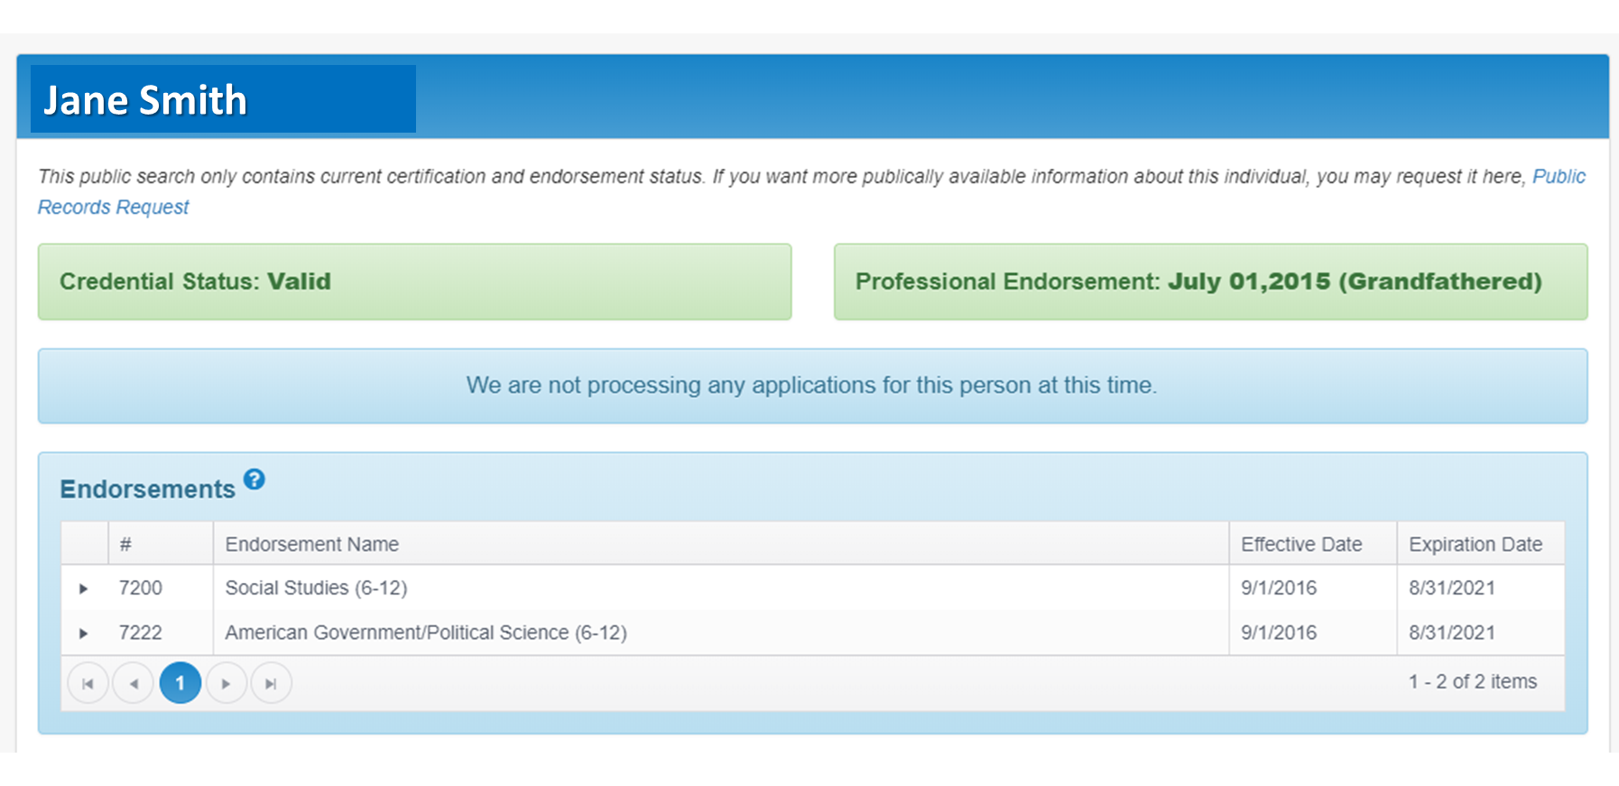
Certification Look-up Tool - Public

Slide 158
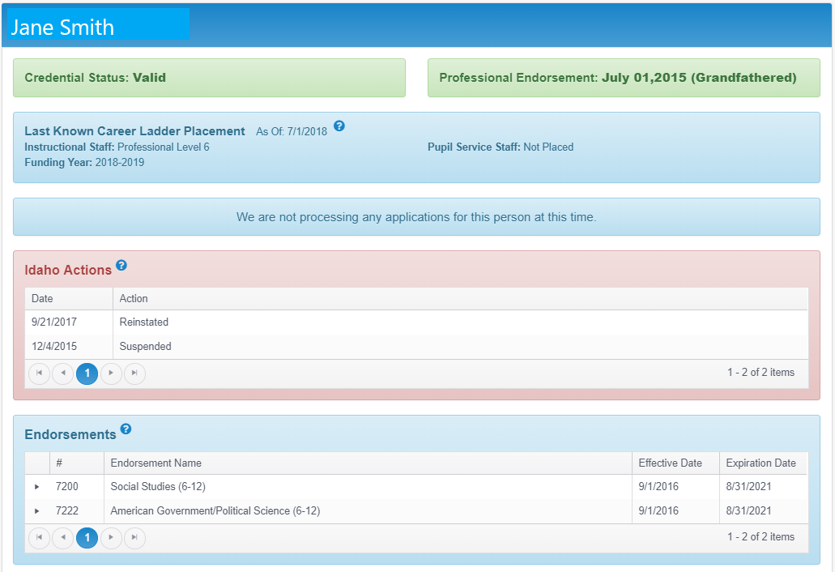
Certification Look-up Tool – District Authorized
District Authorized

Slide 159
Certification/Endorsement
§33-1201, Idaho Code Idaho certification is required!
Proper certification and endorsement is required for all instructional staff, pupil personnel staff and administrators, valid for the services being rendered.
Paraprofessionals (Parapros) and Teacher Assistants
Should never be the teacher of record. They cannot be used as physical education teachers, music teachers, school librarians, study skills teachers, etc.
PLATO, OddesseyWare, Edguenity, NovaNet are forms of curriculum and must be facilitated by a teacher of record who is appropriately certificated/endorsed for the assignment and therefore should not be facilitated by a parapro. This is true for any online curriculum.
Long-term substitute (LTS)
A person who has taken over an assignment for a teacher of record for ten (10) consecutive days or more.
Must be tied to a teacher of record. Lesson plans are the responsibility of the teacher of record.
Should only be used in emergency situations.

Slide 160
Assignment Credential Report & Manual
§33-1201, Idaho Code Idaho certification is required – regardless of funding!
Teacher certification uses the LEA report, called the Assignment Credential Report, to verify proper alignment between assignment and the required certification/endorsement.
Educators must hold the appropriate certificate/endorsement for the assignments that they are “coded”.
If an educator is coded for an assignment for which he/she does not hold the appropriate certificate/endorsement, funding may be reduced from the LEA for the applicable assignments based on the percentage of the FTE for which the individual is not appropriately certificated/endorsed.
Use the SDE Assignment Credential Manual to determine the correct alignment between the assignment and the required endorsement.
Use the LEA Assignment Credential Report to verify proper alignment.

Slide 161
Ensure Funding for Certification Issues
Alternative Authorizations and Emergency Provisional Certificate
Approved Alternative Authorization allow a candidate to teach while they are working towards completing a certification program. Their program and endorsement must align to what is assigned by the LEA to ensure funding. Some Alternative Authorizations are reviewed by the Professional Standards Commission for approval.
Please reference the Application Crosswalk to determine which Alternative Authorization application should be used.
A State Board of Education Emergency Provisional Certificate is available and will ensure funding if approved by the State Board of Education. The Provisional Certificate is not available for special education areas.
Emergency Provisionals submitted after January 1st must be the result of losing certified staff
ENDORSEMENTS CANNOT BE ADDED THROUGH PRAXIS II TESTING ALONE
Notes:
Incomplete applications at the end of the fiscal school year will be ‘not approved’ resulting in funding issues.

Slide 162
Professional Standards Commission

Slide 163

Professional Standards Commission Responsibilities
Advisory board to the State Board of Education
Alternative Authorizations
Teacher to New Certification/Endorsement
Content Specialist
Pupil Personnel Services
Educator Preparation Standards
Standards Reviews
Program Reviews

Slide 164
Professional Standards Commission Responsibilities
Adjudicator of Idaho Code of Ethics Violations
The PSC has its own authority separate and apart from the State Board of Education and State Department of Education.

Slide 165

Idaho Code of Ethics Violation Overview
Who May File a Complaint?
An individual with a substantial interest in the matter
A board of trustees
The Idaho Chief Certification Officer
Note: A student in an Idaho public school may not file an ethics complaint.

Slide 166
Idaho Code of Ethics Violation Overview
What are the Reporting Requirements?
§33-1208A, Idaho Code - Reporting Requirements and Immunity
The board of trustees of an LEA, through its designee, shall, within ten(10) days of the date the employment is severed, report to the chief officer of teacher certification the circumstances and the name of any educator who is dismissed, resigns or is otherwise severed from employment for reasons that could constitute grounds for revocation, suspension or denial of a certificate.
Any person providing a report under the provisions of this section shall have immunity from any liability, civil or criminal, that may otherwise be incurred or imposed.

Slide 167
Idaho Code of Ethics Violation Overview
What is the Formal Complaint Process?
How to file an ethics complaint:
Complete Ethics Complaint Packet
http://www.sde.idaho.gov/cert-psc/psc/ethics.html
Complaint Screening Guidelines
Decision (§33-1208 through §33-1209, Idaho Code)
Issue for the LEA to be resolved locally
Open the case for investigation

Slide 168
Ethics Complaint Process Flow Chart
Signed Ethics Complaint Received
Preliminary investigation
Determine whether to open case
Hearing Requested
Executive Committee Reviews Case
If case is opened, investigation begins
If probable cause is found, recommend disciplinary action
Hearing must be held within ninety days of the request for hearing, unless the respondent and chief certification officer agree otherwise
Executive committee may recommend a stipulation if probable cause is found
Determine whether there is probable cause at one of the next two regularly scheduled PSC meetings
Within 21 days of the conclusion of the hearing, the hearing panel will issue a written decision
Administrative Complaint
An administrative complaint is filed within 30 days of the probable cause determination
Respondent may stipulate to discipline, which will be considered at the next PSC meeting, or
Respondent may request a hearing within 30 days
If respondent does not respond and is held in default, the full PSC decides the case and issues a final decision, usually at the next PSC meeting
The final decision is subject to judicial review

Slide 169

Idaho Code of Ethics Violation Overview
Lessons Learned …
PSC may consider the LEA’s action, BUT employment decisions must not be confused with certification decisions
Have an LEA policy in place in the event of potential violations – Do NOT wait for the PSC to take action!
Have an LEA policy in place regarding social media

Slide 170
Certification & Professional Standards Contacts
Bethani Studebaker
Director
(208) 332-6886
bstudebaker@sde.idaho.gov
Sandra Bonas
Administrative Assistant
(208) 332-6884
sbonas@sde.idaho.gov
Benjamin Greene
Certification
(208) 332-6887
bgreene@sde.idaho.gov
Jerry Jensen
Certification
(208) 332-6882
jbjensen@sde.idaho.gov
Cina Lackey
Assignment credential manual, reporting & funding
(208) 332-6936
clackey@sde.idaho.gov
Annette Schwab
Educator ethics & background checks
(208) 332-6864
aschwab@sde.idaho.gov
Mandy Fulbright
Alternative Authorizations
(208) 332-6885
mfulbright@sde.idaho.gov
Melissa Knutzen
Background Investigation Check/Fingerprints
(208) 332-6883
mknutzen@sde.idaho.gov
Helen Henderson
Professional Endorsements
Educator preparation standards
(208) 332-6879
hhenderson@sde.idaho.gov

Slide 171
Questions?
Dr. Bethani Studebaker, Director
Idaho State Department of Education
650 W State Street, Boise, ID 83702
208 332 6882
bstudebaker@sde.idaho.gov
www.sde.idaho.gov

Slide 172
Content & Curriculum and Mastery Based Learning
Todd Driver, Director

Slide 173
Content and Curriculum
Math
Science
Arts and Humanities
Gifted and Talented
Social Studies
PE and Health
ELA and Literacy
Mastery Education/Innovation
Instructional Technologies
Curriculum Review
Standards Review
Coaching &
Mentoring
Notes:
Content and Curriculum supports you directly in the various content areas via our Content Coordinators and Specialists. These coordinators give expert support to Districts, Curriculum Directors, and teachers by providing focused support by request and/or on a broader scale through Professional Development. Examples: facilitated the development and implementation of curriculum to help teachers with the shifts in science standards to the 3D model, SMART (training teachers in the science of teaching reading ), Create Idaho and <new> Minecraft to teach coding, …
Each year we provide, as a service to districts, a review of select curriculums, available through various publishers, and rate how they align with the Idaho Content Standards. This helps in the vetting process as districts select curriculum. It is especially useful to districts who now need to do this on their own (new language in 33-512A) This provides a starting point if desired thus potentially lessens the lift of a review and may save time and money. These reviews are done on a 6 year cycle. We just finished our review of materials this year in Math and will review ELA next.
We conduct the Idaho Content Standards review process as well and is also done on a 6 year cycle, coordinating with the curricular materials review required by statute.
We also partner with other state agencies and our Universities such as the STEM action center with the iSTEM events or IDLA recently with modules to provide training to teachers to address the new model of education, and training for substitute teachers.

Slide 174
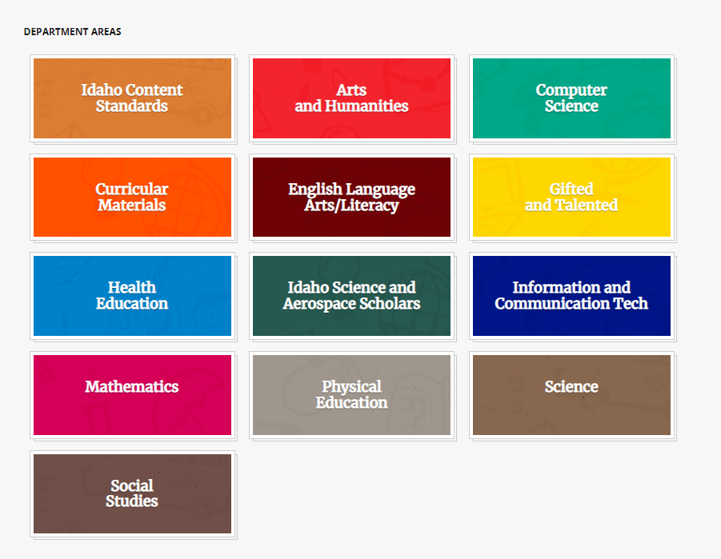
https://www.sde.idaho.gov/

Slide 175




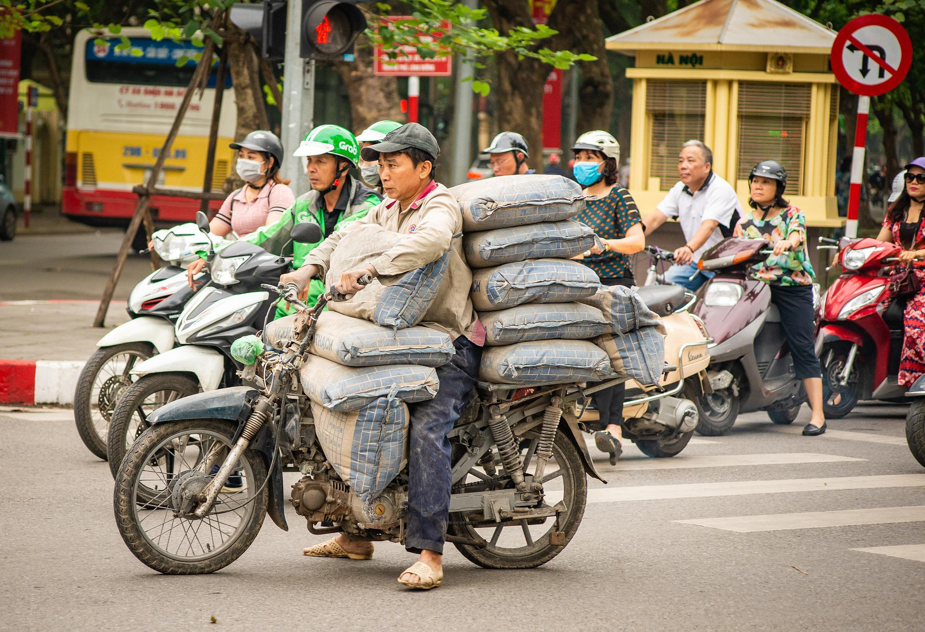
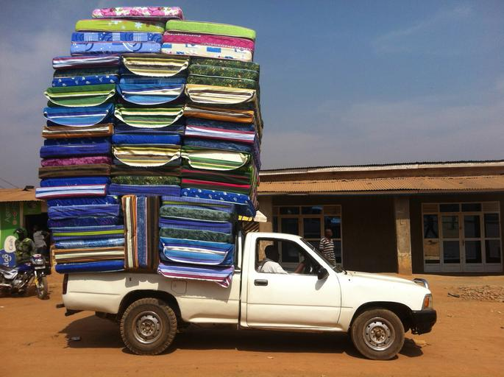
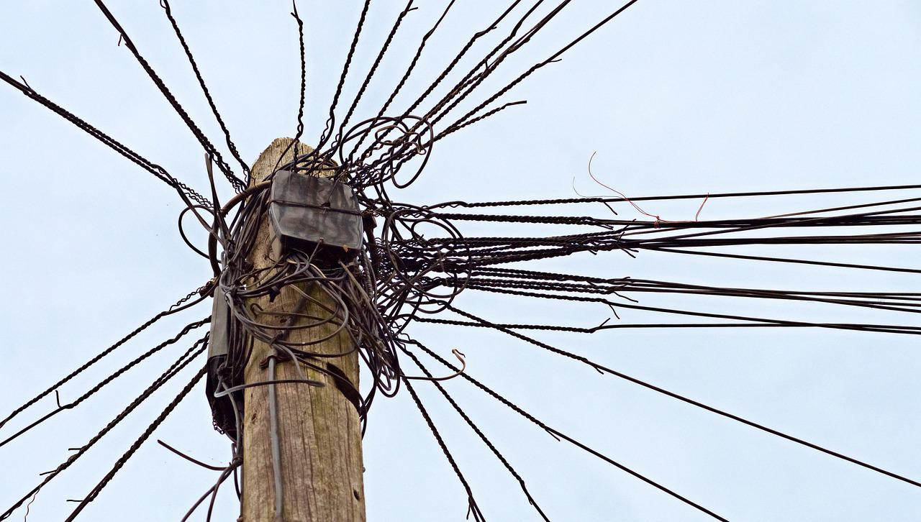
Mastery Based Education
The range of reactions to Mastery…
Or you may feel a little over loaded…

Slide 176

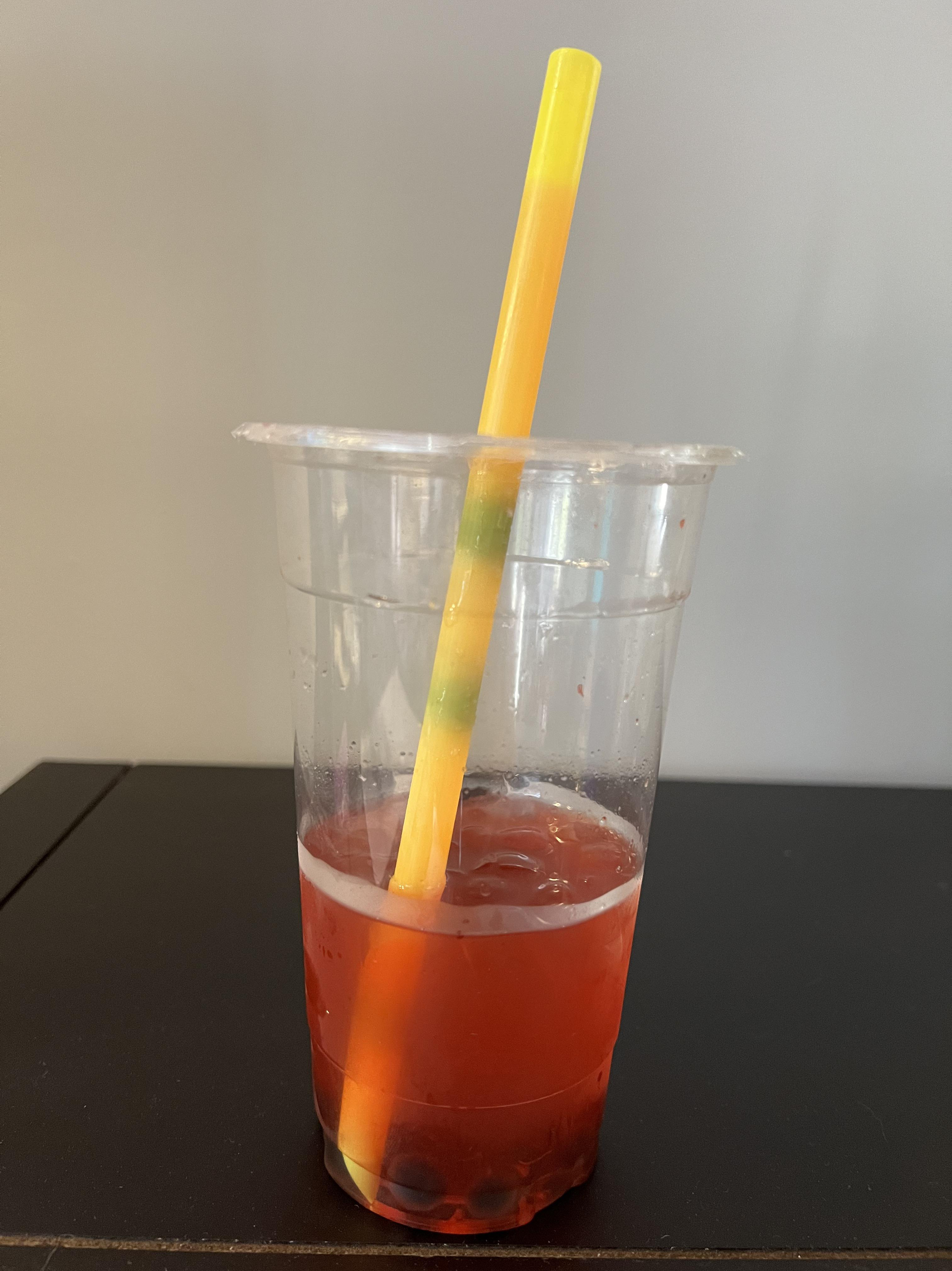
Mastery is now flipped and available for all!
Start with the practices that lead to a mastery perspective!
Keep the vocab simple and concise!
3. Find the right resources (Think, Reflect, Decide)
6x6 Keynote Series: National Experts! Take a Year! What do YOU need?
Fun-Sized PD! 4-6 hours! 3=1 credit! Danielson aligned! 10/30 ready by 9/20/222!
$ Grants! System Change OR Projects!
Where is the Boba in your system straw?

Slide 177



Check out the new Innovate to Elevate Website!
All the current MASTERY PD and Grant resources on one page!
Reach out to Aaron McKinnon with any questions!
amckinnon@sde.Idaho.gov 208-332-6952

Slide 178
Upcoming
IATLC Virtual Conference | Aug 6
Content Standards Webinar | Aug 17
K-3 Literacy Summit | May 2023
Check our website for PD opportunities available now, or to request PD

Slide 179
Questions?
Todd Driver, Director
Idaho State Department of Education
650 W State Street, Boise, ID 83702
208-332-6962
tdriver@sde.Idaho.gov

Slide 180
Public School Finance
Julie Oberle, Director

Slide 181

Public School Finance

Slide 182

State of Idaho - FY 2023 General Fund

Slide 183

State of Idaho - FY 2023 Appropriations
(Other Education includes funding for Career Technical Education, Community Colleges, Ag Research & Extension Service, Special Programs, Health Education Programs, SDE, Voc. Rehabilitation, SBOE, and Idaho Public Television)

Slide 184

State of Idaho – Historical Revenues

Slide 185

State of Idaho – Historical Appropriations

Slide 186
Pupil Accounting and Required Instructional Time – Average Daily Attendance

Slide 187

Pupil Accounting and Required Instructional Time – Full-time Equivalent Enrollment

Slide 188
Idaho Code 33-1002(4)

Slide 189

Support Units
Each bar equals 1 Support Unit of funding

Slide 190

Midterm Reporting Period

Slide 191


Best 28 Weeks Reporting Period

Slide 192
Idaho Code 33-1004A – Experience & Education Multiplier

Slide 193

Salary-based & Benefit Apportionment Calculation

Slide 194
Estimated Statewide Support Unit Value

Slide 195
Public School Foundation Program Appropriation

Slide 196
FY 2023 Distribution Schedule - Idaho Code 33-1009

Slide 197
Foundation Program Calculation – July 15, 2022

Slide 198
Foundation Program Calculation–July 15, 2022

Slide 199
Public School Finance Contacts
Julie Oberle, Chief Financial Officer (208) 332-6840 JAOberle@sde.idaho.gov
Branwyn Phillips (Staffing) (208) 332-6875 BCPhillips@sde.idaho.gov
Dean Reich (Attendance) (208) 332-6983 DReich@sde.idaho.gov
Aaron McCoy (IFARMS) (208) 332-6846 AMcCoy@sde.idaho.gov
Carol Piranfar (Budgets) (208) 332-6844 CLPiranfar@sde.idaho.gov
Diane Winn (208) 332-6845 DWinn@sde.idaho.gov
Morgan Phillips (208) 332-6840 MPhillips@sde.idaho.gov
Tania Goretoy (208) 332-6841 TScurtu@sde.Idaho.gov
FAX (208) 334-2228
Web Site:
Idaho State Department of Education, School Finance
www.sde.idaho.gov/finance/index.html
Idaho State Department of Education
www.sde.idaho.gov/

Slide 200
Questions?
Julie Oberle, Director
Idaho State Department of Education
650 W State Street, Boise, ID 83702
208-332-6840
JAOberle@sde.idaho.gov

Slide 201
Thank you!
Idaho State Department of Education
650 W State Street, Boise, ID 83702
208-332-6800
www.sde.idaho.gov

