Slide 1
How to use the Roster Manager to Add, Modify, and Upload Rosters
Reporting System Training Module Series #6
Notes:
Welcome to training module #6 in the Reporting System series: How to Use the Roster Manager to Add, Modify, and Upload Rosters. Class rosters are a great way to organize students, allow teachers to view their students’ performance, and allow other users to compare the performance of different classes. In this training module we show you how to add a roster, how to view or edit a roster, and how to upload multiple rosters using a template.

Slide 2
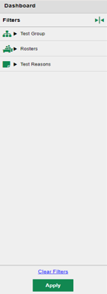
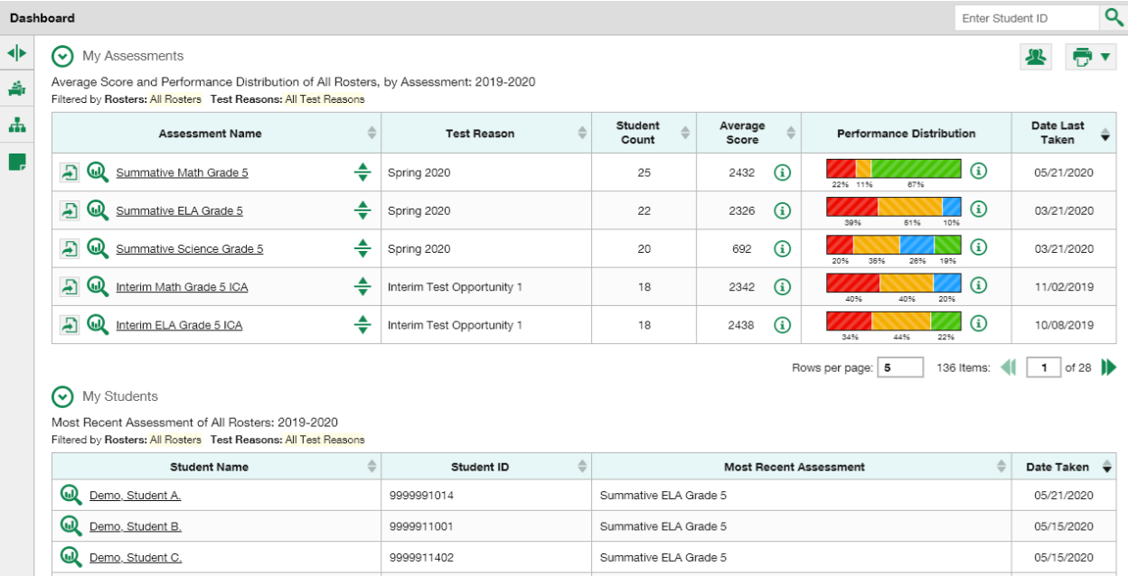
Access the Roster Manager with My Settings
Manage Access
Change Role
Reporting Options
Manage Test Reasons
Use Teachers’ Test Selections
Change Reporting Time Period
Set Student Settings on Item View
Roster Settings
Add Roster
View/Edit Roster
Upload Rosters
Notes:
The Roster Manager tool in Reporting is accessed using the My Settings drop-down menu from the banner. The Roster Settings you see listed in your menu vary by state and district and user role. Here you see options to Add Roster, View or Edit a Roster, and Upload Rosters. There are advantages to creating and modifying rosters for students you have identified as sharing certain characteristics or belonging to a specific group. Any roster you create will appear in your Roster Performance on Test reports. You can filter for that specific group using the Roster Filter on the left side of the dashboard, allowing you to keep a close watch on the students you put on that roster.

Slide 3
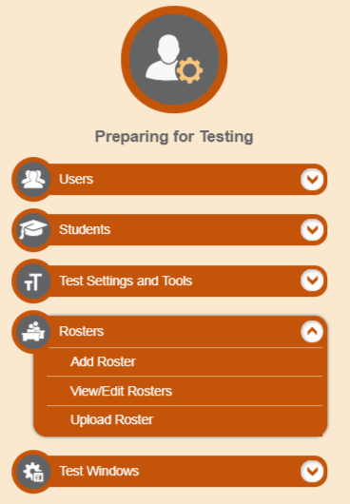
Access the Roster Manager with TIDE
Notes:
You may be familiar with the Roster Manager tool from using it in the Test Information Distribution Engine, or TIDE. It works the same way in both systems.

Slide 4
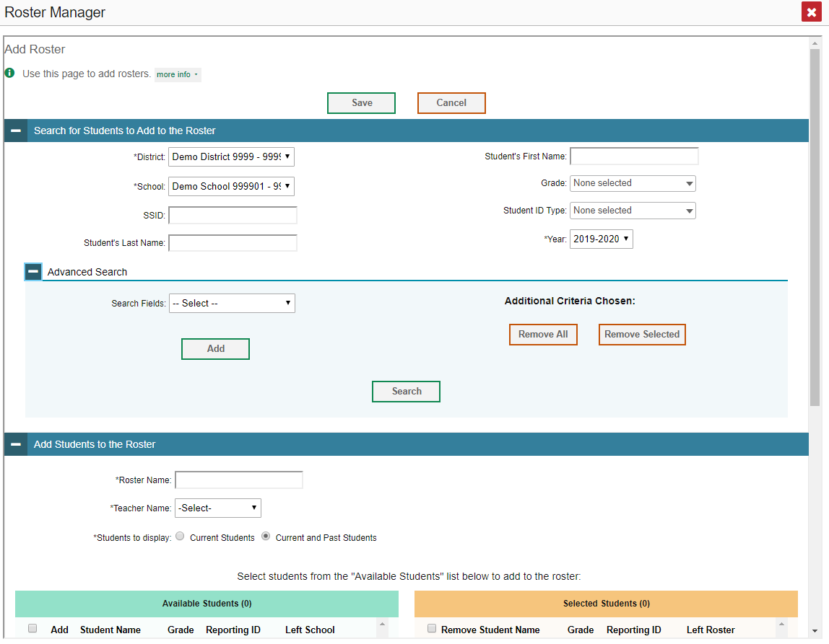
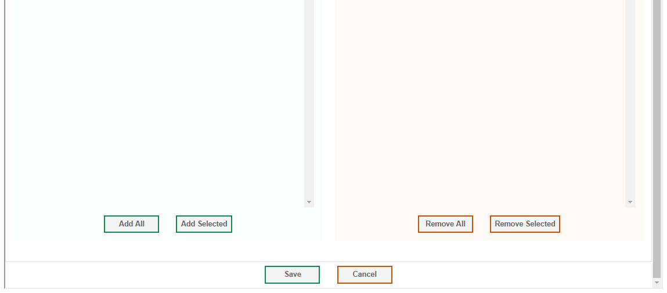
Add Roster
1. Search for Students to Add to the Roster:
Complete mandatory selections (*)
Search categories: SSID, Last Name, First Name, Grade, etc.
Advanced Search
Gender, Braille, Section 504, Paper Tester, Text-to-Speech, etc.
To modify criteria: Remove All and Remove Selected buttons
2. Add Students to the Roster
Name the roster; select a teacher name.
Choose current students or current and past students.
CLICK SEARCH
Notes:
To add a new roster, click on the Add Roster option from the My Settings button in the banner. The Roster Manager window displays.
The Roster Manager windows include “more info” buttons that display instructions for completing the fields specific to that window. You can click on them at any step in the process.
The Add Roster page is organized into two panels, each headed by a blue bar. They are: Search for Students to Add to the Roster and Add Students to the Roster. To search for students that you want to add to your roster, complete the fields under the Search for Students to Add to the Roster panel. The fields marked with an asterisk are mandatory. Search categories are determined by your state and may vary from the sample shown here. Use the options under Advanced Search to further refine your search. Name the new roster, associate it with a teacher, and choose whether to display only current students or current and past students. Past students include former students, including those who have left the selected school. Click the Search button under the Advanced Search heading.

Slide 5
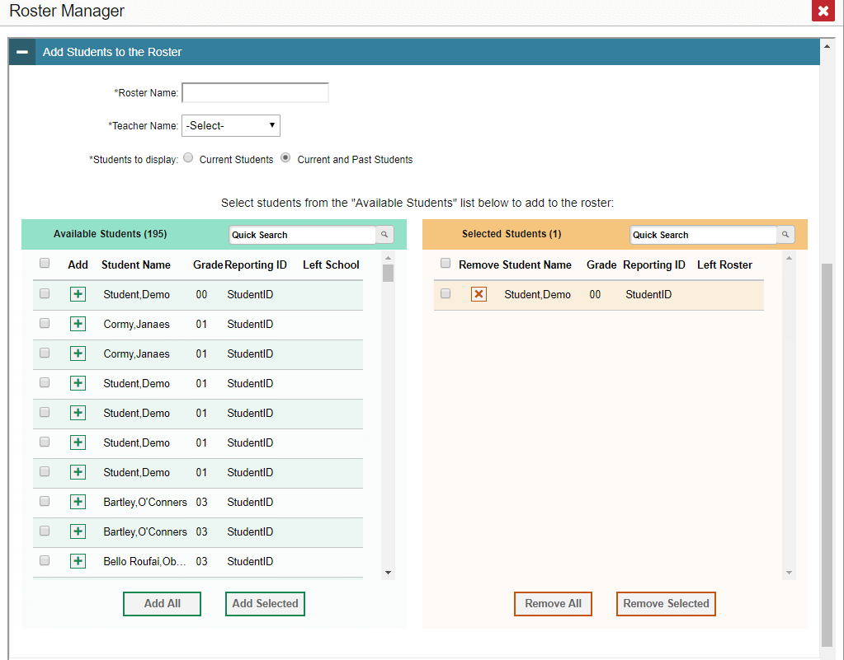
Add Roster (continued)
Add Students to the Roster:
Move students from the green Available Students list to the orange Selected Students list
Click Save
Notes:
The Roster Manager page updates to show available students under the green header on the left. Click the + sign to move students from the green Available Students list to the orange Selected Students list. Or use the Add All or Add Selected buttons to move the students across. You can remove individual students from the roster by clicking the orange X next to the student name. To remove multiple students, mark the checkboxes and use the Remove All or the Remove Selected buttons. When the roster is constructed to meet your needs, click Save. The new roster will appear in any future roster search as a user-defined roster.

Slide 6
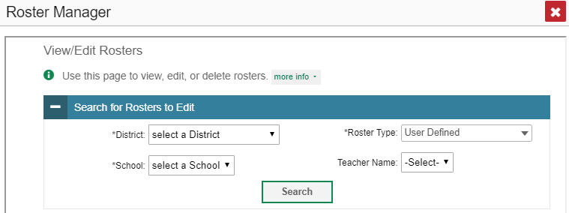
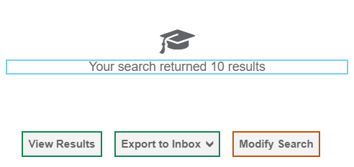
View/Edit Roster
Notes:
You can modify a class roster by changing its name, changing its associated teacher, adding students, or removing students. To view or edit an existing roster, choose the View/Edit Rosters option from the My Settings menu.
The View/Edit/Export window displays a Search for Rosters to Edit panel. The mandatory search boxes, marked with an asterisk, must be completed. The Roster Type box allows you to limit the search to User Defined rosters or System Defined rosters, or both. You can downsize the search results by entering a teacher name, as well. Make your choices and click Search. A search results window opens.
Click View Results to continue. Note that some states may include the option to Export to Inbox.

Slide 7
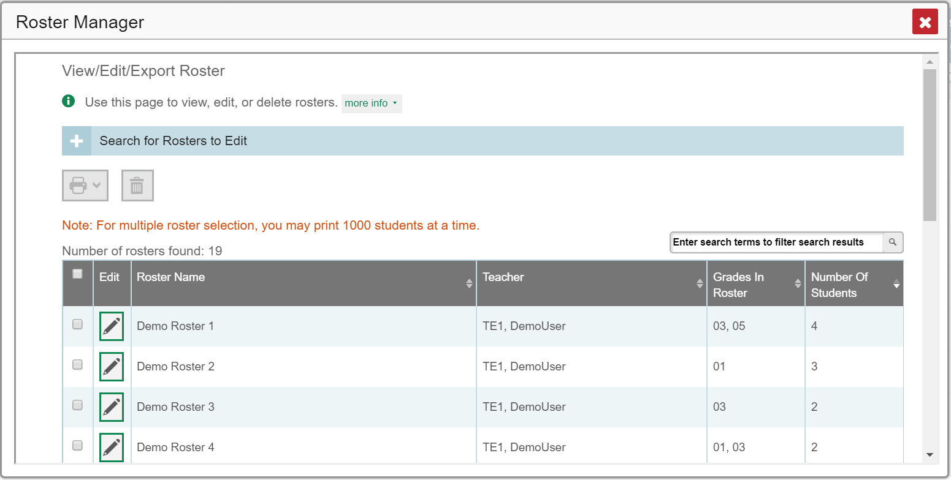
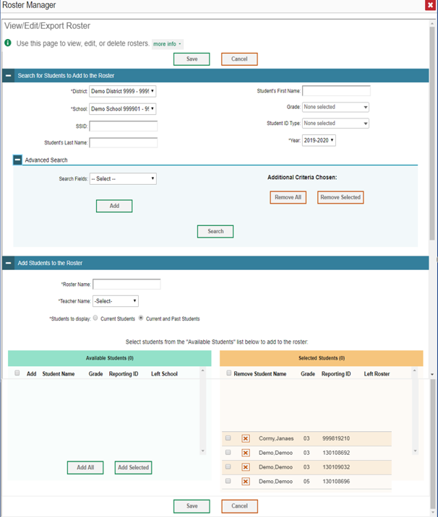
View/Edit Roster (continued)
Notes:
A list of retrieved rosters is generated. Click the pencil icon for the roster you want to view or edit. The View/Edit/Export Roster window opens.
The View/Edit/Export page is organized with the same two Search and Add panels: Search for Students to Add to the Roster and Add Students to the Roster. You can search for students to add to the roster by completing the search fields or delete students from it. Remember to click the Save button after you have made the necessary modifications.

Slide 8
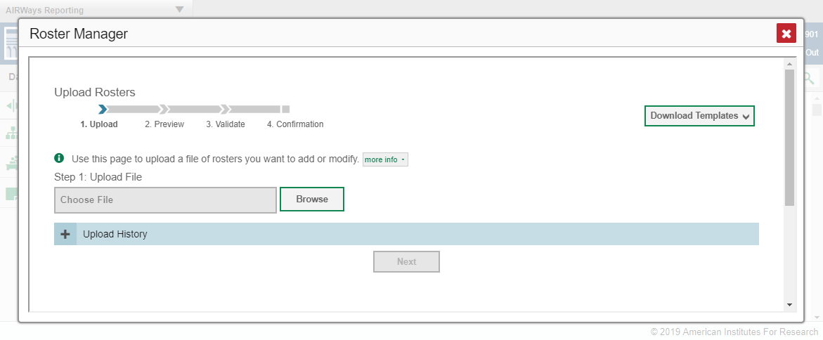
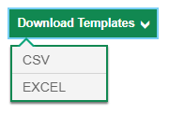

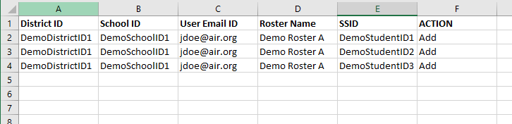
Upload Roster Using a Template
Notes:
If you have multiple rosters to create, it may be easier to use file uploads. This task requires familiarity with composing comma-separated values (CSV) files or working with Microsoft Excel. Choose the Upload Roster option from the My Settings menu. The Roster Manager window displays, showing the Upload Rosters section. The Roster Manager window for the Upload Roster function requires four steps: Upload, Preview, Validate, and Confirmation. To begin, click the Download Templates arrow and select the desired file type. A template will appear at the bottom of the Roster Manager window. Open the template, enter the required information, and save it to your computer. There is a sample Excel worksheet showing the typical template shown on this slide.

Slide 9
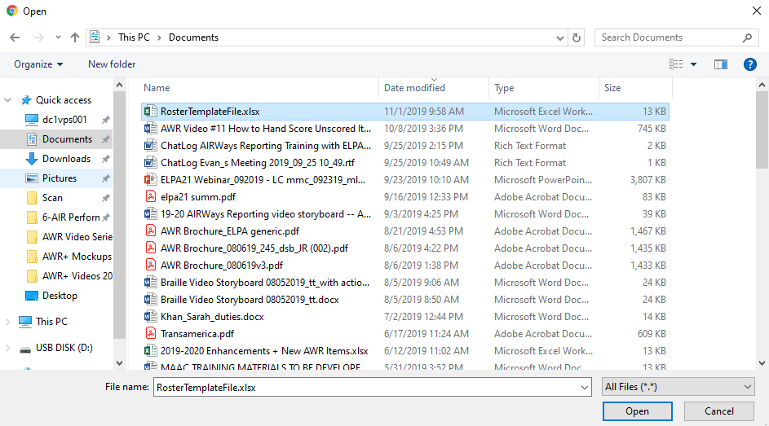
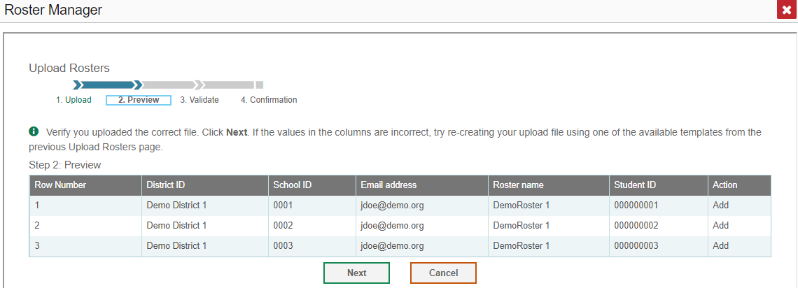
Upload Roster (continued)
Notes:
On the same Upload Rosters page, click the Browse button and select the file you created. Click Next. The Preview Page appears. Review the data in the table and verify that you uploaded the correct file. Click Next to validate the file.

Slide 10
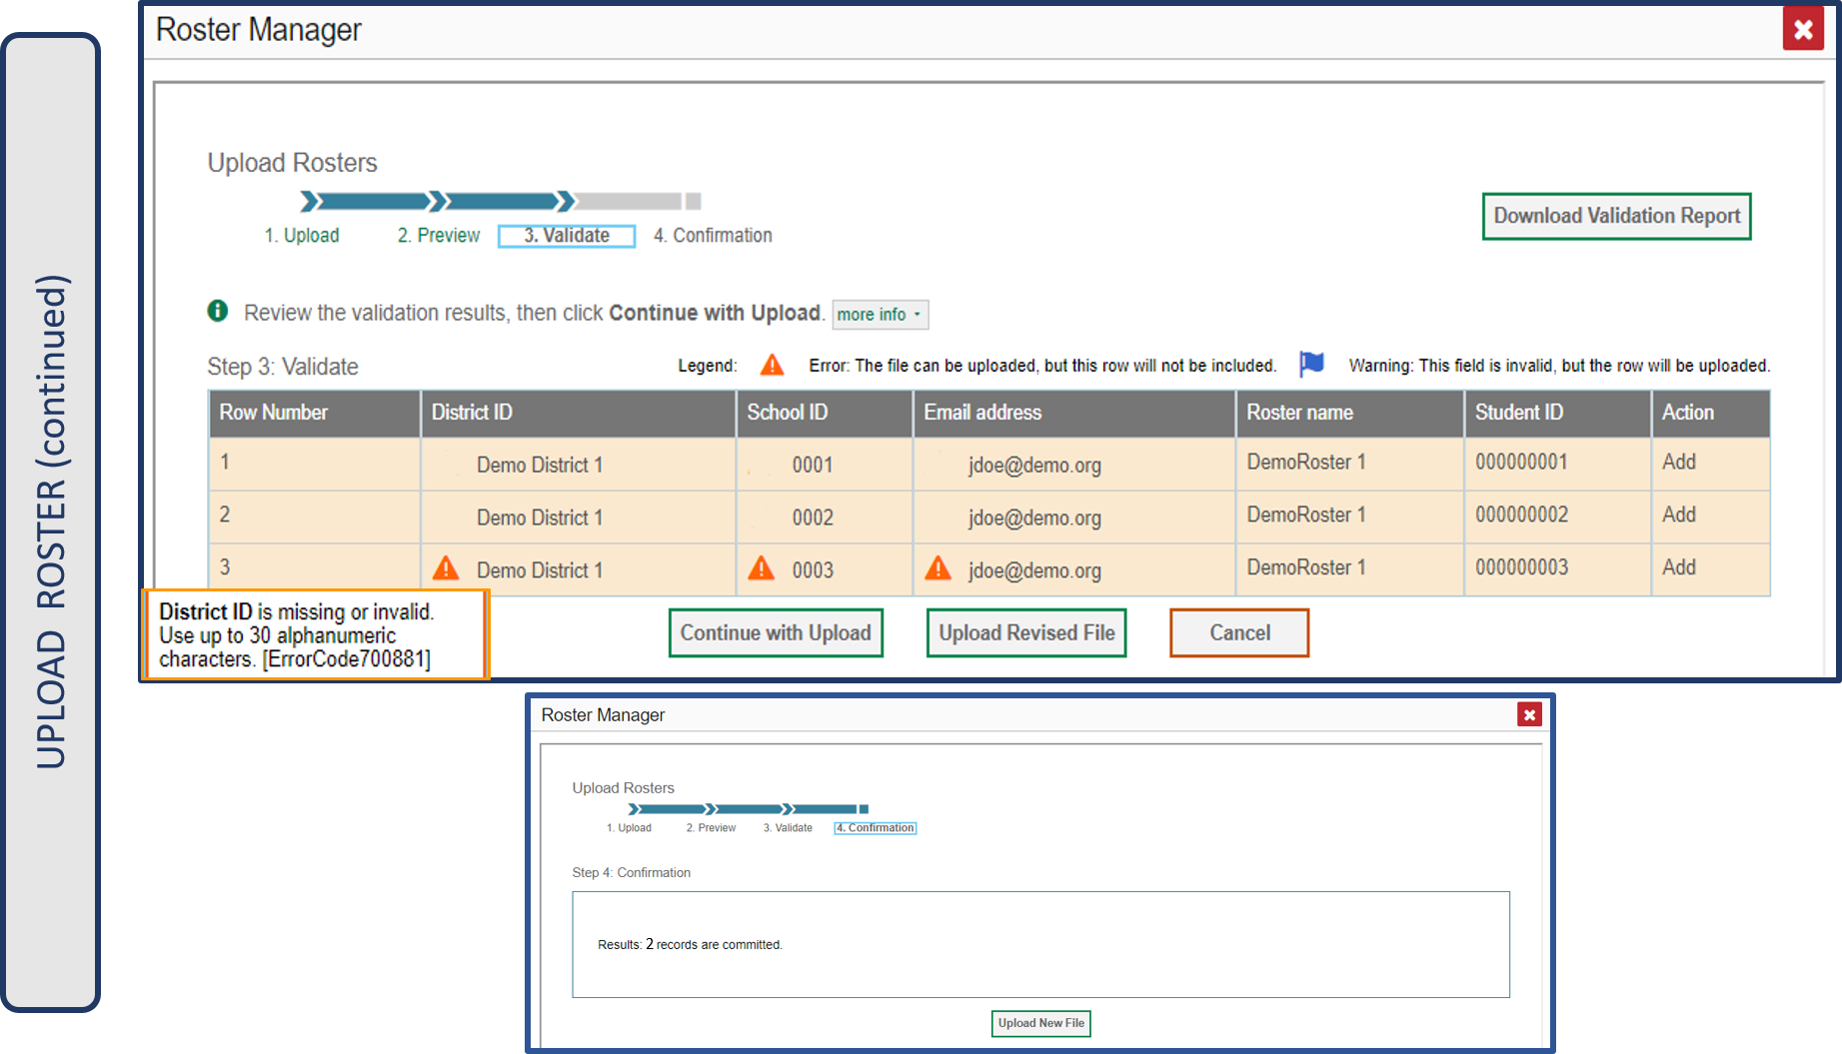
Upload Roster (continued)
Notes:
Any errors or warnings are displayed on the step #3 of the Upload Rosters page, the Validate step. If a record contains an error, that record will not be included in the upload. If a record contains a warning, that record will be uploaded, but the field with the warning will be invalid. Click the icons to view the reason a field is invalid. Your choices at this step are to Continue with Upload, Upload a Revised File, Cancel, or to Download a Validation Report. If you continue with the upload, the Confirmation Page will appear, displaying a message about how many records were committed. Click the Upload New File button.

Slide 11
Upload Roster—Template Guidelines
Column Name | Description | Valid Values
District ID* | District associated with the roster. | District ID that exists in TIDE. Up to 20 characters.
School ID* | School associated with the roster. | School ID that exists in TIDE. Up to 20 characters. Must be associated with the district ID. Can be blank when adding district-level rosters.
User Email ID* | Email address of the teacher associated with the roster. | Email address of a teacher existing in TIDE.
Roster Name* | Name of the roster. | Up to 20 characters.
SSID* | Student’s unique identifier within the district. | Up to 30 alphanumeric characters.
Action | Action to be taken on the student, either adding them to or deleting them from the roster. If blank, the student will be added. | Add or Delete.
*Required field.
Notes:
This table provides the guidelines for filling out the roster template that you can download from the Upload Roster page.

Slide 12
The Reporting System Training Module Series
How to Navigate the Dashboard and Generate Reports
How to Drill Down into Your Results Using Settings and Filters
How to Track Student Performance Over Time Using the Longitudinal Report
How to Print ISRs and Student Data Files
How to Print and Export Data You Can See in Your Reports
How to Use the Roster Manager to Add, Modify, and Upload Rosters
Interim and Benchmark Assessments Only
How to Analyze Item-Level Reports
How to Hand-Score Unscored Items and Modify Machine Scores
Notes:
More training modules are posted on your state or district portal. You may also consult the Reporting System User Guide.

