Slide 1
How to Track Student Performance Over Time Using the Longitudinal Report
Reporting System Training Module Series #3
Notes:
Welcome to the third training module in the Reporting System series: How to Track Student Performance Over Time Using the Longitudinal Report. This training module shows you how to track student performance across school years, across multiple related assessments and different types of tests. Users can quickly determine if student performance has improved or declined.

Slide 2
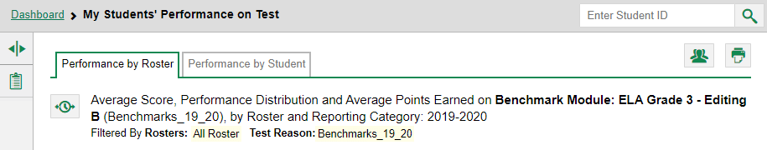
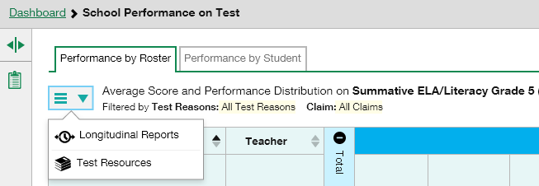
Longitudinal Report Buttons
Notes:
Longitudinal Reports are available for individual students and groups of students who have completed related assessments. They are also available when a student or groups of students have taken the same interim test more than once. They are sometimes called “trend reports” because they help you recognize patterns of performance.
You can tell that a test will generate a Longitudinal Report when a clock-face button, like the one shown in the top image, or a context menu button, shown in the bottom image, displays to the left of a report header. Click the clock-face button to display the Longitudinal Report window.

Slide 3
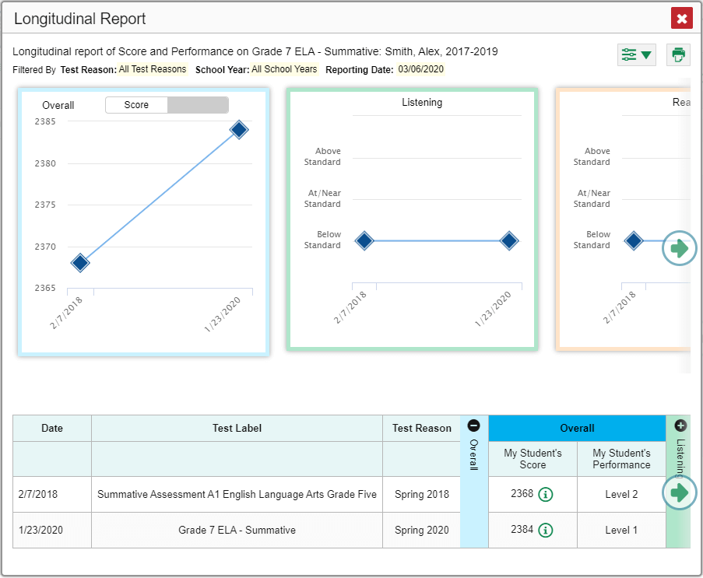
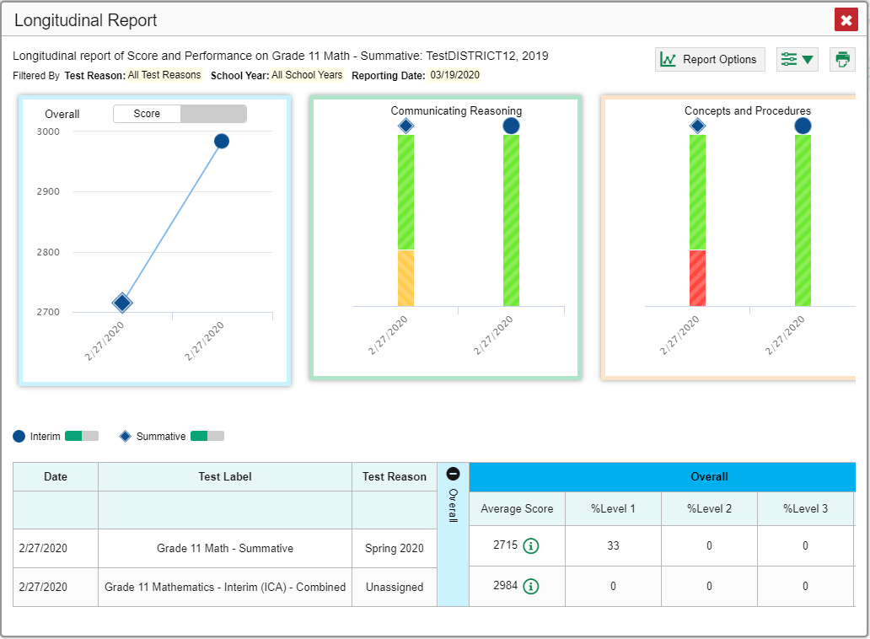
What Does the Longitudinal Report Look Like?
An Individual Student Who Took Related Tests
Multiple Students Who Took Related Tests with Multiple Reporting Categories
Notes:
Two sample reports are shown here; one for an individual student who took two related tests, and another for multiple students who took related tests with multiple reporting categories. You see graphs in the top half of the report and tables in the bottom half. The information is the same. It is simply displayed differently.
If different related tests belong to different test types, the Progression drop-down list appears before the trend report displays.
If you are a teacher looking at results for multiple students, a report options page appears before the trend report displays.
Both of these windows are shown on the next slide.

Slide 4
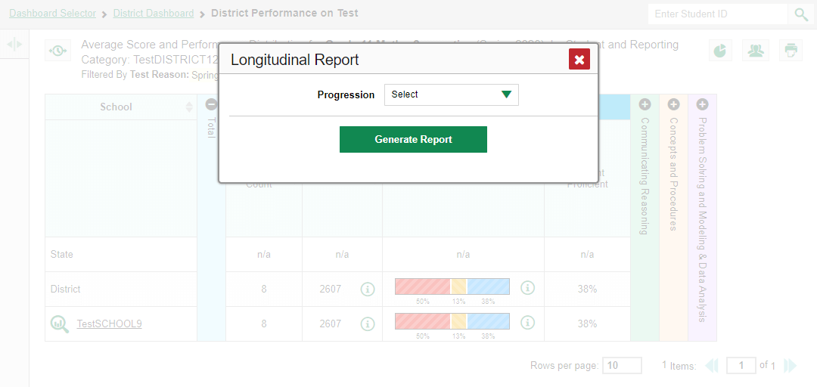
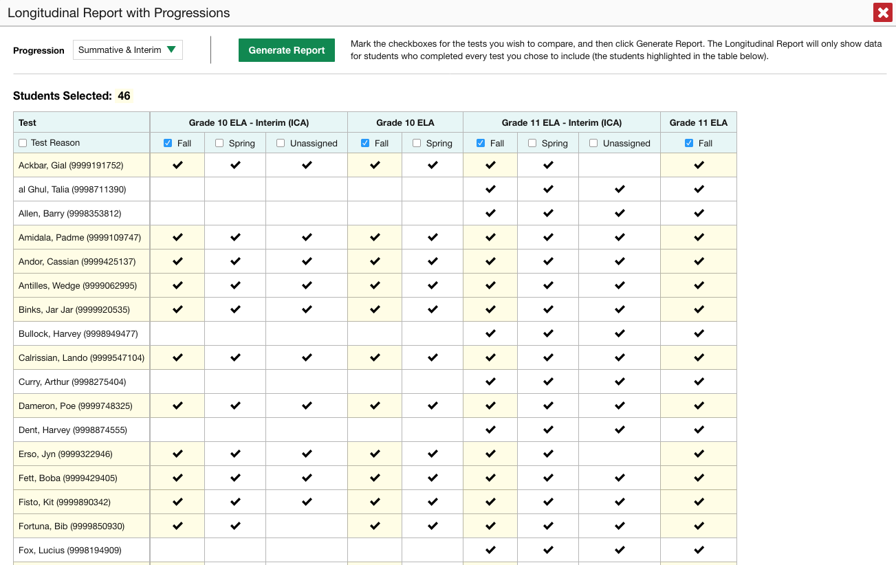
Progression Options Feature
Drop-down options are:
Summatives
Interims
Both
Only students highlighted in yellow will appear on the Longitudinal Report
Notes:
After you click on the clock-face button a Longitudinal Report pop-up window may appear. If it does, you know the related tests on the report are of different types, meaning one of them must be a summative and another one must be an interim or benchmark test. Click the green drop-down arrow to select summative tests only, interim tests only, or a combination of both. Then click the green Generate Report button.
Teachers viewing a longitudinal report for multiple students are presented with the Longitudinal Report with Progressions pop-up window. The Progression drop-down menu is located at the top of their window followed by a table of their students and the related tests. Each test appears in its own column, with sub-columns below for each test reason (categories of tests, or, for a summative, a test window.)
The cells in the columns display checkmarks to indicate which students completed which test and test reason combinations. The students highlighted in yellow have completed all of the related tests and will appear on the longitudinal report, unless you change the tests you want included in the report.
Mark the checkbox for each test/test reason combination you wish to include in the report. Mark the Test Reason checkbox on the left to include all, or clear it to remove all. Click the green Generate Report button at the top of the window to view the Longitudinal Report.

Slide 5
Students’ Overall Performance Over Time
Notes:
Look at the graph in the upper-left corner of the Longitudinal Report. It shows the scores or performance levels of the student(s) each time they took the tests.
Score data are plotted along a line. A symbol appears on each data point. When multiple test types are present, refer to the legend immediately below the graphs to find out which symbols correspond to which types. The interim test is identified with a blue circle and the summative test is identified with a blue diamond to help you distinguish between the test types.
Performance level data are shown either the same way or, for multiple students, in performance distribution bars.
Mouse over the data points in a line graph or the sections in a bar to get more information.
Alternatively, in the table at the bottom of the report, look at the Overall section.

Slide 6
Modify Your Test Groups
Notes:
You can modify the test groups by returning to the Report Options page if you generated the report from the report options page. Click the report options button in the upper-right corner of the window. The report options page reappears, allowing you to change your selection of test types(s) and, if you are a teacher viewing multiple students, your selection of tests and test reasons as well.
Alternatively, if your report contains multiple test types, click the test type toggles in the legend immediately below the graphs to hide and show data for each one. Note that these toggles do not affect report printouts or exports.

Slide 7
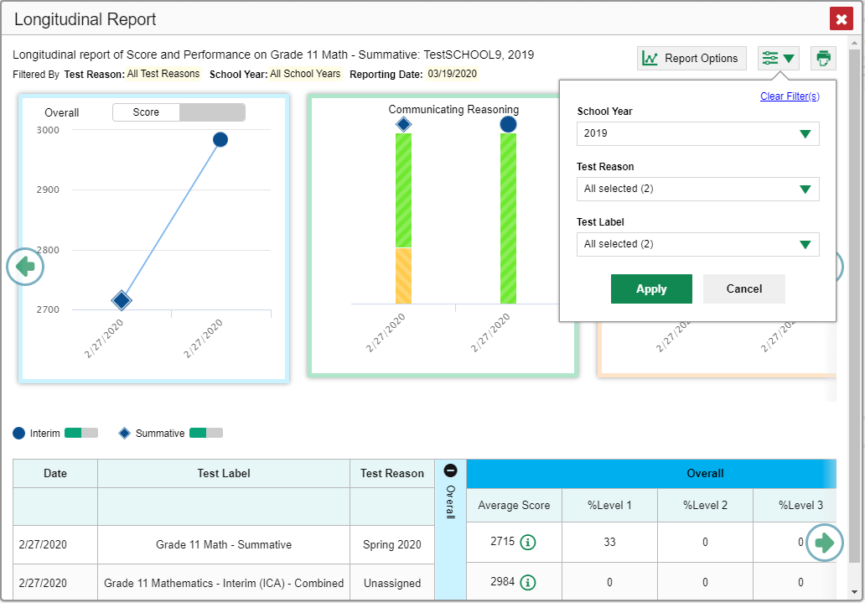
Filter Test Opportunities to Show Some and Not Others
School Year: By default, data is shown for all years. Selecting a date, such as “2019,” will filter the results for the 2019—2020 school year results.
Test Reason: Most helpful for numerous interim and benchmark tests that can be screened by category, omitting those you do not need to see. Test reasons for summative tests are determined by administration date, typically the end of the school year or the course.
Test Label: Deselect the names of the tests you don’t need to see.
Notes:
You may want to filter a Longitudinal Report in order to focus on some test opportunities and not others.
Note that filtering tests may affect the set of students whose data are included in the report.
Open the filter menu at the upper-right corner and select the filter options you prefer from the drop-down lists.
You may want to filter by a particular school year or years. Note that years are not calendar years. “2019” refers to the 2019–2020 school year. By default, Longitudinal Reports show data for all years. Longitudinal Reports can show student performance from a time when the students were not yet associated with you. For example, if you are a seventh-grade teacher, you can use these reports to view your current students’ performance on last year’s sixth-grade tests.
If the report includes interim assessments, you may wish to filter by a test reason (a category of test), which means excluding all other test reasons from the data. For example, you may want to narrow the report down to show only tests taken in the spring. For summative assessments, test reasons are the same as test windows and are not useful.
Finally, you may find that certain individual tests are less relevant than others. In that case, you can use the Test Label options to deselect the names of the tests you don’t want to see.
Click Apply.
Optional: To revert all filters to their defaults, open the filter menu again and click Clear Filters. Click Apply.
A row of filter details appears below the report header, showing the test reasons and school years included in the report.

Slide 8
Switch Between Score Data & Performance Level Data
Notes:
When a graph offers both score and performance level data, a toggle bar appears at the top of it. Click the toggle to switch from score to performance level data. You may want to do this if you find performance level data easier to read, or if you prefer the precision of score data. Sometimes a test includes only one type of data.

Slide 9
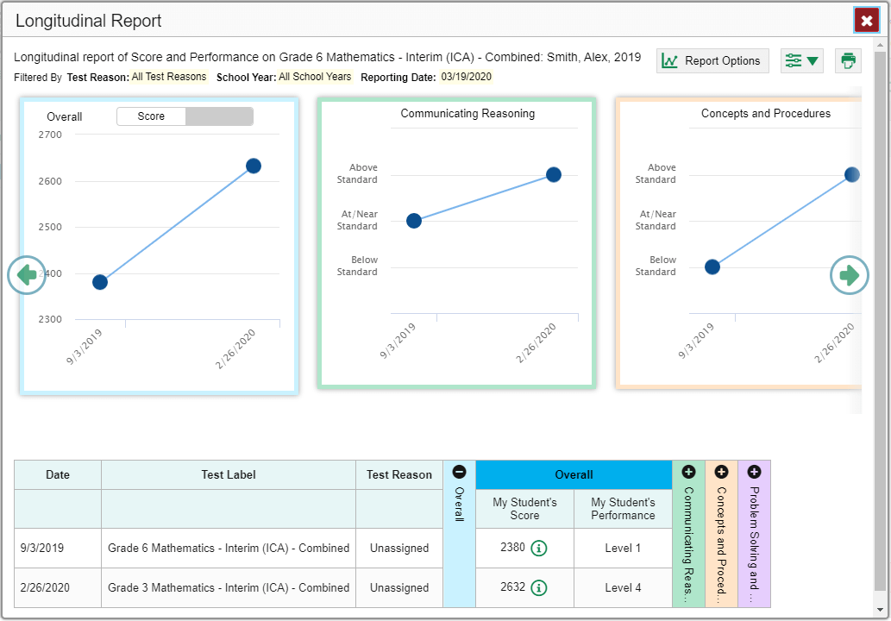
See Performance in Different Areas Over Time
Notes:
You can see your students’ performance in different areas of the test over time. Look at the reporting category graphs to the right of the overall performance graph, or look at the expandable reporting category sections in the table at the bottom. Here, you can see at a glance how students are improving or declining in each area, and you can compare their trajectories in different areas.
To view more reporting category graphs click the green arrow button on the right side of the page.

Slide 10



Longitudinal Reports—Ways to Customize
Results from current & previous school years
Results for current & former students
Filter options: school year, test reason, test label
INDIVIDUAL REPORTS
GROUP REPORTS
Multiple instances of the same test (interims and benchmarks)
Related tests (typically related by standard and determined by school/district administration)
Students who completed the same test multiple times (interims and benchmarks)
Students who completed related tests
Notes:
To review, you can set up your Longitudinal Reports using results from current and previous school years, including data for your current and former students. Three filter options, school year, test reason, and test label, allow you to drill down into a Longitudinal Report to access specific data relevant to your needs.

Slide 11
The Reporting System Training Module Series
How to Navigate the Dashboard and Generate Reports
How to Drill Down into Your Results Using Settings and Filters
How to Track Student Performance Over Time Using the Longitudinal Report
How to Print ISRs and Student Data Files
How to Print and Export Data You Can See in Your Reports
How to Use the Roster Manager to Add, Modify, and Upload Rosters
Interim and Benchmark Assessments Only
How to Analyze Item-Level Reports
How to Hand-Score Unscored Items and Modify Machine Scores
Notes:
More training modules are posted on your state or district portal. You may also consult the Reporting System User Guide.

