Slide 1
How to Print Individual Student Reports and Student Data Files
Reporting System Training Module Series #4
Notes:
Welcome to the fourth training module in the Reporting System series; How to Print Individual Student Reports (ISRs) and Student Data Files. In this training module we show you how to generate the ISR, which is designed to be shared with parents and students, and the Student Data File, which is designed to help you arrange large amounts of data in a spreadsheet application.

Slide 2
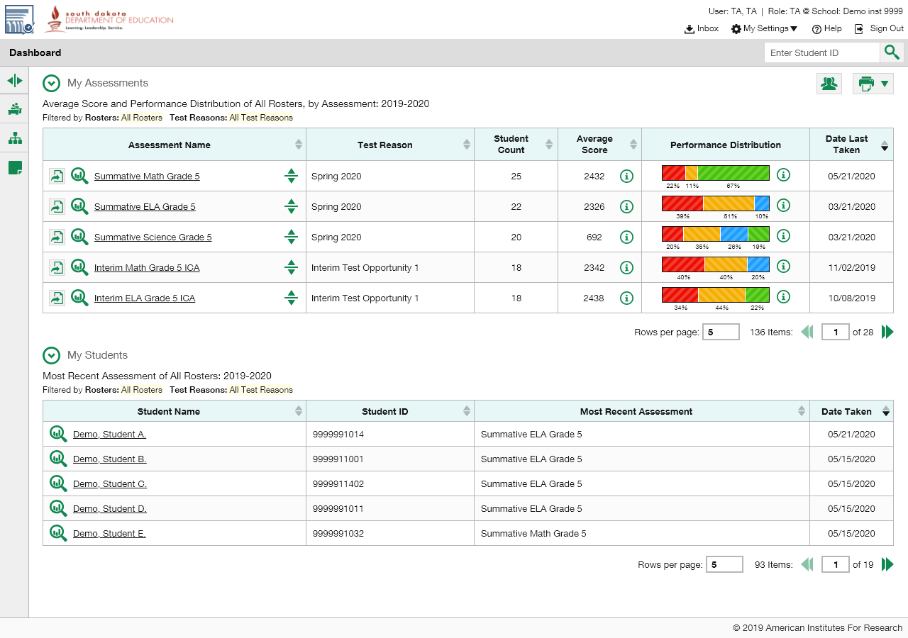
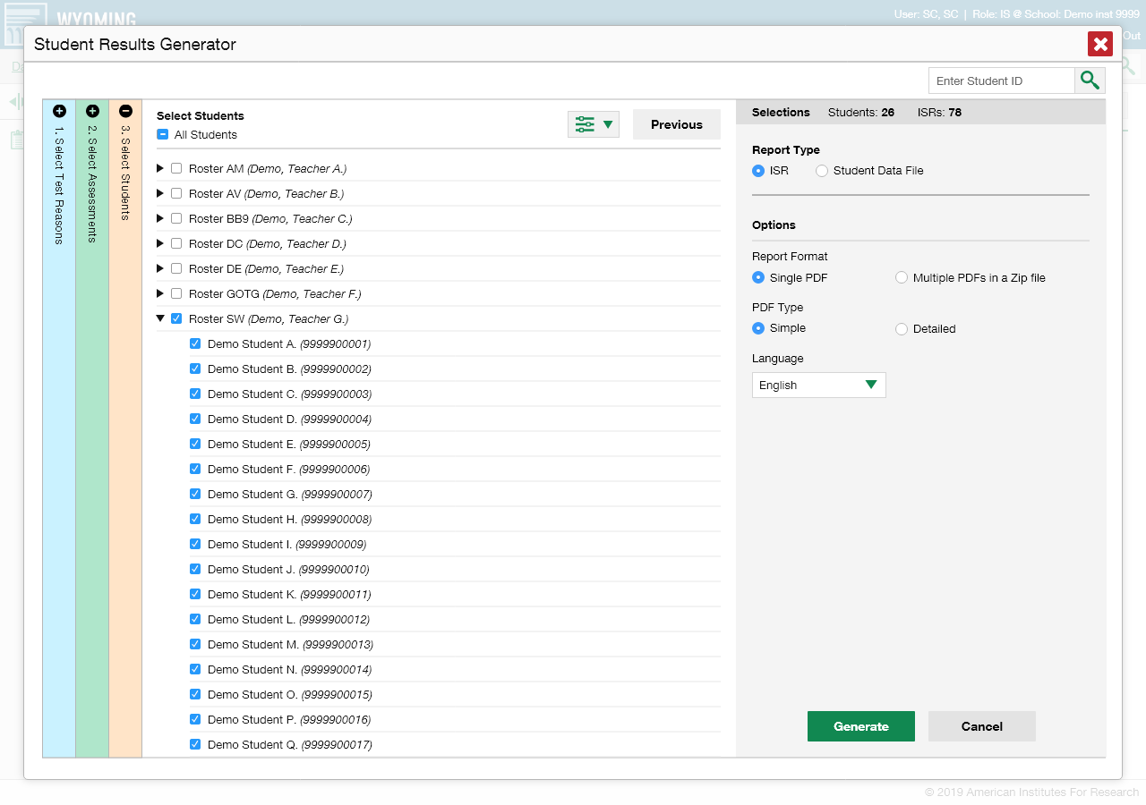
Student Results Generator Page
Notes:
The Student Results Generator button is the “head and shoulders” icon located in the top-right corner of the dashboard and report pages. When you click on it the Student Results Generator pop-up window displays. Both reports, the ISR and the Data File, are built by completing three numbered and colored sections, #1 Select Test Reasons, #2 Select Assessments, and #3 Select Students. In this training module we show you several sample ISRs and then take you through the steps of generating an ISR. You construct the Student Data File in the same way, but your report will be in the form of an Excel or CSV spreadsheet. What you see in your Student Results Generator pop-up window may vary slightly from these images depending on the type of assessments administered in your state or district.

Slide 3
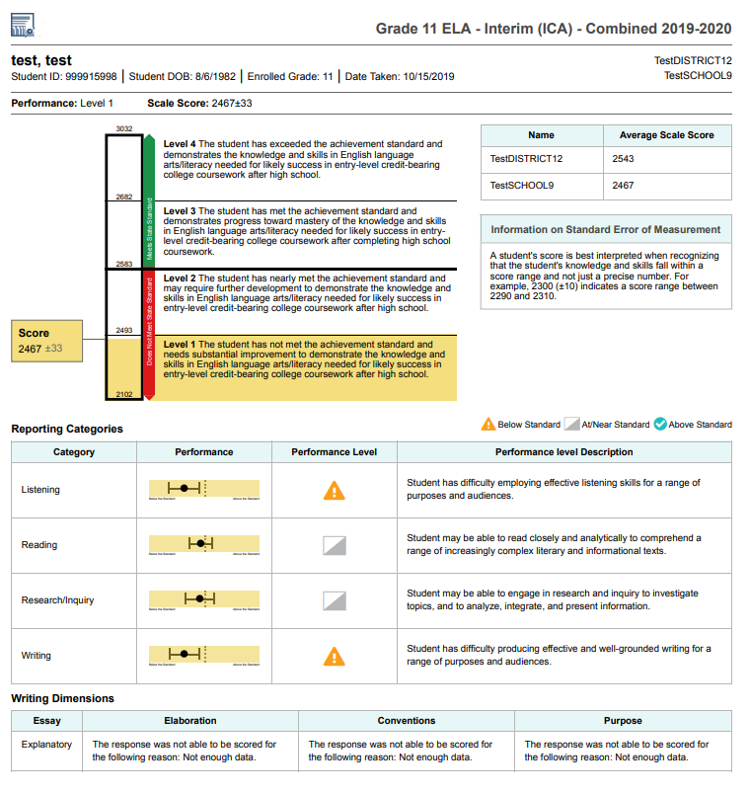
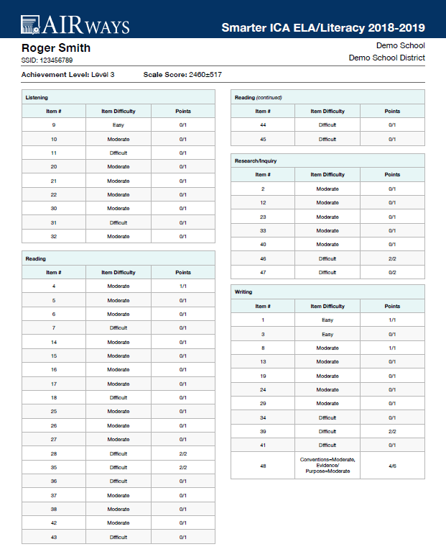
Sample ISRs
Simple ISR with Reporting Categories
2nd Page of a Detailed ISR with Item-Level Data
3
Notes:
An ISR is a PDF that displays the performance results of one test taken by one student. It may consist of a single page, called the “simple report,” or multiple pages, called a “detailed report.” ISR layouts vary according to the type of test. On the left is a simple ISR, showing the results for a Grade 11 Interim English Language Arts assessment. Student, test, and school information is located at the top, followed by a summary of performance. A vertical scale of cut scores and performance levels features prominently on the report page. State, district, and school aggregate scores are included, if available. If the test is structured with reporting categories, levels and descriptors for those are reported, as well. Other data are displayed depending on the state and type of test. If the report is for a fixed-form interim test, like the ISR page on the right, item-specific data are included in the detailed, multiple-page report. This report is for the Interim Comprehensive Assessment in English Language Arts Literacy. The second page of the report, shown here, groups the test items into the four reporting categories, Listening, Reading, Research and Inquiry, and Writing. You see an item difficulty column and a points earned column for each test item.

Slide 4
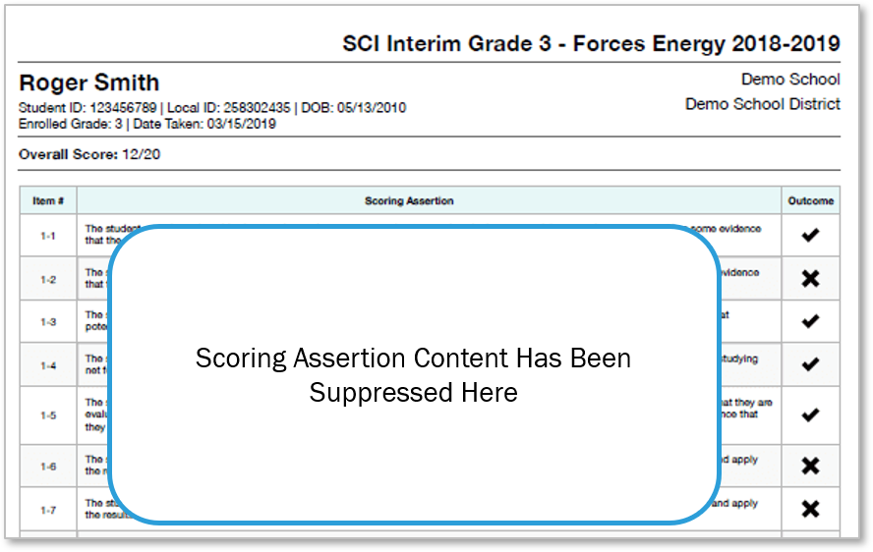
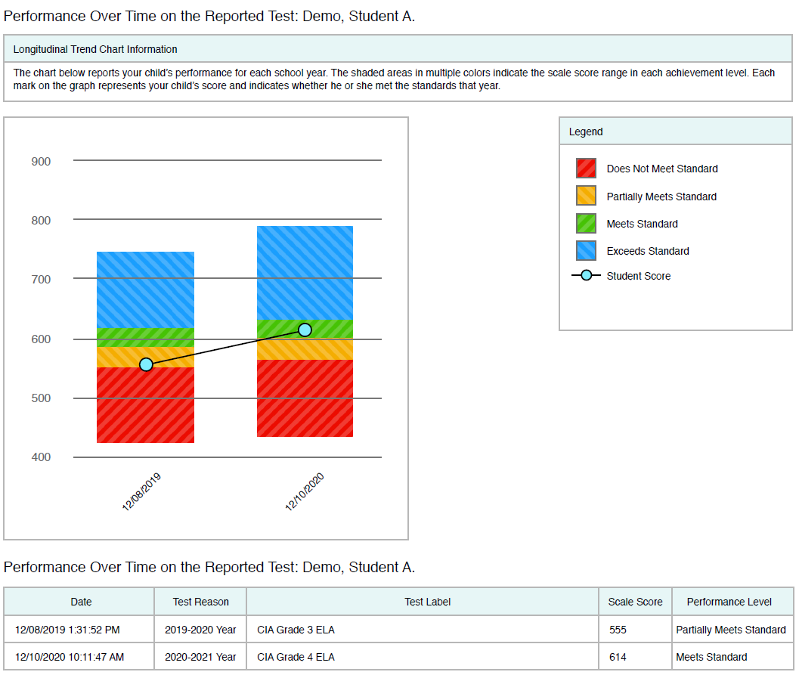
More Sample ISRs
Sample ISR with Scoring Assertions and Item-Level Data
Sample ISR with Trend (Longitudinal) Report
Notes:
On the left is a sample of a detailed ISR for the grade 3 Science Interim test. It includes seven scoring assertions associated with item #1 on the test. Each numbered assertion describes the required task and the outcome indicates if the student fulfilled the expectation or not. On the right is a sample of a detailed ISR showing a trend report. A trend report is the same Longitudinal Report accessed in the Reporting System. This report shows that the student’s scores on the two instances of this test have risen over time. Now we show you how to build the ISRs you need.

Slide 5
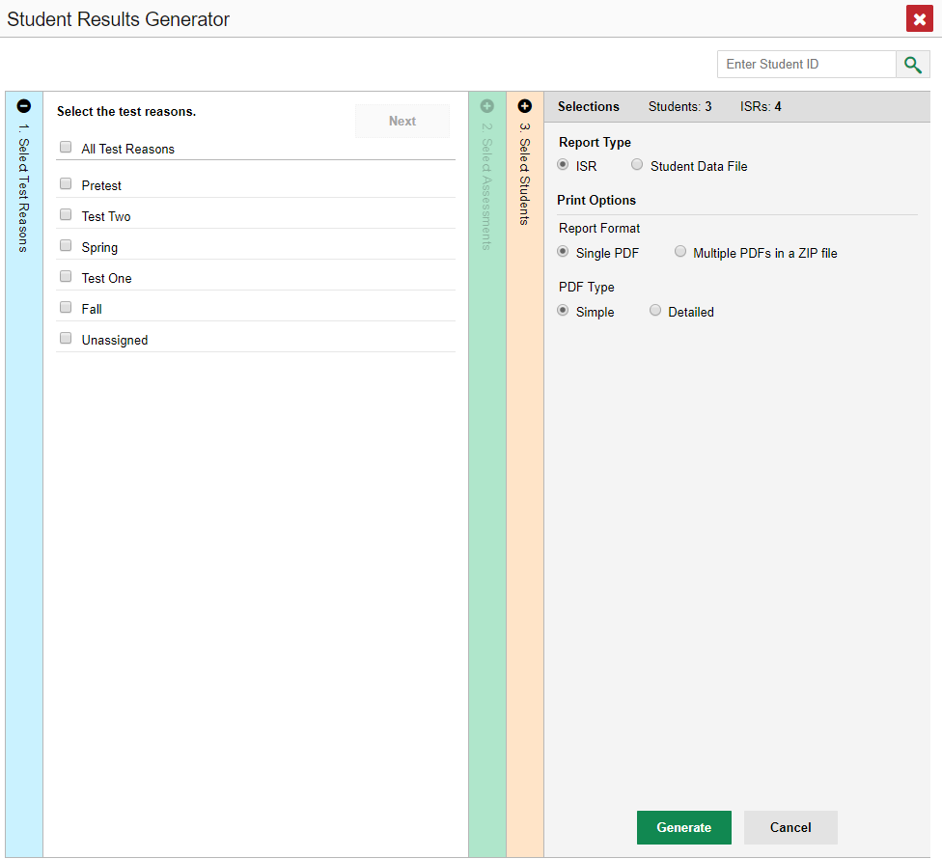
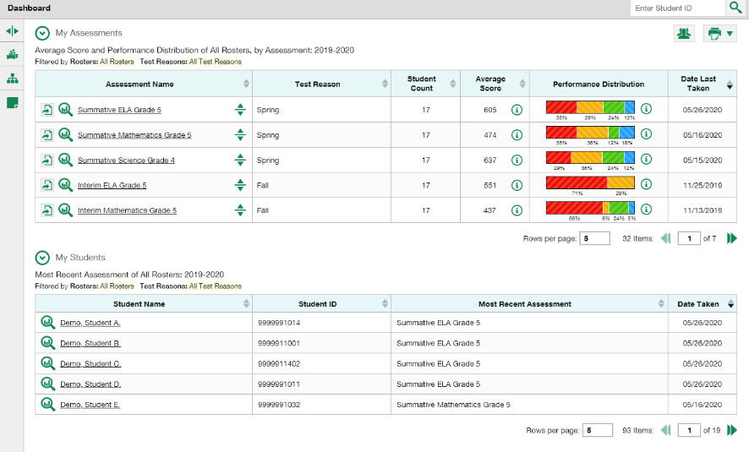
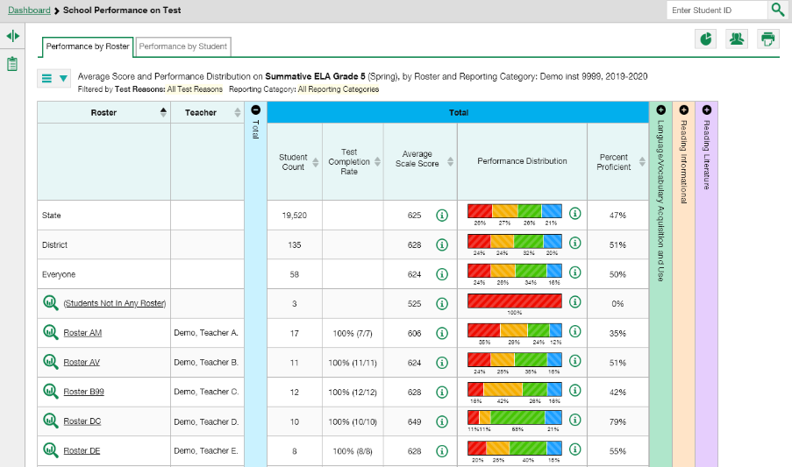
Two Ways to Build an ISR
1. From Dashboard—Generate ISRs from Scratch
2. From Test Report—Generate ISRs Using Pre-Populated Data
5
Notes:
You can build your ISRs from scratch or you can build them using pre-populated data. If you click the generator button from the dashboard, as shown here in the top-left image, the Student Results Generator window opens with all the selection choices unpopulated. You generate the ISR or ISRs by selecting the test reasons, assessments, and students that match your ISR needs. You can choose any combination of test reasons, assessments, and students. The pop-up window displays with column #1 open. If you open the generator from a report page, as shown in the bottom-left image, the Student Results Generator is pre-populated with data associated with the specific test report. The selections are made for you and you only need to confirm them or change them to generate the ISR or ISRs you need. On the next slide we demonstrate the process using a pop-up window with pre-populated data.

Slide 6
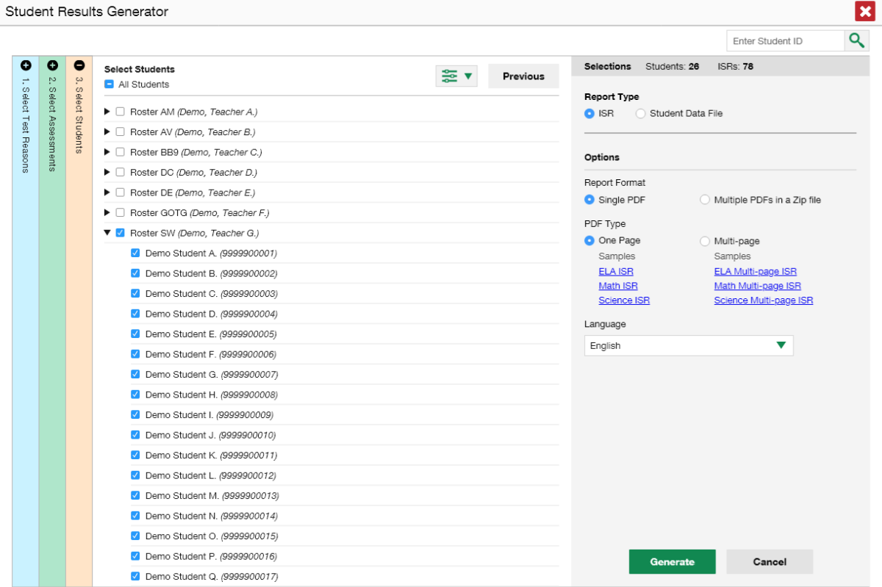
Student Results Generator—Pre-Populated from Report Page
*
Notes:
Here is the Student Results Generator window showing pre-populated selections. Typically, when the generator button is clicked on from a test report page, the Select Students column, #3 displays in the open position. This slide shows the window for a school-level user who is viewing the roster results of Demo Teacher G, specifically Roster SW, on a School Performance on Test report. The Select Students column displays the rosters for all the teachers in the school; however, the students on Roster SW for Demo Teacher G are pre-selected. Each roster can be expanded to show the students on that roster, by clicking on the down arrow next to the roster name. Depending on the ISRs you need to generate, confirm that the pre-selections are those that you want or mark the checkboxes for the rosters and/or students you need. Now go to the other two sections and confirm or change the selections. You open and close each column by clicking the + or - symbols at the top of the columns. Or you can click the Previous and Next buttons at the top of each open column. We explain the sections on the next slide.
* Some states may offer some links to sample ISRs in different subject areas. This varies by state and district.

Slide 7
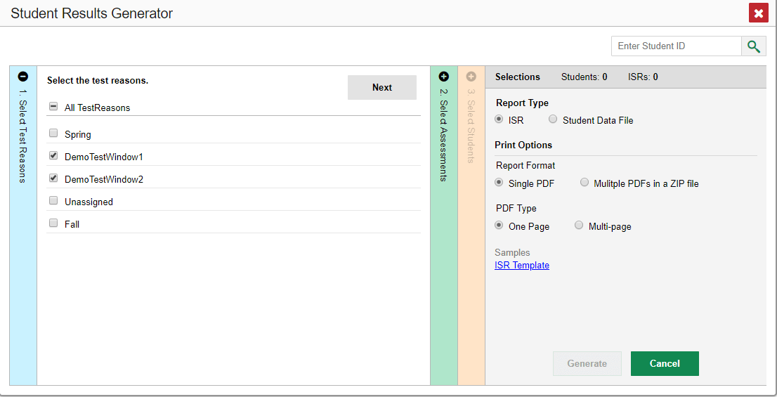
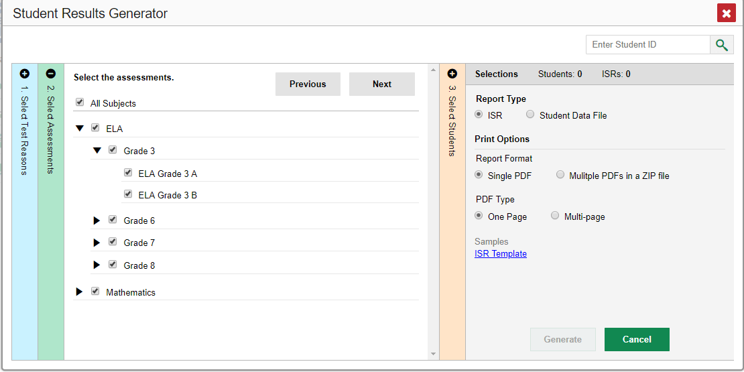
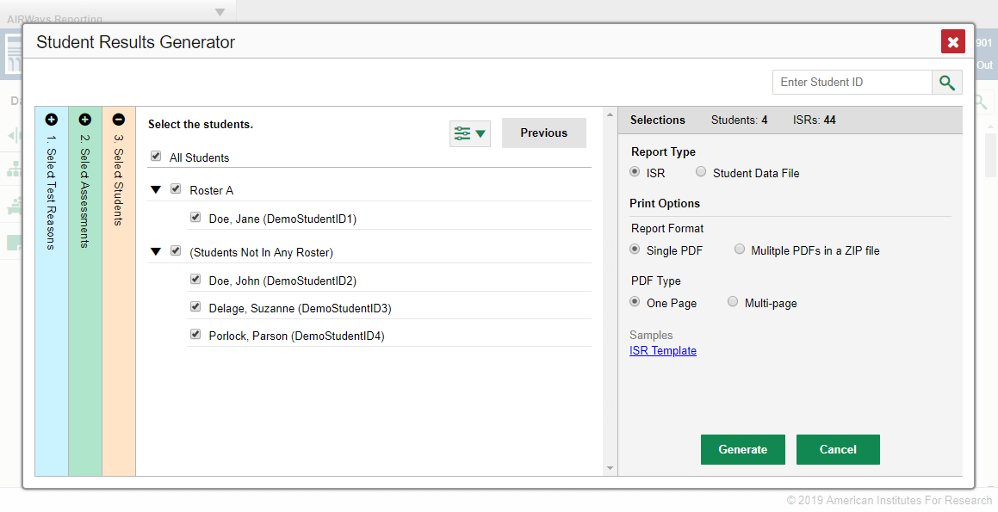
Sections #1, #2, and #3
1. Select Test Reasons
2. Select Assessments
3. Select Students
Notes:
Column #1 is labeled Select Test Reasons. Test reasons are the test administration windows for summative tests. Test reasons for interim, benchmark, and modular tests can be categories, like Pre-test or Post-test, or a numbered opportunity. Mark the boxes for the reasons that apply to the ISRs you need to generate. Column #2 lists assessments by type of test, subject, and grade. Select individual assessments or mark All Subjects. You can generate ISRs for any test in the list. The Select Students column, #3, will load results depending on the user’s role. Teachers and school-level users will see a list of rosters with student names below. District users will see a list of schools. The Selections panel on the right displays a count indicating the total number of students selected and the number of ISRs you have ordered.

Slide 8
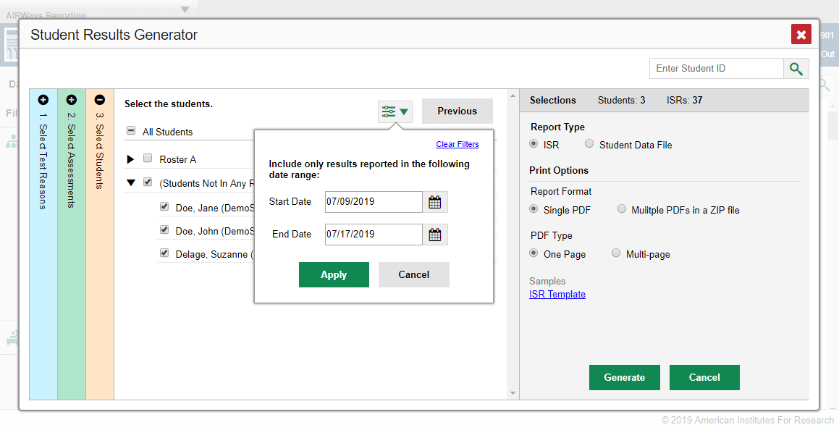
A Fourth Customizing Option
4. Set Date Range
Notes:
A fourth customizing option is accessed via the filter button which is located to the left of the Next and Previous buttons. You can select a range of dates to be included in the ISR by using the calendar to enter a start date and an end date. Click Apply. After making your customizations, click the ISR radio button under Report Type in the Selections Panel. We now explain the Print Options available.

Slide 9
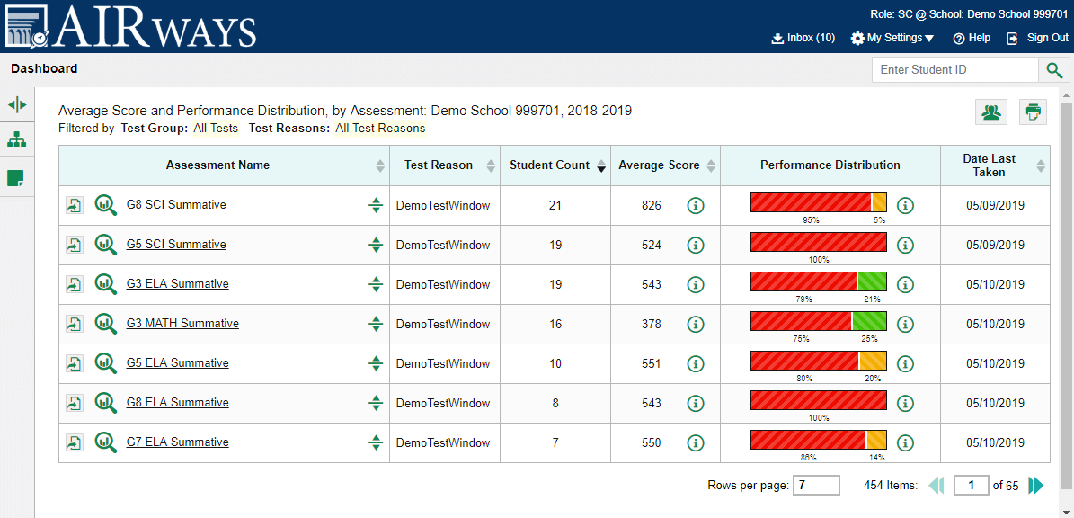
Print Options/Inbox Button
Notes:
After selecting your customization options for the ISRs you choose how to print the reports. Print options for the ISR are listed under that heading in the Selections panel to the right. You can print simple single-page reports or detailed, multiple-page ISRs. Other options allow you to download a sample ISR, choose a print language, and add a cover page. (Not shown.) The options in this panel vary according to your state configurations. After you have made your selections, click the green Generate button. The ISR file, or multiple PDFs in a zip file, will be sent to your Inbox, accessed via the banner on all pages in Reporting. We will explain how to print from the Inbox after we explain the Student Data File.

Slide 10
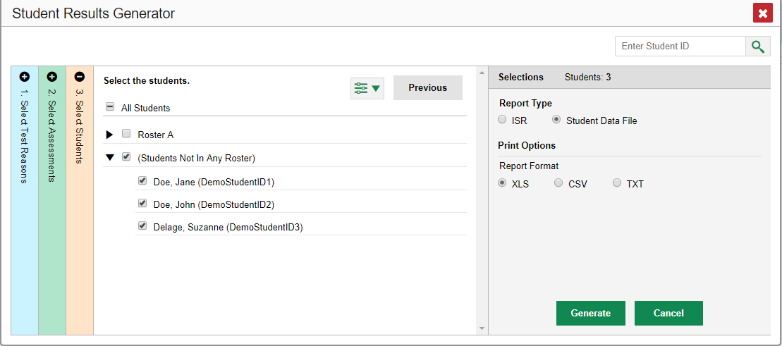
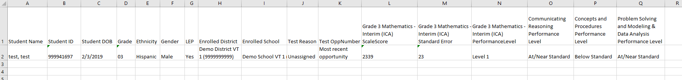
Generate a Student Data File
Student Data File—Excel Worksheet
Notes:
A Student Data File is a user report of performance data, in Excel, CSV, or text format. Files of this nature allow the user to employ the workbook features of a spreadsheet application to organize and sort the data. A sample is shown here. The generation process for a Student Data File is the same one used for the ISR with different print options. Customize the Student Data File using the same three selection columns and the Filters button. Choose your desired print format and click the green Generate button. The Student Data File displays in the user’s Inbox. The next slide shows a sample Inbox.

Slide 11
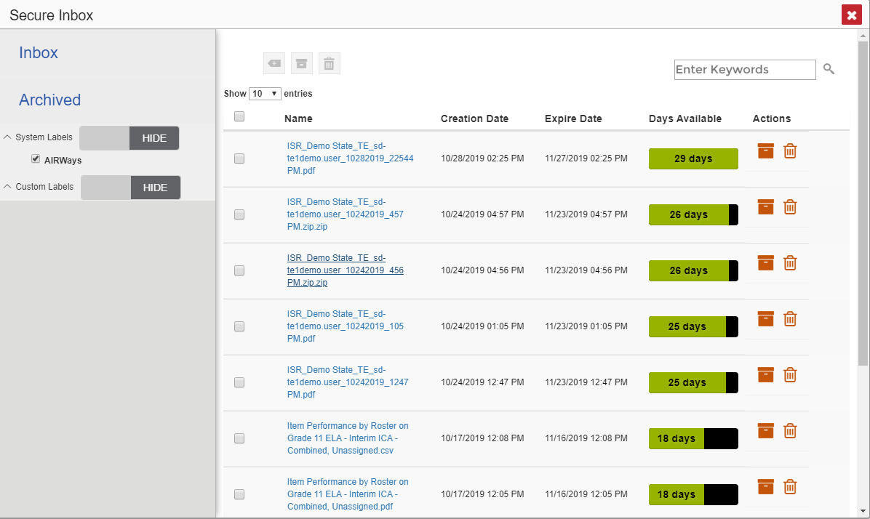
Sample Inbox
Notes:
The Inbox stores any reports you generate using the Student Results Generator tool. Click the name of a file to download it. To learn more about the features of the Inbox consult the appendix section of the Reporting System User Guide or view training module #5 in the series, How to Print and Export Data You Can See in Your Reports.

Slide 12
The Reporting System Training Module Series
How to Navigate the Dashboard and Generate Reports
How to Drill Down into Your Results Using Settings and Filters
How to Track Student Performance Over Time Using the Longitudinal Report
How to Print ISRs and Student Data Files
How to Print and Export Data You Can See in Your Reports
How to Use the Roster Manager to Add, Modify, and Upload Rosters
Interim and Benchmark Assessments Only
How to Analyze Item-Level Reports
How to Hand-Score Unscored Items and Modify Machine Scores
Notes:
More training modules are posted on your state or district portal. You may also consult the Reporting System User Guide.

