Slide 1
How to Navigate the Dashboard and Generate Reports
Reporting System Training Module #1
Notes:
Welcome to the first training module in the Reporting system series: How to Navigate the Dashboard and Generate Reports. Reporting provides student performance data for your summative, interim, and benchmark assessments as well as other modules and language proficiency tests administered in your state or district. Depending on your user role, you can access reports on state, district, school, and class roster results, as well as individual student results.

Slide 2
Objectives
Navigate the Reporting System dashboards to view test results for teachers as well as school-, district-, and state-level users
Analyze Summative Test Reports: Performance Measures and Sorting
Analyze the Standard Measures Report for Adaptive Summative Tests
Analyze Interim Test Reports
Read a Student Portfolio Report
Design a Demographic Breakdown Report
Notes:
In this training module we show you the four dashboard views for teachers, school-, district-, and state-level users. We explain summative test reports, the performance measures used, and the sorting feature. We provide specific instructions on how to analyze the standard measures report for adaptive summative tests, and then cover the item-specific features used with interim tests. We finish by explaining the student portfolio report and how to design a demographic breakdown report.

Slide 3
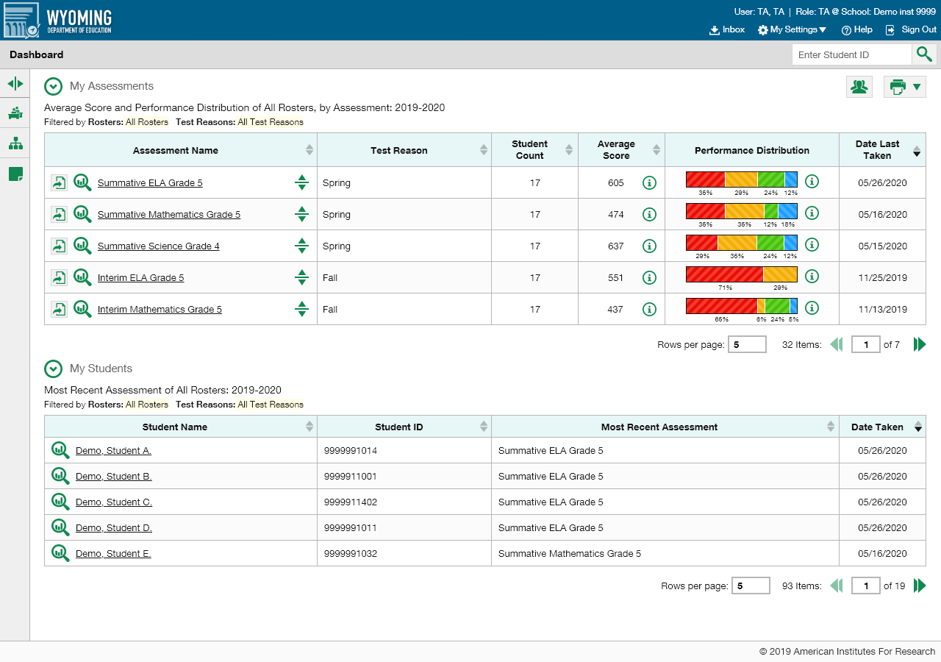
Teacher Dashboard
Notes:
The dashboard is the first page you see after you log in to Reporting, unless you are a state-level user. The teacher dashboard displays two stacked tables, My Assessments and My Students. The My Assessments table lists all the tests taken by a teacher’s students and shows their aggregate results. The My Students table lists all the teacher’s students and is basically a fast pass, for teachers, to the individual Student Portfolio report. Quick analysis can be done directly from the dashboard. Before we explain this, we show you the dashboard layouts for school-, district-, and state-level users.

Slide 4
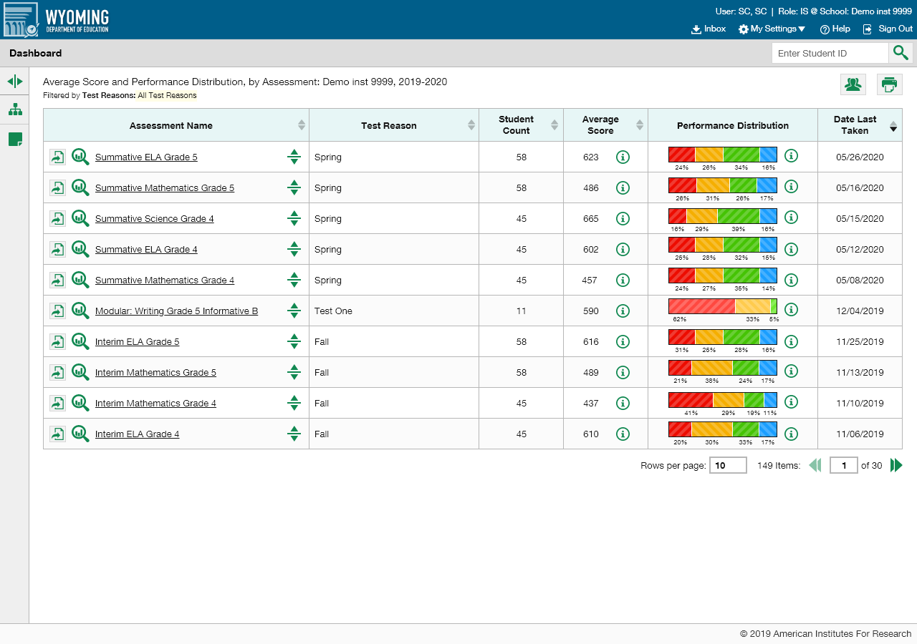
School & District Users’ Dashboard
Notes:
School personnel and district users see one table of all assessments. School users see the aggregate results of tests taken by all the students in their school and access their reports by test name. District users see aggregate assessment results for all the schools in their district.

Slide 5
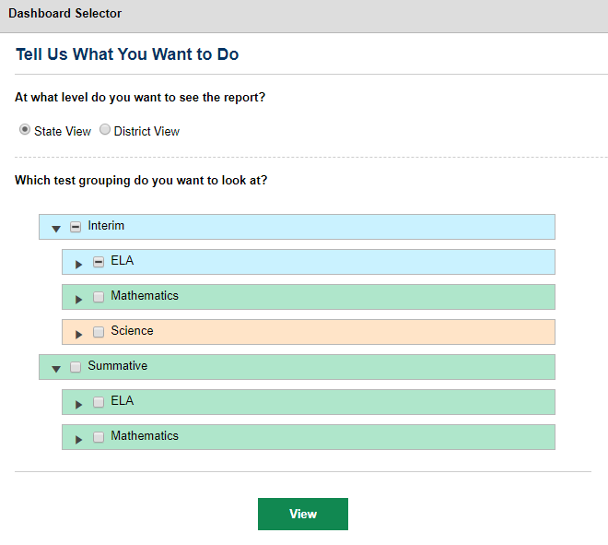
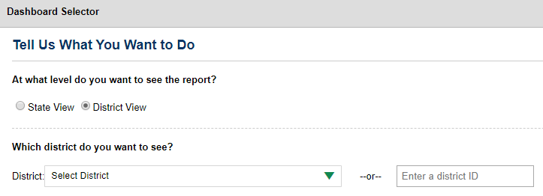
State Users’ Dashboard
Notes:
State-level users have a special landing page called the Dashboard Selector. You can use the Dashboard Selector to access reports at the state level or the district level.
To view overall state results, select the State View radio button and then select the specific test group you need to see. An assessments table appears displaying up to ten of the tests you selected, sorted by Date Last Taken. This helps you understand how your state is performing overall.
To view the test results of a specific district, select District View. Select a district from the drop-down list, or enter a district ID number in the search field.

Slide 6
Reports Available to Users
By all districts in the state and by specific district
By schools in each district
By roster and by student
By schools in the district
By roster and by student
By roster and by student
By roster and by student
State
District
School
Teacher
Notes:
This chart summarizes the levels of data available to users in the Reporting system. Simply choose a test from your dashboard and click through the reports to the level of data you need to see. Now, we will look at the features of the dashboard, show you some quick sorting options, and explain how to navigate to the reports you need.

Slide 7
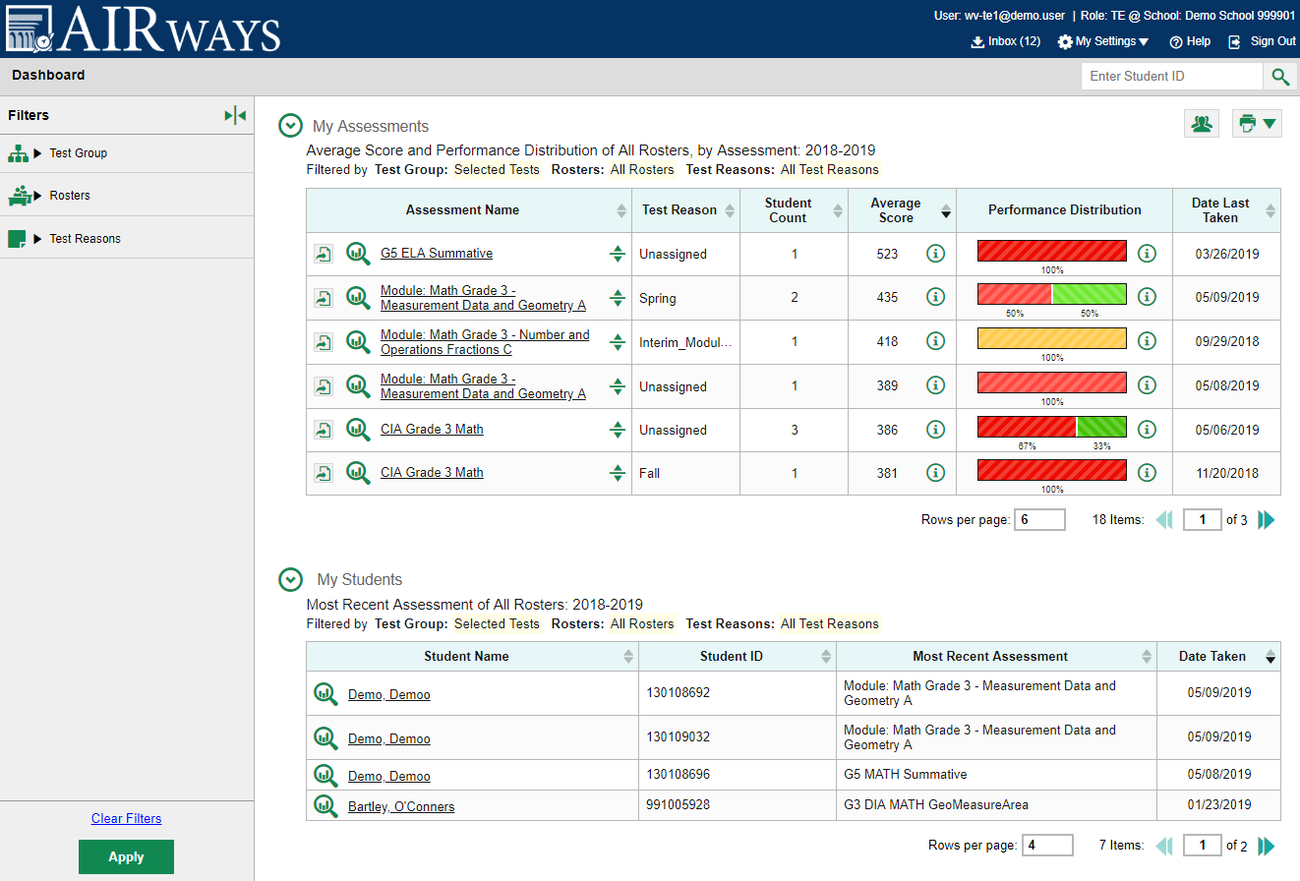
Navigating Reports with Clickable Features
Reporting System Training Module Series
1. How to Navigate the Dashboard and Generate Reports
2. How to Drill Down into Your Results Using Settings and Filters
3. How to Track Student Performance Over Time Using the Longitudinal Report
4. How to Print ISRs and Student Data Files
5. How to Print and Export Data You Can See in Your Reports
6. How to Use the Roster Manager to Add, Modify, and Upload Rosters
7. How to Analyze Item-Level Reports
8. How to Hand-Score Unscored Items and Modify Machine Scores
Notes:
We use the term “navigating” when referring to the dashboard and report pages because of the variety of buttons, arrows, test names, and student names that are all “clickable” and are designed as an entry point to more specific data. It only takes a few taps to uncover the report you need to see. Buttons include: the Inbox, My Settings, the Help feature, the student search box, the print button, the Student Results Generator, and the Filters panel. The magnifying glass view button will take you directly to the report for a particular test or to the student portfolio page for a particular student. The Export button in the assessments table allows you to export a report to a file. Clicking the more information buttons displays legends related to performance measures. You can modify the size of each table by setting the rows per page box. You can advance or return using the arrows on either side of the page number box.
These features are covered, in depth, in the new reporting system training module series, shown here. This first training module is designed to teach you the basics of generating reports and get you well on your way to using the advanced functions of the system.

Slide 8
Dashboard: Headers/Columns/Sort Arrows
Notes:
The Dashboard and report tables in Reporting include headers that describe what is included in the table and any filters applied. The columns in the My Assessments table are Assessment Name, Test Reason, Student Count, Average Score, Performance Distribution, and Date Last Taken. The My Students table, which displays for teachers only, organizes students by Name, Student ID, Most Recent Assessment, and Date Taken.
You can sort your results directly from the dashboard by clicking each column header that has a set of up and down arrows in it. For example, you might want to sort the Average Score column in ascending order to show tests with the lowest scores at the top of the table. You might want to sort the students in the My Students table alphabetically.

Slide 9
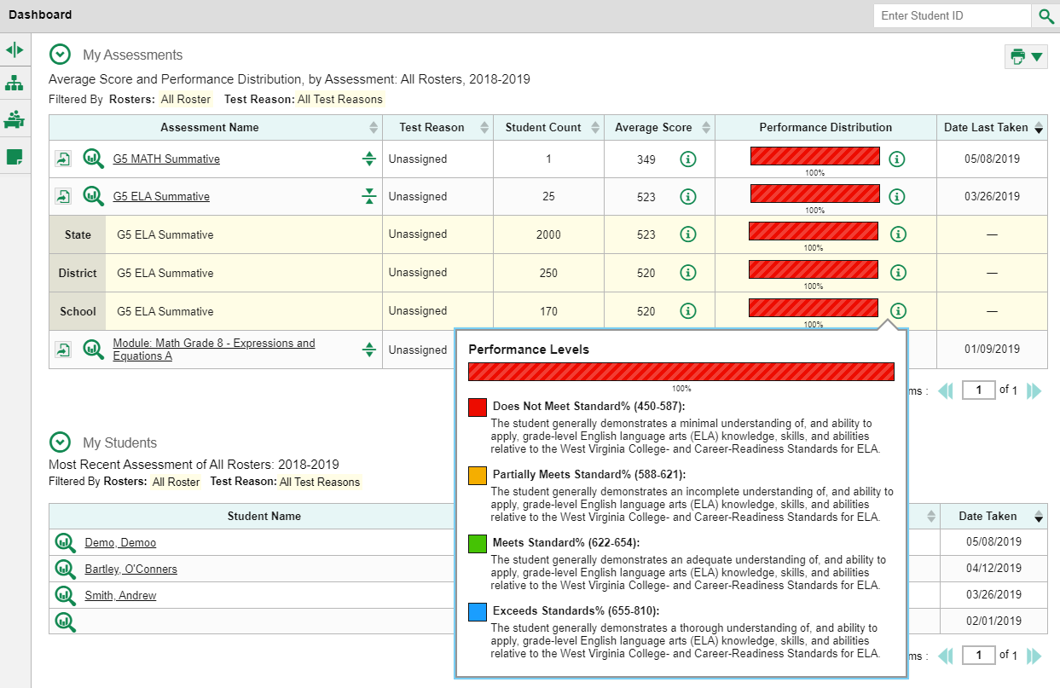
Aggregate Data on the Dashboard
Notes:
In addition to sorting you can compare your results to aggregate state, district, and school data directly from the dashboard, depending on your user role. Simply click the expand button to the right of the assessment name to display them. The aggregates are highlighted in yellow on the report. To display a legend of the scores or performance distribution levels, click the information button next to the data.
Let’s move on to navigating report pages. In the next few slides, we show you several sample reports and then explain the different types of performance measures used in the new reporting system.

Slide 10
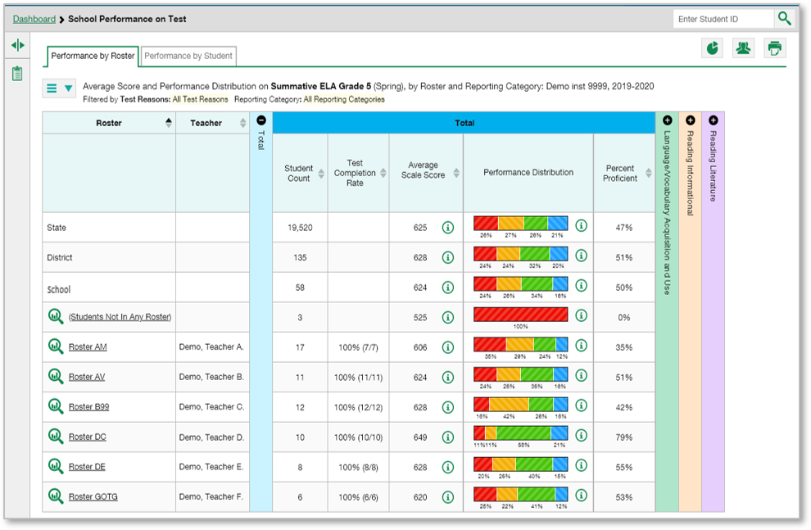
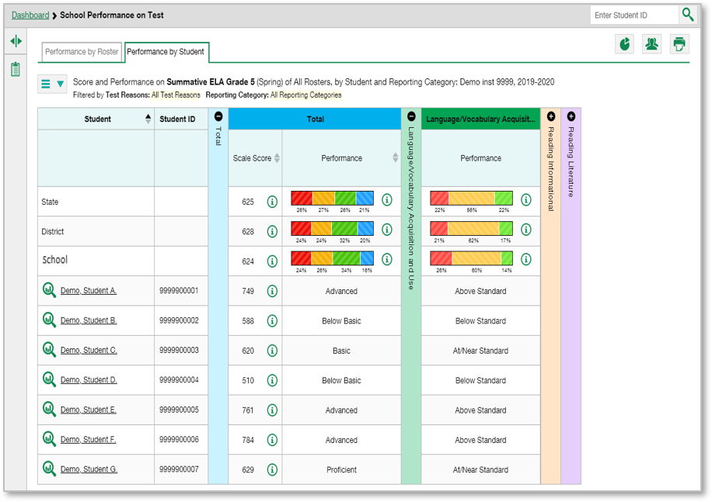
The Test Report Page:
Layout
Grade 5 ELA SUM
Performance by Roster
Performance by Student
Notes:
Reporting storehouses data for lots of different tests. Despite the variety of tests and client preferences, most reports are designed to mirror the dashboard layout. When you navigate away from the dashboard the gray navigation trail at the top of the page marks your path. This is a good way to keep track of what report you are seeing, and you can always return to a previous one from the trail. Click on the name of an assessment or the magnifying glass view button next to it.
For example, here is a report for a school user who clicked on the Summative English Language Arts Grade 5 Assessment from the dashboard. The “School Performance on Test” report lists the class rosters in the left column, along with teacher name. Multi-colored accordion sections are used to display the reporting categories. Expand or collapse them by clicking the + and – signs at the top of the vertical bars, or click on the bars themselves.
The Summative ELA Grade 5 test includes three reporting categories. They are Language/Vocabulary Acquisition and Use in green, Reading Informational in tan, and Reading Literature in purple. School users and teachers will notice two tabs under the navigation trail: Performance by Roster and Performance by Student. You can toggle between the tabs to change the table from a list of rosters to a list of students, as shown here. When the Performance by Student tab is open, student names display in the left column, matched with Student ID. Notice that state, district, and school aggregate results display above the rosters or students in the tables. We explain the performance measures and sorting on the next two slides.

Slide 11
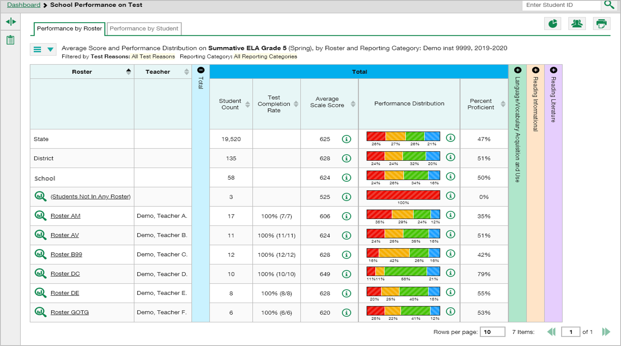
Test Report Page:
Performance Measures
Grade 5 ELA SUM
Notes:
The performance measures used in a report depend on your state or district and the type of assessments administered. Three typical measures include score or average score, performance distribution or performance level, and percent proficient as shown on this School Performance on Test report for the Summative ELA test for Grade 5. Score data can be displayed as scale scores or raw scores, the latter of which may be in the form of percentages or fractions. Interim tests typically report average scale scores while shorter benchmark tests report raw scores. Performance distribution levels are color-coded and some aggregate reports show the percentage of students in each performance level. The percent proficient measurement is used in some aggregate reports. It represents the total percentage of students who achieved proficiency on the test, typically those who fell into the top one to three performance levels. You can sort your results by performance measure whenever you see a set of up and down arrows in the column header.

Slide 12
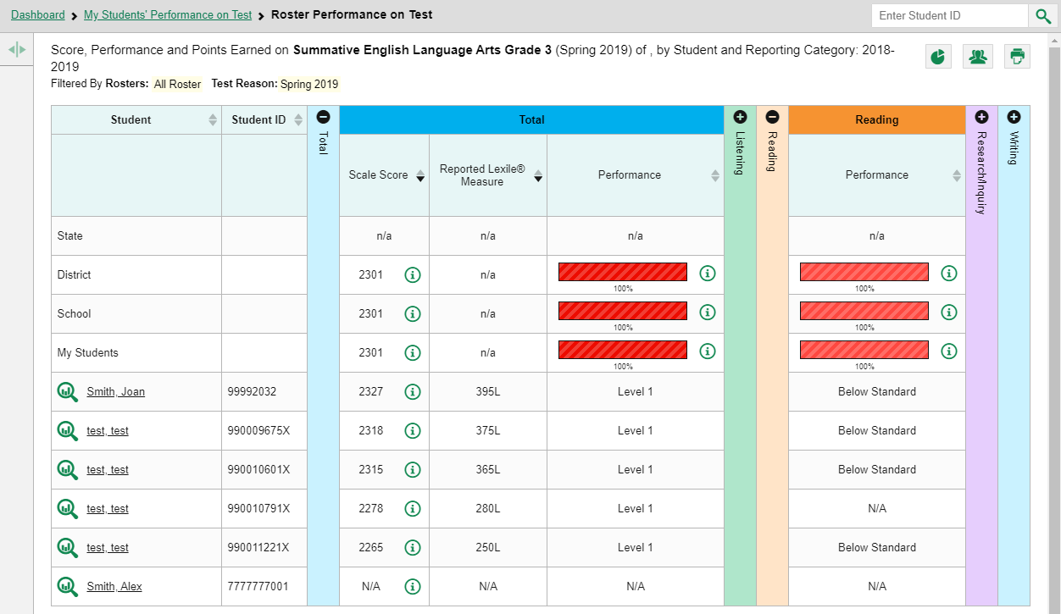
Test Report Page:
Sorting
Grade 3 ELA SUM
Notes:
Sorting is a quick way to see how students and other groups performed, relative to each other, on a particular assessment. This roster report shows the students sorted by descending scale scores, with the students who scored the highest on top. Individual performance levels are listed as such, in lieu of the patterned bar. You can sort in this column, as well.
Notice an additional, individual performance measure, the “Reported Lexile Measure.” Your state or district may or may not use this measure. Again, users can sort results by this measure and by performance in the reporting categories.

Slide 13
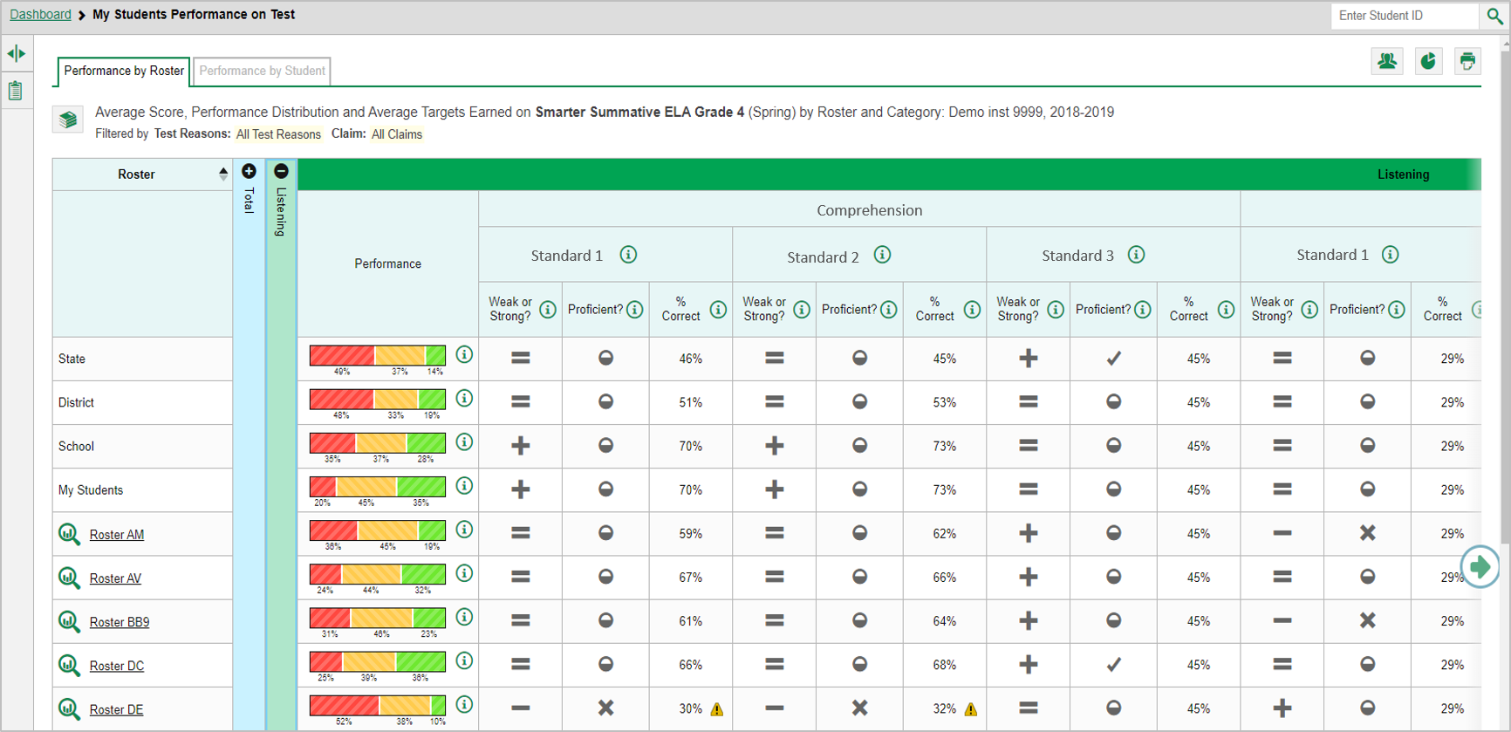
Standard Measures for
Adaptive Summatives
Grade 4 SB
ELA SUM
Notes:
You may open a report and see some special indicators in the performance measurement columns, like this report for the Smarter Summative ELA Grade 4 assessment. The indicators include plus, minus, and equal signs, a checkmark, an X, and a warning triangle, among others. The symbols give detailed information about students’ performance on specific learning standards. The performance indicators used in this report are designed to help teachers evaluate the effectiveness of their teaching and take immediate action where necessary. Other educators can use these measures to determine the areas of relative strength and weakness in each standard on an adaptive summative test in their school or district. Please note that terminology varies by state and district.
The report shown here is a generic version. For example, in this My Students’ Performance on Test report for a teacher, the Listening reporting category of the Summative ELA test is expanded. Under that is a standard cluster labeled Comprehension. Under the standard cluster are three standards labeled Standard 1, Standard 2, and Standard 3. Under the standards are three performance measures: Weak or Strong?, Proficient, and % Correct. Your state or district may use some of these measures and not others. You will see this type of report for an adaptive summative assessment. Adaptive assessments are those that adjust to the ability level of the student as the test is being administered. You will not see this type of report for any assessment that is fixed-form. You will see it for groups of students, not for individual students. On the next two slides we show the legends you can expand to view more information about standards and measures.

Slide 14
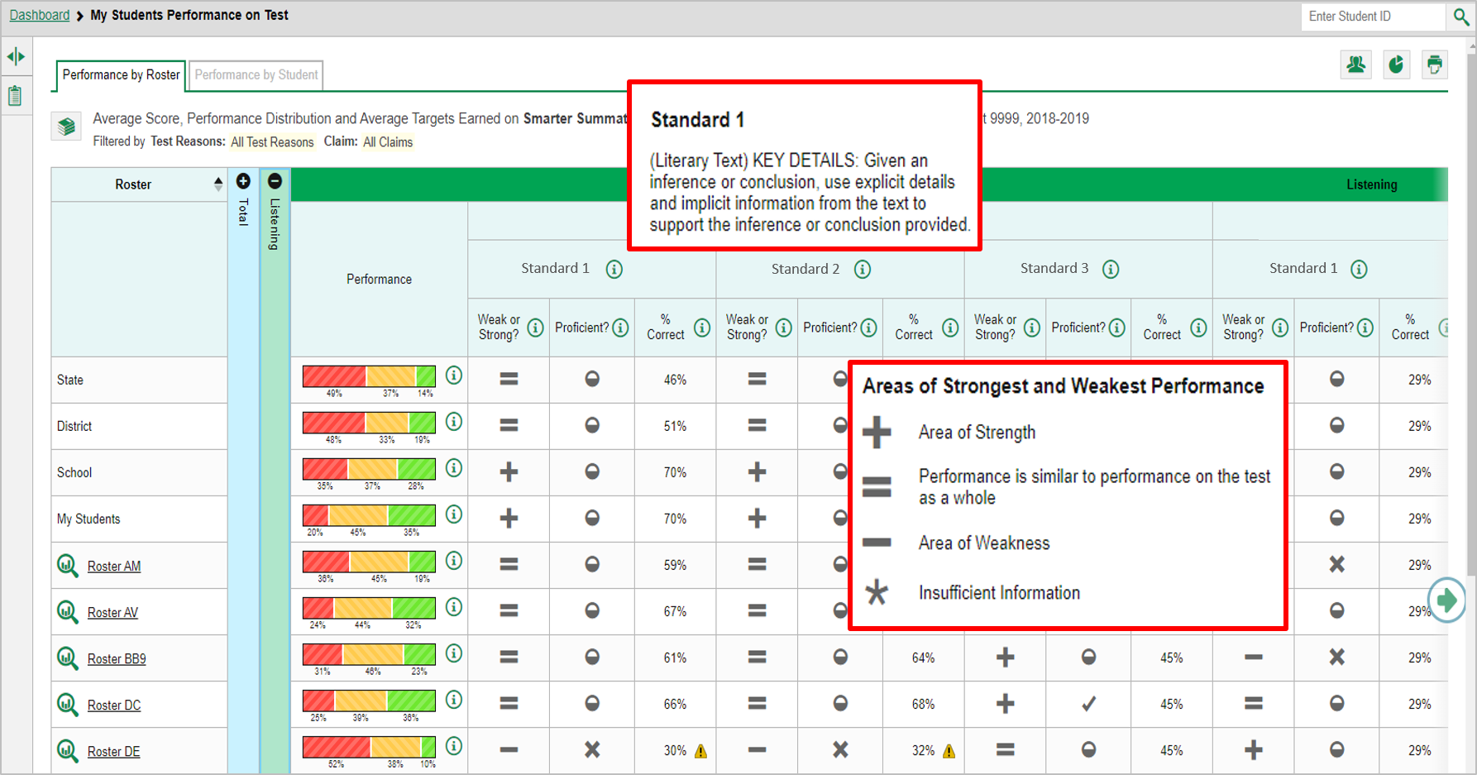
Standard 1 and Weak or Strong?
Grade 4 SB
ELA SUM
Notes:
Click the more information buttons to view pop-up legends for the standard or measure. The legend for Standard 1 describes exactly what students must do to hit the target. The performance indicators under that standard reflect how close the students came to hitting that target. In the Weak or Strong? column the + sign indicates that this group of students demonstrates strength in this standard; they performed better on items from this standard than they did on the rest of the test. The minus sign indicates that this is an area of weakness. The students did not perform as well on items from this standard as they did on the rest of the test. An equal sign indicates that their performance on this standard is like their performance on the rest of the test.

Slide 15
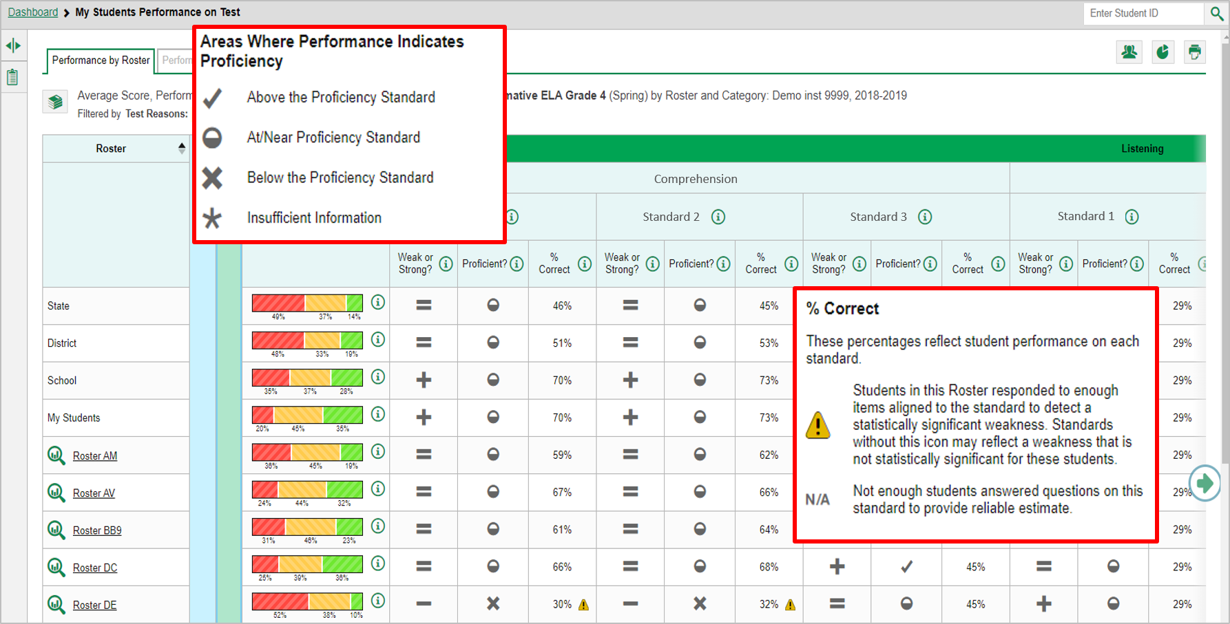
Proficient? And % Correct Measures
Grade 4 SB
ELA SUM
Notes:
The Proficient column reflects the student's proficiency level in that standard. Students may perform above the standard, as indicated by a checkmark, they may be borderline, as indicated by a half-full circle, or they may perform below the standard, as indicated by an X. The third performance indicator, % Correct, reflects student performance on the standard. You may see a yellow caution sign with an exclamation point inside it in a reporting cell. This means that the students on this roster responded to enough items aligned to the standard to detect a statistically significant weakness. Teachers and other educators should investigate this class thoroughly in order to provide more instruction to shore up the weakness.

Slide 16
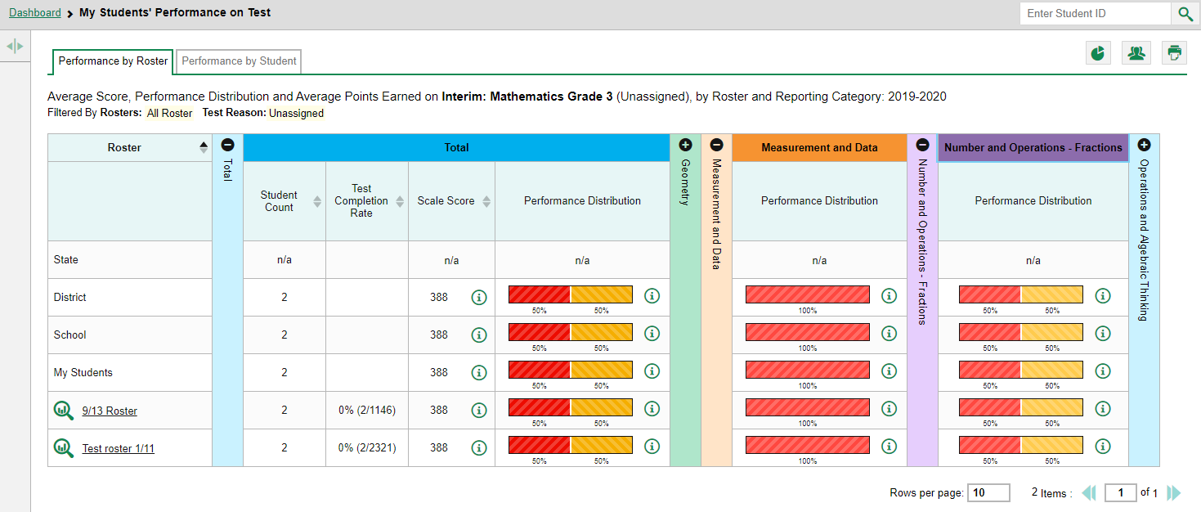
My Students’ Performance on Test Report
Grade 3 Math INT
Notes:
Here is a sample report for a teacher who clicked on the Interim Mathematics test for Grade 3 from the dashboard. All of the teacher’s class rosters are listed in the Roster column.
The My Students’ Performance on Test report displays, showing the reporting categories of Geometry, Measurement and Data, Number and Operations - Fractions, and Operations and Algebraic Thinking. You can click the column headers to sort your class rosters by Student Count, Test Completion Rate or Scale Score. This allows you to evaluate all your rosters, and make comparisons.
You can now click on any roster in the table to look at the students in that class or group. Click the roster name or the magnifying glass view button next to it. As in the School Performance on Test report, you can click the Performance by Student tab to view a list of your students.

Slide 17
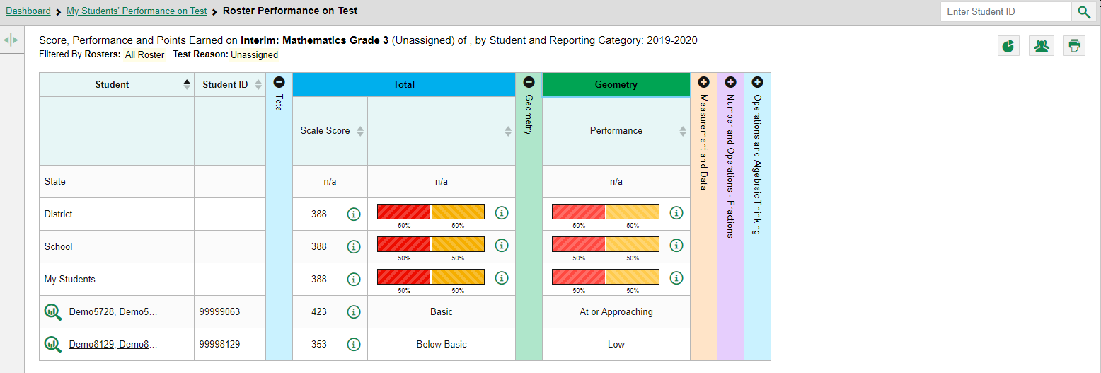
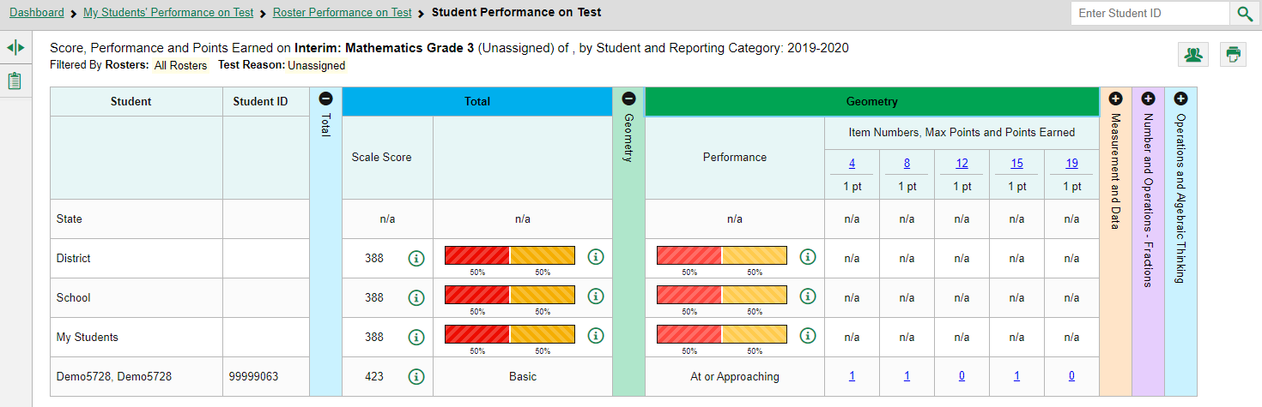
Single-Roster Report/
Single-Student Report
Grade 3 Math INT
Notes:
The Roster report opens showing results for the students in that class, shown here in the top image.
You can sort these students by performance level in each of the reporting categories assessed by the test. (Geometry, Measurement and Data, Number and Operations-Fractions, and Operations and Algebraic Thinking.) This is a good way to determine which topic areas need more work.
To drill down to the individual student level, click on any student name or magnifying glass view button in the table. You see that the demo student in the bottom image has a basic understanding of Grade 3 Math, noted in the blue Total column, and in the Geometry category they are At or Approaching Proficiency. Notice that the Student Performance on Test report for this interim math test shows the items included in each reporting category. The Geometry category is expanded here showing that items #4, 8, 12, 15, and 19 are questions related to the Geometry standards. You can click on the points earned link under the item number to see the actual item and the student’s response.
You may be familiar with item-level data as it relates to interim and benchmark assessments. If unfamiliar with this type of report, please view training module #7 in the series, How to Analyze Item-Level Reports.

Slide 18
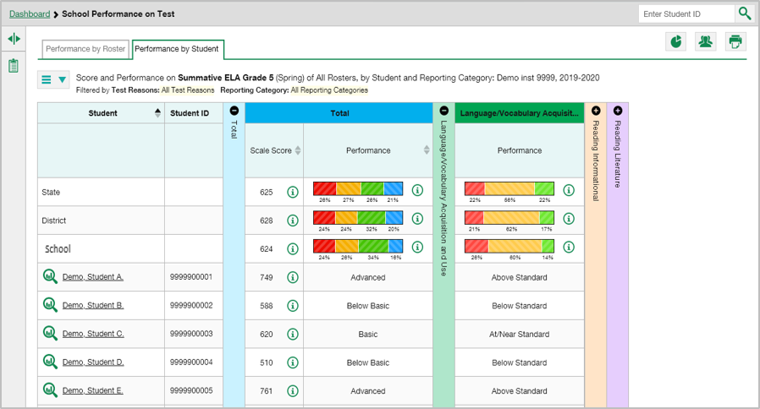
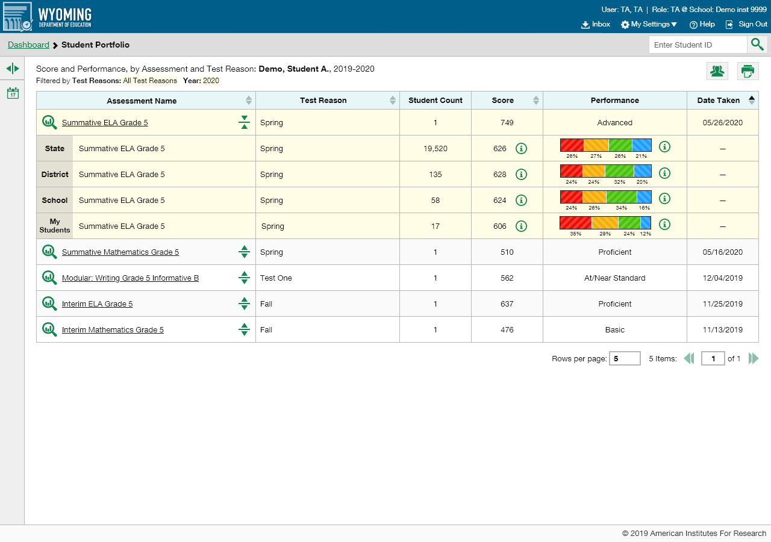
The Student Portfolio Report
Grade 5 ELA SUM
Notes:
There is another report, the Student Portfolio Report, that shows you results for all the tests an individual student took.
All users can access the report from any test report page. Copy and paste the student ID number into the search box and then click the search button, as shown in the top image.
The Student Portfolio Report for Demo student A is shown here and explained on the next slide.
Teachers have a fast pass to this report from their My Students table on the dashboard. Simply click the student name or the magnifying glass and the report displays.

Slide 19
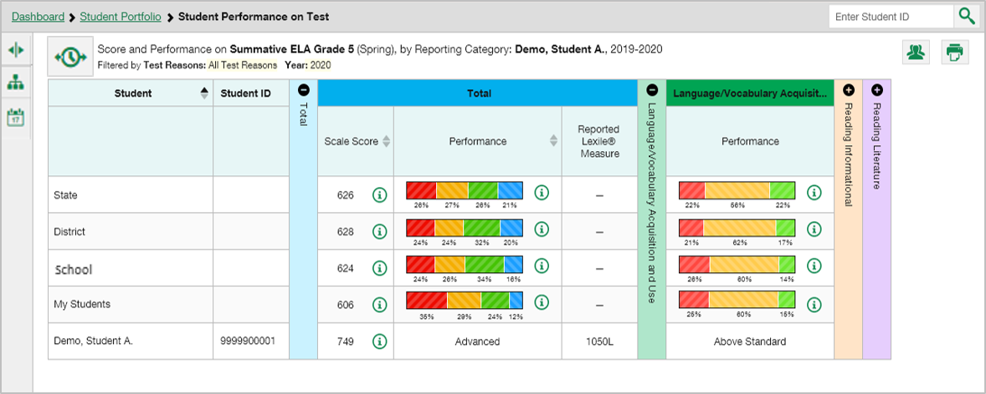
The Student Portfolio Report (cont.)
Grade 5 ELA SUM
Notes:
Like all other reports in the Reporting system, the Student Portfolio Report mirrors the dashboard design. It features a comprehensive list of all assessments taken by the student, across school years. Aggregate comparison rows for your state, district, school, and/or total students are displayed when you click the expansion arrow set beside a test name.
To view the results for a specific test, click on the test name or the magnifying glass view button next to it. The Student Performance on Test Report displays, shown here at in the bottom image. Here you see the individual results for the Summative ELA Grade 5 test for Demo Student A. You can expand each reporting category to see the performance in that topic area. Remember, you can click on the more information buttons at any time to display the legend for scale scores or performance distribution levels. Now we will show you a way of looking at very specific groups of students, based on their demographic attributes such as gender, grade, English Language Proficiency, or IEP status. This is called the demographic sub-group report, also known as a breakdown report.

Slide 20
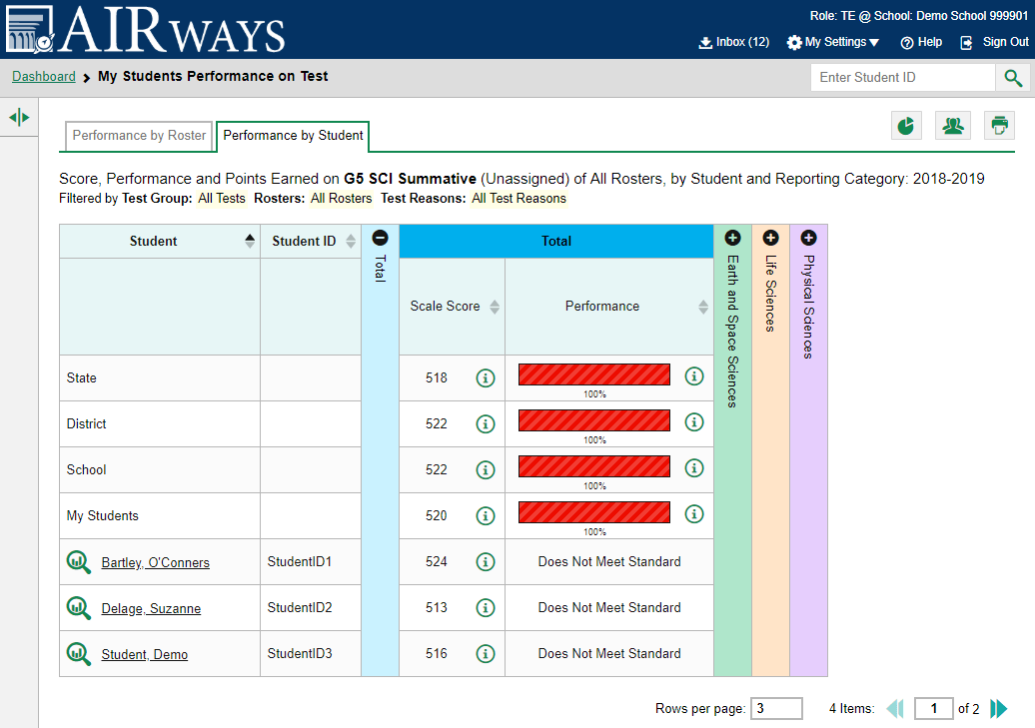
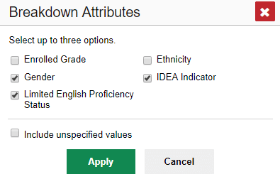
How to Build a Demographic
Breakdown Report
Grade 5 Sci SUM
Notes:
You can create a demographic breakdown report from any page in Reporting that displays data for multiple students. Click the pie chart button located below the student search box, upper-right corner of the page. A Breakdown Attributes window opens displaying the attributes available to you. These choices vary by state and district. You can select up to three options for your report.
For example, here you see a teacher’s My Students’ Performance on Test report for the Grade 5 Science Summative test. The Performance by Student tab is open showing all the teacher’s students who took that test. You can build a report for a specific group of students based on any three attributes listed in the Breakdown Attributes window. For a sample report we have marked the gender, limited English proficiency status, and Idea Indicator boxes. A checkbox is displayed next to the term “Include unspecified values”. This option, when selected, will include any of the user’s students with no demographic information assigned to them in TIDE. Click Apply. The customized report displays, as shown on the next slide.

Slide 21
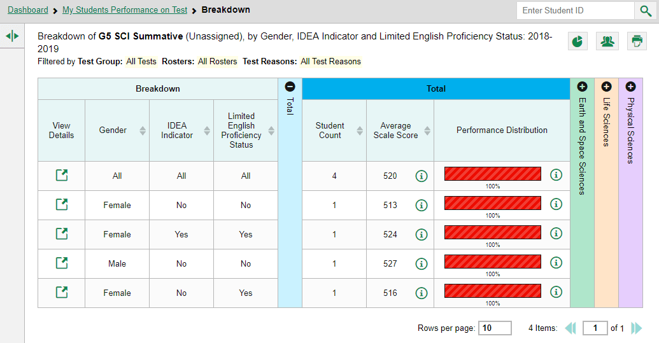
The Demographic
Breakdown Report
Grade 5 Sci SUM
Notes:
The breakdown page is organized according to the combinations selected. The number of rows in the table will depend on how the students fall into the demographic categories. A row appears for each possible sub-group combination. For example, here you see a row for ALL the students, followed by some possible combinations. If a combination does not appear in the table, it means none of the teacher’s students fall into that sub-group. Notice that the table header has updated to reflect the chosen attributes. You see from this breakdown report page that there are four students who are divided into four sub-groups. You can sort the sub-groups in several different ways, by gender, Idea Indicator, Limited English Proficiency Status, Student Count, and Average Scale Score. To look closer into a specific sub-group, click the View Details button in that row.

Slide 22
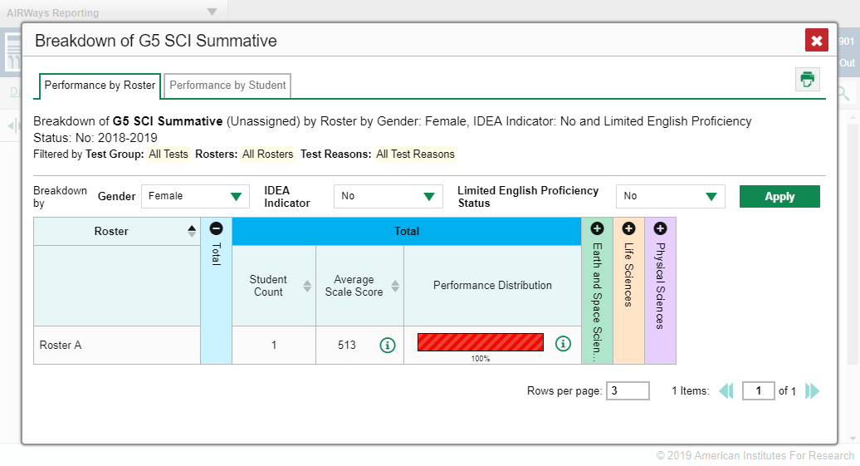
The View Details Window/
Breakdown Report
Grade 5 Sci SUM
Notes:
A Breakdown window opens, displaying detailed results for that sub-group. A row of drop-down menu buttons appears above the table, displaying the attributes of the group you chose. The Performance by Roster tab is open. To see the student names toggle the Performance by Student tab. To quickly transition to another demographic sub-group, you can apply the breakdown menu options that display above the table of results. Select an attribute you want from the drop-down menus and click Apply. The new sub-group will display. We are finished showing you the sample reports you will see in Reporting. You can see that the page design and the features are consistent across all types of reports and levels of data. It will not take you long to learn to navigate to the results you need to see.

Slide 23
Objectives Met!
Navigate the Reporting System dashboards to view test results for teachers and state-, district-, and school-level personnel
Analyze Summative Test Reports: Performance Measures and Sorting
Analyze the Standard Measures Report for Adaptive Summative Tests
Analyze Interim Test Reports
Read the Student Portfolio Report
Design a Demographic Breakdown Report
Notes:
We explained the different dashboard views and covered the clickable features of various report pages. We provided instruction on analyzing the summative test reports, including the standard measures report for adaptive summative assessments. We reviewed the design and features of the interim test reports and finished with the student portfolio report and the demographic breakdown report. You are well on your way to becoming an expert with the system. Thank you for viewing this training module.

Slide 24
The Reporting System Training Module Series
How to Navigate the Dashboard and Generate Reports
How to Drill Down into Your Results Using Settings and Filters
How to Track Student Performance Over Time Using the Longitudinal Report
How to Print ISRs and Student Data Files
How to Print and Export Data You Can See in Your Reports
How to Use the Roster Manager to Add, Modify, and Upload Rosters
Interim and Benchmark Assessments Only
How to Analyze Item-Level Reports
How to Hand-Score Unscored Items and Modify Machine Scores
Notes:
More training modules are posted on your state or district portal. You may also consult the Reporting System User Guide.

