Slide 1
How to Hand-Score Unscored Items and Modify Machine Scores
Reporting System Training Module Series #8
Notes:
Welcome to training module #8 in the Reporting System series, How to Hand-Score Unscored Items and Modify Machine Scores. Some items, such as essays and short answer responses, require hand-scoring for data to appear.
You can also modify scored items which arrive in the Reporting System with suggested automated scores. This training module shows you how to complete both tasks.

Slide 2

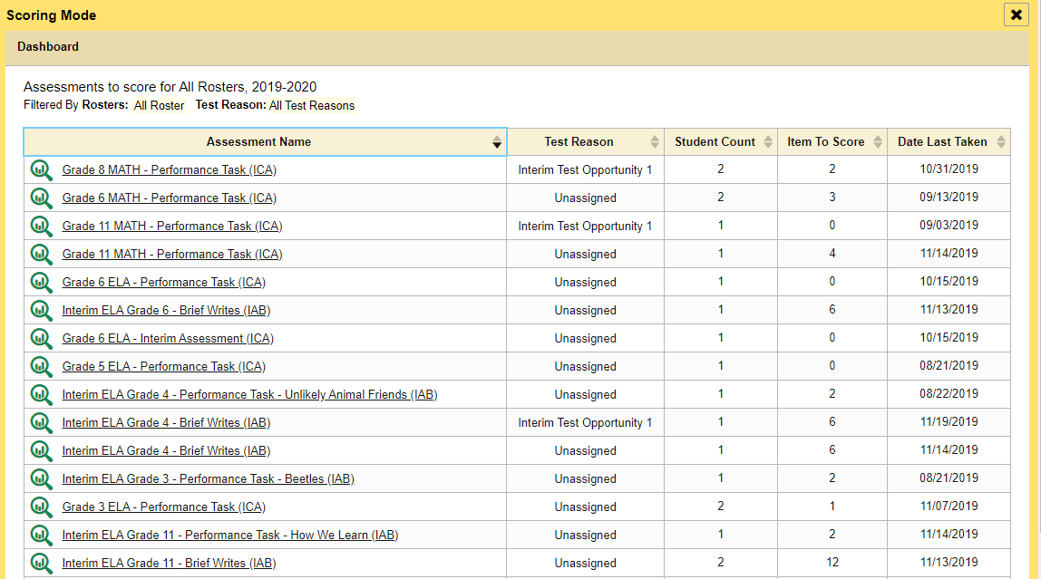
How to Access Tests that Need Hand-Scoring
Notes:
When you have tests that need to be manually scored, a yellow notification message appears in the banner. Click the Tests to Score notification.
The Scoring Mode window opens, displaying a list of tests with unscored items. Click the name of the test or the magnifying glass of the test you wish to score.

Slide 3
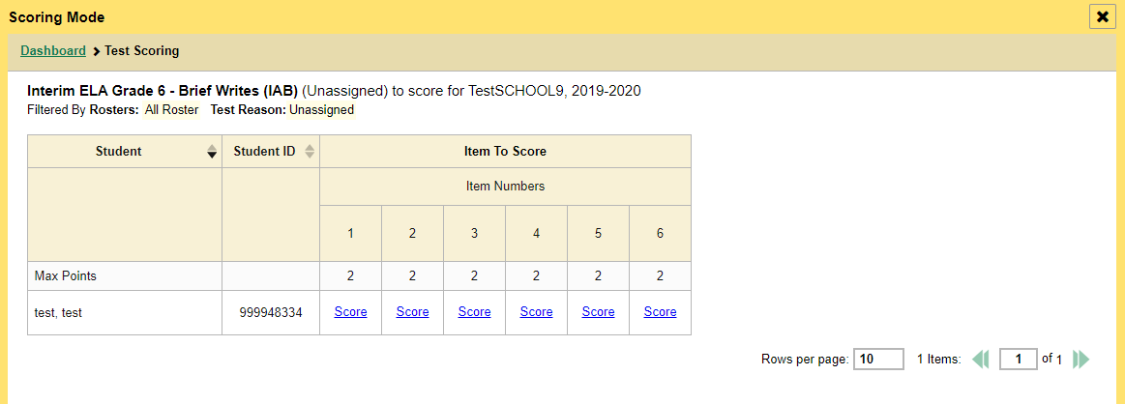
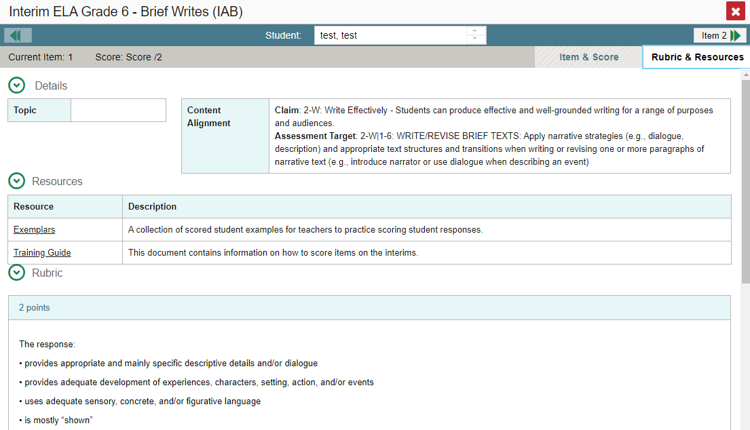
Scoring Mode Window & Item-View Window
Notes:
The Scoring Mode window displays a list of students and items awaiting scoring for the selected test. To enter scores for an item, click the score link for the item in the student’s row.
The item-view window opens. You can review the rubric and available resources on the Rubric & Resources tab, if necessary.

Slide 4
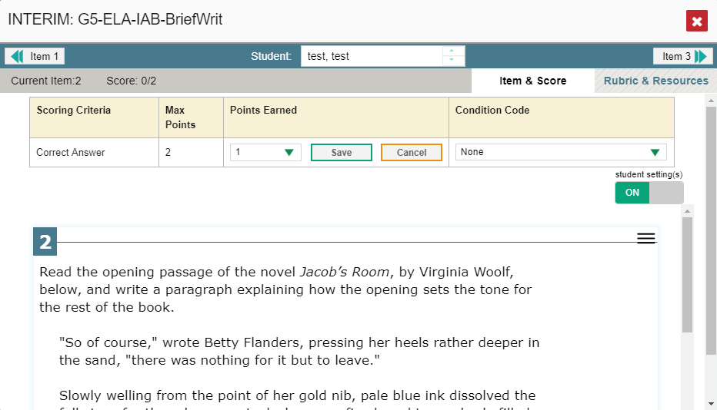
Assign Points Earned & Condition Codes
Notes:
In the Item & Score tab, click the pencil icon in the table at the top of the window.
The item-view window updates with a drop down menu for Points Earned and for Condition Codes. Review the student’s entered response for scoring.
To enter a score for the response, select or type a numerical score in the Points Earned drop-down menu and click Save. If you need to assign a condition code to the response, select the appropriate option from the Condition Code drop-down list. Condition codes include instances such as blank or insufficient answer, off-topic or off-purpose answers, and the use of non-scorable language.
You can continue scoring unscored items in the item-view window.
To view another unscored item for the same student, use the previous/next arrows on the left and right sides of the item-view banner.
To view the same unscored item for another student, use the up/down arrows in the navigation tool in the center of the banner to switch between students.
After you enter scores for all the unscored opportunities of a test, that test is removed from the Scoring Mode window. However, you can still modify the item scores on that test directly from the reports by following the procedure for modifying scores. We explain this process on the next several slides.

Slide 5
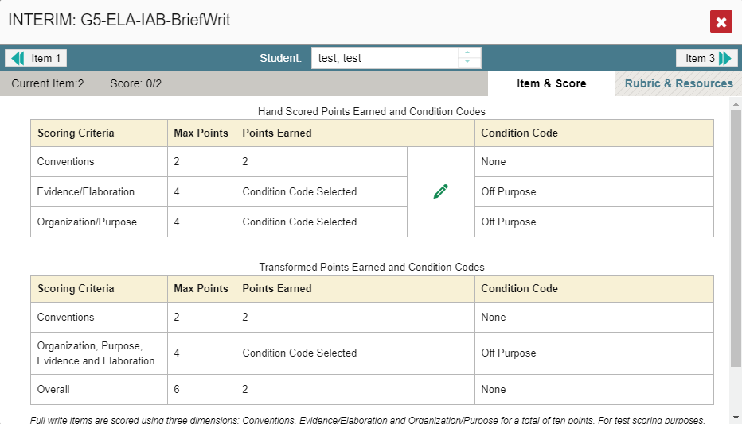
Two Scoring Criteria Tables
2/10
Notes:
Certain long-write test items will display two tables in the item-view window.
The table on top displays the pencil icon allowing you to modify the scores in three different dimensions. You can see that the Conventions dimension is worth 2 points and the demo student earned two points. Evidence and Elaboration is worth 4 points but the student’s answer was off purpose. The Organization and Purpose dimension is worth 4 points as well.
If you edit the scores and refresh the item-view window or navigate away from it, the table on the bottom displays the transformed scores.

Slide 6
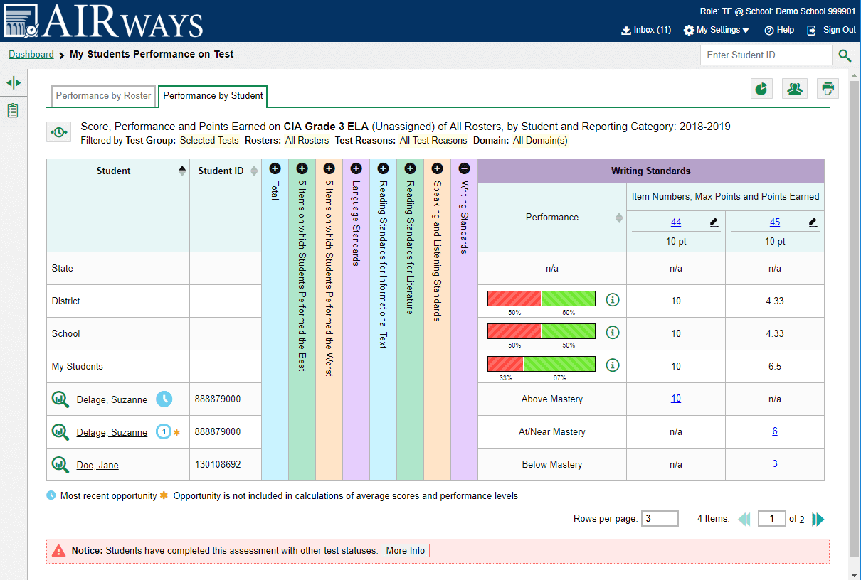
Modify Scores
Notes:
Machine-scored items are items that would typically require hand scoring, but which arrive in the Reporting System with automated scores suggested by the machine scoring system. Reports display a pencil icon in the column headers for each item with editable scores.
If a machine-suggested score has a low confidence level, a yellow warning triangle appears next to the score link. It is highly recommended that teachers view low-confidence scores.
Click the score link in the student’s row of the report.

Slide 7
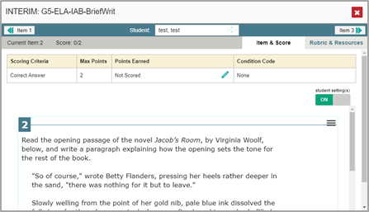
Modify Scores in Item & Score Tab
Notes:
The item-view window opens. You can review the Rubric & Resources content by toggling to that tab.
Click on the pencil icon under Points Earned.
Choose from the options listed in the drop-down menus for Points Earned and Condition Codes.
Click Save.
You can move between students and items by using the navigation tools in the blue banner. When you close the item-view window, any average scores or performance distributions on the assessment report update automatically.
Now we show you an item with multiple scoring criteria.

Slide 8
The Reporting System Training Module Series
How to Navigate the Dashboard and Generate Reports
How to Drill Down into Your Results Using Settings and Filters
How to Track Student Performance Over Time Using the Longitudinal Report
How to Print ISRs and Student Data Files
How to Print and Export Data You Can See in Your Reports
How to Use the Roster Manager to Add, Modify, and Upload Rosters
Interim and Benchmark Assessments Only
How to Analyze Item-Level Reports
How to Hand-Score Unscored Items and Modify Machine Scores
Notes:
More training modules are posted on your state or district portal. You may also consult the Reporting System User Guide.

