Slide 1
How to Analyze Item-Level Reports
Reporting System Training Module Series #7
Notes:
Welcome to training module #7 in the Reporting System series, How to Analyze Item-Level Reports. In this training module we show you the unique reporting characteristics of non-summative tests that include item-level data. We also show you how to drill down into your reports using filters and settings so that you see precisely the data you need.

Slide 2
Types of Non-Summative Tests that
Report Item-Level Data
All Tests
Non-Summative Tests
Benchmarks:
—fixed-form tests with 8-12 items within a specific topic or skill area
—users can compare item-level scores across all students
—a.k.a. module, modular, Interim Assessment Block (IAB), benchmark module, benchmark, diagnostic
Interims:
—fixed-form or adaptive tests that cover some or all of the standards students are required to learn
—users can see item-level scores for individual students who took an adaptive interim
—a.k.a. Comprehensive Interim Assessment (CIA), interim
Summative Tests
Our Focus:
Item-Level Data Included on Benchmark and Interim Test Reports
Notes:
The focus of this training module will be on non-summative test reports that contain item-level data, access to the items themselves and access to student responses to the items. This chart shows how tests in Reporting can be categorized.
All tests are either summative or non-summative assessments. Summative tests are end-of-year or end-of-course comprehensive tests that assess the student’s command of an entire subject. Non-summative tests vary by state and district and can be divided into benchmark and interim tests.
Benchmarks are small, single-skill-area tests with non-secure items. Users can compare item-level scores and the items themselves, for all their students.
Interims are larger than benchmarks, but smaller than summative tests. Many interim tests will report item-level data, depending on the type of test, and state and district policies.
We’ll show you how to analyze the item-level data on these reports. Then we show you how to trim your reports by using settings and filter options that apply specifically to item-level data.

Slide 3
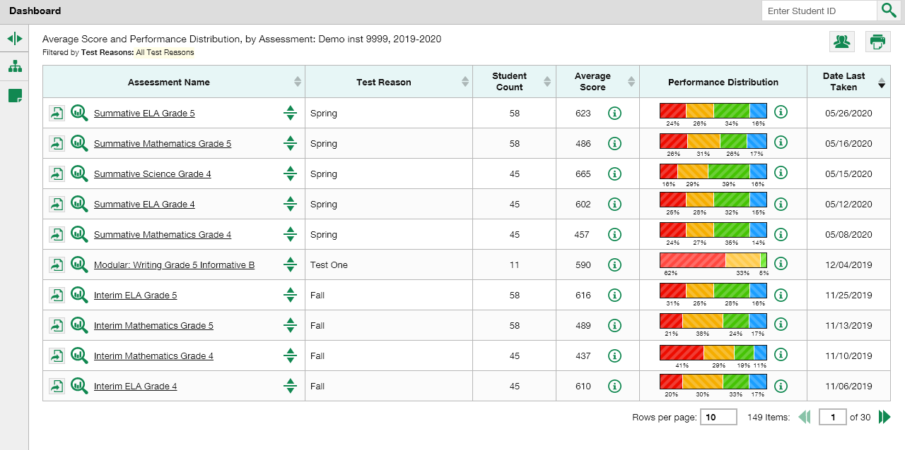
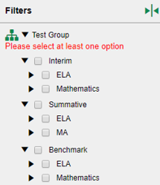
Dashboard View
Notes:
We start by showing you an unfiltered dashboard for a school-level user in Reporting. You see five non-summative tests listed on the school user dashboard, shown here.
You also see the test group option expanded in the filters panel, on the left. The test groups are listed by type of test, subject, and grade. You can use this filter to trim the number of reports listed on your dashboard.
Test items can be analyzed to provide a clear view of the student’s reasoning and subsequent performance on the test.
The first report we show you is a report for a benchmark assessment that tests a single standard with more than ten items on the test.

Slide 4
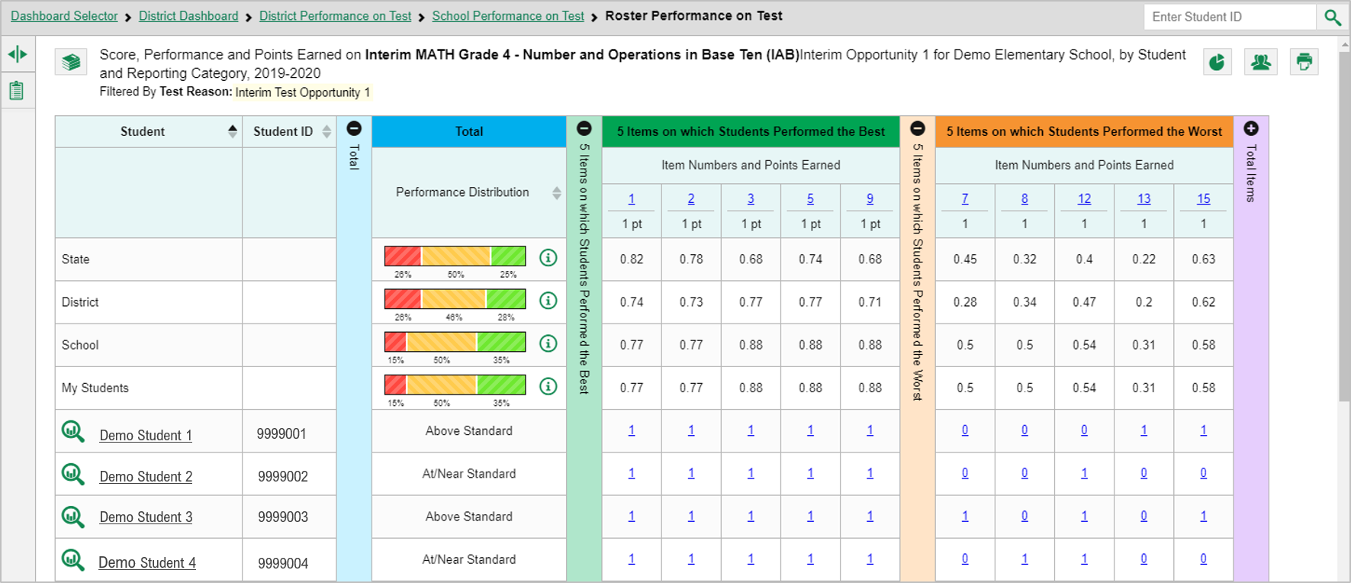
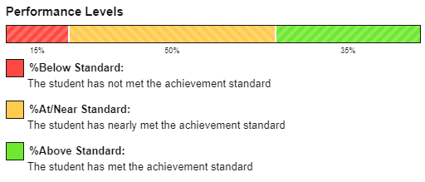
Report Design: Single-Skill Topic Area
Notes:
Here is a roster report for four demo students who took the Grade 4 Math Interim – Number and Operations in Base Ten. This is an interim/benchmark test assessing a single skill, also called a topic area or reporting category.
The colored sections in the table include a Total performance measurement section in blue, a green section for the 5 Items on which Students Performed the Best, an orange section for the 5 Items on which Students Performed the Worst, and a purple section for Total Items. You can expand or collapse the columns by clicking on the + and – signs at the top of the column.
You can see the state, district, school and teacher aggregates displayed above the list of student results. You can click on the information button to display the legend for the performance levels.
To show you how to analyze your results, we will focus first on the orange section, showing the 5 items on which students performed the worst.

Slide 5
Report Design: Single-Skill Topic Area (continued)
Notes:
The first two rows under the section header, 5 Items on which Students Performed the Worst, list the item number and the number of points assigned to the item. The students on this roster performed the worst on items #7, #8, #12, #13, and #15..
For example, the results for item #8 show that students at the aggregate state level earned an average of .32 of a point. The district average is .34 of a point, and the students in the school averaged .5 of a point. The teacher’s students earned the same .5 of a point. Of the four demo students in the table, Demo Student 4 answered that item correctly and earned 1 point.
Now we show you a report with fewer than ten items on it.

Slide 6
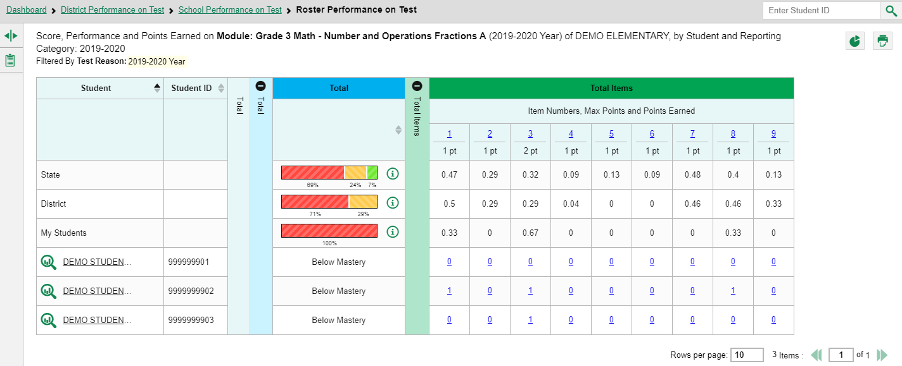

Report Design: Single-Skill Topic Area
(< 10 items)
School
Notes:
Item-level reports with fewer than ten items do not display with the 5 Best and 5 Worst sections. You see a Total Items section, as shown here on the Grade 3 Math Module on Number and Operations Fractions.
The state, district, and school aggregate average point values display above the students listed and their student score links.
Now we show you how to access the item and the student’s response to it.

Slide 7
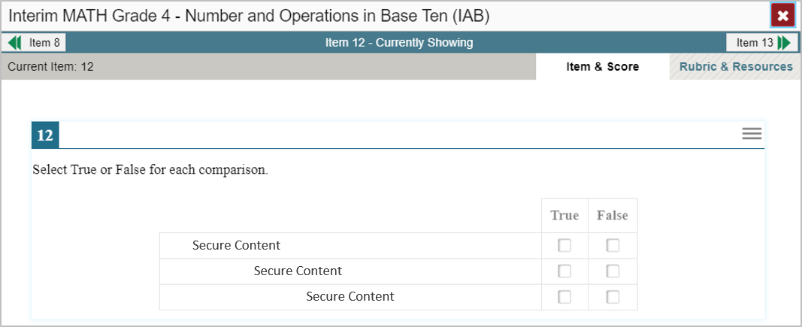

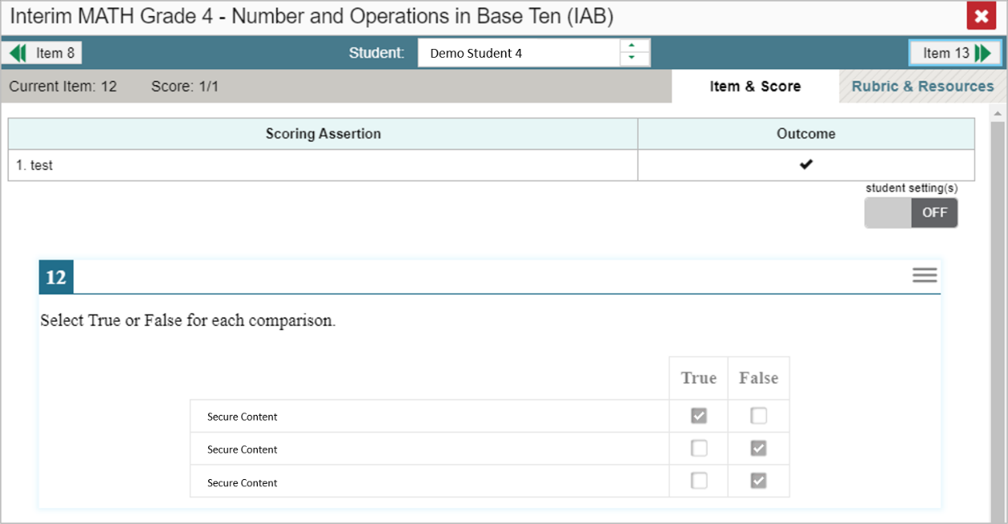
View an Item and Student Response
Notes:
To view a test item in the blank state, click the item number link in the first row of the report table. The item-view window displays the test question as it appeared on the assessment in the Student Testing Site.
To view the student’s response to the item, find that student’s name in the Student column on the left. Then click the blue score link under the numbered item. In this example we look at item #12 for Demo Student 4.
The item-view window displays the item, along with the answer provided by Demo Student 4.
We will explain the features of the item-view window on the next slide.

Slide 8

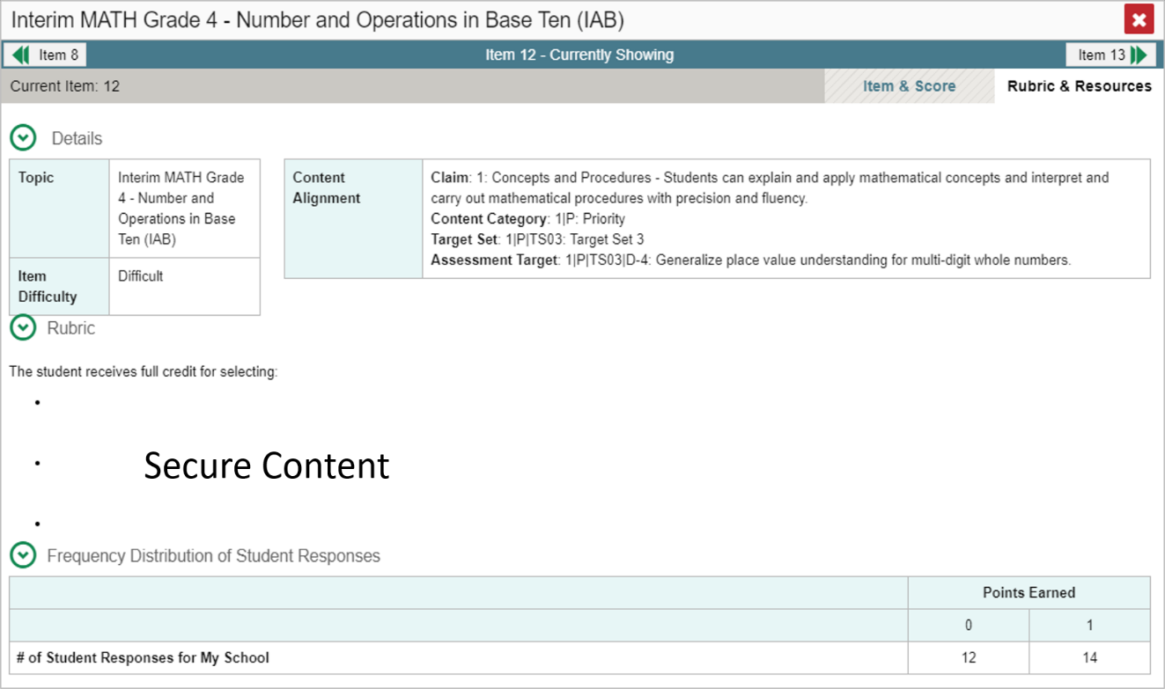
Item & Score Tab
Notes:
You can see the current item number and the score for that item in the gray bar in the banner. The student answered incorrectly with a score of 0 out of 1 point on item #12.
Moving to the right in the gray bar you see two tabs, Item & Score and Rubric & Resources. You can toggle between these tabs to display associated content. The Item & Score tab is open in the top image and the Rubric & Resources tab is open in the bottom image.
In the teal-colored bar at the top of the window are three navigation tools to help you move between students and items without returning to the report. The name of the selected student displays in the middle box. Clicking the down arrow takes you to the next student listed in the report table. Clicking the up arrow takes you to the previous student. The navigation tool on the left moves you to the previous item. The navigation tool on the right takes you to the next item. Because we opened Item #4 from the 5 Worst section on the report, Item 8 displays as the previous item listed under the 5 Worst column.
Underneath the teal and gray banners, the Scoring Assertion and the Outcome for the test item are displayed.
The Scoring Assertion states exactly what the student must do to earn the point value for the item. The Outcome box shows a checkmark for a correct answer, or an X for each incorrect answer. Some windows display “Scoring Criteria” instead of “Scoring Assertion.”
The test item is displayed below along with the student’s response to it. Reviewing a student’s response in this window provides important clues into the struggles experienced by the student.
You can show or hide a student’s visual settings, like large fonts, different color contrasts, or Spanish, on a per-item basis. To do so, click the toggle at the upper right of the item you are viewing.
We explain the Rubric & Resources tab on the next slide.

Slide 9
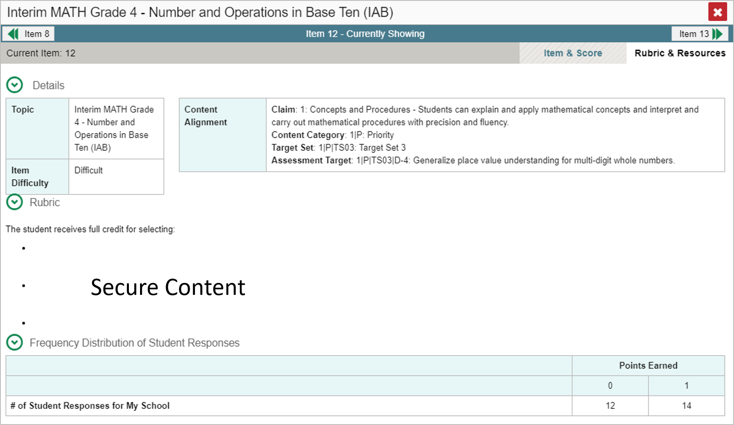
Rubric & Resources Tab
Notes:
The Rubric & Resources window has the same teal and gray banner features and is divided into three sections: Details, Rubric, and Frequency Distribution of Student Responses. The sections are expanded and collapsed using the circled arrows to the left. The information included in each section varies, depending on the test item.
The Topic lists the skill area to which the item belongs. The Content Alignment section describes, in detail, the academic or learning standard to which the item is aligned. The Rubric displays the criteria used to score the item.
A simple correct answer may be listed, or this section may include a score breakdown, a human-readable rubric, or an exemplar, which provides an example of a response for each point value.
The Frequency Distribution of Student Responses provides a breakdown of how many students earned each possible point value available for the item. In this example, 26 students in the school responded to item #412 on this Math benchmark test. Fourteen of them answered correctly and earned one point for the item.
Now we show you a test report for a Comprehensive Interim Test with reporting categories for each skill area.

Slide 10
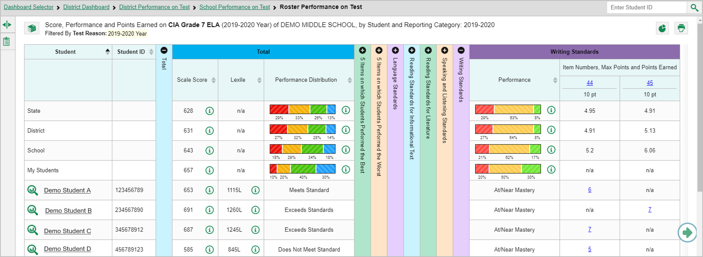
Reports with Multiple Topic Areas
Notes:
Here is a My Students Performance on Test report for the Grade 7 ELA Comprehensive Interim Assessment.
Notice that the table includes five reporting categories in addition to the blue Total section and the 5 Best and 5 Worst sections. The items included in each of the reporting categories are the ones that assess those skill areas.
Under each reporting category the item number displays as a blue item link and the maximum points for the item displays under the link.
The student responses display as blue score links. The number reflects the points earned for that item. For example, you can see that item #44 under Writing Standards is worth 10 points. The sample student, Demo Student C earned 7 points for their answer to that item.
Every topic section in this report includes a performance column that can be sorted. Click the up or down arrow next to the column header to sort in ascending or descending order. When you sort your students this way you can quickly see who needs more support in each topic area.
You may sometimes see “n/a” instead of a score for an item. It means that the student did not respond to the item, or the item was not included in that form of the test.
Advance further into the report pages by clicking the green circled arrow on the right side of the page.
Now we show you a report for a test that features multiple scoring assertions.

Slide 11
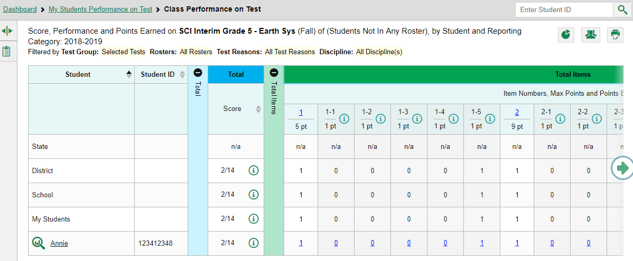
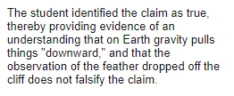
Items with Multiple Scoring Assertions
Notes:
The report shown here is for a Grade 5 Science Interim on Earth Systems.
The test items are designed as clusters with multiple scoring assertions. For example, item #1 is worth five points. Each point is associated with a sub-item, listed as 1-1, 1-2, 1-3, and so on. Cluster items usually feature a reading passage, along with graphic images like maps, tables, and illustrations. Several test items are associated with the passage and images. Students are instructed to use what they have learned from the stimuli to perform the associated sub-item tasks. You can see that the demo student, Annie, answered items 1-1 thru 1-4 incorrectly and 1-5 correctly. She earned one of the possible five points.
The information button displays the scoring assertions associated with each of the sub-items. The legend displayed here is from item 1-5.
When you click on the student’s score link, the Item & Score tab of the item-view window shows all five scoring assertions listed in that section of the page. The student outcomes for each sub-item are indicated.
We now show you how to filter your item-level data by standard and how to assign test reasons to your item-level tests and how to filter by test reason.

Slide 12
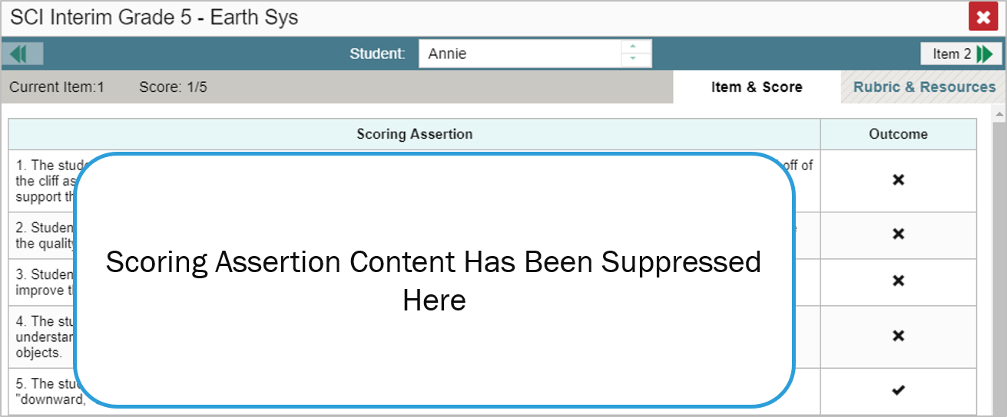
Items with Multiple Scoring Assertions (continued)
Notes:
When you click on the student’s score link, the Item & Score tab of the item-view window shows all five scoring assertions listed in that section of the page. The student outcomes for each sub-item are indicated.
We now show you how to filter your item-level data by standard and how to assign test reasons to your item-level tests and how to filter by test reason.

Slide 13
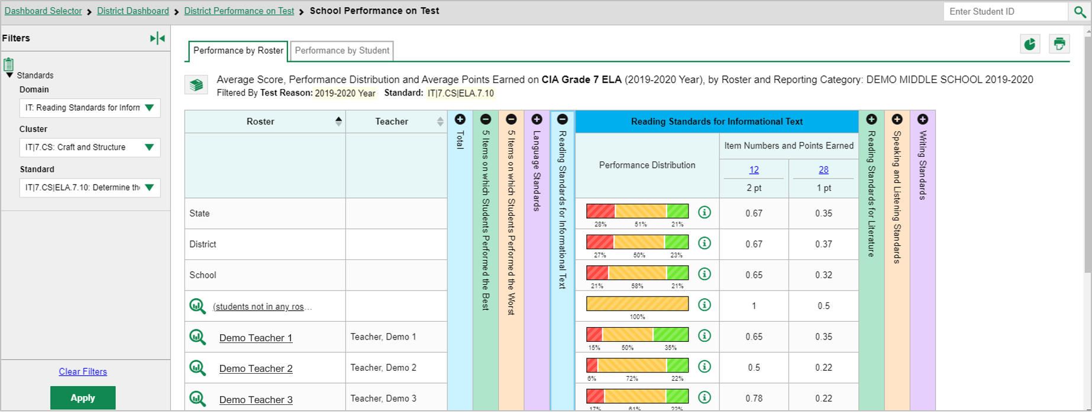
Use the Standards Filter
Notes:
Sometimes it is helpful to use the Standards filter to trim a comprehensive interim test so that you can focus on the students’ performance in a single skill area. Please note that terms used to refer to skill areas, and the filter options vary by state and district.
There are 45 items on this comprehensive interim assessment in Grade 7 ELA. The items are associated with five topic areas, also known as domains or reporting categories: Language Standards in purple, Reading Standards for Informational Text in blue, Reading Standards for Literature in green, Speaking and Listening Standards in tan, and Writing Standards in purple.
Open the Filters panel by clicking the expansion arrow or on the standards icon. Use the drop-down list under Standards to select a top-level domain. Here we have selected Reading Standards for Informational Text.
Keep making selections from the drop-down lists as they appear. In this example, we chose the cluster “Craft and Structure.” Then we selected the standard “Determine the Meaning of Words and Phrase.”
Click Apply to update the report.
The table header updates to show the standard selected.
The filtered report shows only the items associated with the standard selected. You can see that Items #12 and #28 under Reading Standards for Informational Text are the ones associated with this standard in this reporting category.
You can compare the results of the teacher’s classes on this School Performance on Test Report. The average points earned for the times are is listed for each of the teachers’ classes in the school who had students who took this test.
You can look at another standard by changing the selections in the drop-down filter options, or you can clear filters and click Apply.
On the next slide we show you the Roster Performance on Test report, which displays each student’s score link to the item.

Slide 14
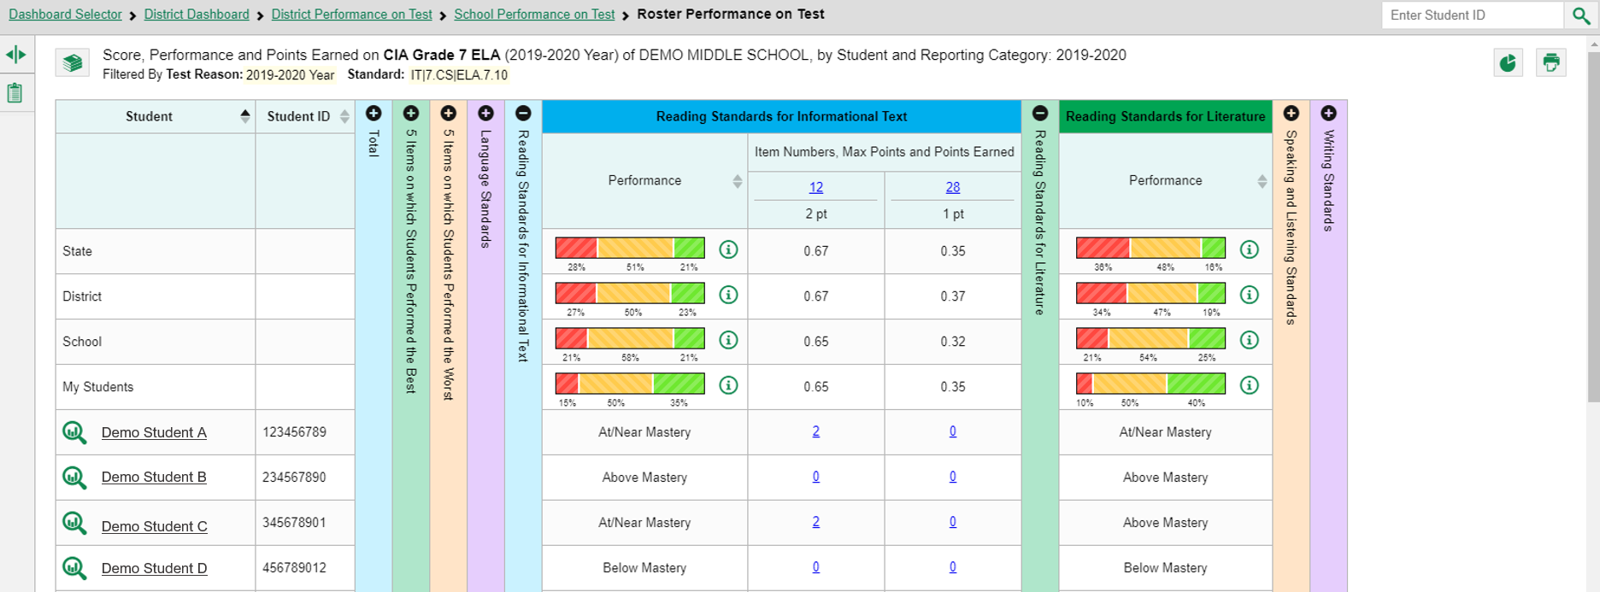
Use the Standards Filter (continued)
Notes:
This is the same CIA Grade 7 ELA test showing four sample students on a roster. You can click on the student score links to open the Item-View Windows for Item #12 and #28. Notice that there are no items listed in the Reading Standards for Literature category. None of the items in this category are associated with standard that we filtered for.
Now we explain the Test Reason Manager and the Test Reason filter. These are two options that apply only to interim and benchmark tests.

Slide 15
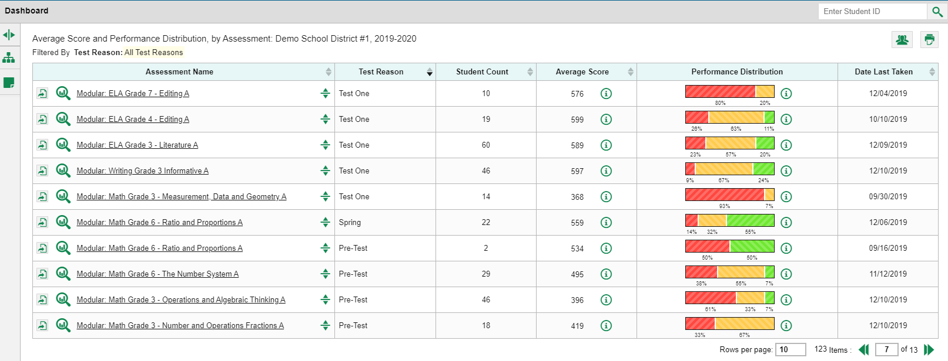
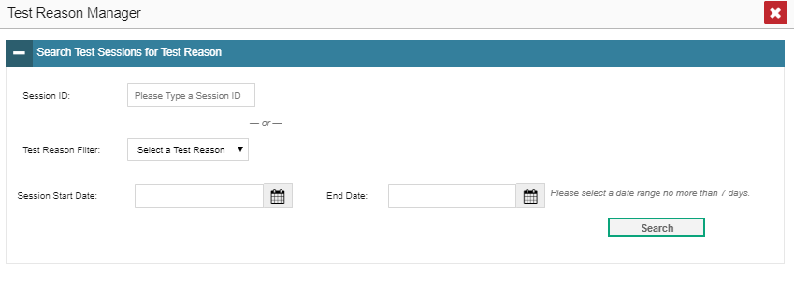
Assign Test Reasons
Manage Access
Change Role
Reporting Options
Manage Test Reasons
Select Tests to Include on Reports
Change Reporting Time Period
Set Student Settings on Item View
Roster Settings
Add Roster
View/Edit Roster
Upload Rosters
Notes:
Test reasons are categories used to classify test opportunities for reporting purposes.
They typically indicate a numbered opportunity, a timeframe in which tests were taken, or a category like “Pre-test”, and they’re a good way to organize tests into groups.
Test reasons should ideally be assigned in the Test Administration Site at the time of testing. However, you can use the Test Reason Manager in the Reporting System to assign a different test reason to an interim or benchmark test opportunity after the test is completed.
From the My Settings drop-down menu in the banner, select Manage Test Reasons. The Test Reason Manager window opens.
To search for test opportunities to categorize, do either of the following:
In the Session ID field, enter the session ID in which the opportunities were completed in the test delivery system or (TDS).
Or select a test reason associated with the opportunities you want to edit.
Then select a range of dates during which the test session was administered. The range cannot exceed seven days. Then click Search.

Slide 16
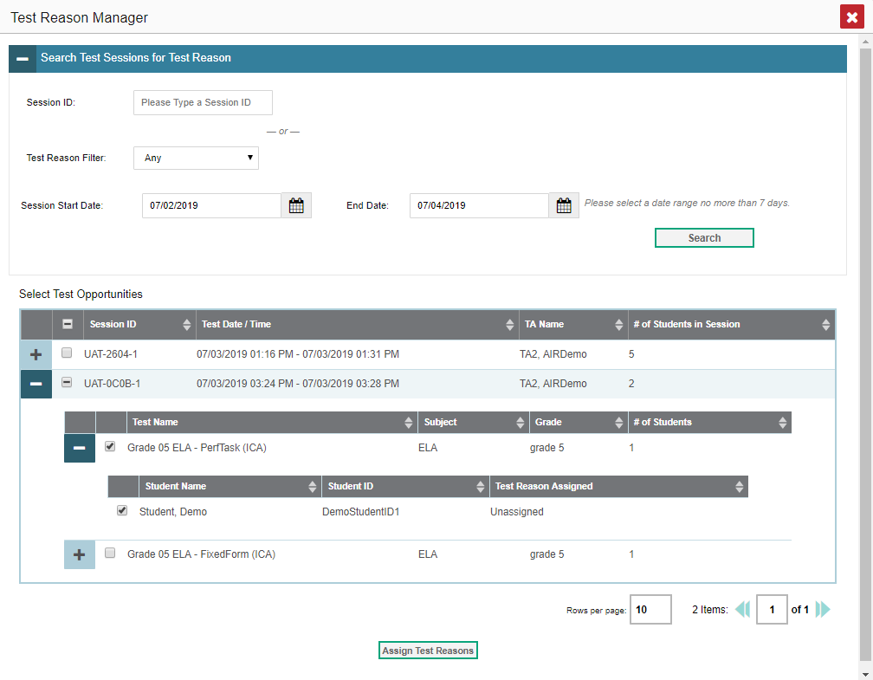
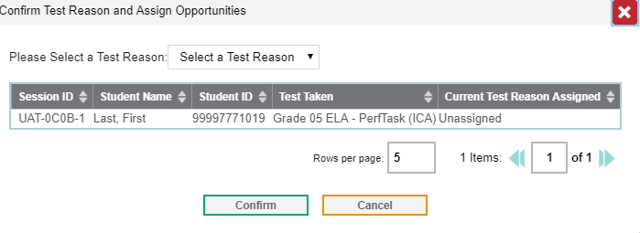
Assign Test Reasons (continued)
Notes:
A list of retrieved test sessions appears in the section Select Test Opportunities.
Click the + button(s) to expand the list of tests in each session and the list of students who took each test opens. Mark the checkboxes for each session, test, or opportunity that requires a test reason.
Click Assign Test Reasons.
In the confirmation window, select a new test reason to assign to the selected opportunities and click Confirm.
Assigning or reassigning test reasons will make the filter by test reason option more useful. We explain why on the next slide.

Slide 17
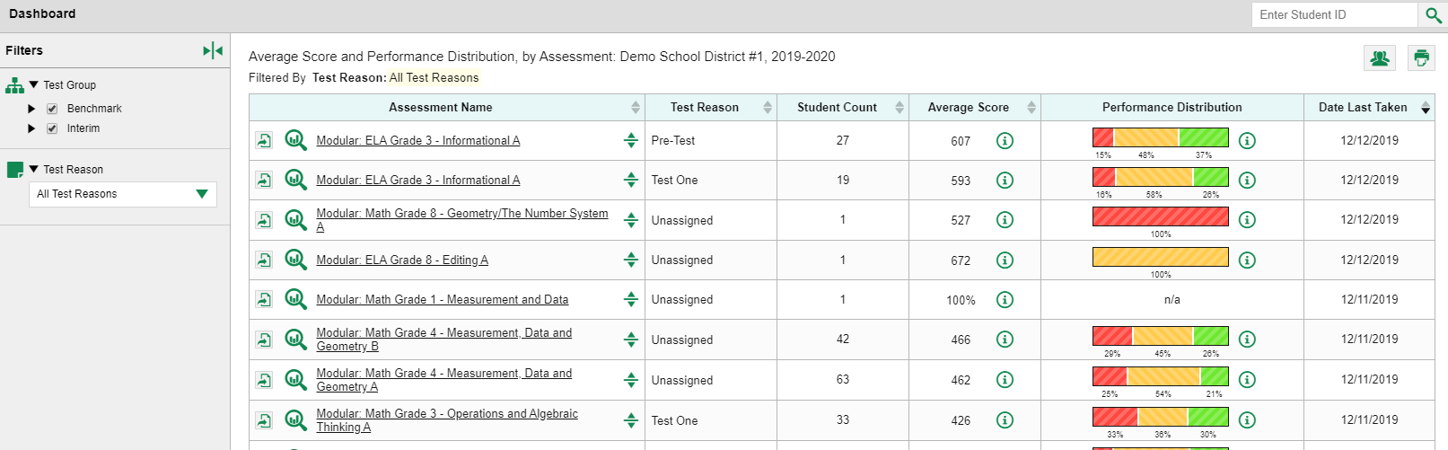
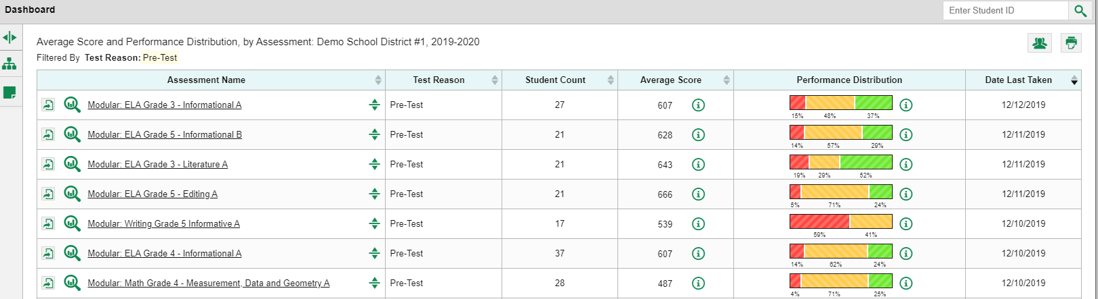
Filter by Test Reason
Fall
Pre-Test
Post-Test
Spring
Test One
Test Two
Unassigned
Winter
Notes:
When your test opportunities have test reasons, you can filter reports by a single test reason.
For example, you may want to filter by Pre-Test and look at ELA performance, then filter by Test One and see if students have improved on ELA material. If you don’t filter, you’ll see data for all different test reasons. Filtering allows you to view a single test reason instead of multiple test reasons side by side. You may find reports easier to understand when you’re viewing only a single test reason. The test reasons filter is available on the dashboards for teachers as well as school- and district-level users. On the left side of the dashboard, click the Test Reason button to display the drop-down list of test reasons. Make a selection from the drop-down list and click Apply. For our example we selected the Pre-Test reason.
The filtered report displays with an updated table header. You see only the tests identified with that reason in your results. You can return to the Filters drop-down menu and select another reason to make comparisons.

Slide 18
The Reporting System Training Module Series
How to Navigate the Dashboard and Generate Reports
How to Drill Down into Your Results Using Settings and Filters
How to Track Student Performance Over Time Using the Longitudinal Report
How to Print ISRs and Student Data Files
How to Print and Export Data You Can See in Your Reports
How to Use the Roster Manager to Add, Modify, and Upload Rosters
Interim and Benchmark Assessments Only
How to Analyze Item-Level Reports
How to Hand-Score Unscored Items and Modify Machine Scores
Notes:
More training modules are posted on your state or district portal. You may also consult the Reporting System User Guide.

